Slide 1
Certificate of Higher Education in Skills for the Workplace
Effective Team Working & Communications
(BMSK 4002)
Communication in Organisations

Slide 2

So far…..
We have..
Overview the module
Defined what communication is?
Explored the functions of communication
Discussed 3 models of communication
Identified the barriers to communication

Slide 3
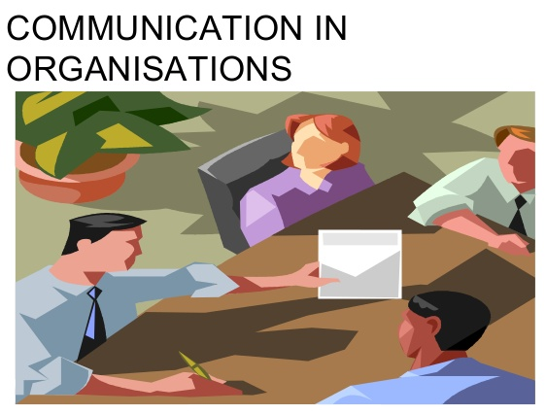
In this session we will discuss…..

Slide 4
Types of organisational communication
Every organisation must enable communication in several directions;
Vertical Communication
Horizontal Communication
Diagonal Communication

Slide 5
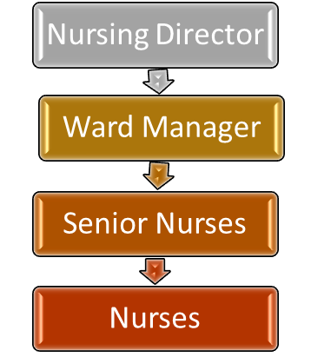
Vertical Communication
Downward Communication
It is the formal communication in which the line of authority starts from the top and extends to the lowest level.
In companies with extremely authoritative style of management (Weihrich & Koontz, 1993).
The oldest to types of communication.
Seniors, superiors or elder ones give some information, advice, counseling, suggestion, instruction, order or warning to their juniors, subordinates or younger ones.
An integral part of the traditional organisation.
Still the most frequently used channel in the organisation.
It may be oral, written, visuals and by electronic devices.

Slide 6
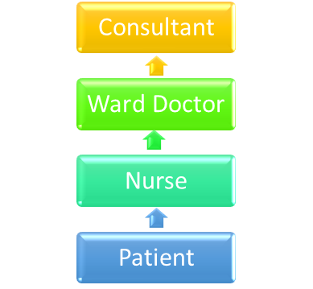
Vertical Communication
Upward Communication
Communication flows from down to upward, i. e. from subordinates to superior levels.
Either in the nature of feedback or in the nature of original thoughts and suggestions at the initiative of the lower levels.
The communication are invited from the lower levels.
The subordinates convey their actions, attitudes and opinions about varied subjects of vital concern to their superiors
Upward communication is often communicated for decision making purposes. Subordinates pass information about progress and problems to superiors so that superiors i.e. Management can decide what to do and when to do.

Slide 7

Horizontal Communication
It is the formal/ informal exchange of ideas between different individuals/departments at the same level of hierarchy in the organisation.
Advantages:
Encourages free information exchange.
Higher information flow between departments is necessary.
Makes an atmosphere where employees are comfortable to talk to people in different departments and gain from their learning.
Disadvantage:
Sometimes, horizontal communication leads to disputes between individuals/departments. In such cases higher officials have to step in to resolve the matter.
Hospital Chief Executive
Chief Finance Officer
Estates Manager
Finance Manager
Director of HR
HR Manager
Chief Operational Officer

Slide 8
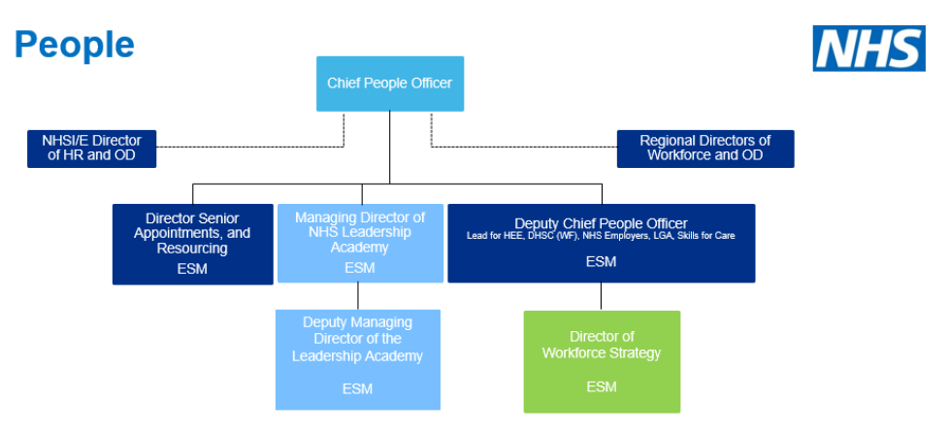

Diagonal Communication
Communication that takes place between a manager and employees of other workgroups is called diagonal communication.
It generally does not appear on organisational chart.
For instance - To design a training module a training manager interacts with an Operations personnel to enquire about the way they perform their task

Slide 9
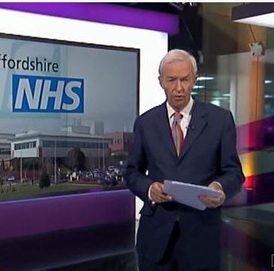
Activity
Watch this video about the failings at Mid-Staffordshire NHS Trust.
Were communication failings; vertical? Horizontal? Diagonal?
Who within the trust needed to communicate more effectively?

Slide 10
Methods of communication in organisations
Internal & External communication
  Internal communications happen within the organisation.
  External communications take place between the organisation and outside individuals or organisations.
Formal & Informal communication
  Formal communications are official messages sent by an organisation,
  eg an official memo, fax or report.
  Informal communications are unofficial messages not formally approved by the business, eg: everyday conversation or gossip between staff.
Verbal communication: face-to-face, telephone, radio or television and other media.
Nonverbal communication: eye movements, gestures, facial expressions.

Slide 11
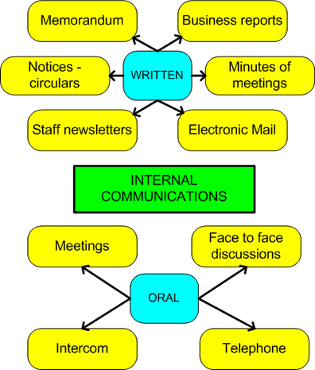
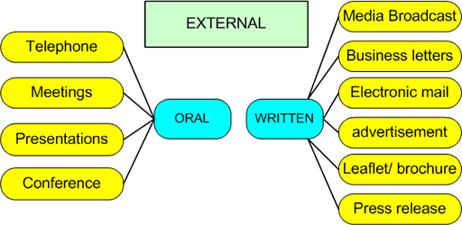
Channels of communication
Source: Taylor. S (1996)
Notes:
Discuss about the various stakeholders of an organisation.

Slide 12

WRITTEN COMMUNICATION IN ORGANISATION
EFFECTIVE COMMUNICATION DOCUMENTS :
EXERCISE:
NAME AND EXPLAIN THE PURPOSES OF FIVE EFFECTIVE DOCUMENTS USED IN A CARE HOME

Slide 13
Document Name | Purpose

Slide 14
WRITTEN COMMUNICATION IN HEALTHCARE
It is very important to maintain good written records of the care given to patients/clients for three main reasons:
To ensure continuity of care is safely provided for patients irrespective of which staf are on duty, 24 hours a day, seven days a week
To keep a record the care that has been given to the patient/client
To make sure there is an accurate record to be used as ‘evidence’ when there is a complaint from a patient/client about the care they have received.
(Royal College of Nursing, nd)

Slide 15
WRITTEN COMMUNICATION IN HEALTHCARE
The principles of written communication in healthcare are that you should:
Be specific and accurate
Wrong Way Right Way
Mrs Jones was admitted around lunchtime Mrs Jones was admitted at 12.15 pm.
Always write information simply and clearly
Wrong Way Right Way
Fluid Intake = 400 mls/12 hrs Mrs Jones drank 400 mls during 12-hour shift
Write legibly (if hand-written) and as error-free as possible if keyed into a computer
Wrong Way Right Way
Mr Smith not vry appy 2day but lkng fwd to his son Mr Smith has not been very happy today but
vstng later is looking forward to his son visiting later
Avoid giving personal opinions
Wrong Way Right Way
I think Mr Smith haven’t had enough food Mr Smith ate half of his dinner but refused to eat his breakfast and lunch
Avoid writing anything judgemental or which may seem personally abusive or insulting. Report factually what you have observed.
(Royal College of Nursing, nd)

Slide 16
Activity : Give an example of wrong way & right way
When reporting on a patient or resident that has been awake several times in the night.
Wrong way.
Right way.

Slide 17
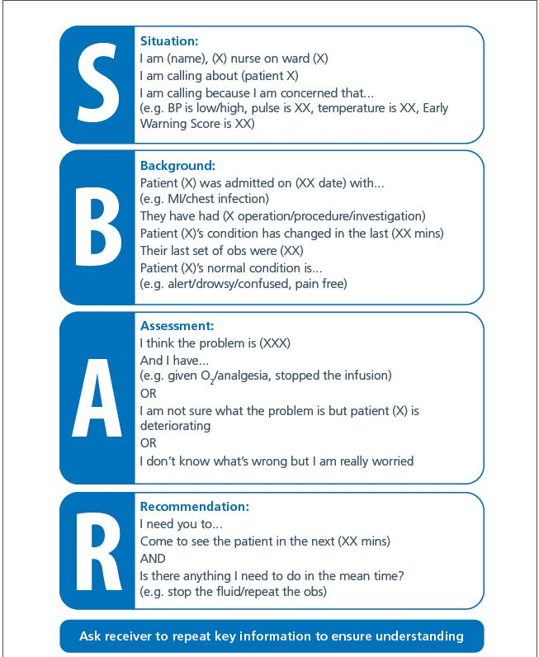
SBAR – Communication tool in Healthcare
S –Situation
B- Background
A – Assessment
R - Recommendation

Slide 18
Activity
Write an SBAR example based on your role/life experience.

Slide 19
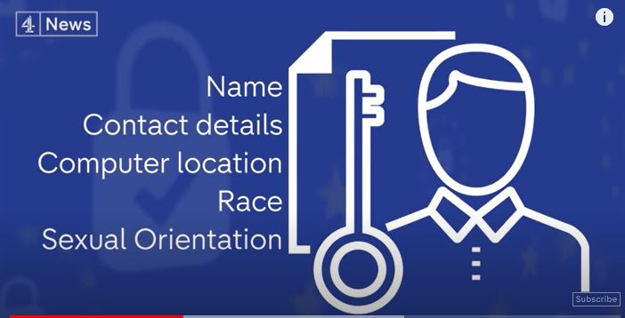
UK GDPR Legislation
Data Protection Act 2018

Slide 20
Ethical Communication
Ethical communication
– provides recipients with accurate and up to date information with acknowledgment of those involved in creating the information.
- Recipients are able to make informed decisions or opinions based on the information.
Unethical communication
– provides recipients with distorted or incomplete information or does not acknowledge those involved in creating the information.
- Recipients are not able to make informed decisions or opinions based on the information.

Slide 21
Technology and communication/Virtual communication

Slide 22
Technologies used by organisation for communication
Technology is a powerful medium of communication in the modern world
Organisation use technologies for daily running of their business
Different applications are used to communicate:
  E-mail
  Discussion Forums
  Intranet
  Chat rooms
  Social media
  Business specific software
  Video/Audio

Slide 23





Advantages of using technological communication
It allows diverse members to collaborate from various locations with out the need of meeting them face to face
Financial and logistical benefits are attractive
Technology helps to communicate quickly
It allows improved knowledge sharing
Build better relationship with customers and stakeholders
(Griffiths and Dunham, 2015)

Slide 24
Problems of using technological communication
Virtual communication may not be as efficient as face-to face communication
Lack of non-verbal cues make it less rich/ambiguous. This may affect the building of a cohesive team
Hard to establish trust using online communication
As trust is difficult to achieve members will be reluctant to interact and share their opinions
Very difficult to communicate complex information
Decision making process will be delayed
(Griffiths and Dunham, 2015)

Slide 25
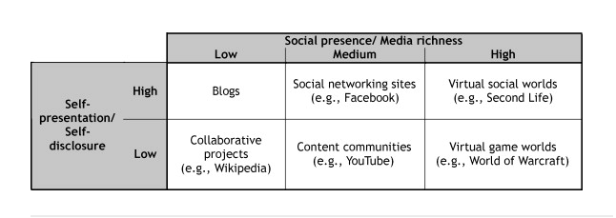
Social Media
An effective tool for communication
Social media refer to digital technologies emphasizing user-generated content or interaction (Kaplan & Haenlein, 2010)
Based on media richness/social presence and self presentation/self disclosure social media can be classified as follows:
Table 1: Classification of Social Media by social presence/media richness and self-presentation/self-disclosure (Kaplan & Haenlein, 2010)

Slide 26
Opportunities of social media
Collaborative projects: Collaborative projects provides joint effort of many and leads leads to a better outcome. Eg: Wikipedia
Blogs: They are the Social Media equivalent of personal web pages and can come in a multitude of different variations. Eg: Travel blog, personal blog
Content communities: The main objective of content communities is the sharing of media content between users. Eg: YouTube
Social networking sites: Social networking sites are applications that will connect users by creating personal information profiles, inviting friends and colleagues to have access to their profiles, and sending instant messages between each other.
All these opportunities of media can be used by organisations for improving their business and maintaining communication with employees, customers and stakeholders

Slide 27
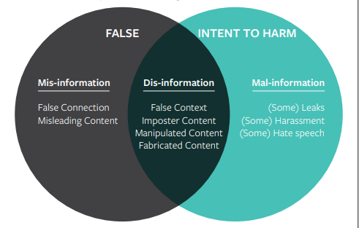
Misinformation, Disinformation, and mal-information in social media
There are three types of information disorders
Misinformation: Information that is false, but not created with the intention of causing harm.
Disinformation: Information that is false and deliberately created to harm a person, social group, organization or country.
Mal-information: Information that is based on reality, used to inflict harm on a person, organisation or country
Figure 2: Information disorder
(Wardle and Derakhshan, 2018)

Slide 28
Security and privacy
Recent advances in information technology threaten privacy of people.
The amount of control over personal data is reduced
Information on social media sites may not only be searched without permission or knowledge but may be permanently stored and used by others.
“Right to Be Forgotten” (RTBF) law, which allows individuals “to demand that Google and other search engines erase links” considered “prejudicial” to them (p. 273).
The EU Charter provides a set of access and privacy rights: “Everyone has the right of access to data which has been collected concerning him or her, and the right to have it rectified” (Lipschultz, 2018, p.208)

Slide 29
Remembering human factor when implementing technology in healthcare or business.
When using technology to communicate in healthcare/business
  Make sure you know your customers, staff or patients.
  Respect their privacy
  Try to avoid disruptions in the daily routine of your customers, staff or patients.
  Provide training and support for employees to handle the technology
  Keep a face to face element of communication available
  Alternate ways of communication should be provided for people who do not use technology

Slide 30
References
Griffith, B., and Dunham, E., (2015), Working in Teams: moving from high potential to high performance, Los Angeles, SAGE Publications.
Kaplan, A.M. and Haenlein, M., (2010) Users of the world, unite! The challenges and opportunities of Social Media. Business horizons, 53(1), pp.59-68.
Lipschultz, J.H., (2018) Social media communication: Concepts, practices, data, law and ethics. Taylor & Francis.
Morgan, P. (2017), The Business Student’s guide to study and employability, London: SAGE.
Mehrabian, A. (1981) Silent Messages: Implicit Communication of Emotions and Attitudes, Boston: Wadsworth Publishing Company.
Royal College of Nursing, n.d. Written Communication | First Steps. [online] Rcni.com. Available at: <https://rcni.com/hosted-content/rcn/first-steps/written-communicat ion> [Accessed 17 May 2020].
Wardle, C. and Derakhshan, H., (2018) Thinking about ‘information disorder’: formats of misinformation, disinformation, and mal-information. Ireton, Cherilyn; Posetti, Julie. Journalism,‘fake news’& disinformation. Paris: Unesco, pp.43-54.

Slide 31

Summary
Can you explain;
The types of organisational communication?
The technologies used by organisation for communication?
What is ‘ethical communication’?
Questions & Answers

Slide 32

Next Session…
We will discuss..
Face to face communication

