Slide 1

Gerard Egan’s contribution to our understanding of the role helping and support in an educational setting.
Shannon Jenkins
2010009
Supporting the Learner: SJIE4002

Slide 2
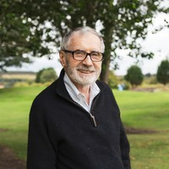
INTRODUCTION TO HIS WORK
Gerard Egan, Professor Emeritus of Organisation Development and Psychology at Loyola University in Chicago.
Egan began with Roger’s theory, the importance of the core conditions and building a non-judgmental relationship with the client but went further.
He produced a map to show the process of change, identifying where you are and where you would like to go.
His model is based on understanding, exploring and action.
Egan considers his methods to consist more of prevention than cure.
(Patanella, 2019)

Slide 3
WHAT IS HELPING
Helping is about decision making and real change- internally and externally.
Egan quotes that “in the end helping is about work that produces outcomes that favourably impact the lives of help seekers.” (Egan, 2010, p.xi)
Egan suggests that to understand the meaning of helping, it is useful to consider two points;
  why people are seeking help in the first place
  what the principal goals of the helping process are.

Slide 4
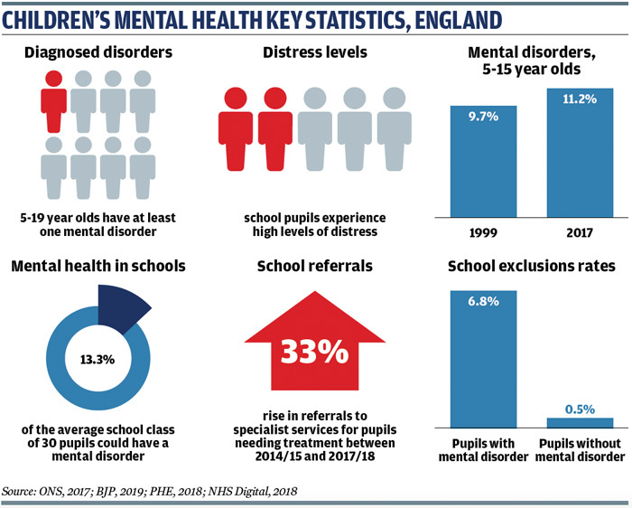
MAIN PROBLEMS PEOPLE PRESENT
Egan (2010) suggests that the main problems people present are:
They are experiencing problem-situations that they are struggling to handle.
Lack various skills – if people acquire skills, they could manage and solve their problems
Have experienced misused opportunities.
Common problems that young people present in school:
ACEs.
Mental health & stress.
Experience of being unloved or rejected by a significant person.
Deprived deficiency needs.
Lack of self-esteem.
(Hayes, 2019).

Slide 5
ROGER’S CORE CONDITIONS
Egan agrees with Rogers that there are three key qualities that should be in place:
Empathy
Congruence
Unconditional Positive Regard
However, Egan did not feel these three core conditions were sufficient and that action is also needed – doing rather than being.

Slide 6
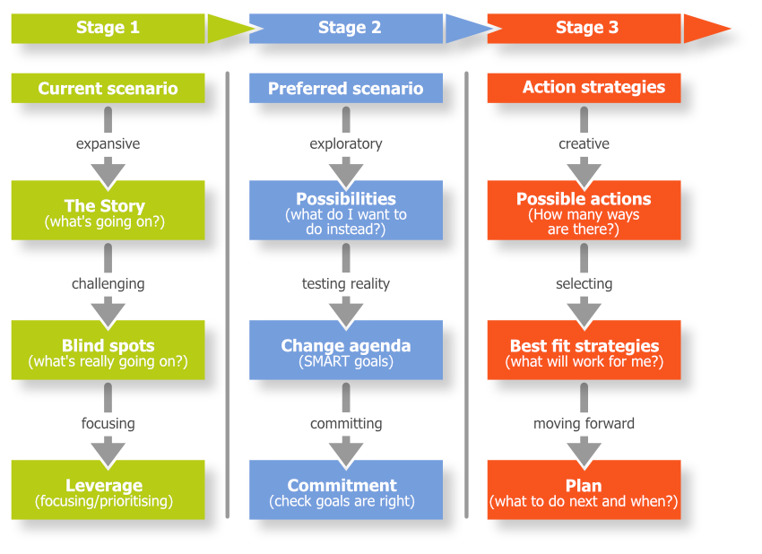
THE SKILLED HELPER MODEL
Client-centred approach.
The model is based on understanding, exploration and change.
The model acts on the way people think, act, and how they come to express their emotions.
A map to show where you are and where you are going.
Truyens, 2019.

Slide 7
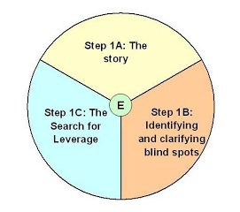
Egan’s Three Stage Process
Stage 1:
What’s going on?
Allow clients to tell their story.
Help clients to develop new perspectives of their stories and identify blind spots.
Identify issues that will make a significant difference.
(Rosink, 2009)

Slide 8
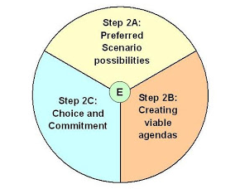
Egan’s Three Stage Process
Stage 2:
Help clients to use their imagination to create possibilities for a better future.
Help clients choose and develop realistic and challenging goals that are real solutions to the problem-situations and opportunities identified in stage 1.
Help clients to find incentives that will help them to commit to their goals.
(Rosink, 2009)

Slide 9
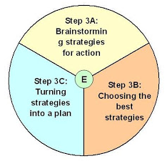
Egan’s Three Stage Process
Stage 3:
Answers the question “how do I get there?” by identifying strategies and plans to accomplish their goals (Egan, 2010).
Help clients review possible strategies to achieve goals.
Help clients choose the strategies that best-fit their resources.
Help clients pull chosen strategies into a viable plan.
(Rosink, 2009)

Slide 10
EFFECTIVE LISTENING- SOLER
Effective listening is key to being a skilled helper. Egan developed the various skills needed as the acronym SOLER.
S – Sit Squarely.
O – Maintain an Open Posture.
L – Lean towards the client (as appropriate).
E – Maintain appropriate Eye Contact.
R – Be a Relaxed helper.

Slide 11
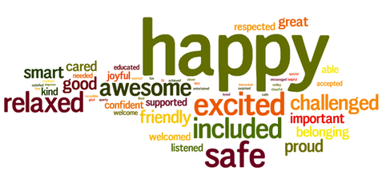
ROLES IN SCHOOLS – Pastoral Care
Why Pastoral Care?
To provide a safe, secure environment for children to feel safe, acknowledged and valued.
School staff are ideally placed to recognise the early stages of mental health and stress.
Pastoral support staff do not have the stress of achieving academic targets. Their main priority is the children/young people’s wellbeing and happiness.
Children and young people spend most of their time in educational settings, so it is an ideal place for staff to promote good emotional wellbeing and behaviour.
Teaching Assistants
Pastoral Care
Nurture Groups
ELSA (Emotional Literacy Support Assistant)
(Tempo Primary School n.d.)

Slide 12
REFERENCE LIST
Ackerman, C. (2020). 10 Person-Centred Therapy Techniques Inspired by Carl Rogers. Available at: https://positivepsychology.com/client-centered-therapy/ (Accessed: 22nd December 2020).
Counselling Tutor (2020). Carl Roger’s Core Conditions. Available at: https://counsellingtutor.com/counselling-approaches/person-centred-approach-to-counselling/carl-rogers-core-conditions/ (Accessed: 18th December 2020).
Dr Cheek, B. (2020). Egan’s Skilled Helper Model. Available at: https://www.gp-training.net/mentoring/egans-skilled-helper-model/ (Accessed: 17th December 2020).
Egan, G. (2010). The Skilled Helper A Problem Management and Opportunity Development Approach to Helping. 9th Ed. Available at: http://www.leaderlabs.asia/uploads/4/7/6/2/4762488/________the_skilled_helper.pdf (Accessed: 21st December 2020).
Hayes, D. (2019). Mental Health in Schools: Policy Context. [Picture] Available at: https://www.cypnow.co.uk/features/article/mental-health-in-schools-policy-context (Accessed: 21st December 2020).
Lambert, S. (n.d.) Core Conditions and Carl Rogers. Available at: https://www.suelamberttrust.org/wp-content/uploads/2018/02/HO10-Core-Conditions-and-Carl-Rogers-v3.pdf (Accessed: 18th December 2020).
McLeod, S. (2014). Carl Rogers. Simple Psychology. Available at: https://www.simplypsychology.org/carl-rogers.html (Accessed: 18th December 2020).
McLeod, S. (2019) Person Centred Therapy. Available at: https://www.simplypsychology.org/client-centred-therapy.html (Accessed: 18th December 2020).

Slide 13
REFERENCE LIST
Nelson, P. (2007). An Easy Introduction to Egan’s Skilled Helper Solution Focused Counselling Approach. Available at: http://highgatecounselling.org.uk/members/certificate/CT1W3%20Paper%202.pdf (Accessed: 17th December 2020).
Pantanella, M. (2019). Speaking Without Words. A Look At Renowned Professor Gerard Egan. [Picture] Available at: https://medium.com/live-your-life-on-purpose/speaking-without-words-9e551432e36a (Accessed: 22nd December 2020).
Pierce, M. (2016). 3 Core Condition for Therapeutic Change. Available at: https://trueselfcounseling.com/2016/02/20/3-core-conditions-for-therapeutic-change/#:~:text=Rogers%20maintains%20that%20therapists%20must,%2C%20and%20(3)%20accurate%20empathic (Accessed: 18th December 2020).
Ramsey, K. (2019). Carl Rogers and the Core Conditions of Counselling. Available at: https://medium.com/achology/carl-rogers-and-the-core-conditions-of-counselling-a87167028905 (Accessed: 17th December 2020).
Rosink, J. (2009). Understanding the problem: the skilled helper. [Pictures] Available at: http://testconsultant.blogspot.com/2009/02/understanding-problem-skilled-helper.html (Accessed: 21st December 2020).
Tempo Primary School (n.d.) Pastoral Care. [Picture] Available at: https://tempops.weebly.com/pastoral-care.html (Accessed: 22nd December 2020).
Truyens, M. (2019). Skilled Helper Model. [Picture]. Available at: https://marcr.net/marcr-for-career-professionals/career-theory/career-theories-and-theorists/skilled-helper-model-egan/ (Accessed: 16th December 2020).

