Slide 1
An Analysis Of The Ecological Footprint Methodology In Delivering Sustainable Strategies For Camping and Caravanning Tourism: The Case Of Gower, South Wales.
MSc Environmental Conservation and Management
By Abi Lewis

Slide 2
Introduction
In post-industrial society the changing demographics and socio-economic forms have put serious pressures on the globes natural environments.
To address the problems society needs robust measurement tools to acquire accurate information from which appropriate sustainable policies can be developed.
One such management tool is the ecological footprint

Slide 3
Rationale
Wales is highly dependent on trade, tourism in particular accounts for an estimated 3.2% of the Welsh GDP
The welsh coastline attracts more than 4 million visitors annually amounting to a spend of £648 million. (WAG,2008)
With a dependence on tourism the coastal zones of Wales are seen to be highly important, therefore the care and management of these areas is a priority.
Research to understand the impacts of tourism to these zones is highly important particularly for the development of sustainable management strategies.
Bower & Turner, 1997: 1, Phillips & Jones, 2005
Notes:
Wales is highly dependent on trade, tourism in particular accounts for an estimated 3.2% of the Welsh GDP and with the coastline attracting more than 4 million visitors per annum, amounting to a spend of £648 million, it is an important zone for the Welsh economy (WAG,2008).
With a dependence on tourism the coastal zones of Wales are seen to be highly important, therefore the care and management of these areas is a priority.
Research to understand the impacts of tourism to these zones is highly important particularly for the development of sustainable management strategies.
Bower and Turner state that the coastal zone is a continuously adapting environment, and the need for adaptive management strategies is of significant importance when considering the economic gains that come from its usage ( stated by Phillips and Jones).

Slide 4
Rationale
With the coastal areas of Wales and the tourism that it attracts contributing greatly to the economy , it is important that human impacts upon these areas are not causing continued degradation
Considering these facts it is important to note the lack of literature and resarch projects focusing on the below topic areas :-
The impacts related to short/ staycation holidays is research that has not been widely undertaken utilising the ecological footprint as a measurement tool.
Likewise research comparing home ecological footprints and the ecological footprints of short/ staycation holidays
Notes:
With the coastal areas of Wales and the tourism that it attracts contributing greatly to the economy , it is important that human impacts upon set areas are not causing continued degradation
Considering these facts it is important to note the lack of literature and resarch projects focusing on the below topic areas :-
The impacts related to short/ staycation holidays is research that has not been widely undertaken utilising the ecological footprint as a measurement tool.
Likewise research comparing home ecological footprints and the ecological footprints of short/ staycation holidays
The impacts related to short/ staycation holidays is research that has not been widely undertaken utilising the ecological footprint as a measurement tool.
Likewise research comparing home ecological footprints and the ecological footprints of short/ staycation holidays

Slide 5
Aims and Objectives
The study concerned the undertaking of a detailed Ecological Footprint survey within two coastal campsite locations in South Wales.
The aim : To assess how effective the ecological footprint method can be in delivering sustainable strategies for camping and caravanning tourism within a non built-up coastal location.
Objectives :
Objective 1: To compare the ecological footprint of camping and caravanning holiday within a coastal location to that of respondent’s home life.
Objective 2: Evaluate the reasons for the ecological footprints produced through camping and caravanning holidays.
Objective 3: Examine effectiveness of the REAP tool in facilitating the development of a sustainable camping strategy.
Objective 4: To propose a set of recommendations for the development of a sustainable camping and caravanning strategy for coastal tourist locations.
Notes:
The study concerned the undertaking of a detailed Ecological Footprint survey within two coastal campsite locations in South Wales.
The aim : To assess how effective the ecological footprint method can be in delivering sustainable strategies for camping and caravanning tourism within a non built-up coastal location.
Objectives :
Objective 1: To compare the ecological footprint of camping and caravanning holiday within a coastal location to that of respondent’s home life.
Objective 2: Evaluate the reasons for the ecological footprints produced through camping and caravanning holidays.
Objective 3: Examine effectiveness of the REAP tool in facilitating the development of a sustainable camping strategy.
Objective 4: To propose a set of recommendations for the development of a sustainable camping and caravanning strategy for coastal tourist locations.

Slide 6
Literature Review
Ecological footprinting is not new, its has been developed over two decades or more.
Ecological footprint : Definition
“Ecological footprint analysis is an accounting tool that enables us to estimate the resource consumption and waste assimilation requirements of a defined human population or economy in terms of a corresponding productive land area.” (Wackernagel & Rees, 1996;9).
Furthermore Venetoulis and Talberth (2006) state :
“Ecological footprint measures how much of the biosphere’s annual regenerative capacity is required to renew the natural resources used by a defined population in a given year.”
Notes:
Ecological footprinting is not new, its has been developed over two decades or more.
Ecological footprint : Definition
“Ecological footprint analysis is an accounting tool that enables us to estimate the resource consumption and waste assimilation requirements of a defined human population or economy in terms of a corresponding productive land area.” (Wackernagel & Rees, 1996;9).
Furthermore Venetoulis and Talberth (2006) state :
“Ecological footprint measures how much of the biosphere’s annual regenerative capacity is required to renew the natural resources used by a defined population in a given year.”

Slide 7
Ecological foot printing is a widely utilised tool
The ecological footprint like many things within the academic world does not come without criticism :-
One of the main critiques is that the footprint is a quantitative measure which in some instances fails or ignores matters at the heart of sustainability, and avoids some social and economic factors.
Too simplistic
Some of the more harsh critics have said that the “ecological footprint is not in itself anything more than an important attention grabbing device.” (Moffatt, 2000).
Notes:
The meaning of the ecological footprint has captured the attention of the general public as it is something that people can relate to, the portrayal of the footprint upon the surface of the earth is a strong message, and a metaphor that has been proven to be of significance when re-iterating the need for the current population to adopt sustainable practices within their everyday life.
[Read section about criticism]
Despite these criticisms, ecological foot printing is still a key tool in assessing and measuring environmental sustainability within many fields including that of the costal environment. It is recognised to be “the most comprehensive measure of environmental impact to date” (York et al, 2003 : 279)
is been seen to be a tool used by governments and local authorities in the consideration, construction and formulation of policy
And it is the simplicity and adaptability of the method that has made it a widely utilised tool.

Slide 8
literature relating to dissertation topic :
Ecological Footprint Research
Collins, A. & Flynn, A. (2007), “Engaging with the ecological footprint”
House. C, Phillips. M.R, and Beynon. P, 2008, What kind of footprint do events want to leave on ‘our beach’?, Swansea Metropolitan University, 2008, P 9.
Hunter. C & Shaw. J, 2006, Applying the ecological footprint to ecotourism scenarios, Environmental Conservation, 2006, Vol. 32, Issue 4, P 294 – 304, Cambridge University Press.
Wackernagel. M & Rees. W.E, 1996, Our Ecological Footprint: Reducing The Human Impact On The Earth, The New Catalyst Bioregional Series; Issue 9, P 1 – 9.
Notes:
Ecological foot printing is a widely utilised tool
literature relating to dissertation topic :
Ecological Footprint Research
Collins, A. & Flynn, A. (2007), “Engaging with the ecological footprint”
House. C, Phillips. M.R, and Beynon. P, 2008, What kind of footprint do events want to leave on ‘our beach’?, Swansea Metropolitan University, 2008, P 9.
Hunter. C & Shaw. J, 2006, Applying the ecological footprint to ecotourism scenarios, Environmental Conservation, 2006, Vol. 32, Issue 4, P 294 – 304, Cambridge University Press.
Wackernagel. M & Rees. W.E, 1996, Our Ecological Footprint: Reducing The Human Impact On The Earth, The New Catalyst Bioregional Series; Issue 9, P 1 – 9.

Slide 9
Sustainable Tourism
World Tourism Organisation defines sustainable tourism as;
“tourism which leads to management of all resources in such a way that economic, social and aesthetic needs can be fulfilled while maintaining cultural integrity, essential ecological processes, biological diversity and life support systems.” (WTO, 1996).
Hunter. C and Green. H, 1995, Tourism and the environment: A sustainable relationship?, Routledge, London and New York.
ICLEI, 1999,Sustainable Tourism: A local Authority Perspective, Commission on Sustainable Development Seventh Session, New York, Pp 1-13
Shah. K, McHarry. J and Gardiner. J, 2002, Sustainable Tourism- Turning The Tide, Economic Briefing No.4, Paper towards the Earth Summit 2002, Pp 1-16.
Notes:
Sustainable Tourism
World Tourism Organisation defines sustainable tourism as;
“tourism which leads to management of all resources in such a way that economic, social and aesthetic needs can be fulfilled while maintaining cultural integrity, essential ecological processes, biological diversity and life support systems.” (WTO, 1996).
Hunter. C and Green. H, 1995, Tourism and the environment: A sustainable relationship?, Routledge, London and New York.
ICLEI, 1999,Sustainable Tourism: A local Authority Perspective, Commission on Sustainable Development Seventh Session, New York, Pp 1-13
Shah. K, McHarry. J and Gardiner. J, 2002, Sustainable Tourism- Turning The Tide, Economic Briefing No.4, Paper towards the Earth Summit 2002, Pp 1-16.

Slide 10
Methodology : Pilot Study
A pilot study was undertaken (August 2010) : timed ecological footprint questionnaire : 10 respondents
Hypothesis : ‘Staycation’ holidays have lower ecological footprints that that of staying at home.
Data inputted into REAP petite and REAP tourism ecological footprint software.
Conclusions :
mathematical calculations needed to make REAP petite and REAP tourism data comparable.
Data disproved the hypothesis
Questionnaire was slightly lengthy
Notes:
The time and place for the undertaking of field work is highly important in order to draw respondents, and is seen as a fundamental part of research when conducting a questionnaire based study (Oppenheim, 1992).
Considering these facts and the aims and objectives of this project the field work was undertaken during the school summer holidays in August 2010. Survey days were chosen when weather conditions were optimum, ideally dry, sunny days as it was expected that more people would be using campsites or going on short camping breaks.

Slide 11
Methodology : Full Study
Amendments were made to the questionnaire based on the conclusions found from the pilot study.
Field work was undertaken during the school summer holidays in August 2010.
Survey days were chosen when weather conditions were optimum, ideally dry, sunny days.
Data collection via an ecological footprint questionnaire : 71 respondents
Notes:
Amendments were made to the questionnaire based on the conclusions found from the pilot study.
Field work was undertaken during the school summer holidays in August 2010.
Survey days were chosen when weather conditions were optimum, ideally dry, sunny days.
Data collection via an ecological footprint questionnaire : 71 respondents

Slide 12
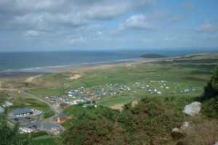
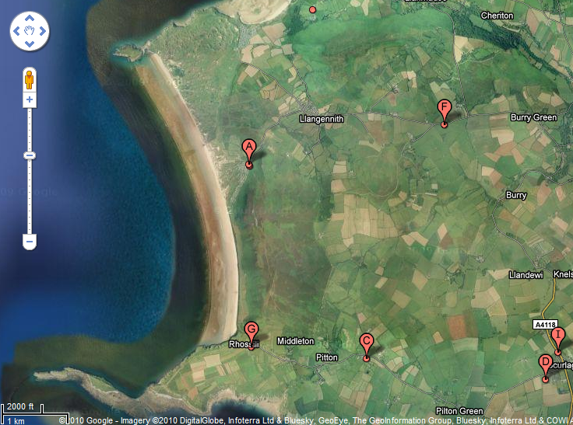
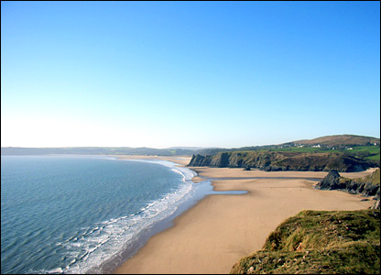
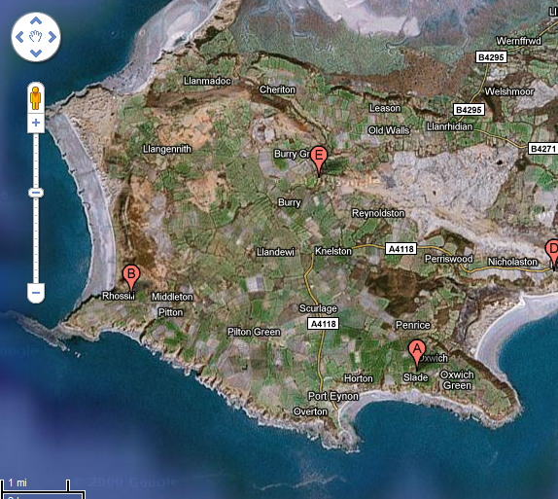
Venues located on the Gower coastline of South Wales.
1. Llangennith Capsite: (Campsite Review, no date) Llangenith: (Google Maps, 2010)
2. Oxwich Bay : (Google Images,2010) Oxwich: (Google Maps, 2010)

Slide 13


REAP petite & REAP tourism Software
REAP petite :
Designed to help communities calculate their ecological or carbon footprint.
works on a yearly calculation for an ecological footprint
REAP tourism:
Designed to calculate the environmental footprint of visitors to any area within the UK
Works on a daily calculation for an ecological footprint
Notes:
The software used for this project were developed by Stockholm Environment Institute

Slide 14
Data Analysis
Data inputted into REAP petite and REAP tourism software
Data sets analysed : home ecological footprints
: ‘staycation’ ecological footprints
Statistical analysis of data
Comparisons could then be made
Recommendations for sustainable management policies and future research could be put forward.

Slide 15
Data Analysis: REAP petite
Notes:
The average ecological footprint for the respondents ‘home’ ecological footprint has been calculated to be 5.76 gha per capita
the lowest ‘home’ ecological footprint value: 4.47gha attributed to respondent 7
the highest ‘home’ ecological footprint value: 8.41 gha attributed to respondent 17.
The majority of the data is grouped along the linear line with relatively low variability around the mean. This variability reflects the natural variation found in any natural data set and is likely to be the cumulative effect of variation in each of the factors used to calculate the ecological footprint. For example, normal, ‘home’ travel is likely to vary from one individual to another. Although day-to-day travel will be relatively low for most people, the specific travel requirements for individuals will be determined by the specifics of their personal domestic and work circumstances.

Slide 16
Data Analysis : REAP tourism
Notes:
The ecological footprint average for the respondents ‘staycation’ ecological footprint has been calculated to be 10.10 gha per capita.
the lowest recorded ecological footprint value was 2.80 gha attributed to respondent 14,
the highest ecological footprint value recorded on the study for the ‘staycation’ holiday was 23.92 gha attributed to respondent 70.
This can be classed as an extreme variation, with the difference between respondent fourteens holiday footprint and respondent seventy’s footprint being 21.12 global hectares.
The graph indicates that there is very little consistency in ‘staycation’ behaviour, with considerable variability around the mean of 10.1 gha, indicated by the standard deviation of 4.1 gha.

Slide 17
Data Analysis : Total Ecological Footprints
Notes:
average global hectares for ‘home’ ecological footprints is 5.76 and the for ‘staycation’ holidays, 10.10 global hectares, a doubling of footprint whilst on holiday is therefore indicated, however this is not the case. Each ecological footprint is not doubled whilst on holiday, there is a wide variation to the range of change seen from ‘home’ ecological footprints and those gained whilst on holiday. It is true to state that a large number of the respondents footprints do indeed double, however there are also instances where by the footprint has tripled or quadrupled.
To clarify, the data shows that ecological footprints of tourists on camping holidays are higher than their ecological footprint at home. The reason attributed to this finding is linked solely to the ecological footprint developed via food consumption over the duration of the holiday
Out of the total 71 respondents five had lower ecological footprints whilst on holiday when compared to the ecological footprint of their home life these were classed as anomalies

Slide 18
Notes:
This graph clearly shows the variation between ‘home’ ecological footprints and ‘staycation’ ecological footprints.
. As the footprints accumulated on holiday begin to reduce so does the variation, however the figures still represent a tripling at least. It is interesting to note that respondent 45 and respondent 2 have lower than average home ecological footprints, this suggests that it is not a generic fact that people who gain high ecological footprints whilst on holiday have high ecological footprints at home. It in fact reiterates the point that it is the variability away from normal home life that causes an increase within the footprint and this has a direct link to the habits of food consumption on holidays.
The discovery of increased ecological footprints linked to behavioural change in food consumption patterns for holiday makers, is a finding that has great importance to the tourism and travel industry.

Slide 19
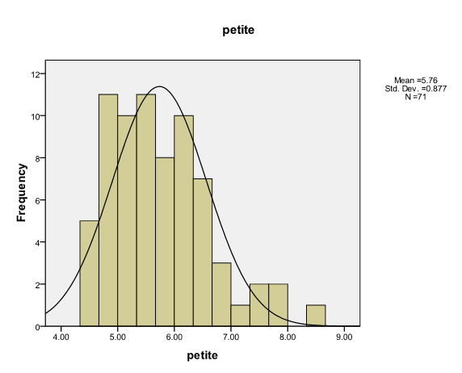
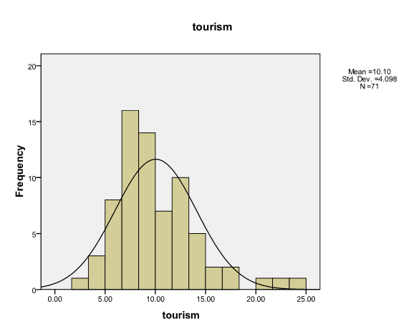
Histograms of REAP petite and REAP tourism data
Notes:
These graphs further emphasise that respondents are fairly consistent within their home behaviour and follow the line of nominal distribution, however there is far more variation away from the line of nominal distribution when the respondents are on holiday.
The assumption can then be made that 93% of respondents have changes to their normal consumption habits whilst on holiday. The only feasible reasoning behind this finding is the fact that the current economic climate has aided in the promotion of sustainable money saving alternatives for everyday home life, and encourages sustainable living in order to reduce the running costs associated with home life.

Slide 20
Summary
The data showed that the ecological footprints of 93% of the respondents were higher whilst on holiday
Food consumption accounted for 99% of the ecological footprint gained by respondents whilst on holiday
A clear pattern emerged that links high ecological footprints to the consumption of certain food groups, in particular meat and alcoholic drinks.
Behavioural variation of respondents within their home life is low.
In contrast, the standard deviation of the ‘staycation’ ecological footprint was high indicating that the variability in respondents’ behaviour is enormous whilst on holiday
The variability within the data suggests that behavioural norms change whilst on holiday and as a result ecological footprints increase. Within this study it has been highlighted by overwhelming ecological footprints linked to food consumption.
Notes:
The data showed that the ecological footprints of 93% of the respondents were higher whilst on holiday, the remaining 7% in fact had lower ecological footprints when compared to the ecological footprint that was calculated for their home lifestyle.
Food consumption accounted for 99% of the ecological footprint gained by respondents whilst on holiday, mode of travel to and from the location also being a minor factor
A clear pattern emerged that links high ecological footprints to the consumption of certain food groups, in particular meat and alcoholic drinks.
The low standard deviation of 0.88 for the ‘home’ ecological footprints indicates that the behavioural variation of respondents within their home life is low.
In contrast, the standard deviation of the ‘staycation’ ecological footprint was high indicating that the variability in respondents’ behaviour is enormous whilst on holiday
the variability within the data suggests that behavioural norms change whilst on holiday and as a result ecological footprints increase. Within this study it has been highlighted by overwhelming ecological footprints linked to food consumption.

Slide 21
Recommendations
The focus for future sustainable tourism strategies should therefore hold food consumption in high regard considering the impact it can have upon ecological footprints within tourist locations
In order that lower ecological footprints of tourists to be realised varied care specific strategies have to provide visitors with similar rules and regulations to those seen within ‘home’ life scenarios
amendments to tourism strategies to incorporate social/ behavioural changes it is the conclusion of this study sustainable food production and consumption be promoted
Academic research is needed to gain further knowledge to the impacts of staycation tourism in coastal locations
The use of ecological footprinting in the development of sustainable coastal management strategies
The use of ecological footprinting in the monitoring of focused management strategies, with emphasis on food consumption

Slide 22
Problems
Questionnaire design
Data acquisition
Data handling
Utilising two different pieces of software, namely REAP petite and REAP tourism

Slide 23
References
Bower. B.T & Turner. K.R, 1997, Characterising and Analysing Benefits from Integrated Coastal Zone Management (ICZM), CSERGE Working Paper, P 1.
Collins, A. & Flynn, A. (2007), “Engaging with the ecological footprint”
House. C, Phillips. M.R, and Beynon. P, 2008, What kind of footprint do events want to leave on ‘our beach’?, Swansea Metropolitan University, 2008, P 9.
Hunter. C and Green. H, 1995, Tourism and the environment: A sustainable relationship?, Routledge, London and New York.
Hunter. C & Shaw. J, 2006, Applying the ecological footprint to ecotourism scenarios, Environmental Conservation, 2006, Vol. 32, Issue 4, P 294 – 304, Cambridge University Press.
ICLEI, 1999,Sustainable Tourism: A local Authority Perspective, Commission on Sustainable Development Seventh Session, New York, Pp 1-13
Moffatt, I., (2000), “Ecological footprints and sustainable development”, Ecological Economics, Issue 32, 359-362.
Phillips. M.R, & Jones. A.L, 2005, Erosion and tourism infrastructure in the coastal zone: problems and consequences of management, Tourism Management, 2006, Vol. 27, Issue 3, P 517 – 524.
Shah. K, McHarry. J and Gardiner. J, 2002, Sustainable Tourism- Turning The Tide, Economic Briefing No.4, Paper towards the Earth Summit 2002, Pp 1-16.
WAG, 2008, Coastal Tourism Strategy, Visit Wales, 2008, Cardiff, P.3
Wackernagel. M & Rees. W.E, 1996, Our Ecological Footprint: Reducing The Human Impact On The Earth, The New Catalyst Bioregional Series; Issue 9, P 1 – 9.
Venetoulis. J & Talberth. J, 2006, Refining the ecological footprint, Environment, Development and Sustainability, Springer.

Slide 24
Thank You for listening

