Slide 1
CertHE Applied Leadership and Management in the Workplace
Module: BMSK4014
Problem Solving and Decision Making

Slide 2
Blended Learning
Session 2

Slide 3
Problem Categories Recap
Strategic problems - are longer term, wide ranging problems that have significant consequences for the organisation as a whole
Operational problems - are usually medium to short term and involve the management of resources to achieve particular objectives
Administrative problems - are usually short term or have a right or wrong answer according to the policies and procedures of the organisation.
Notes:
In Groups –
Work together to give examples of each category from the workplace – (each group present back to class)
Give an example of a strategic problem facing a government or economy

Slide 4
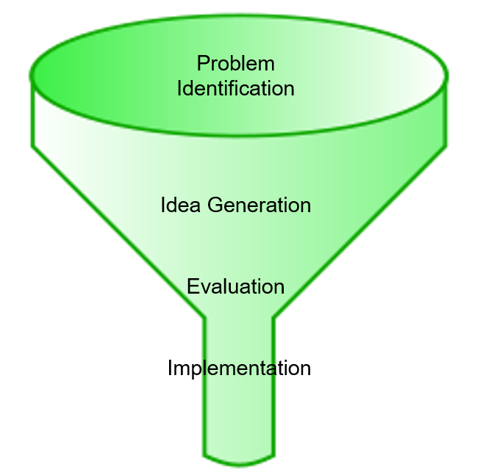
Stages of Creative Problem Solving
Each stage of the problem-solving process involves a closing down or ‘funnelling process’.

Slide 5
Creative and Analytical Skills
  5-minute exercise
  Applying both analytical and creative skills:

Slide 6
Exercise 1 - Dots
• | • | •
• | • | •
• | • | •
Join all the dots using just four straight lines without taking the pen off the paper.
3 mins

Slide 7

Exercise 1 - Dots
Spatial and creative thinking is used to solve the problem by going
outside the dots to arrive at the solution

Slide 8
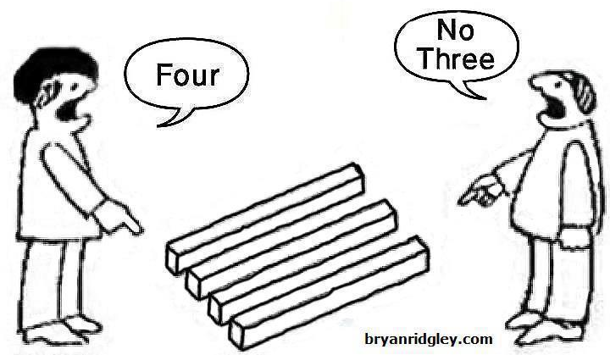
At First Glance
Reality can be so complex that equally valid observations from differing perspectives can appear to be contradictory.

Slide 9
Mental Agility
Exercise 2:
Add one straight line so that the equation makes sense:
5 + 5 + 5 = 550
3 Mins

Slide 10
Mental Agility
Exercise 2:
Add one straight line so that the equation makes sense:
5 + 5 + 5 = 550
3 Mins

Slide 11
The size of the problem
Problems can often be deceptive – what appears to be a small problem can sometimes turn out to be a far bigger and possibly different problem.

Slide 12
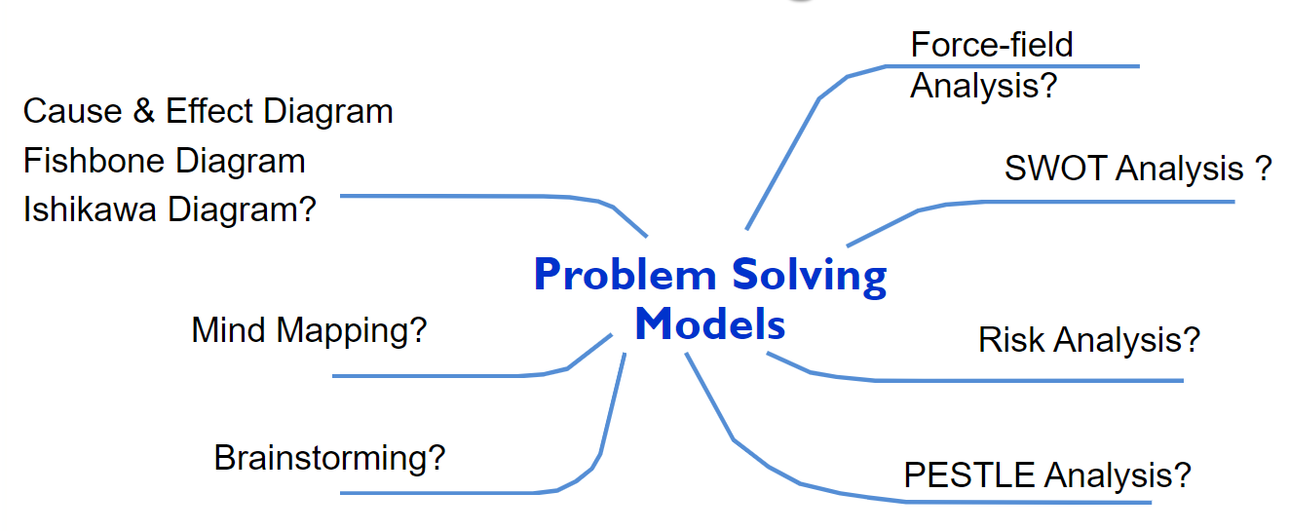
Problem Solving Models

Slide 13
Problem Solving Skills
Simple ways to recognise, investigate and analyse problems.
Objective setting in relation to problem
Brainstorming and creative thinking techniques
How to evaluate options
Simple decision-making techniques
Effective presentation of a case – i.e., providing facts and evidence, not just opinion
Monitoring and review techniques to evaluate outcomes of problem-solving activities

Slide 14
Mental Agility
Exercise 3: 5 mins
Think up a sentence of more than 15 words all beginning with the letter ‘T’

Slide 15
Mental Agility
Exercise 3: 5 mins
Trevor took the trouble to take the train ticket to the terminus to transfer the train time to ten tomorrow.

Slide 16
Six steps to effective problem solving
Identify the problem
Specify the cause, the reasons and the effects
Identify possible solutions
Evaluate and select the most promising solutions
Plan the action, and
Action the plan and……monitor

Slide 17

Problem Solving
Scope & Impact

Slide 18

Scope & Impact
Scope – Who is affected? How wide does the problem reach?
Impact – How are they affected?

Slide 19
References
Clegg, B., Birch, P. (2007). Instant Creativity: Simple Techniques to Ignite Innovation & Problem Solving. Kogan Page Ltd.
Higgins, J. M. (1994). 101 Creative Problem Solving Techniques: The Handbook of New Ideas for Business. New Management Pub. Co.
Kepner, C. H., Tregoe, B.B., (1967). The Rational Manager. McGraw-Hill.
Proctor, T. (2005). Creative Problem Solving for Managers: Developing Skills for Decision Making and Innovation. 2nd ed. Routledge.
Williams, K. (2006). Introducing Management a Development Guide. 3rd ed. Butterworth-Heinemann.

Slide 20
Further research
Define a complex problem in the workplace including its scope and impact

Slide 21
Reflect
Please take a few minutes to review the session and complete your learning log

