Slide 1
BMIH4003 Hospitality and Guest Services
JW Marriott
Presented by A K Zakaria Ibrahim

Slide 2
Table of Contents
Introduction
JW Marriott's main consumers
Nature, scope and role of the guest services and facilities
Role and function of guest services
Importance of hospitality
Meeting guest expectations
Conclusion
References

Slide 3
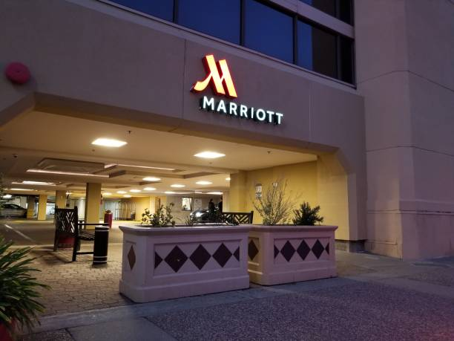
Introduction
The importance of offering high-quality service, hospitality, and guest services in the hospitality sector is crucial to the success of hotels such as JW Marriott International. As a global hotel chain, JW Marriott has a reputation to uphold and strives to provide top-notch experiences for guests at their 7,000 properties in 131 countries. The focus on providing excellent service and hospitality differentiates JW Marriott from its competitors and contributes to the brand's success in the industry (Buhalis et al., 2014).
Notes:
The importance of offering high-quality service, hospitality, and guest services in the hospitality sector is crucial to the success of hotels such as JW Marriott International. As a global hotel chain, JW Marriott has a reputation to uphold and strives to provide top-notch experiences for guests at their 7,000 properties in 131 countries. The focus on providing excellent service and hospitality differentiates JW Marriott from its competitors and contributes to the brand's success in the industry (Buhalis et al., 2014).

Slide 4

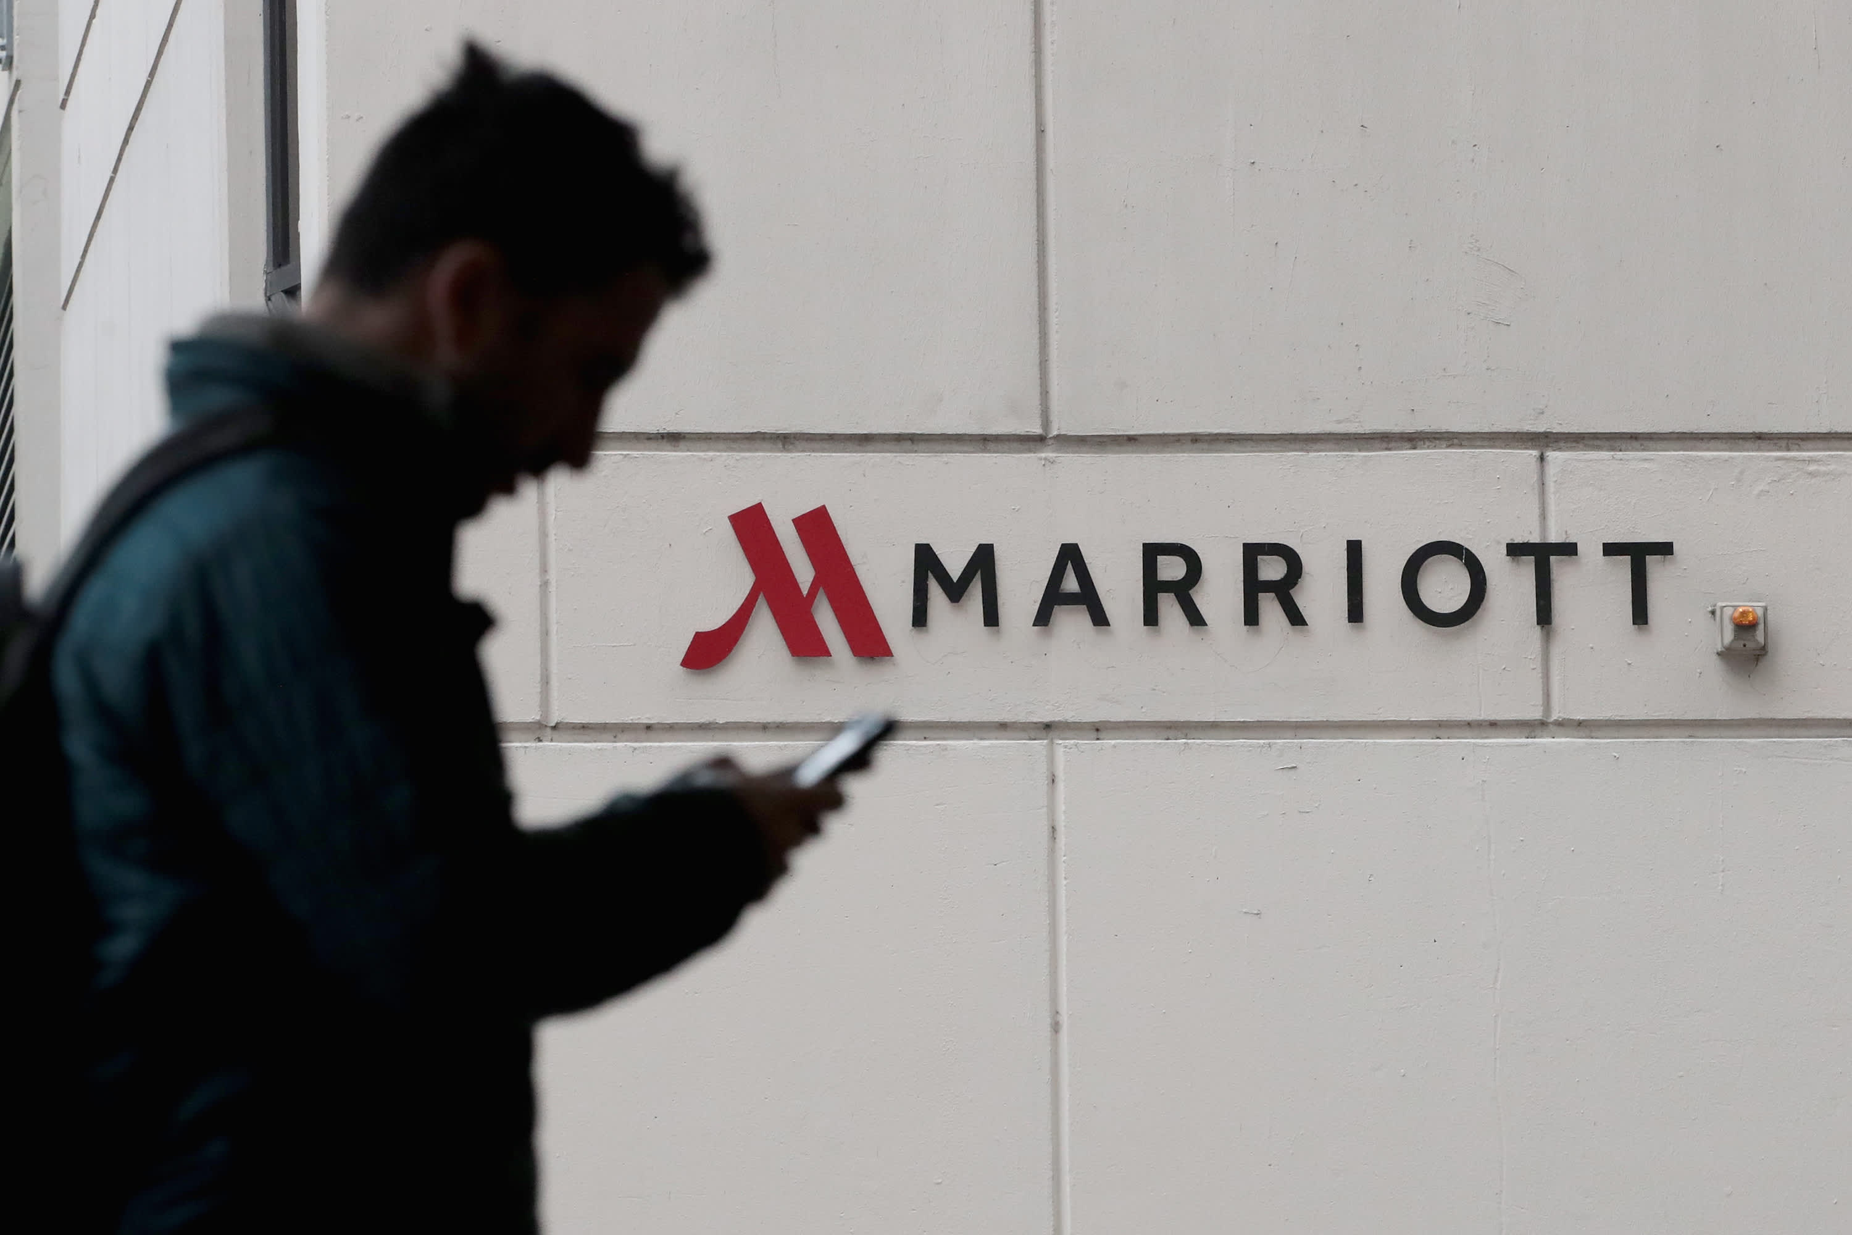
JW Marriott's main consumers
JW Marriott caters to a diverse range of customers, from individual travellers on leisure trips to business travellers on work trips, as well as groups and events. To accommodate these customers, JW Marriott provides a variety of accommodation options, including luxury resorts with high-end amenities, full-service hotels that offer a complete range of services, and extended-stay properties for those who need a home away from home (Kapiki, 2012). JW Marriott offers a diverse array of options, allowing it to cater to various types of travellers, regardless of their purpose or budget.
Notes:
JW Marriott caters to a diverse range of customers, from individual travellers on leisure trips to business travellers on work trips, as well as groups and events. To accommodate these customers, JW Marriott provides a variety of accommodation options, including luxury resorts with high-end amenities, full-service hotels that offer a complete range of services, and extended-stay properties for those who need a home away from home (Kapiki, 2012). JW Marriott offers a diverse array of options, allowing it to cater to various types of travellers, regardless of their purpose or budget.

Slide 5
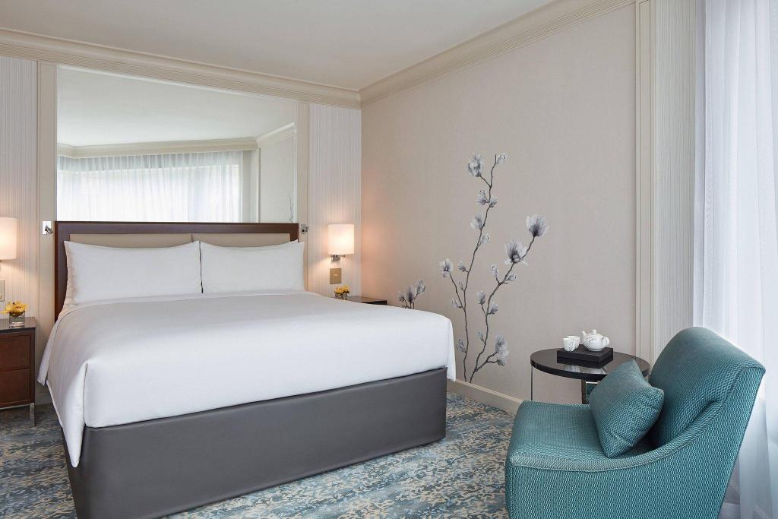
Nature, scope and role of the guest services and facilities
Room service
Concierge service
Laundry service
Fitness centres
Business centres
On-site restaurants and bars
Meeting and event spaces
Spa and wellness services
Notes:
The guest services and facilities offered by JW Marriott encompass a wide range, and serve a crucial role in satisfying its guests. These services include:
Room service: JW Marriott hotels offer room service for guest convenience and enhanced experience, featuring a variety of meals, drinks and options for special dietary needs.
Concierge service: JW Marriott hotels offer a concierge service with knowledgeable staff to assist guests with their needs and enhance their overall experience during their stay.
Laundry service: JW Marriott hotels provide laundry services for guest comfort and convenience, including options for same-day turnaround or express service, adding to the level of luxury during guests' stays.
Fitness centres: JW Marriott hotels provide fitness centres with state-of-the-art equipment and fitness classes to help guests stay active and refreshed during their stay.
Business centres: JW Marriott hotels have business centers with computers, printers, and other equipment, offering guests a convenient and productive space to work during their stay (Ionel, 2016).
On-site restaurants and bars: JW Marriott hotels have on-site restaurants & bars offering local cuisine & drinks. Fine to casual dining options available.
Meeting and event spaces: JW Marriott hotels offer meeting & event spaces with advanced technology.
Spa and wellness services: JW Marriott Hotels offer spa and wellness services, incl. massages, facials, body treatments, fitness, etc. Check with hotel for updated information.

Slide 6
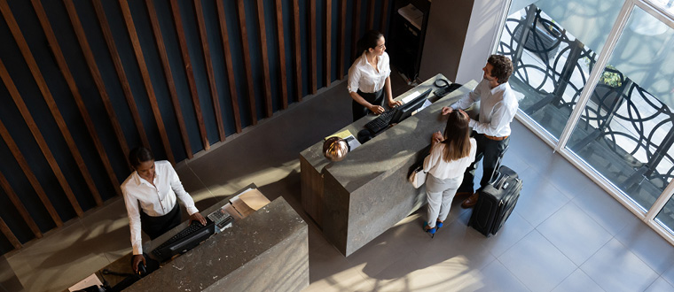
Role and function of guest services
It is imperative to acknowledge the importance of guest services for a hotel brand's success. Guest services play a crucial role in creating a positive guest experience, which can lead to increased customer loyalty and positive word-of-mouth marketing. Guest services also play a critical role in the overall customer experience (Car et al., 2019). A positive guest experience can lead to increased customer loyalty, repeat business, and positive word-of-mouth marketing. On the other hand, poor guest services can lead to negative reviews, low customer satisfaction, and a decline in business (Shin and Jeong, 2022).
Notes:
It is imperative to acknowledge the importance of guest services for a hotel brand's success. Guest services play a crucial role in creating a positive guest experience, which can lead to increased customer loyalty and positive word-of-mouth marketing. Guest services also play a critical role in the overall customer experience (Car et al., 2019). A positive guest experience can lead to increased customer loyalty, repeat business, and positive word-of-mouth marketing. On the other hand, poor guest services can lead to negative reviews, low customer satisfaction, and a decline in business (Shin and Jeong, 2022).

Slide 7
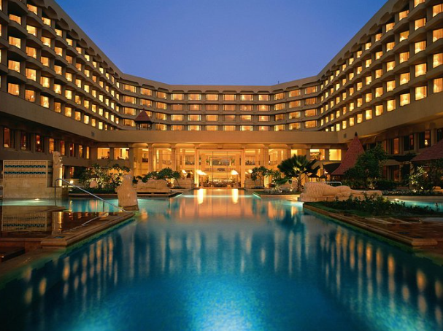
Importance of hospitality
Hospitality is the act of providing friendly and generous service to guests. Providing quality service is a critical component of the hotel industry, playing a vital role in satisfying guests and exceeding their expectations. JW Marriott International places a strong emphasis on hospitality and provides extensive training to their staff to ensure that guests receive the highest level of service (Stifanich et al., 2019).
Notes:
Hospitality is the act of providing friendly and generous service to guests. Providing quality service is a critical component of the hotel industry, playing a vital role in satisfying guests and exceeding their expectations. JW Marriott International places a strong emphasis on hospitality and provides extensive training to their staff to ensure that guests receive the highest level of service (Stifanich et al., 2019).

Slide 8
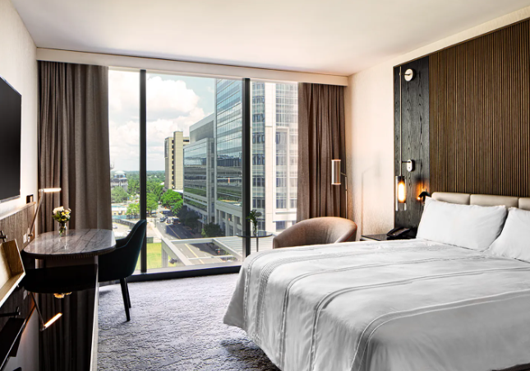
Meeting guest expectations
JW Marriott International is a global hotel brand that is committed to meeting and exceeding guest expectations by providing exceptional service and luxurious amenities. One of the ways that JW Marriott International meets and exceeds guest expectations is by providing personalised service to guests. The brand's loyalty programme, JW Marriott Bonvoy, allows guests to earn points and rewards for their stays and also offers members exclusive perks and benefits (Šimunić et al., 2019).
Notes:
JW Marriott International is a global hotel brand that is committed to meeting and exceeding guest expectations by providing exceptional service and luxurious amenities. One of the ways that JW Marriott International meets and exceeds guest expectations is by providing personalised service to guests. The brand's loyalty programme, JW Marriott Bonvoy, allows guests to earn points and rewards for their stays and also offers members exclusive perks and benefits (Šimunić et al., 2019).
JW Marriott International also meets and exceeds guest expectations by providing a comfortable and clean environment. The brand is committed to maintaining high standards of cleanliness and safety and has implemented enhanced cleaning protocols and safety measures in response to the COVID-19 pandemic (De Ruyter et al., 2012).
JW Marriott International is also known for its commitment to sustainability, which is an important aspect for many guests. JW Marriott has taken various steps to minimize its environmental footprint, such as recycling programs and energy-saving practices (Blazevic et al., 2012).

Slide 9

Conclusion
Guest services, hospitality, and quality service are integral to the success of the hotel industry. JW Marriott International's commitment to providing these services is demonstrated through the wide range of facilities and services they offer to their guests. By consistently exceeding guest expectations, JW Marriott is able to create a positive guest experience that leads to increased customer loyalty and positive word-of-mouth marketing.
Notes:
Guest services, hospitality, and quality service are integral to the success of the hotel industry. JW Marriott International's commitment to providing these services is demonstrated through the wide range of facilities and services they offer to their guests. By consistently exceeding guest expectations, JW Marriott can create a positive guest experience that leads to increased customer loyalty and positive word-of-mouth marketing.

Slide 10
References
Berezan, O., Millar, M. and Raab, C., (2014). Sustainable hotel practices and guest satisfaction levels. International Journal of Hospitality & Tourism Administration, 15(1), pp.1-18.
Bilgihan, A. and Nejad, M., (2015). Innovation in hospitality and tourism industries. Journal of hospitality and Tourism Technology, 6(3).
Car, T., Stifanich, L.P. and Šimunić, M., (2019). Internet of things (iot) in tourism and hospitality: Opportunities and challenges. Tourism in South East Europe, 5, pp.163-175.
Golubovskaya, M., Robinson, R.N. and Solnet, D., (2017). The meaning of hospitality: do employees understand? International Journal of Contemporary Hospitality Management, 29(5), pp.1282-1304.
Ionel, M., (2016). Hospitality industry. Ovidius University Annals: Economic Sciences Series, 1(1), pp.187-191.
Jasmand, C., Blazevic, V. and De Ruyter, K., (2012). Generating sales while providing service: A study of customer service representatives' ambidextrous behaviour. Journal of Marketing, 76(1), pp.20-37.
Kansakar, P., Munir, A. and Shabani, N., (2019). Technology in the hospitality industry: Prospects and challenges. IEEE Consumer Electronics Magazine, 8(3), pp.60-65.
Kapiki, S., (2012). Quality management in tourism and hospitality: An exploratory study among tourism stakeholders. International Journal of Economic Practices and Theories, 2(2).
Law, R., Buhalis, D. and Cobanoglu, C., (2014). Progress on information and communication technologies in hospitality and tourism. International Journal of Contemporary Hospitality Management.
Shin, H.H. and Jeong, M., (2022). Redefining luxury service with technology implementation: the impact of technology on guest satisfaction and loyalty in a luxury hotel. International Journal of Contemporary Hospitality Management.
Wernick, D.A. and Von Glinow, M.A., (2012). Reflections on the evolving terrorist threat to luxury hotels: A case study on JW Marriott International. Thunderbird International Business Review, 54(5), pp.729-746.

