Slide 1
Social Epidemiology and Public Health Development
Semester 1 2021/22
Foundations of Social Epidemiology
Understanding epidemiological statistics
Dr Aishat Bakre

Slide 2
Learning outcomes
On successful completion of this module, you should be able to:
Demonstrate a thorough understanding and knowledge of the various approaches to social epidemiology interventions and ways for monitoring epidemiological information of a population during the life course.
Apply knowledge on the link between social environment and health for the development of needs assessments, considering the social determinants of health and impact of social factors on individual and public health.
Communicate analysis and evaluation of outcomes of epidemiological studies and how these outcomes relate to social and cultural contexts, public health interventions and policies.
Demonstrate knowledge and understanding of the various forms of health inequalities in the UK and globally, and critically compare and evaluate public health policies and interventions.

Slide 3
Module Summary
The module aims overall to introduce students to the various approaches to interventions and ways for monitoring public health information related to health inequalities, social determinants of health, socio-economic and demographic characteristics of a population.
To familiarise students with the core concepts of social epidemiology and public health development and to acquire the skills necessary to describe and interpret epidemiological information.

Slide 4
Aims of the Session
To understand
Public health measurement/statistics
Relative risk and interpretation
Odd ratio and interpretation

Slide 5
Epidemiological statistical measurement

Slide 6
Epidemiological statistical measurement
The popular epidemiological statistical measurement used in studies include
Relative Risk (RR) and
Odds Ratio (OR)
Hazard ratio (HR)

Slide 7
Epidemiological statistical measurement
Relative Risk (RR) and Odds Ratio (OR) are used to measure the strength of an association between an exposure and a disease outcome

Slide 8
Relative risk

Slide 9
Relative Risk (RR)
RR tells you how many times exposure to a risk factor increases a person’s risk of contracting the disease.
Is the ratio of incidence of disease in exposed persons to the incidence of disease in unexposed persons.
Studies that create a sample population based on exposure can use relative risk- like controlled trials or cohort studies.
Formula: RR = p of getting the disease if exposed / p of getting the disease if not exposed

Slide 10
RR Interpretation
RR = 1
  If the incidence in the exposed group and the unexposed group is the same then there is no increased risk and no association between the exposure and the outcome.
RR > 1
  If the incidence in the exposed group is greater than that of the unexposed group, so there is a greater risk and a positive association between the exposure and the outcome.
RR < 1 The
  If the incidence in the exposed group is less than that of the unexposed group so there is decreased risk and a negative association between the exposure and the outcome.

Slide 11
Relative Risk (risk ratio)
Incidence of disease in the exposed group divided by the incidence of disease in the unexposed group.
A relative risk of 1 indicates that the risk of developing the disease is the same in the exposed and the unexposed groups.
A relative risk of greater than 1 (RR=1.2) indicates that there is an increased risk in the exposed group.
A relative risk of less than 1 (RR=0.5) indicates that there is a decreased risk in the exposed group.

Slide 12
RR Interpretation
RR is calculated using incidence data to measure the probability of developing disease.
Since the calculation is dependent on incidence data and only Controlled Trials and Cohort Studies can be used to calculate incidence, you should only see RR in Controlled Trials or Cohort Studies.
This is also why you see RR less than OR even though it is easier to calculate and understand – Controlled Trials and Cohort Studies are expensive and time consuming so there are fewer of them.

Slide 13
Activity
Watch the video below
https://youtu.be/xk2uK14eHNs
Feedback what you have learnt to the whole class

Slide 14
Activity
Working in groups look for a cohort study article and check the result section both in the abstract and the body of the article and report the statistical findings
Feedback your findings to the class

Slide 15
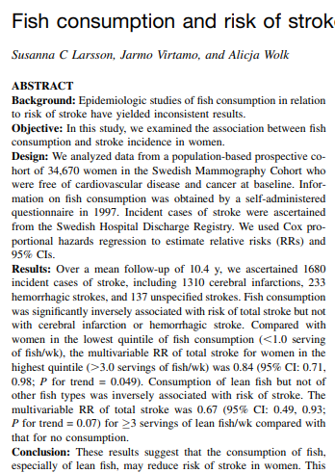
Sample article
Larsson, S.C., Virtamo, J. and Wolk, A., 2011. Fish consumption and risk of stroke in Swedish women. The American journal of clinical nutrition, 93(3), pp.487-493.

Slide 16
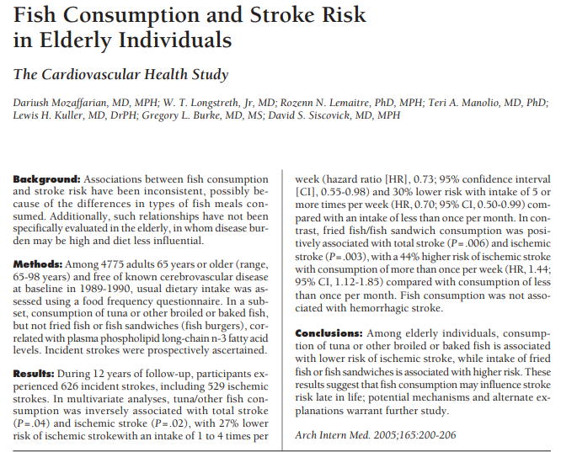
Sample article
Mozaffarian, D., Longstreth, W.T., Lemaitre, R.N., Manolio, T.A., Kuller, L.H., Burke, G.L. and Siscovick, D.S., 2005. Fish consumption and stroke risk in elderly individuals: the cardiovascular health study. Archives of Internal Medicine, 165(2), pp.200-206.
Notes:
Mozaffarian, D., Longstreth, W.T., Lemaitre, R.N., Manolio, T.A., Kuller, L.H., Burke, G.L. and Siscovick, D.S., 2005. Fish consumption and stroke risk in elderly individuals: the cardiovascular health study. Archives of Internal Medicine, 165(2), pp.200-206.

Slide 17
Odd Ratio

Slide 18
Odds Ratio (OR)
A clinical odds ratio usually refers to the odds that a person with a disease was exposed to a risk factor in the past divided by the odds that the control group had exposure to the risk factor.
Is a way of comparing patients that already have a certain condition with patients that do not have the condition.
Case Control studies compare cases that have experienced the event and controls who have not and then looks at whether each individual was exposed or not.
Formula: OR = odds of the exposure in people with disease odds of the exposure in people without disease.

Slide 19
Odds Ratio
Odds of being exposed- case =odds ratio (OR)
Odds of being exposed-control
A odd ratio of 1 indicates that there is no association that is risk of developing the disease is the same in the exposed and the unexposed groups.
A odd ratio of greater than 1 (OR=1.2) indicates that there is an increased risk in the exposed group.
A odd ratio of less than 1 (RR=0.5) indicates that there is a decreased risk in the exposed group.

Slide 20
OR Interpretation
OR = 1
  The exposure is not associated with the disease.
OR > 1
  The exposure is positively associated with the disease.
OR < 1
The exposure is negatively associated with the disease.
Since all the cases already have the disease/outcome, you can’t calculate incidence and therefore can’t calculate risk.

Slide 21
Activity
Watch the video below
https://youtu.be/ITi0SxmQTO8
Feedback what you have learnt to the whole class
Notes:
How to calculate an odds ratio - YouTube

Slide 22
Activity
Working in groups look for a case control study article and check the result section both in the abstract and the body of the article and report the statistical findings
Feedback your findings to the class

Slide 23
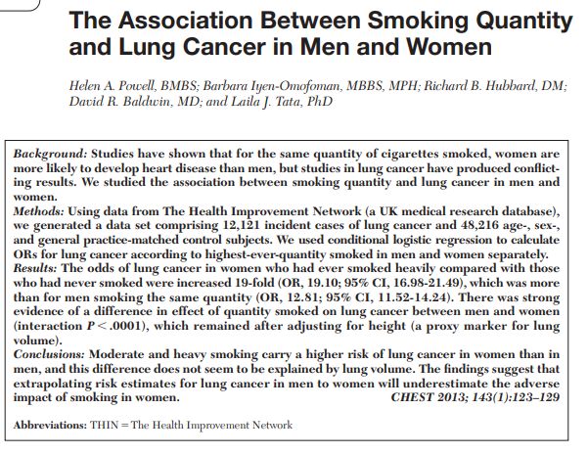
Study sample
Powell, H.A., Iyen-Omofoman, B., Hubbard, R.B., Baldwin, D.R. and Tata, L.J., 2013. The association between smoking quantity and lung cancer in men and women. Chest, 143(1), pp.123-129.

Slide 24
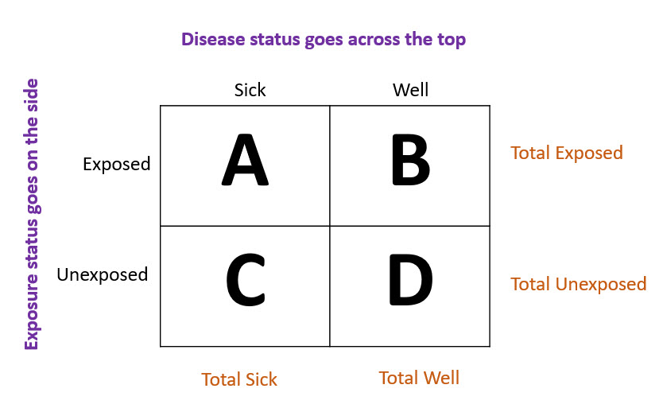
2x2 Table & Formulas

Slide 25
2x2 Table & Formulas
OR = (A/B) / (C/D)
RR = (A / (A+B)) / (C / (C+D))

Slide 26
Epidemiological statistics terminologies

Slide 27
Epidemiological statistics terminologies
Proportion,
Rate, and
Ratio,
Probability
Odds

Slide 28
Proportion
  A proportion is the comparison of a part to the whole.
  It is a type of ratio in which the numerator is included in the denominator.
  You might use a proportion to describe what fraction of clinic patients tested positive for HIV, or what percentage of the population is younger than 25 years of age.
  A proportion may be expressed as a decimal, a fraction, or a percentage.

Slide 29
Rate
  Rate is a measure of the frequency with which an event occurs in a defined population over a specified period of time.
  Because rates put disease frequency in the perspective of the size of the population.
  Rates are particularly useful for comparing disease frequency in different locations, at different times, or among different groups of persons with potentially different sized populations; that is, a rate is a measure of risk.

Slide 30
Ratio
  The relative magnitude of two quantities or a comparison of any two values.
  Calculated by dividing one interval- or ratio-scale variable by the other.
  The numerator and denominator need not be related.
  The result is often expressed as the result “to one” or written as the result “:1.

Slide 31
Probability
  Is a percentage.
  The number of events of interest divided by the total number of events.
  Ranges between 0 and 1 or 0% to 100%.
  Formula: Probability = events / events & non-events.
  Formula example:
  Probability = Number of people with a cold / Total number of people in the sample

Slide 32
Odds
  Is a ratio.
  The odds are the probability that the event will occur divided by the probability that the event will not occur.
  Ranges from 0 to infinity.
  Formula: Odds = events / non-events/
  Formula example: Odds = Number of people with a cold / Number of people without a cold.
    Note the denominator is NOT the total sample.

Slide 33
Other Epidemiological statistical measurement

Slide 34
Epidemiology statistical measurement
Absolute Risk
Absolute Risk Reduction (ARR)
Attributable Risk
Control Event Rate (CER)
Experimental Event Rate (EER)
Relative Risk Reduction (RRR)

Slide 35
Epidemiology statistical measurement
Absolute Risk
The likelihood of an event occurring under specific conditions.
Absolute Risk Reduction (ARR)
Absolute risk reduction is just the absolute difference in outcome rates between the control and treatment groups. We are asking what proportion of participants benefit from the intervention.

Slide 36
Epidemiology statistical measurement
Attributable Risk
Attributable Risk (AR) is the difference in the disease rates in exposed and unexposed individuals. AR is calculated from prospective data.
Control Event Rate (CER)
The proportion of patients in the control group who experience the studied event.

Slide 37
Epidemiology statistical measurement
Experimental Event Rate (EER)
The proportion of patients in the experimental treatment group who are observed to experience the outcome of interest.
Relative Risk Reduction (RRR)
Relative risk reduction measures how much the risk is reduced in the experimental group compared to a control group. We are asking what proportion of affected participants in the control group would benefit by being in the experimental group.
RRR is calculated as 1 minus the relative risk.

Slide 38
References
Bonita, R., Beaglehole, R., & Kjellström, T. (2006). Basic epidemiology (2. ed). World Health Organization.
Irwig, L., Irwig, J., Trevena, L., & Sweet, M. (2008). Relative risk, relative and absolute risk reduction, number needed to treat and confidence intervals. Hammersmith Press. https://www.ncbi.nlm.nih.gov/books/NBK63647/
Principles of Epidemiology: Home|Self-Study Course SS1978|CDC. (2019, March 7). https://www.cdc.gov/csels/dsepd/ss1978/index.html
Schechtman, E. (2002). Odds ratio, relative risk, absolute risk reduction, and the number needed to treat—Which of these should we use? Value in Health: The Journal of the International Society for Pharmacoeconomics and Outcomes Research, 5(5), 431–436. https://doi.org/10.1046/J.1524-4733.2002.55150.x
Schmidt, C. O., & Kohlmann, T. (2008). When to use the odds ratio or the relative risk? International Journal of Public Health; Basel, 53(3), 165–167. http://dx.doi.org/10.1007/s00038-008-7068-3

