Slide 1

Exploring the Hidden Curriculum
SJIE 6001
Lianne Bowen

Slide 2

The hidden curriculum
Many researchers have studied the hidden curriculum and its impact on students.
They understand the importance that the hidden curriculum plays in education.
They may look at the issue of the hidden curriculum in different ways, but they all agree that the hidden curriculum is a very real phenomena and that it is pervasive in the school system.

Slide 3
Cultural Capital
Bourdieu and Passeron (1977)
One main way that education ensures the reproduction of society is by the passing on of cultural values from one generation to another
Cultural capital is a set of values, characteristics and behaviours that the dominant class groups already have and that subordinate class groups must strive to acquire if they want to compete for educational success

Slide 4
Critical Approaches to the hidden curriculum
Functionalist – education plays a role in making sure that society ‘functions’ properly by teaching children appropriate values and behaviours
Marxist – education allows the dominant culture (e.g. capitalism) to keep everyone in their place. It teaches the workers, women etc. to follow the rules and do as they are told.

Slide 5
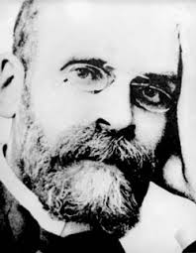
Functionalism
Functionalism is a theory that is based on the ideas of Emile Durkheim.
Functional sociologists look at the structures within society in order to understand their functions for that society.
Emile Durkheim was one of the founders of sociology.
His ideas became the basis of functionalism.

Slide 6
Functionalism
Two main functions in education:
Creates social solidarity
Creating trust between members of society, we feel connected to one another. It helps lawlessness and passing on cultural values from one generation to another. It also helps society’s norms and values.
Turns children into ‘social beings’

Slide 7
Functionalism
  Functionalists believe that babies are born with a blank slate and then they go through a socialization process. So they learn to behave and what is expected of them .
  School is seen as a miniature society; it has its own rules and does things in its own way. This is a practice the wider society in later life for children.
2. Specialist Skills
  Children need specialist skills to get a job in the future.

Slide 8
Functionalism
Functionalists say that society is based on shared norms and values.
They believe that we need schools to help us feel part of society
We learn social rules and social roles in schools
Schools sort out people for the most appropriate jobs for their skills and abilities.

Slide 9
Functionalism
Functionalists see the hidden curriculum as a positive part of school life.
This is because it is a form of secondary socialisation whereby children learn universalistic values and these values prepare children to integrate into wider society especially the world of work.
Functionalists do not look in detail at individual social behaviour because they believe that the causes of human behaviour are to be found by looking at the larger and wider picture of the way in which societies are organised institutionally.

Slide 10
What is Meritocracy?
Functionalist say the education system acts as a ladder of opportunity for people to achieve the best that they can, according to their ability.
The best people go on to gain the best jobs and become the leaders of their society.
This belief is known as meritocracy.

Slide 11
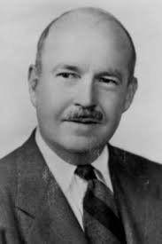
Talcott Parsons
Is a well-known American theorist.
He developed Structural-Functionalist theory.
Parsons suggests schools are an agency of secondary socialisation.
They train children to accept the norms and values of wider society.
They act to select which children will be trained for the top jobs in society.
They teach children that the system is fair and equal to all.

Slide 12
Talcott Parsons
Viewed educational practices from the functionalist perspective.
The majority of his work focused on the general theoretical system for the analysis of society, and attempts to explain social structures such as schools as institutions that have evolved to fill social needs
For example; one of the fundamental goals of education is to impart culture across the generations; hence, education serves to establish certain values and ideals in students as they move through the school system.

Slide 13
Talcott Parsons
Talcott Parsons taught that education is like a bridge between the family and wider society preparing us for our adult roles in society.

Slide 14
The strengths of Functionalism
It points to links between and within social institutions in society
It emphasises the importance of socialisation within schools
It influences New Right thinking and research

Slide 15
The Weaknesses of Functionalism
It justifies inequality
There is little supporting evidence
People do not all share norms and values
It ignores structural inequalities such as racism, sexism and social class

Slide 16
Examples of ‘functionalism’
‘Anger after schoolgirl excluded from class for dying her hair purple’
Read more at: http://www.shieldsgazette.com/news/anger-after-schoolgirl-excluded-from-class-for-dying-her-hair-purple-1-8117156
The Prime Minister’s speech on schools and meritocracy
http://www.conservativehome.com/parliament/2016/09/the-prime-ministers-speech-on-schools-and-meritocracy-full-text.html

Slide 17
Marxism
It is based on the ideas of Karl Marx from the 19th century, who believed a society evolved through several stages, the most important of which were feudalism, capitalism, and finally socialism.
19th century Europe was a capitalist society where the rich upper class called the bourgeoisie were a minority of the population. And the poor lower class, called the proletariat, were the majority.

Slide 18
Marxism
Education reproduces the inequalities and social relations of production of Capitalist Society.
Education serves to legitimate these inequalities under the guise of Meritocracy.
Education socialises working class children into accepting their subordinate status to the middle class.
Education conveys the ideology of the ruling class.
Education prepares individuals for the world of work, in order to accept their position in a capitalist society.

Slide 19
Bowles and Gintis (1976)
Bowles and Gintis view the hidden curriculum from a Marxist perspective.
In their book Schooling in Capitalist America written in 1976, they wrote that all school does is produce a hard-working disciplined workforce, so education is about getting people (especially the working class) ready for the world of work.
They said that capitalism needs a workforce of demoralized individuals willing to accept hard work, low pay and follow orders from above.
They also stated that education, in the way we tend to understand it, such as learning subjects is a secondary role of schools, they believe that social inequalities are reproduced by the hidden curriculum.

Slide 20
Bowles & Gintis (1976)
Noticed in their study that the prevalent practices in school include:
    Uniform, Time keeping, Seating in classrooms, Rules for corridor movement
40+ years since Bowles and Gintis’ 1976 study but the rituals and routines still prevail in schools today
In addition further forms of control are now exercised through the organisation of pupils into groups

Slide 21
Effects of Grouping
Pupils are being given different ‘values’ e.g. academic versus vocational
Different ‘experiences’ for the individual pupil in terms of the ‘enthusiasm’ and ‘behaviour’ of their peers in the group
The ‘attitude’ of the teachers to different groups .e.g “That lot are trouble”
The ‘type of work’ given
‘Expectations’ of the ‘amount’ and ‘level of work’ they need to produce

Slide 22
Marxist Strengths
It points out how ideology is transmitted within schools via the hidden curriculum.
It recognises conflict of interest in schools; not everyone shares values.
It points out the inequalities of both opportunity and outcome in the system

Slide 23
Marxist weaknesses
It assumes teachers are unaware of class dynamics and are all middle class agents
Many working class children do succeed in the education system
It overemphasises class and ignores other structural inequalities: ethnicity and gender

Slide 24
Summary of Marxism
Schooling prepares working class pupils for working class lives /roles
It prepares students to be exploited
It creates class inequalities
It upholds bourgeois rule.

Slide 25

The truly ‘Hidden’ curriculum
Pupils learn how to survive on the corridors and in unsupervised areas such as the toilets
They are aware of the pecking order that goes unnoticed by the official school system
An unofficial process of learning that these pupils go through the school is a preparation for, and reflects, the communities that they will live in

Slide 26
Learning Outcomes
Critically evaluate the approaches adopted to deliver the ‘Hidden Curriculum’ within a range of different educational settings.
Critically analyse and discuss the elements that comprise of the ‘Hidden Curriculum’ in your setting and the potential impact on the attitudes of the learners.
Organise your knowledge and learning through the use of a range of information sources, including ICT and present their work at the appropriate level

Slide 27

Assessment 1
Assessment Component 1 - 60%
Submission Date: 10.01.2021 23:59pm
Academic Poster (3500 words equivalent)
Create an academic poster which critically analyses the aspects of the Hidden Curriculum in your chosen setting. You should ensure that you refer to theoretical perspectives of the Hidden Curriculum and demonstrate an understanding of what messages the Hidden Curriculum is giving to children and their families.

Slide 28
Assessment 2
Assessment Component 1 - 40%
Submission Date: TBC
Individual presentation: 10 minutes per person
Give a 10-minute presentation in which you expand on the key arguments set out in your poster.

Slide 29
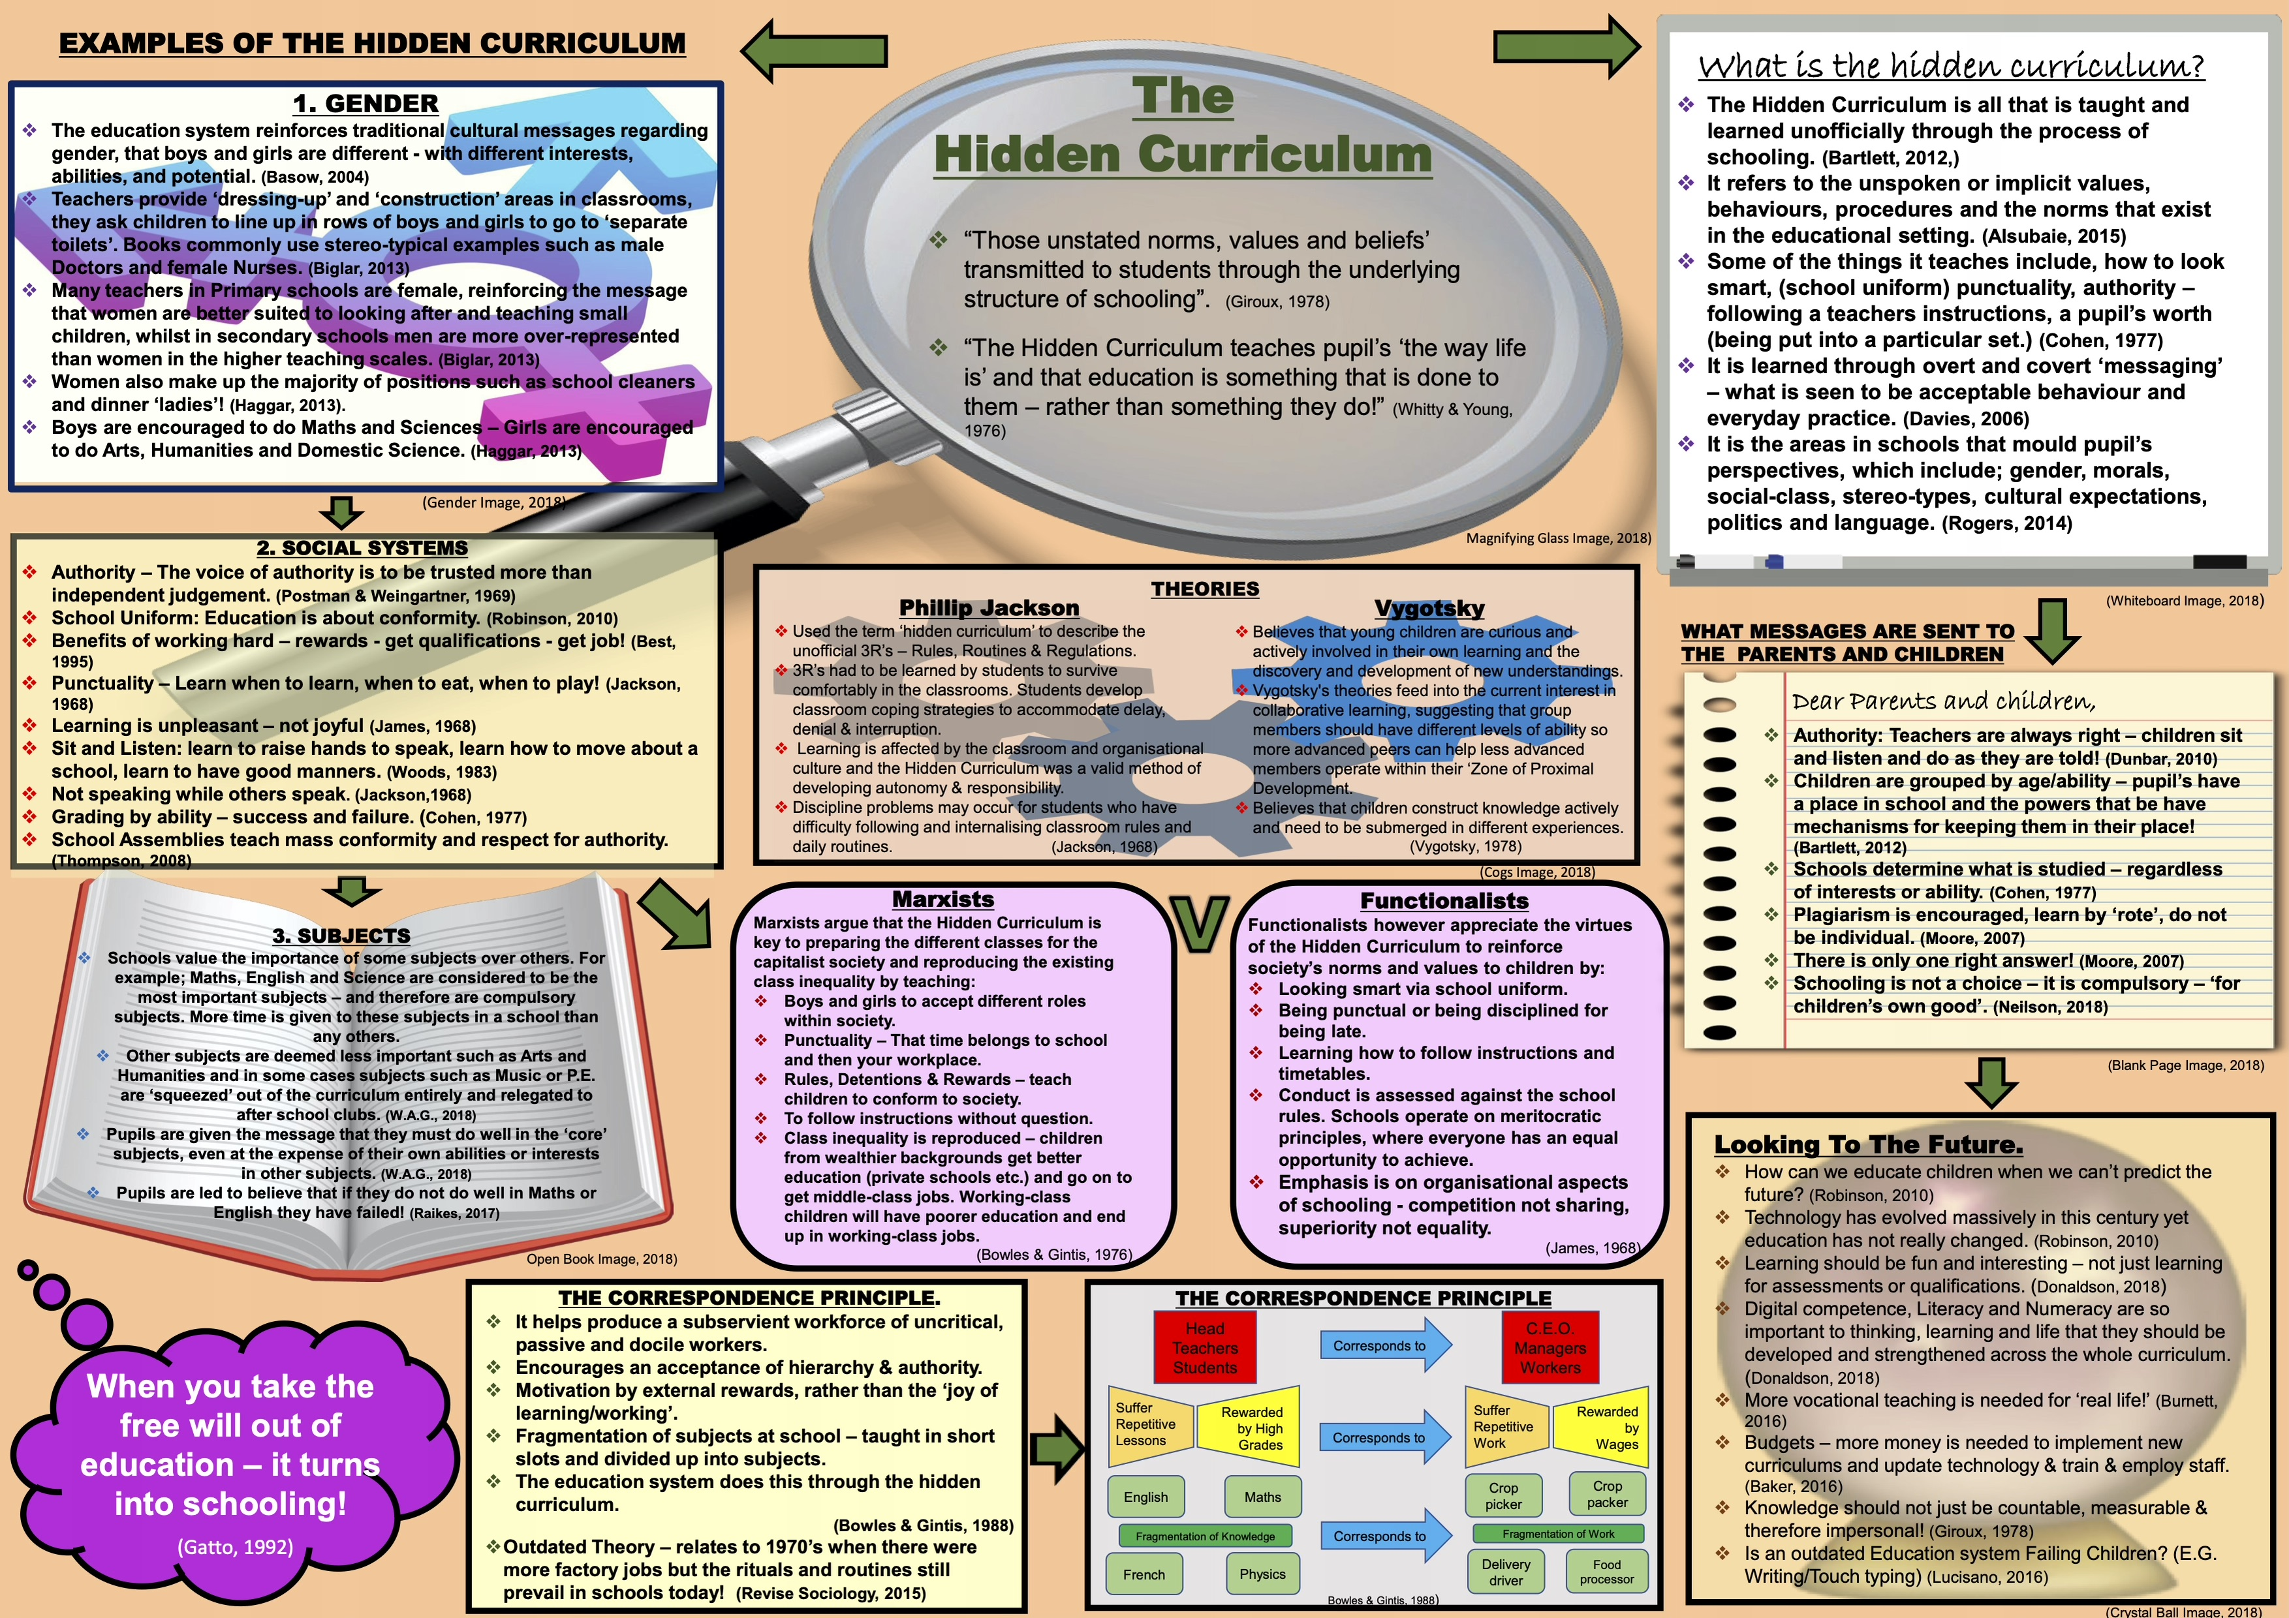

Slide 30
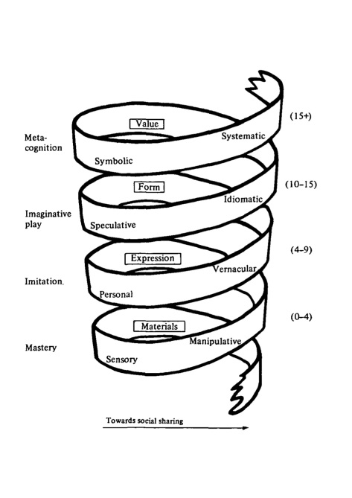
Perspectives Of Education
Education is the process of learning and developing knowledge, skills, values and beliefs.
The Hidden Curriculum
Functionalist
Positive Function.
Teaching Skills For Work.
Teaching Core Values.
Social Norms & Beliefs Transmitted Through Classroom Structure & Social Relationships.
Marxist
Broadly Constructivist & Critique.
Student Centered.
Pupils Obey Authority.
The unofficial, unintended, unwritten values and perspectives that pupils learn at school.
Educational Methods
Discussion
Storytelling
Research
Training
Divergent Thinking In The Classroom
Allows changes in attitudes, beliefs and values of pupils which are communicated through social and cultural messages.
New Curriculum in Wales 2022
Educational Theorists
Broader Holistic Approach.
Help Learners To See Relevance of Their Study in Their Daily Lives.
Focus on Learners Development.
Bruner – Spiral Curriculum
Skinner – Operant Conditioning
Play
Chase Curiousity
Reducing risks has a negative effect on learning
Creative Risk Taking
Creative Constraint
Ensuring teaching and learning experiences are allowing students to construct meaningful understanding to the new knowledge they have learned
Children learn through rewards and positive reinforcers
Curriculum in 1980’s
Rights Respecting School
Enterprise Activities
Core subject focus : MFL
Mathematics, Science, English, R.E, P.E
Learning should be broken down into smaller learning steps to overcome a pupils fear of failure
Independent Living Skills
Welsh Baccalaureate
Curriculum Cymraeg
Health & Well-being
Expressive Arts
Children's intellectual ability develops in stages
Children need to learn principles, concepts and structure of ideas rather than memorising data
Pupil Voice In Special Education
School
Council
Preparation for working life
Spiral Curriculum: Ideas are repeated. Learning opportunities are organised from simple to complex.
Association between behaviours and consequence

Slide 31


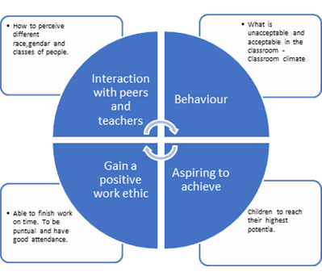

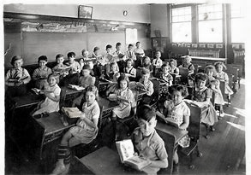
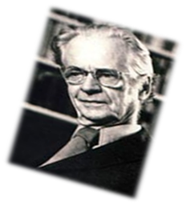
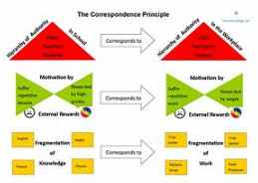
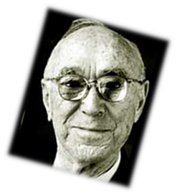

Exploring the Hidden Curriculum.
Shutter Stock (2018)
Shutter stock (2018)
Definitions of the Hidden Curriculum
The hidden curriculum as those unstated norms, values,
and beliefs embedded in and transmitted to students
through the underlying rules that structure the routines
and social relationships in school and classroom Henry Giroux (1983)
Emphasized that hidden curriculum involves various
interests, cultural forms, struggles, agreements, and compromises Michael Apple (1982)
Source (Kentli 2009).
FUNCTIONALIST OR MARXIST – What are the theories in today’s schools?
Functionalist theory has an emphasis on positive aspects of schools such as socialisation: the learning of skills and attitudes in school. Emile Durkheim views are that functionalist’s education helps maintain society by socialising young people into values of achievement, competition and equality of opportunity. (Trueman, 2015)
Functionalist sociologist support the traditional gender roles as these are assumed to be the norm in society. (Thompson, 2008). Functionalist believe this prepares children for their adult and working life.
OR
The Marxist view on educational achievement is greatly influenced by social class background. Middle class parents strive to provide the support and equipment to ensure that their children have a positive experience of school and have a high attainment than children from a working-class background (Revise Sociology, 2016).
However, Marxists argue the hidden curriculum produces a unequal and unjust environment for children to learn and the overall view is to steer them to be part of the work force of the country (Thompson, 2008).
What is the Hidden Curriculum?
The Hidden Curriculum is all that pupils are taught unofficially throughout their school life
Bowles and Gintis suggest that schools are developing students which conform to authority, wear uniform and be trained in boredom. This study was 30 years ago but ritual and routines are still at the forefront of modern schools today. (Bartlett, 2012)
Class 1/2/3
Streaming introduced in 1980’s.
Place in society.
Affect on behaviours and attitude to teacher.
Reaching expectation of the class.
Higher level teaching for higher level pupils
High achieving pupils tend to have status positions within the school.
(Bartlett, 2012).
.Dr Roberts-Holmes study suggests that
Streaming from an early age can affect their development and well-being.
Awareness of which set they are in can affect self-esteem.
Dr Robert-Holmes suggest move to a Scandinavian model of education would benefit children (Roberts-Holmes, 2018)
Gender
.The education structure reflects traditional gender roles.
Boys encouraged to study mathematics and science.
Female teachers in secondary schools tend to teach the lower grades.
Male teachers tend to teach mathematics and science.
Pupils are aware of gender hierarchy.
Boys tend to have higher levels of praise.
Girls tend to receive positive responses for be compliant within school. (Paludi, 2004)
Is education the same as way back then?
Schools today tend to have the same floor plan of corridors classrooms.
Children are educated by age.
Teachers tend to teach one subject mainly females teaching lower classes.
Schools divided into departments.
Schools have assemblies.
Schools are standardised through assessments and examinations.
The teaching tends to comprise of listening to the teacher from standard material.
Children do not have choice on what they learn.
Worksheets are now digital. (Shaw, 2018)
In reality no difference than the 1940’s, regarding aspects of the hidden curriculum.
“Everybody is a genius. But if you judge a fish by its ability to climb a tree, it will live its whole life believing that it is stupid” (Einstein, 1898).
(Duryeapa.com, 2018)
Skinner 1904-1990
Behavioural engineering.
Process of ‘operant conditioning’.
External rewards rewarded for ‘right responses.
“Schools teach exactly what they are intended to teach and they do it well: how to be a good Egyptian and remain in your place in the pyramid.” (Gatto, 2013)
Welsh Government Successful Futures
Messages to pupils and parents.
Education is designed to produce a compliant workforce.
Promotion of morals and values.
Education helps keep the country economically competitive (Moore 2000).
Ambition capable learners
Health confident individuals.
Enterprising, creative contributors
Ethical informed citizens
So that pupil:- are ready to learn
and become valued and respected members of society. Who will contribute to the country with a positive working life (Welsh Government, 2015).
Bruner 1915-2016
Supported work of Piaget and Vygotsky.
Curriculum theory should not focus on the memorisation of facts.
Developed the concept of ‘spiralling’ in learning. Understand new facts or concepts by referring to previous education.
Revise Sociology.com (2017)

Slide 32
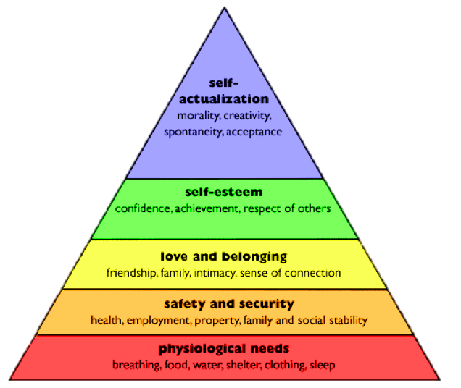
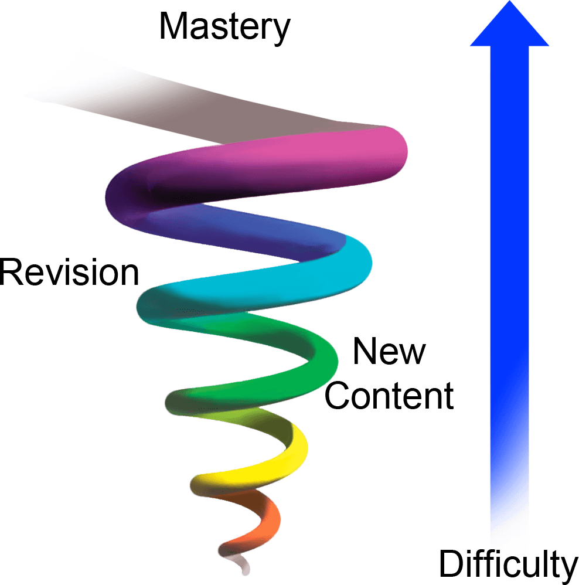

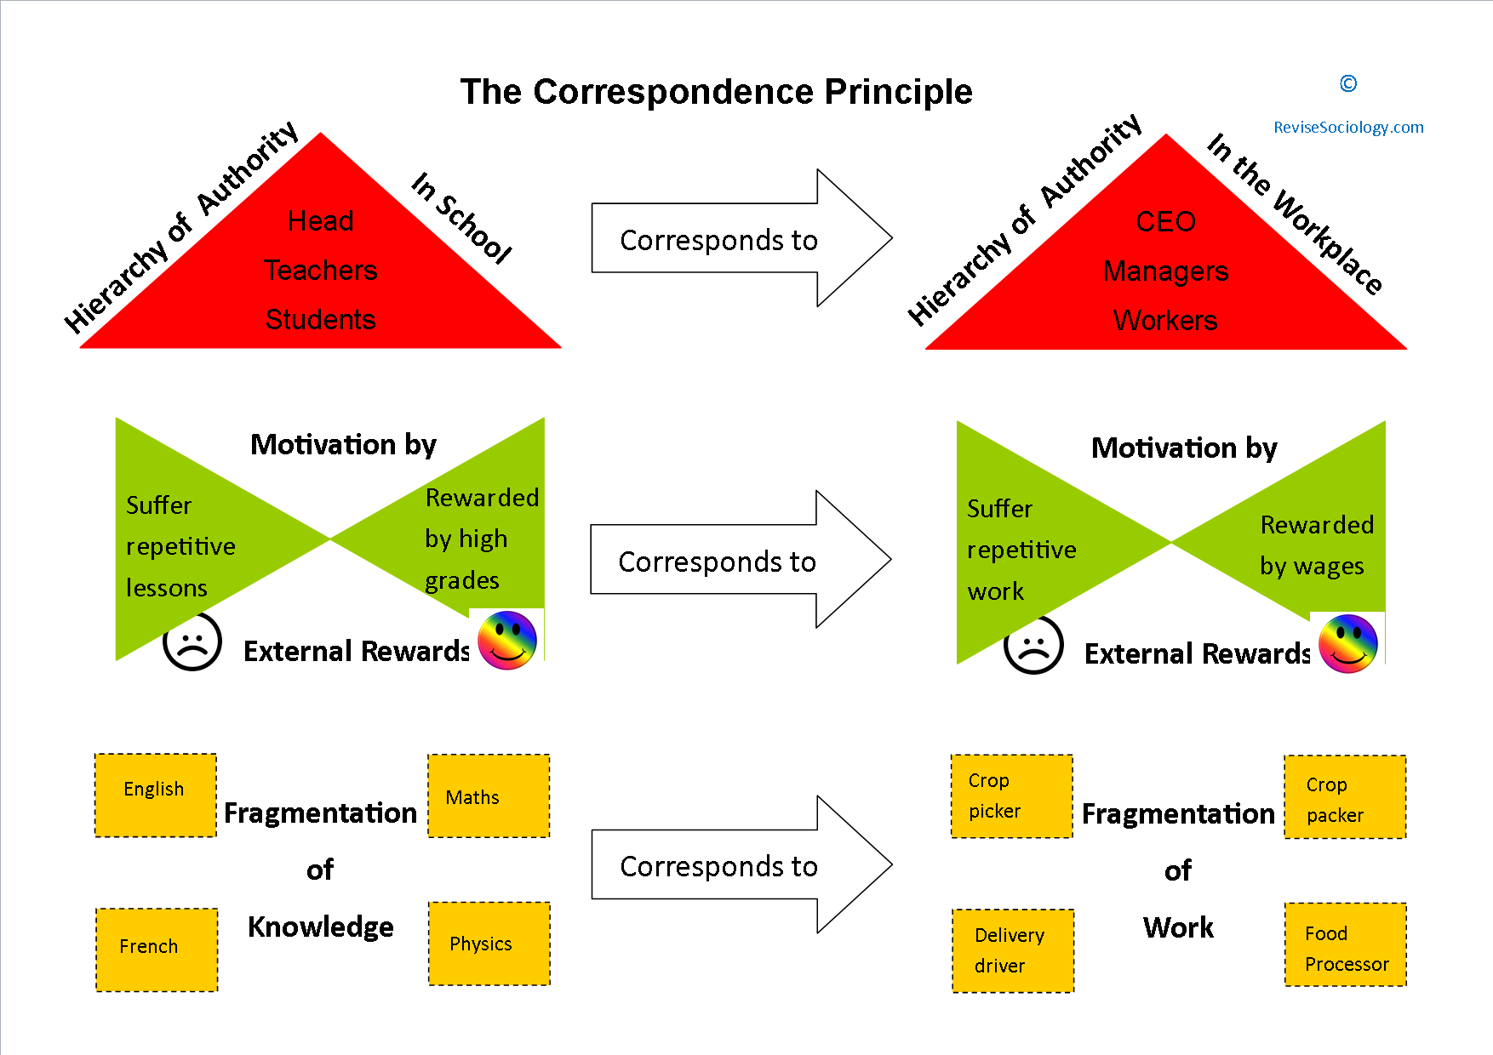
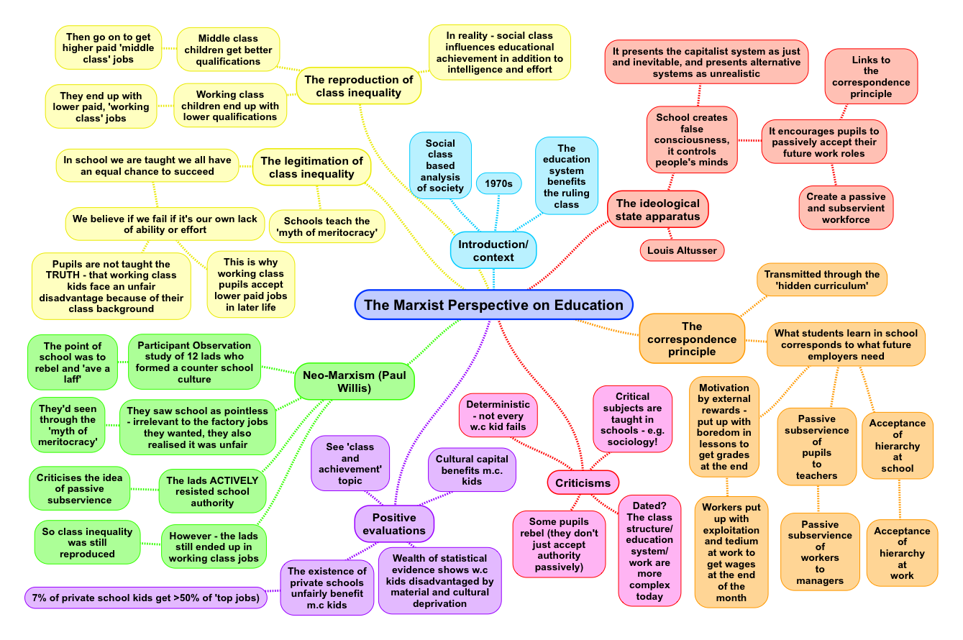

The Hidden Curriculum
Successful Futures
Happier time in education
Higher pass rates
Sense of belonging in the outside world
Increase in self-esteem
Increase in attendance as bullying is monitored.
Welsh Government, 2014
Unisex toilets
Everyone is equal
Zero tolerance to bullying
Toilets frequently monitored
Everyone is treated the same
However….
Uncomfortable
Low attendance
Poor punctuality to lessons
Leaving during lessons
Increase in bullying
Values
Traditional Values and under class values
Punctuality
Attendance
Attainment
Strade School policies, 2018
Inverting Maslow’s Hierarchy
Spiral approach Curriculum Education School Course, no date.
Theories
Bowles & Gintis – maxism, schooling in Capatilist America, 1976.
Bruner – spiralling curriculum, 1960
Maslow – Hiarachy of needs, belonging and self esteem, 1943
Althusser – Maxism, 1971
A hidden curriculum is a side effect of schooling, which are learned but not openly intended" such as the transmission of norms, values, and beliefs conveyed in the classroom and the social environment.
https://www.edglossary.org/hidden-curriculum/
Bruner Saul McLeod, 2008,
https://revisesociology.com/2015/01/27/marxist-perspective-education
Inverting Maslow’s Hierarchy
Functionalist
Education plays a role in making sure that society functions properly by teaching children appropriate values and behaviours
Marxist
Education allows the dominant culture (e.g. capitalism) to keep everyone in their place. It teaches the workers, women etc. to follow the rules and do as they are told.
Comparison of Marxist and Functionalism
Factory model of Education
Uniform
Banding
School bell
Attendance
Behaviour
https://revisesociology.com/2015/01/27/marxist-perspective-education
Hidden curriculum
The official curriculum
What is formally taught in the school through subjects on the time tables
The hidden curriculum
Is all that is taught and learned unofficially through the process of schooling
UNESCO, 2010
https://takeabreak.co.uk/hottopics/articles/should-schools-have-unisex-toilets

Slide 33
references
Bain, Linda (1985) Quest Vol. 37 Issue 2 pp 145-154 available at: https://ezproxy.uwtsd.ac.uk/login?url=http://search.ebscohost.com/login.aspx?direct=true&db=s3h&AN=19754378&site=ehost-live (Accessed 28/11/2020)
Bourdieu P & Passeron J (1977) Reproduction in Education, Society and Culture, London: Sage
Bowles S & Gintis H (1976) Schooling in Capitalist America: Educational Reform and the Contradictions of Economic Life, London: Routledge & Kegan Paul

