Slide 1
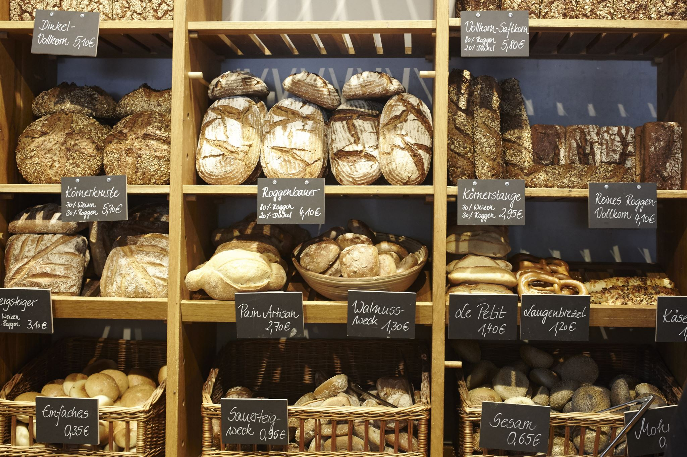
Basil's Bakery Business Analysis Presentation Draft
Title
Basil's Bakery: Business Environment Analysis
Student Name: Rajpal Singh
Student Number: 2508102
Module Code: LCLM4004
Lecturer: Dr Frank

Slide 2
Introduction
Presentation Structure
Overview of Basil's Bakery
Issues causing sales stagnation
PESTEL Analysis
Fishbone (Cause-and-Effect) Diagram
Key Findings

Slide 3
Overview
Basil's Bakery is an independent artisan bakery established in Coventry in 2015. Sales grew steadily until the COVID-19 pandemic. Although restrictions ended, sales have remained approximately 25% below 2019 levels. This presentation analyses the external and internal factors affecting the business.

Slide 4
Issues Affecting Sales
Main Issues
Reduced customer footfall in the retail park
Closure of neighbouring shops
Staff redundancies reducing customer numbers
Hybrid working reducing lunchtime trade
No delivery service
Poor pre-order system
Rising utility bills
Higher rent and business rates
Increasing cost of organic ingredients
Analysis
These factors have reduced customer demand while increasing operating costs, placing pressure on profitability.

Slide 5
PESTEL Analysis
Factor | Application to Basil's Bakery
Political | Higher business rates and government regulations increase costs.
Economic | Inflation and rising costs reduce consumer spending and increase expenses.
Social | Working from home and changing shopping habits reduce customer visits.
Technological | No online ordering or delivery limits customer convenience.
Environmental | Organic ingredients are affected by crop failures and climate conditions.
Legal | Food hygiene, employment law and health & safety regulations increase compliance costs.

Slide 6
Fishbone (Cause-and-Effect) Diagram
Main Problem
Sales Stagnation
Causes
Customers
Working from home
Reduced spending
Changing buying habits
Location
Lower retail park footfall
Empty retail units
Technology
No delivery service
No online ordering
Limited pre-order system
Costs
Rising rent
Utilities
Insurance
Organic ingredient prices
Operations
Basil cannot answer every phone call
Limited staff
Production depends on Basil
Market
Reduced employment nearby
Increased competition

Slide 7

Discussion
PESTEL identifies the external environmental pressures affecting the business, while the Fishbone Diagram identifies the root causes of sales stagnation.
Possible improvements include:
Introduce online ordering
Offer delivery services
Improve digital pre-ordering
Promote the bakery on social media
Develop customer loyalty schemes

Slide 8
Key Findings
Sales remain approximately 25% below pre-pandemic levels.
Customer numbers have declined because of hybrid working and reduced retail footfall.
Rising operating costs have reduced profitability.
Lack of digital services limits sales opportunities.
Introducing delivery and online ordering could improve future performance.

Slide 9
References (Harvard Style)
Johnson, G., Scholes, K. and Whittington, R. (2020) Exploring Strategy. 12th ed. Harlow: Pearson.
Kotler, P. and Keller, K.L. (2022) Marketing Management. 16th ed. Harlow: Pearson.
Office for National Statistics (2024) Labour Market Overview. London: ONS.
Porter, M.E. (1980) Competitive Strategy. New York: Free Press.
UK Government (2024) Business Guidance. Available at: https://www.gov.uk/business (Accessed: 16 July 2026).

Slide 10

Thank You
Q & A

