Slide 1


Petal Bloom: Sustainable Floral Boutique
Module: Entrepreneurship
Module code: LCBB5001
Student ID: 2242725
ic
Notes:
Welcome to the business plan for Petal Bloom, an up-and-coming flower shop in Birmingham. This presentation describes our vision for an eco-conscious, low-impact flower shop whose customers will experience a personal service and a high-tech environment. With its passion to bring pleasure and class through personalized floral designs and ecological practices, Petal Bloom seeks to serve the public.

Slide 2
Contents
Business Overview
Ownership and Legal Structure
Management Structure
SWOT Analysis
Cash Flow Forecast
Marketing Strategy: 4Ps
Future Plan and Expansion
Conclusion
References
ic
Notes:
Welcome to the business plan for Petal Bloom, an up-and-coming flower shop in Birmingham. This presentation describes our vision for an eco-conscious, low-impact flower shop whose customers will experience a personal service and a high-tech environment. With its passion to bring pleasure and class through personalized floral designs and ecological practices, Petal Bloom seeks to serve the public.

Slide 3
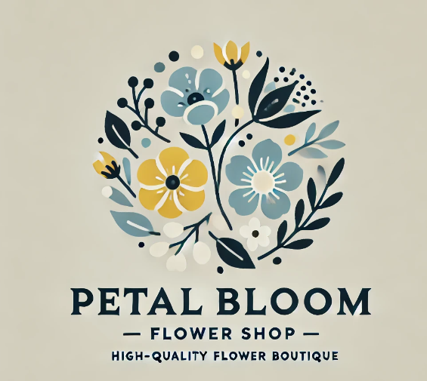
Business Overview
Petal Bloom is a Birmingham based boutique florist specialising in eco-friendly, bespoke floral designs. We blend a retail location with a strong online ordering and delivery infrastructure. Our most popular products and services are custom flowers for weddings and occasions, seasonally subscriptions, and same-day deliveries.
Our vision is to bring joy and beauty in each bouquet by making sustainable choices. We want to make Petal Bloom Birmingham’s most environmentally conscious florist, in line with contemporary customer desires for sustainability and personalisation.
Physical Store
Online Platform
Sustainable Practices
Friendly boutique featuring our bio-based floral designs and bio-friendly packaging. (Albrecht, Green and Hoffman, 2023).
Easy to order and customize and schedule deliveries from the site.
Buying local, sustainable suppliers and using sustainable materials (Dessyana and Riyanti, 2017).

Slide 4
Ownership and Legal Structure
Petal Bloom is a Private Limited Company (Petal Bloom Ltd). It has a few advantages such as limiting liability protection of private property, easing access to loans and investments, and the ability to scale and manage. The company will be solely owned and operated at first, but we might be able to partner in the future. It is an architecture that facilitates efficient decision making and clear accountability early in the business (Gupta and Starr, 2014).
Limited Liability
Financial Flexibility
Protects personal assets from business debts and liabilities.
Easier access to loans and investments for business growth.
Scalability
Tax Benefits
Allows for easy expansion and addition of partners in the future.
Potential for tax advantages compared to sole proprietorship.

Slide 5
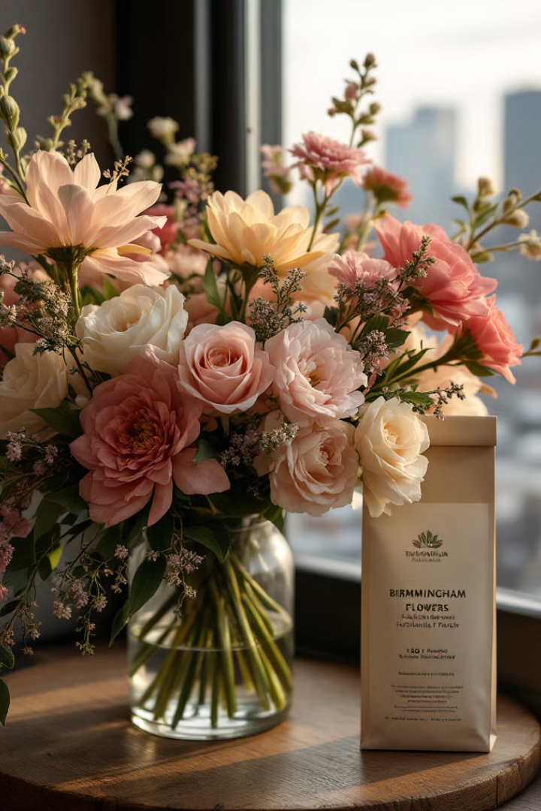
Management Structure
The management model at Petal Bloom is efficient and flexible. The Owner/Manager is responsible for day-to-day management, budget and supplier management. Two expert Florists design special arrangements, process orders, and serve in-store customers. Two Delivery Staff deliver fresh and on time shipments while processing logistics. Support is offered by a part-time Sales Associate on demand days. A financial accountant, a marketing consultant and a digital strategist are also on board to provide additional assistance. We integrate technology with POS and inventory management to drive efficiencies (Storey, 2014).
Owner/Manager
Oversees all aspects of the business, including strategy and partnerships.
Florists
Create custom arrangements and manage customer orders.
Delivery Staff
Handle logistics and ensure timely deliveries.
Sales Associate
Provides additional support during busy periods.

Slide 6

SWOT Analysis
Petal Bloom’s market share is analysed through a SWOT analysis. Our strengths include sustainability, personalized floral design, and strong presence online. But we have our starting points of limited brand awareness and limited supply due to our dependence on local partners.
There is an opportunity in the expanding demand for environmentally-friendly products and possible collaborations with event managers and companies. Our survival will be threatened by fierce competition from the big florists, as well as recessions of discretionary spending (Kraus, Mahto and Walsh, 2021).
Strengths: Sustainability focus, unique designs, online presence
Weaknesses: Limited brand recognition, supply constraints
Opportunities: Rising eco-friendly demand, potential partnerships
Threats: Established competition, economic fluctuations

Slide 7
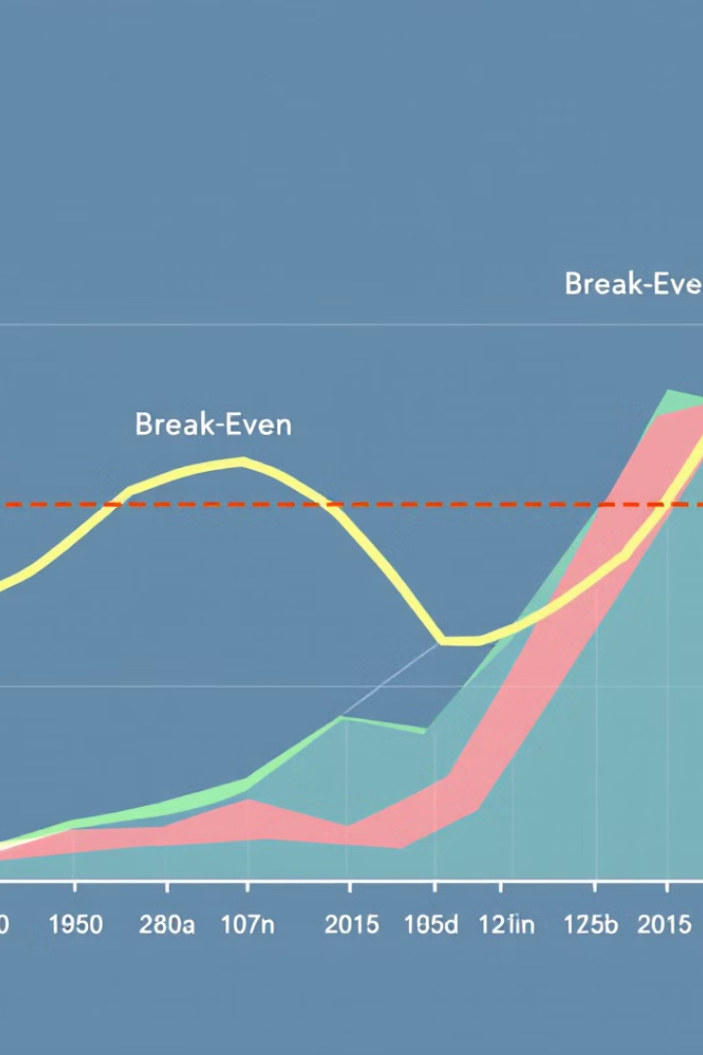
Cash Flow Forecast
In the first 12 months, Petal Bloom's forecast of revenue looks positive. We have a base investment of £25,000 but we expect the income to increase from £1,500 at Month 1 to £7,500 at Month 12. With event-related orders beginning in Month 3, we anticipate an additional £1,000 per month.
Important costs are rent and bills (£1,500/month), staff (£4,300/month), equipment (£2,000/month, peaking in busy periods), and marketing (£500/month, £1,000 at Christmas). We will be break-even in Month 8 and will make a net profit of £6,000 by the end of Year 1.
Initial Investment
Break-Even
£25,000 startup funding
Achieved in Month 8
Revenue Growth
Year 1 Profit
£1,500 to £7,500 monthly
£6,000 projected

Slide 8




Marketing Strategy: 4Ps
Petal Bloom’s business model revolves around the 4Ps. Our Product range includes custom, sustainable flower arrangements and seasonal subscriptions. Pricing is competitive with packages for different price points (subscriptions are available at discounted prices). Place strategy: A high traffic boutique store along with an easy-to-use online shop. Promo strategies include social media ads, partnerships with wedding planners and venues, and events in the community.
Seasonal offers, partnerships with planners, and brand promotion through local markets and online competitions are some of the most prominent marketing strategies. With this full-stack strategy, we can reach the right audience and build a successful brand (Farias, et al., 2019).
Product
Price
Place
Promotion
Eco-friendly, personalized floral arrangements
Competitive pricing with subscription discounts
Boutique location and online store
Social media, partnerships, and events

Slide 9
Future Plan and Expansion
Petal Bloom is an expanding and diversifying company, and we have huge ambitions for growth. Our next plan is to start forming partnerships with smaller companies, planners and events centres to expand our footprint and win larger orders.
We will also be introducing flower-arranging classes, taking advantage of the experiential shopping movement and offering an additional source of income.
Our digital marketing initiatives are on the upswing, with investments in specialized SEO, influencer programs, and targeted social media campaigns (Kitsios, F., Kyriakopoulou, M. and Kamariotou, 2022).
We even think about geographical expansion potentially opening satellites in neighbouring cities or a franchise.
Expand Partnerships
Introduce Workshops
Scale Digital Marketing
Geographic Expansion
Collaborate with more local businesses and event planners
Launch flower-arranging classes for customers
Invest in advanced SEO and social media strategies
Explore satellite locations or franchise opportunities

Slide 10
Conclusion
Petal Bloom is a revolutionary new platform in the floral world, combining sustainability, quality and customization. Our model caters to both individuals and businesses offering a direct route to profitability and growth. Through an emphasis on sustainable and cutting-edge marketing, we have every opportunity to be Birmingham’s sustainable florist. Petal Bloom is more than a business, it’s an experiment in conscious consumerism and beauty of the natural world. Let is create joy and beauty for our customers and do the same for the world.

Slide 11

References
Albrecht, M.G., Green, M. and Hoffman, L., (2023). Principles of marketing
Dessyana, A. and Riyanti, B.P.D., (2017). The influence of innovation and entrepreneurial self-efficacy to digital startup success. International research journal of business studies, 10(1), pp.57-68.
Farias, L.F., de Araújo, P.P.P., Carneiro, T.D.C., Araújo, S.B. and da Silva, L.A., (2019). Organizational Behavior of Supply Chain Management: A Case Study Carried Out in a Textile Industry in the Northeast Brazil. International Journal of Business Management & Economic Research, 10(3).
Gupta, S. and Starr, M.K., (2014). Production and operations management systems (Vol. 4). Boca Raton: CRC Press.
Kitsios, F., Kyriakopoulou, M. and Kamariotou, M., (2022). Exploring Business Strategy Modelling with ArchiMate: A Case Study Approach. Information 2022, 13, 31.
Kraus, S., Mahto, R.V. and Walsh, S.T., (2021). The importance of literature reviews in small business and entrepreneurship research.
Storey, D.J., (2014). Understanding the small business sector: reflections and confessions. P. Braunerhjelm (ed.), 20, pp.21-33.
.

Slide 12

Thank You
We appreciate your time and attention in reviewing Petal Bloom's business plan presentation. Our vision for a sustainable, innovative floral boutique represents an exciting opportunity in the evolving retail landscape. We are confident in our ability to deliver beautiful, eco-friendly floral arrangements while building a profitable and socially responsible business.
Contact Us
Email: info@petalbloom.com
Visit Our Store
123 Flower Lane, Birmingham, UK
Follow Us
@PetalBloomUK on social media
Invest in Sustainability
Join us in our eco-friendly mission

