Slide 1

Programme: BA (Hons) Business Management
Module: Entrepreneurship
Module code: LCBB5013
Task 2:
Zara Business Plan Presentation
Student: MANDICA GABRIEL STOCHITA – 2230353
Lecturer: ASO ABDULAH

Slide 2

Zara business Plan Summary
Business model: fast fashion supported by a vertically integrated supply chain and omnichannel retailing.
Presentation focus: company overview, USP, SWOT, competitors, target market, 4Ps and financial growth.

Slide 3

1. Company Overview
Zara is Inditex’s flagship brand, founded in Spain in 1975.
It operates in more than 90 countries through stores and e-commerce.
The customer is at the centre of its model, which integrates design, production, distribution and sales.
Its omnichannel proposition includes Click & Collect, home delivery and easy returns.
Sources: Ghemawat and Nueno (2009); Gallaugher (2008); Inditex (2025); Verhoef, Kannan and Inman (2015).

Slide 4

2. Products, Services and USP
Product portfolio: womenswear, menswear, childrenswear, footwear, accessories, beauty and Zara Home.
Services include website/app shopping, digital receipts, flexible returns and customer support.
Zara’s USP is speed: new products can move from design to store in around 2–3 weeks.
Limited production runs create scarcity and encourage immediate purchase decisions.
Sources: Barnes and Lea-Greenwood (2010); Cachon and Swinney (2011); Tokatli (2008); Inditex (2024); Image: Zara (n.d.).

Slide 5
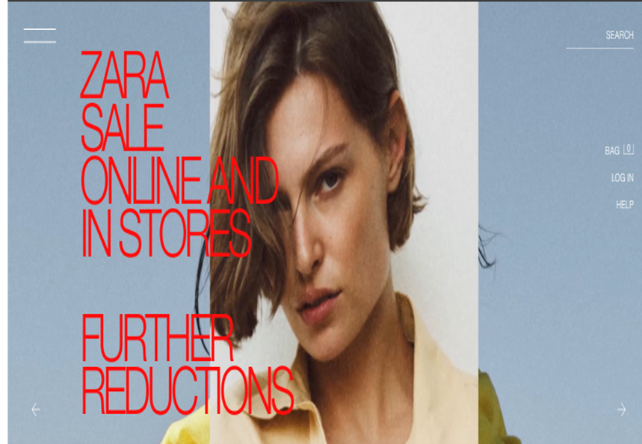
3. Business Objectives
Short-term priorities: improve customer experience, online sales and inventory efficiency using AI and data analytics.
Long-term priorities: strengthen global leadership while embedding sustainability, innovation and international growth.
Zara continues to invest in logistics, digital platforms and circular fashion initiatives.
Sources: Aaker (2020); Kotler and Keller (2022); Inditex (2024); Inditex (2025).

Slide 6
4. SWOT Analysis
Strengths | Opportunities
Global brand | Emerging markets
Responsive supply chain | Sustainable fashion
Omnichannel model and strong international presence | AI and further e-commerce growth
Weaknesses | Threats
Criticism of fast fashion | Shein and H&M competition
Reliance on trend forecasting | Inflation, regulation
Higher prices than discounters | Supply-chain disruption
Sources: Aaker (2020); Tokatli (2008); Joy et al. (2012); McNeill and Moore (2015); Baena (2024); Inditex (2025).

Slide 7

5. Competitor Analysis
H&M is Zara’s closest direct competitor in global fast fashion.
Primark competes more strongly on price and value-led retailing.
Zara differentiates itself through speed, design freshness and perceived quality.
Its integrated supply chain supports faster market response than many rivals.
Sources: Barnes and Lea-Greenwood (2010); Cachon and Swinney (2011); Tokatli (2008).

Slide 8
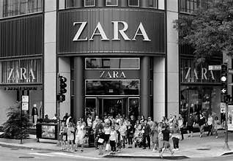
6. Target Market and Marketing Mix
Target customers: fashion-conscious consumers aged roughly 18–45 with medium to upper-middle incomes.
Product: trend-led collections, frequent launches and broad category range.
Price: affordable premium positioning between luxury brands and discount retailers.
Place: flagship stores plus e-commerce; Promotion: visual merchandising, social media and limited traditional advertising.
Sources: Baines et al. (2019); Solomon (2023); Kotler and Keller (2022); Verhoef, Kannan and Inman (2015); Inditex (2025); Image: Zara (n.d.).

Slide 9
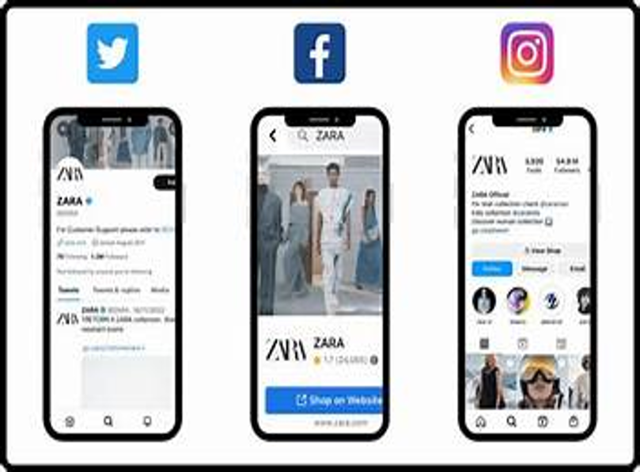
7. Online Strategy and Financial Planning
Zara integrates website, app, social media and personalised digital touchpoints.
Growth has been supported largely through reinvested profits rather than heavy external finance.
Inditex reported €38.6bn revenue in 2024/25; Zara remained its largest brand.
Digital capability and financial discipline support continued expansion.
Sources: Chaffey and Ellis-Chadwick (2022); Kim and Ko (2012); Burns (2020); Ghemawat and Nueno (2009); Inditex (2024); Inditex (2025);
Image: Zara (n.d.).

Slide 10

8. Conclusion
Zara’s business plan is built on speed, trend responsiveness and a tightly integrated supply chain.
Its competitive advantage combines fast fashion, omnichannel retail and strong brand positioning.
Future success depends on balancing growth with sustainability, innovation and digital transformation.
Sources: Burns (2020); Tokatli (2008); Inditex (2024); Inditex (2025).

Slide 11
Aaker, D.A. (2020) Strategic Market Management. 11th edn. Hoboken, NJ: Wiley.
Baena, V. (2024) ‘The shift from fast fashion to socially and sustainable oriented practices: Evidence from Zara’, Corporate Social Responsibility and Environmental Management.
Baines, P., Fill, C., Rosengren, S. and Antonetti, P. (2019) Marketing. 5th edn. Oxford: Oxford University Press.
Barnes, L. and Lea-Greenwood, G. (2010) ‘Fast fashion in the retail store environment’, International Journal of Retail & Distribution Management, 38(10), pp. 760–772.
Burns, P. (2020) Entrepreneurship and Small Business. 5th edn. London: Red Globe Press.
Cachon, G.P. and Swinney, R. (2011) ‘The value of fast fashion: Quick response, enhanced design and strategic consumer behaviour’, Management Science, 57(4), pp. 778–795.
Chaffey, D. and Ellis-Chadwick, F. (2022) Digital Marketing. Harlow: Pearson.
Gallaugher, J. (2008) ‘Zara: Fast fashion from savvy systems’, MIS Quarterly Executive, 7(1), pp. 15–26.
Ghemawat, P. and Nueno, J.L. (2009) ZARA: Fast Fashion. Revised edn. Boston: Harvard Business School Publishing.
Inditex (2024) Annual Report 2024. Available at: https://www.inditex.com (Accessed: 9 July 2026).
Inditex (2025) FY2025 Results. Available at: https://www.inditex.com (Accessed: 9 July 2026).
Joy, A., Sherry, J.F., Venkatesh, A., Wang, J. and Chan, R. (2012) ‘Fast fashion, sustainability, and the ethical appeal of luxury brands’, Fashion Theory, 16(3), pp. 273–295.
Kim, A.J. and Ko, E. (2012) ‘Do social media marketing activities enhance customer equity?’, Journal of Business Research, 65(10), pp. 1480–1486.
Kotler, P. and Keller, K.L. (2022) Marketing Management. 16th Global edn. Harlow: Pearson.
McNeill, L. and Moore, R. (2015) ‘Sustainable fashion consumption and the fast fashion conundrum’, International Journal of Consumer Studies, 39(3), pp. 212–222.
Solomon, M.R. (2023) Consumer Behaviour: Buying, Having and Being. Harlow: Pearson.
Tokatli, N. (2008) ‘Global sourcing: Insights from the global clothing industry—the case of Zara’, Journal of Economic Geography, 8(1), pp. 21–38.
Verhoef, P.C., Kannan, P.K. and Inman, J.J. (2015) ‘From multi-channel retailing to omni-channel retailing’, Journal of Retailing, 91(2), pp. 174–181.
Zara (n.d.) Zara UK website [Online]. Available at: https://www.zara.com/uk/ (Accessed: 06 July 2026).
Reference List

