Slide 1
Session 3
Price and Cost Analysis in Procurement

Slide 2


Slide 3
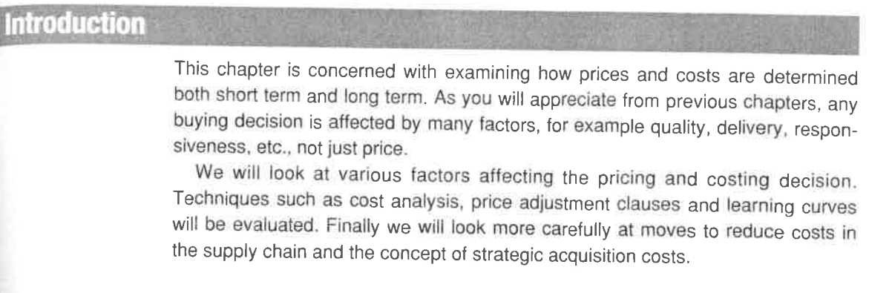

Slide 4
Video Links
Tesco Takes Steps to Reduce Prices Amid Cost of Living Struggles
How did Toyota beat FORD & GM using its GENIUS Supply Chain Model?
Case Study: Cutting Procurement Costs - Advanced Industrial Engineering
How to Understand Your Cost to Serve in Logistics
The Best Way to Save on Costs with Procurement
Toyota's Procurement Policy and the KEIRETSU Strategy
How did Toyota beat FORD & GM using its GENIUS Supply Chain Model?
REDUCING COST WITH SUPPLIERS
Cost Reduction Program: 5 Strategies and 60 Tactics for Impact
6 Easy Ways to Cut Supply Chain Costs - That You Can Do Yourself

Slide 5
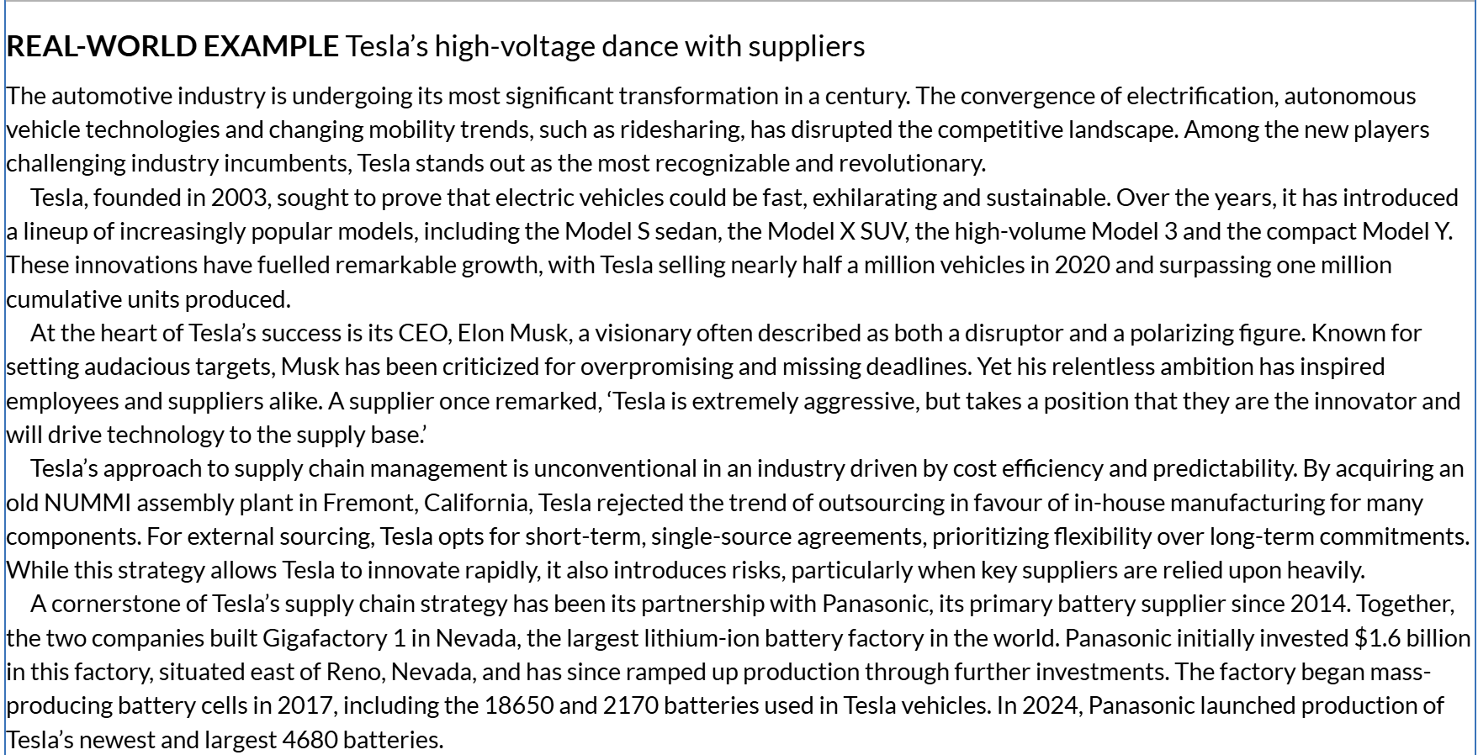

Slide 6
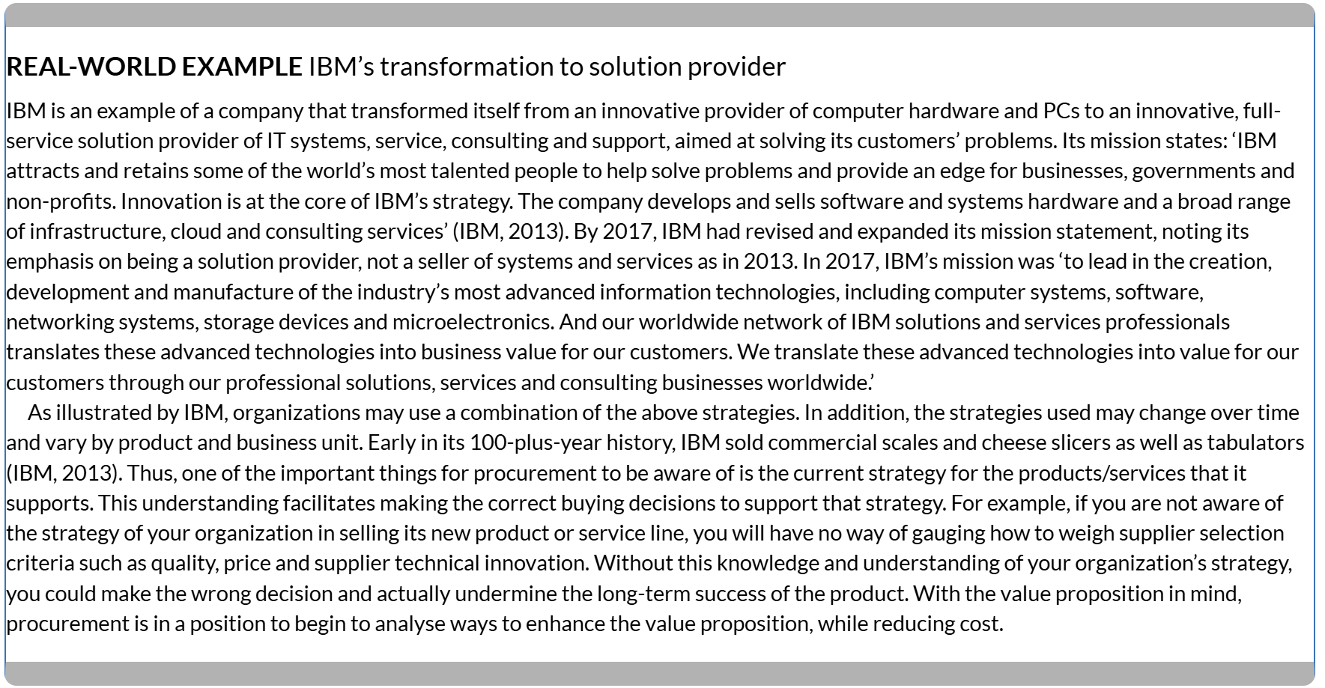

Slide 7
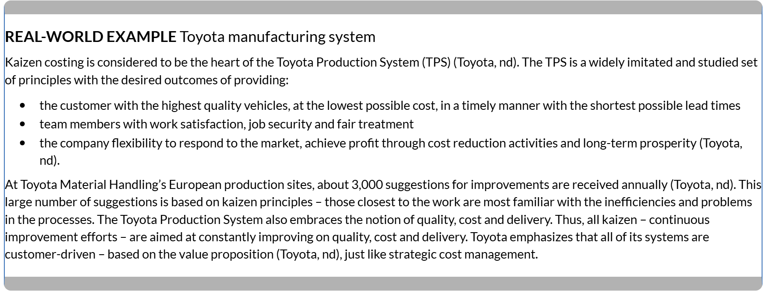

Slide 8
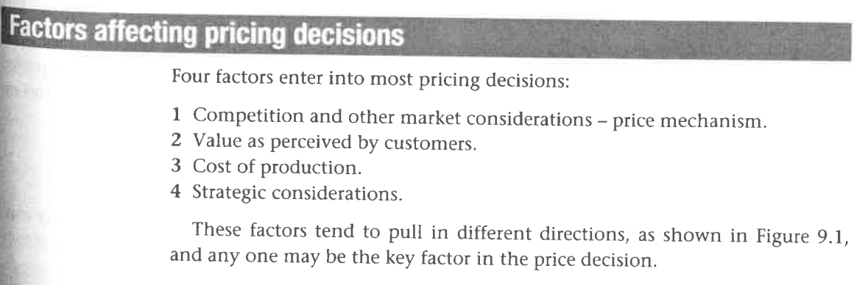

Slide 9


Slide 10


Slide 11


Slide 12

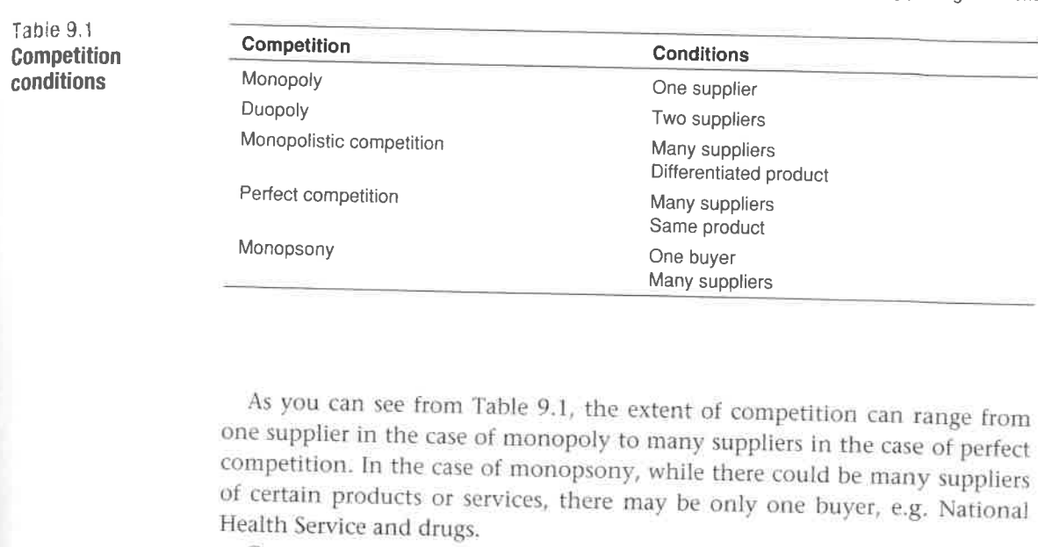

Slide 13
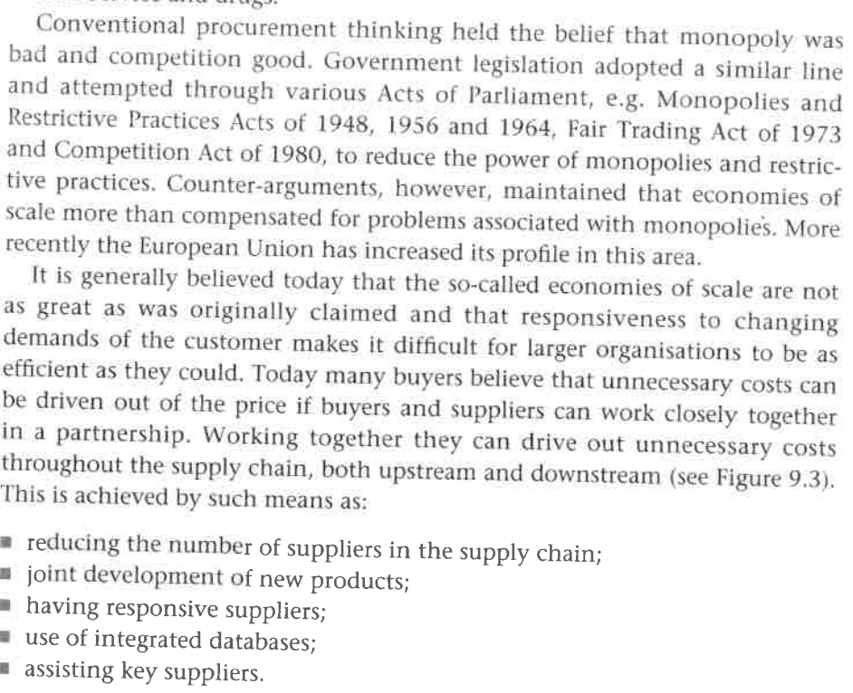

Slide 14
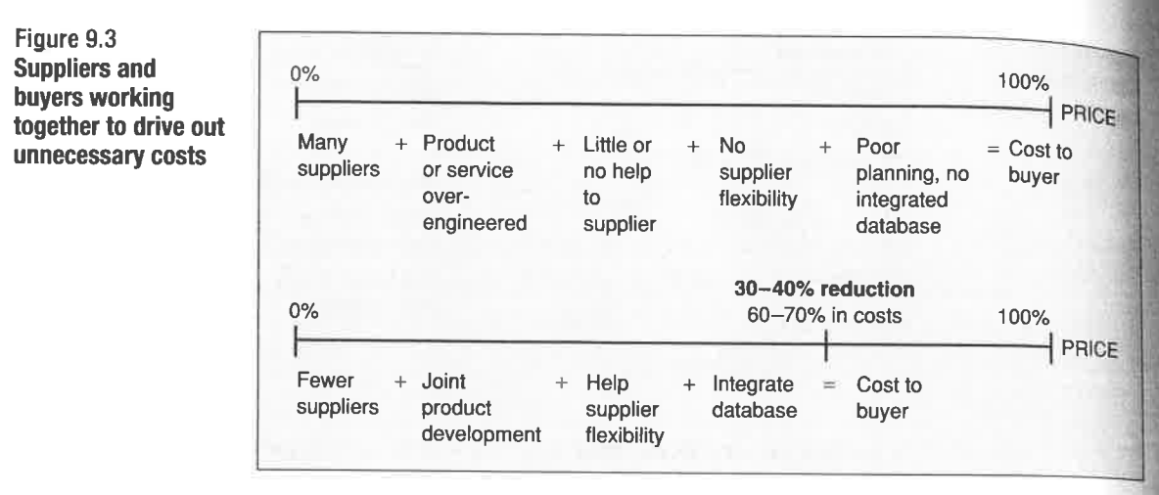

Slide 15



Slide 16
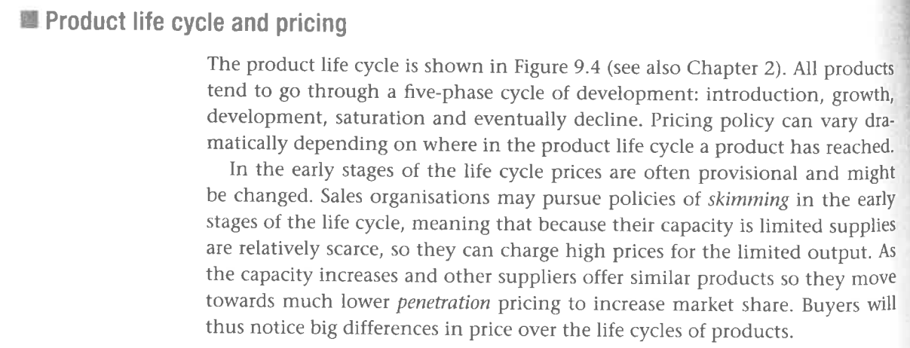

Slide 17
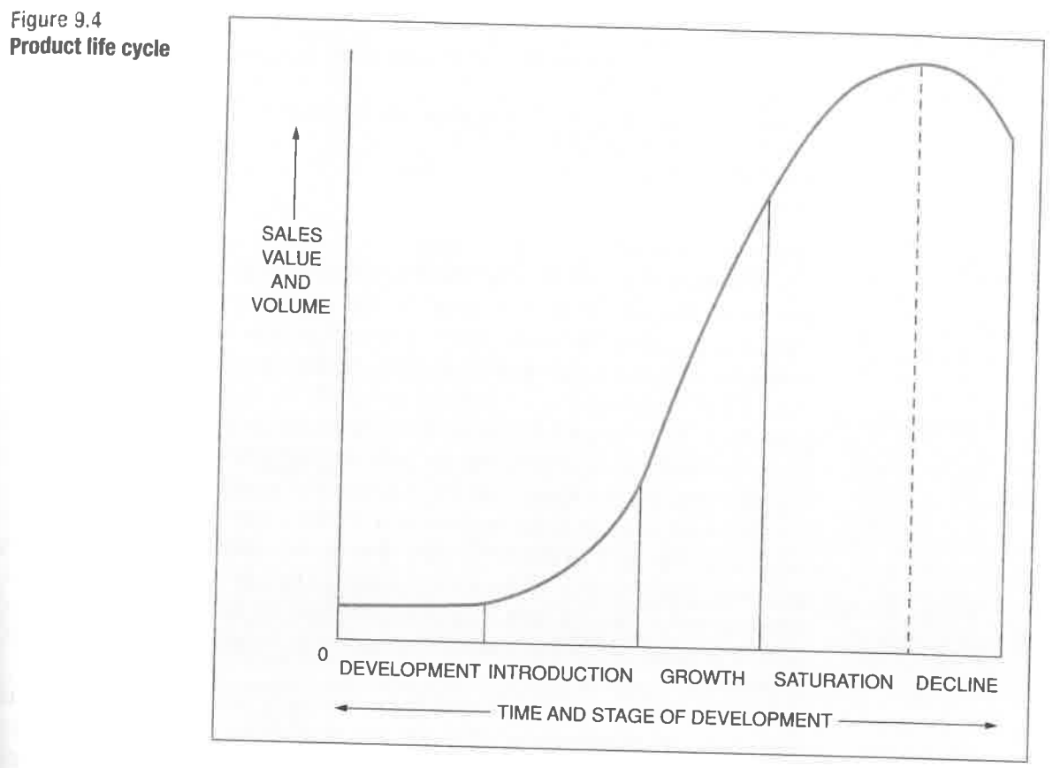

Slide 18
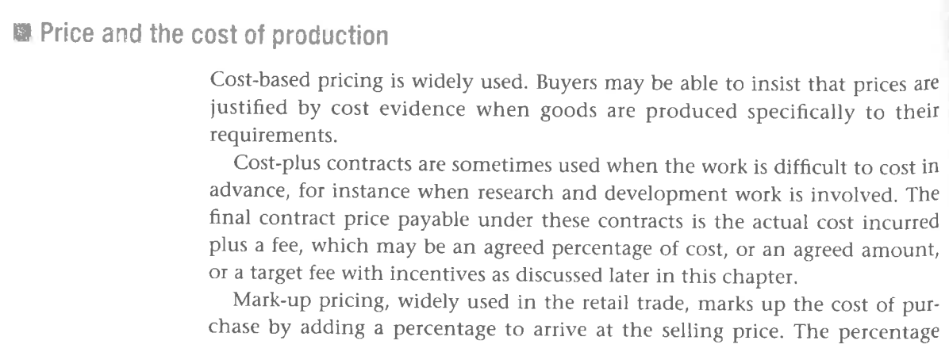
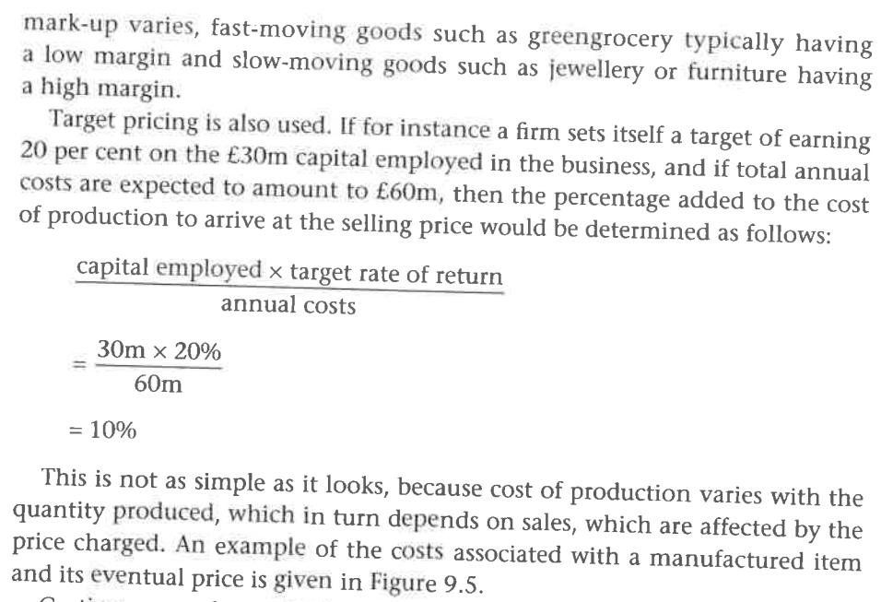

Slide 19


Slide 20

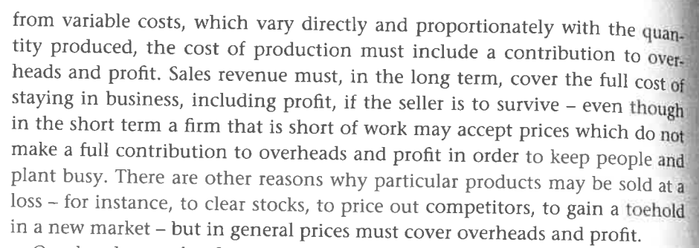

Slide 21
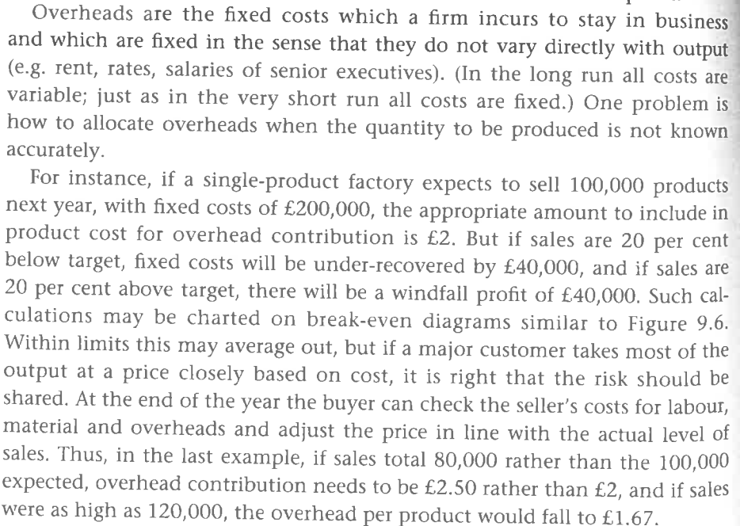

Slide 22
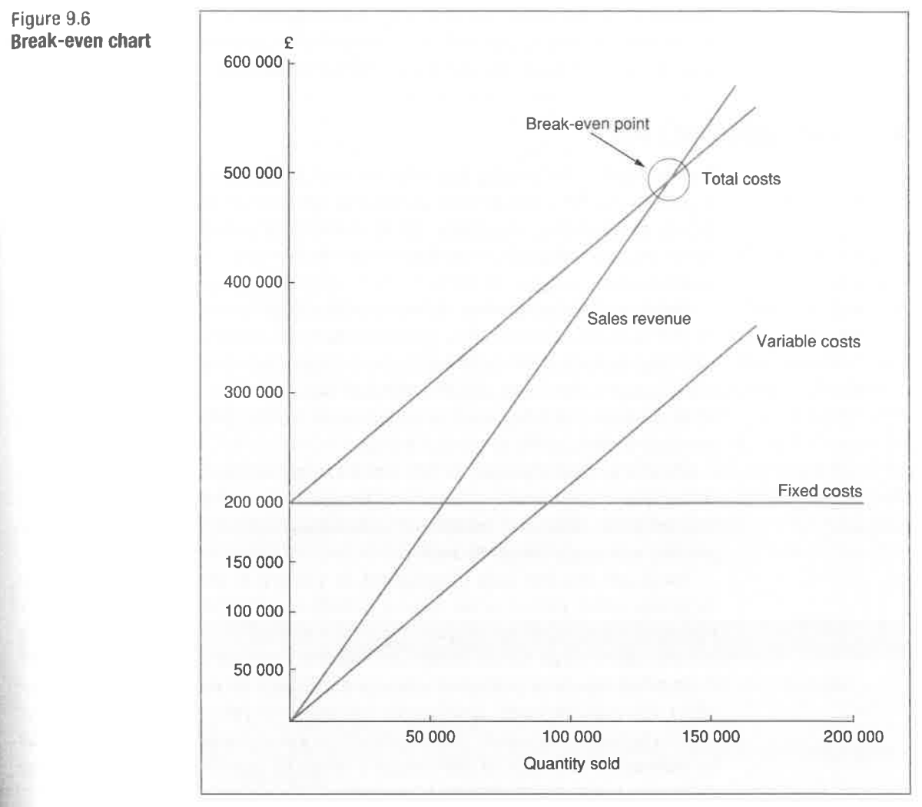

Slide 23
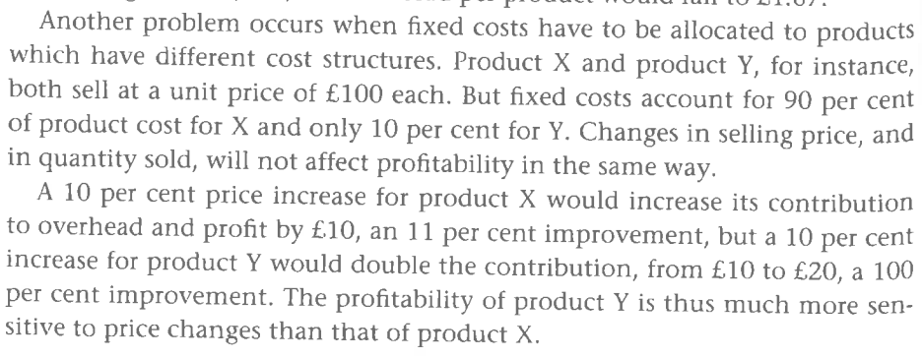


Slide 24



Slide 25
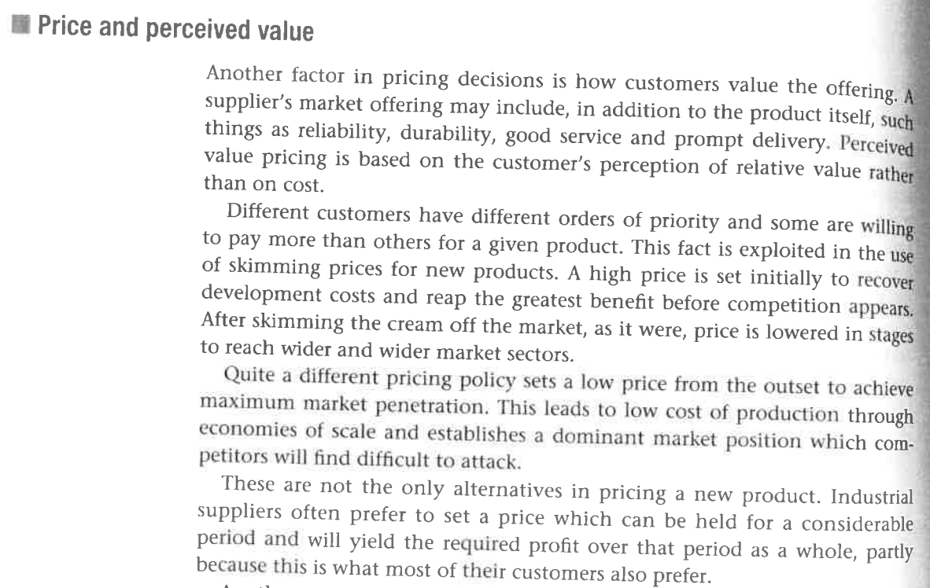

Slide 26
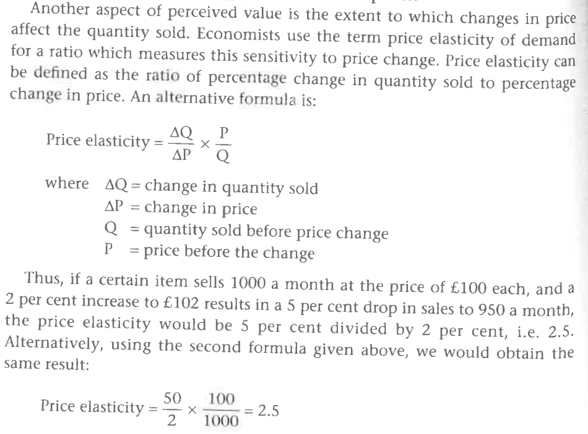


Slide 27

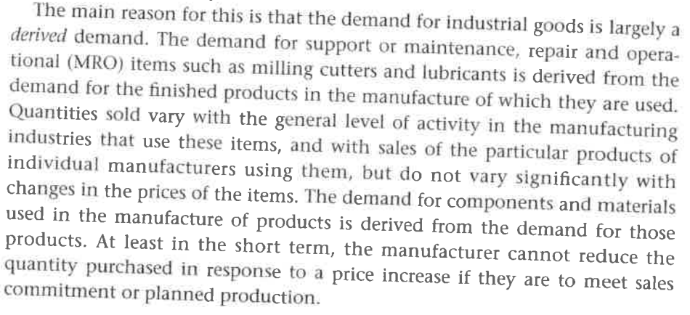

Slide 28
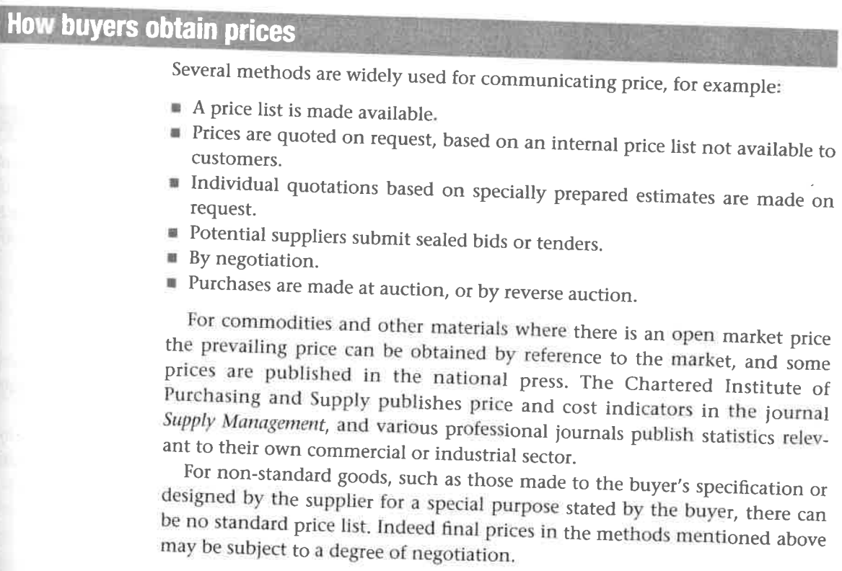


Slide 29
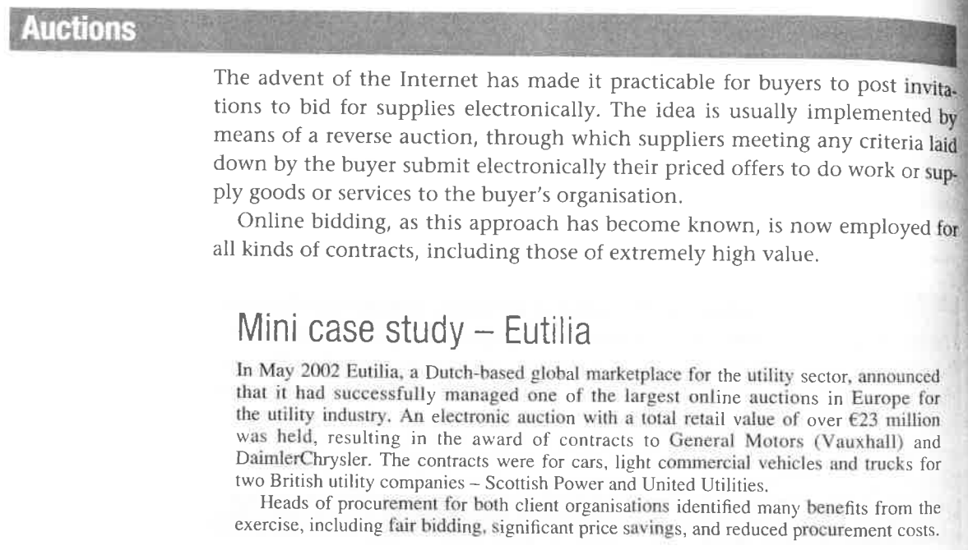

Slide 30



Slide 31



Slide 32
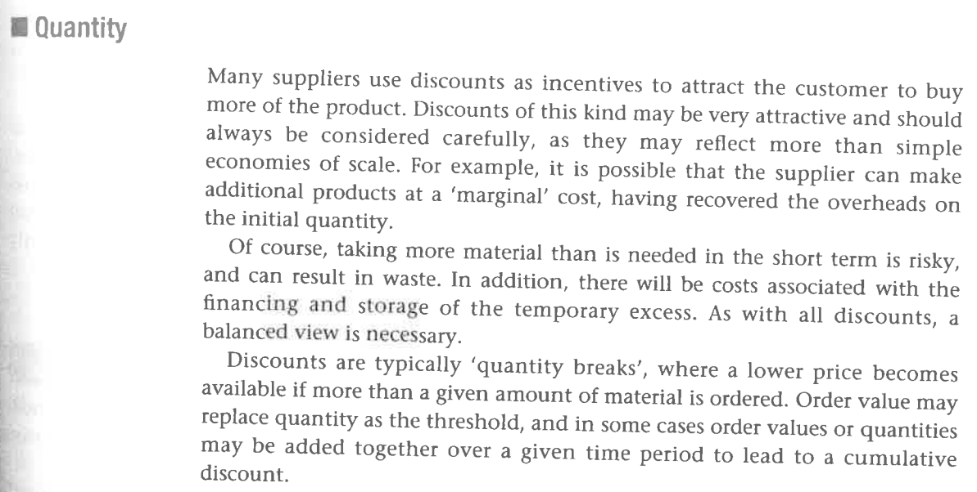

Slide 33

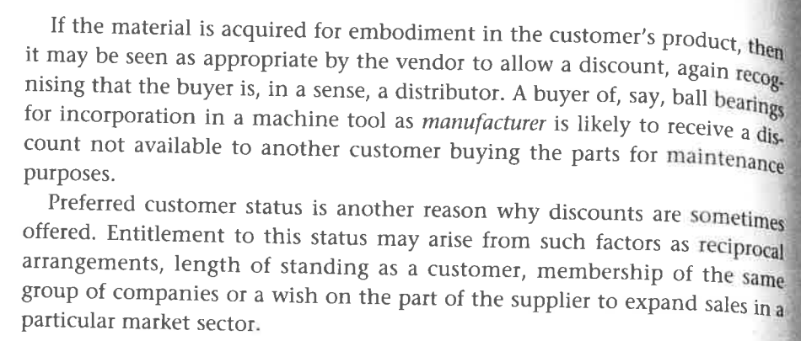

Slide 34
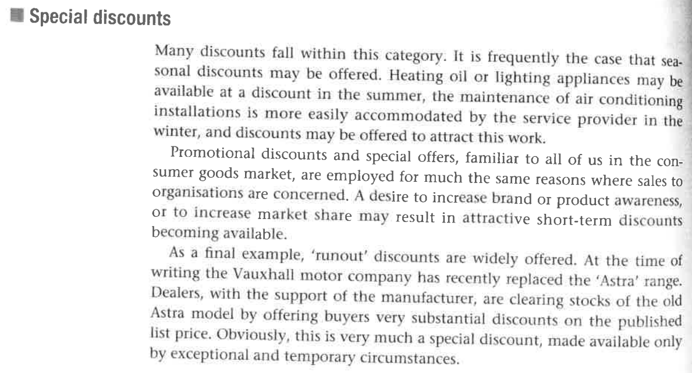

Slide 35
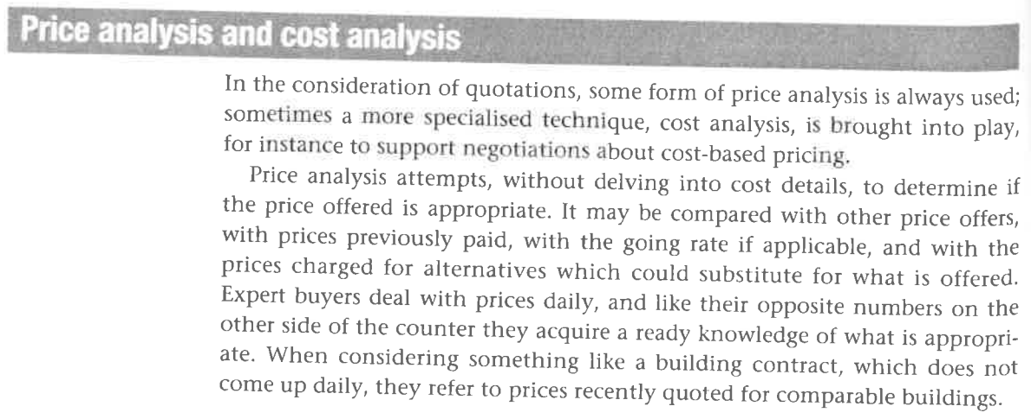

Slide 36
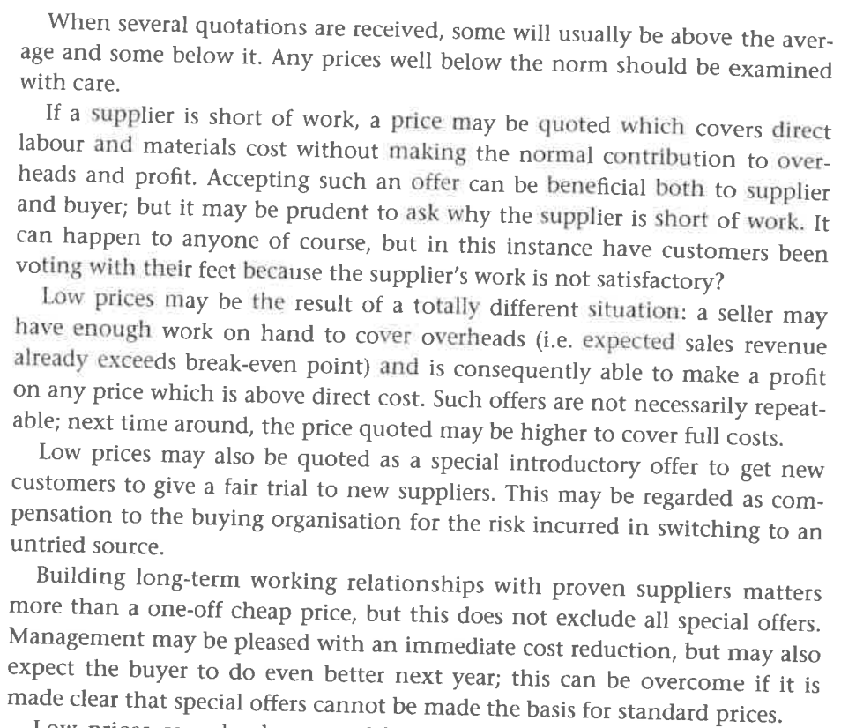

Slide 37
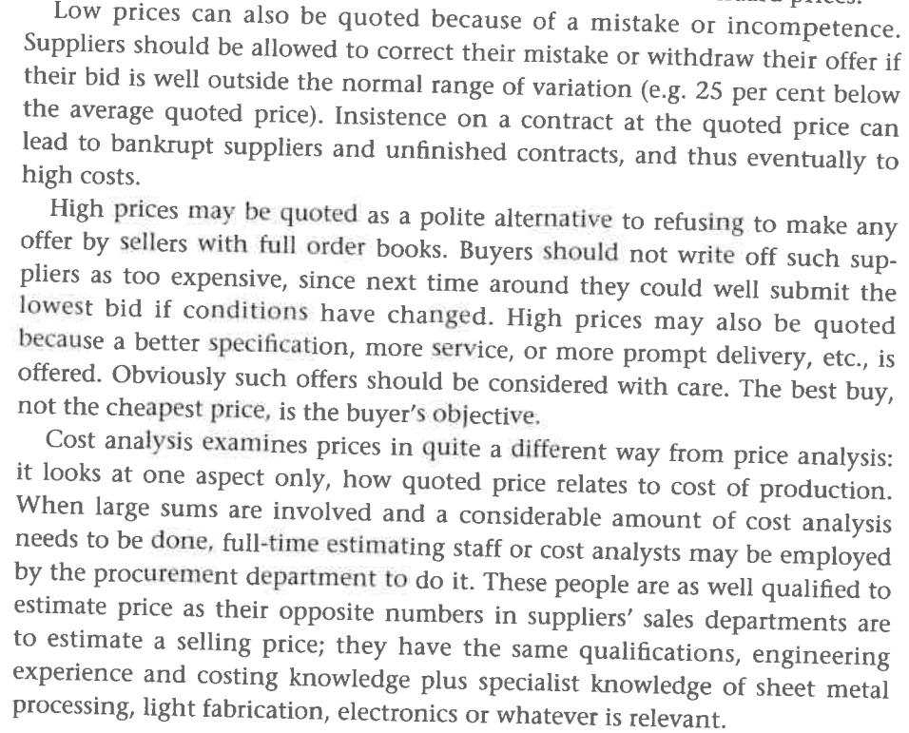

Slide 38
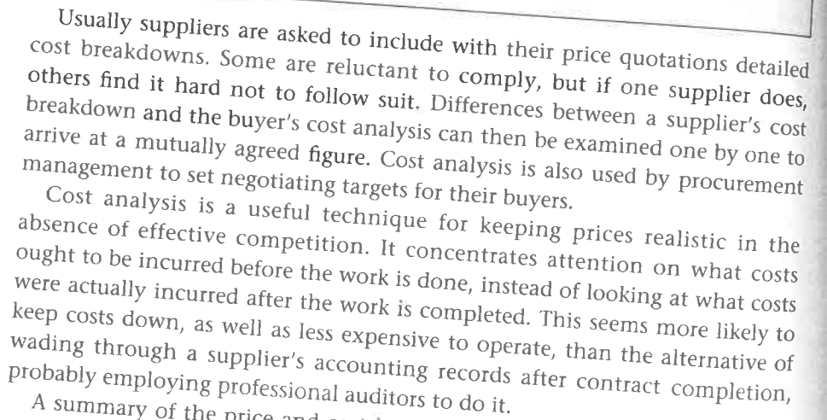

Slide 39

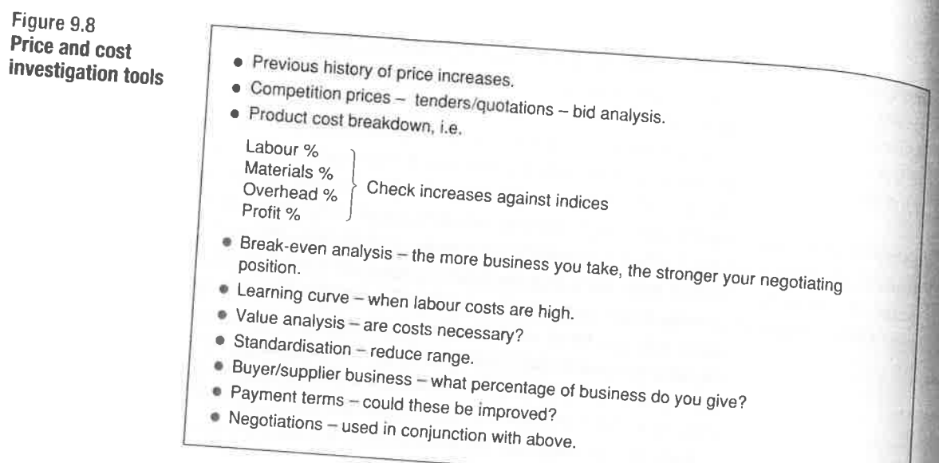

Slide 40
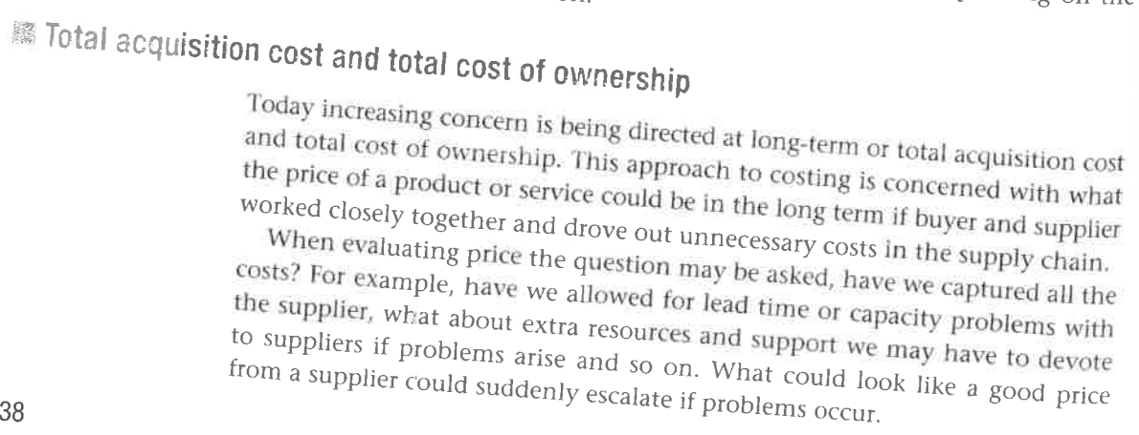


Slide 41

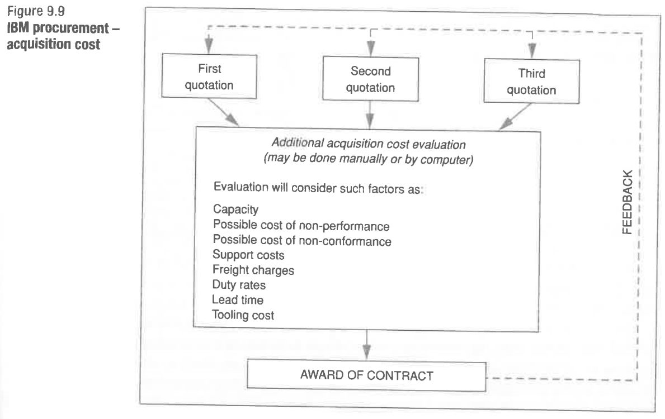

Slide 42
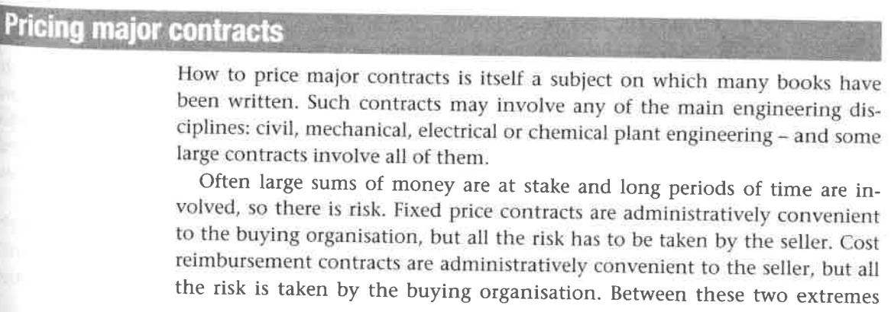


Slide 43
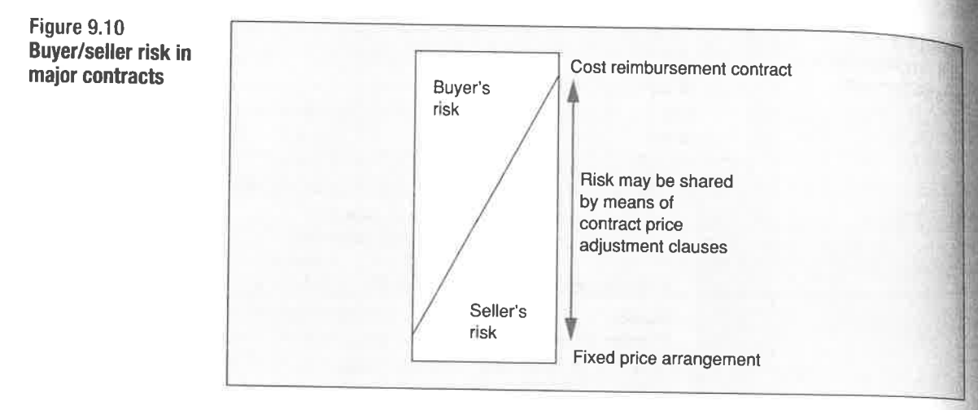

Slide 44
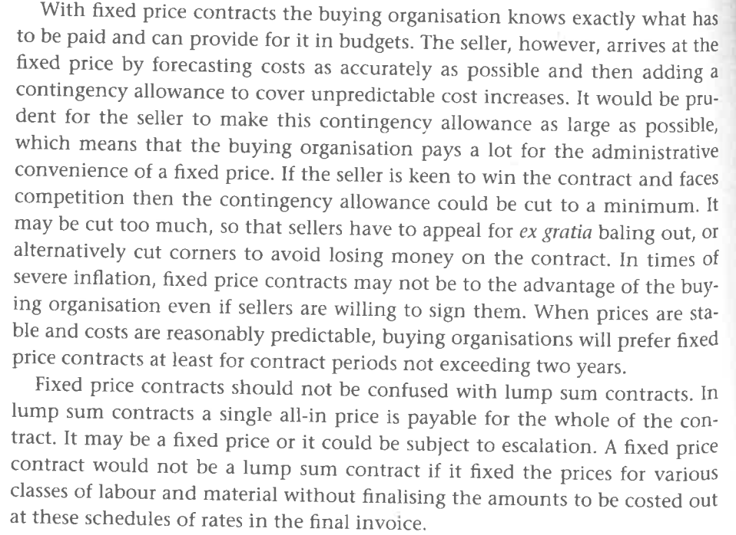

Slide 45



Slide 46
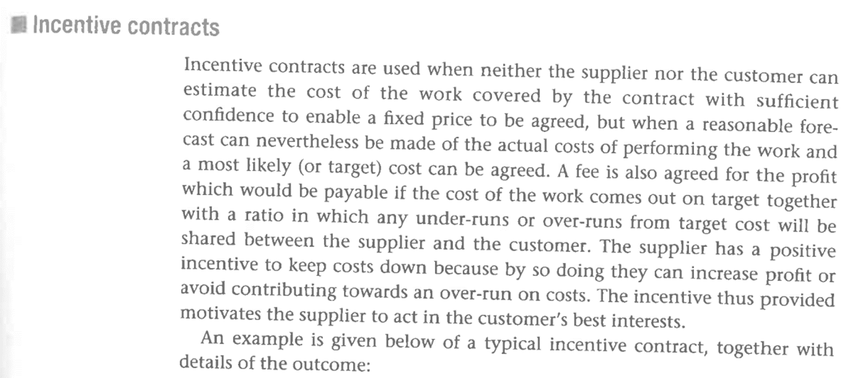

Slide 47
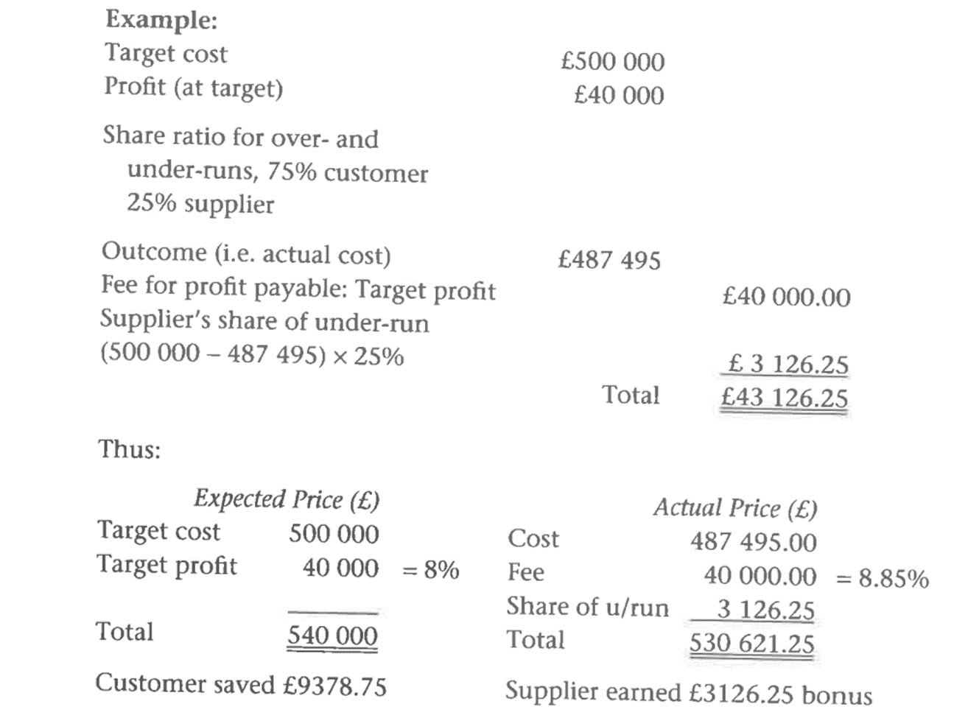

Slide 48
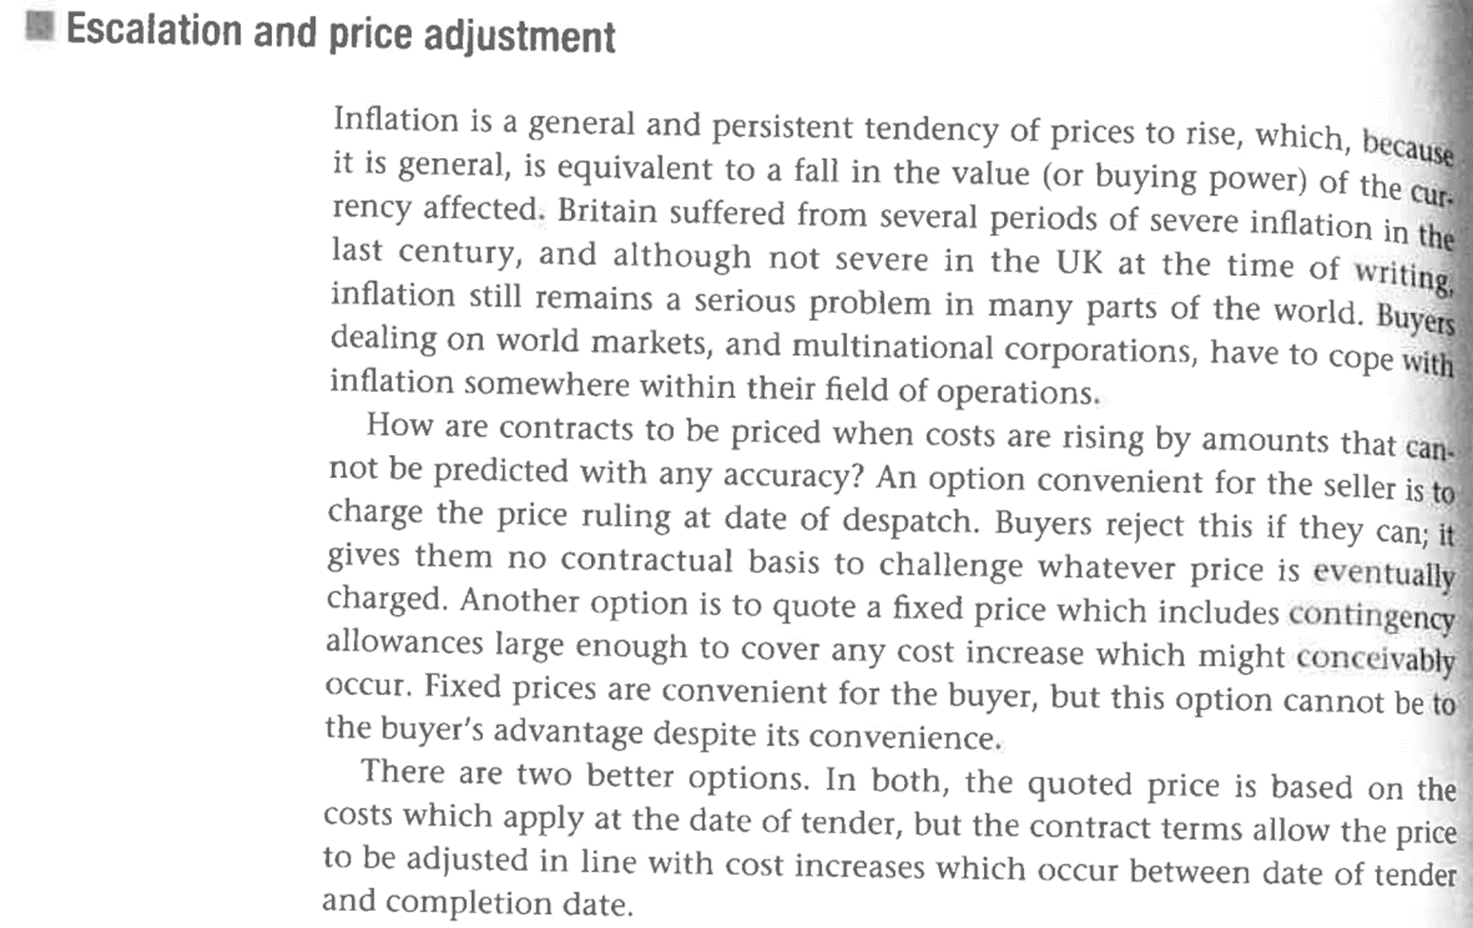

Slide 49
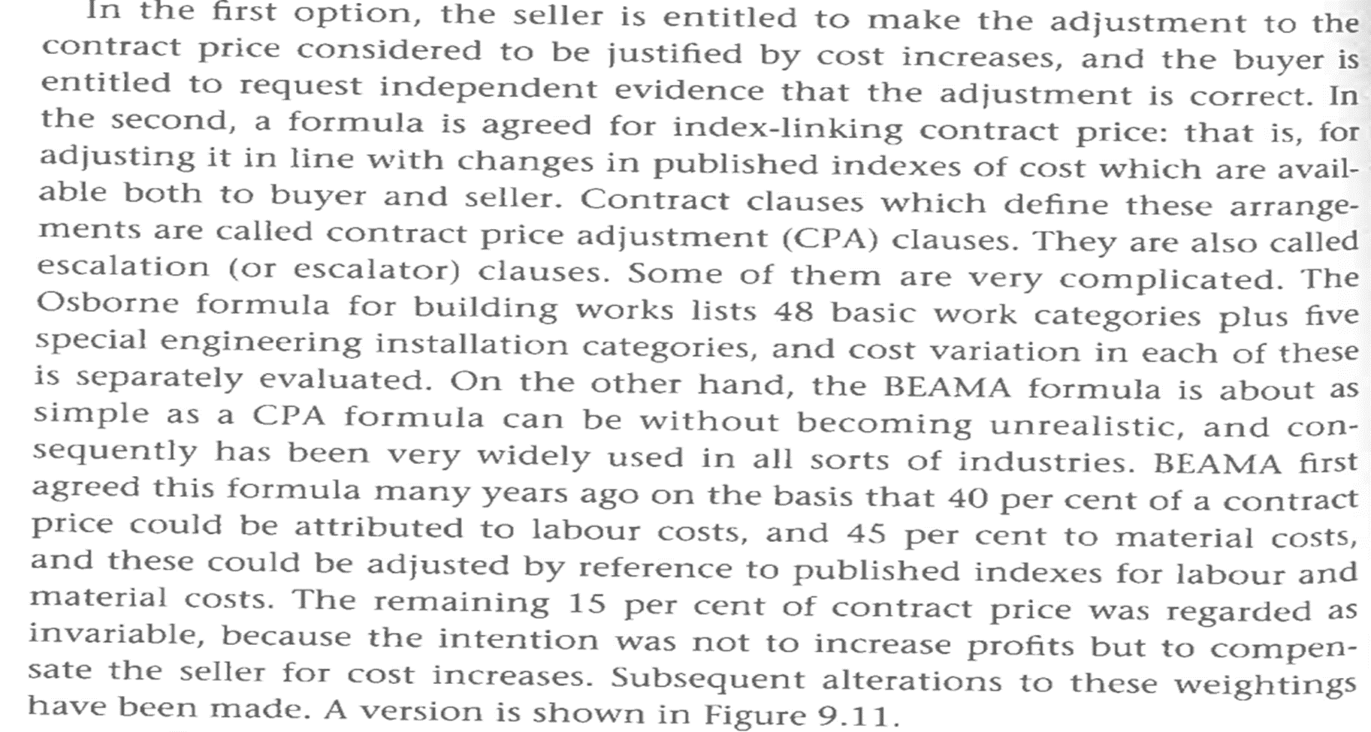

Slide 50


