Slide 1


Introduction to public health code-LCHS 4008
Mumps by- Humayera, luzimayra,trinity,hala

Slide 2

What are the main aproaches and strategies that could be used to monitor an infectionous disease outbreak BY LUZI
To monitor an infectious disease to spread ,the public health services keep checking the number of cases to see how disease is spreading in the community .In this case, after Mry was diagnosed with mumps ,health services would monitor if other students in her school became sick .
Strateghy is reporting new cases from hospitals ,GP surgeries ,and shools. For example, if more children have swollen necks or fever ,the school can report this to health services .
Another way is contact tracing .People who were close to Mary ,such as classmates or family members ,can also be checked for symptoms to stop the infection spreading .

Slide 3
What are the main approaches and strategies that could be used to measure an infectious disease outbreak ? by-luzimayra
To confirm an infectious disease outbreak ,public health services use monitoring systems to find out the number of new cases in the community. In this case ,Mary was diagnosed with mumps in the hospital ,so her case would be reported and added to health record. This helps health services to know if the disease is spreading at a slow or rapid rate
One strategy that can be used is reporting cases from hospitals ,GP surgeries ,and schools. For example ,if other students in Marys school have the same symptoms, the school can inform the health services about the case .
Health services can provide the use of vaccination records to measure the outbreak .For example ,checking if students had the MMR vaccine that can help to identify who is at risk.

Slide 4
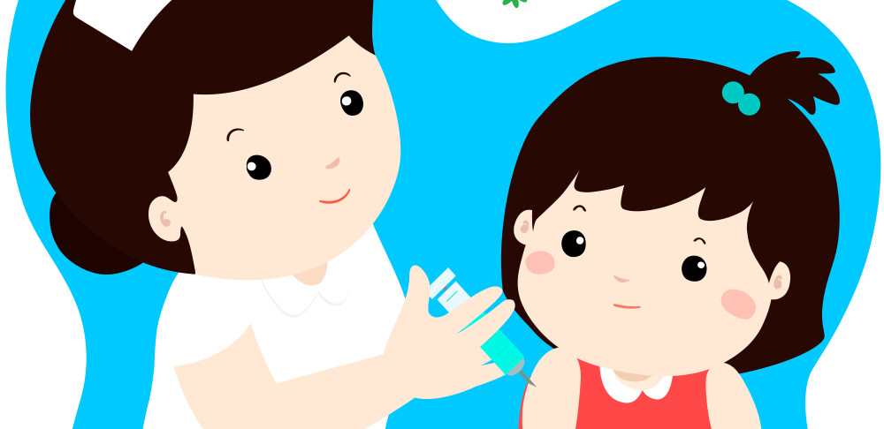
the main approaches which could be used to monitor infectious disease is- Vaccination by- Humayera
Mumps is a viral infection which spreads through saliva and respiratory droplets when am infected person coughs , sneezes, or talks, because it spreads easily in places like schools, it is important to control the outbreak quickly.
One strategy is vaccination, in the UK , children are given MMR vaccine (mumps). This vaccine helps protect people from getting mumps and reduce the chances of outbreak in schools and communities.
For example, if Mary had received both doses of the MMR vaccine when she was younger, the chances of her getting mumps would have been much lower. If most students in her school are vaccinated , it helps stop virus from spreading to other children.

Slide 5
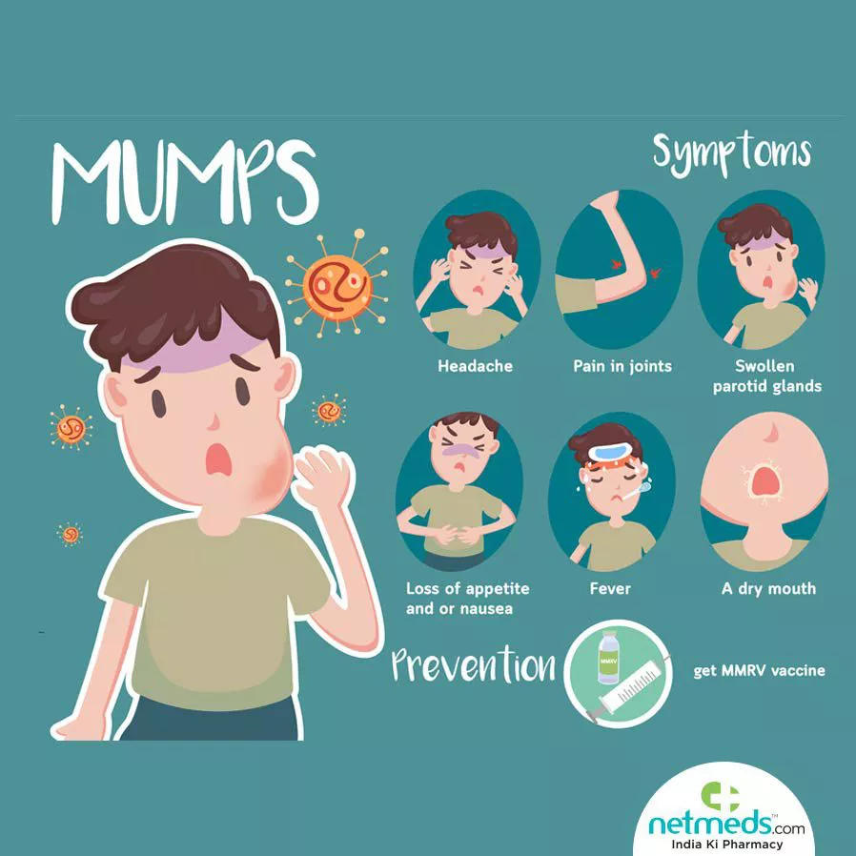
early detection
Another strategy is early detection of symptoms. It means recognizing the sign of the disease as soon as possible so action can be taken quickly. This is important because mumps spread easily though saliva and coughs, especially in places like schools where children are in close contact
for example, . In the case study Mary first had neck pain and difficulty eating, which are early symptoms of mumps, if symptoms are recognized early, parents and teachers can act quickly, such as keeping the child at home and seeking advice.
by- Humayera

Slide 6

The UK government uses different policies to protect public health and reduce spread of infections disease like mumps.
One key strategy is the national immunisation programme provides vaccines for children and young people. The MMR vaccine is offered for both children in early childhood to protect them.
Another strategy is disease surveillance. Health organisation collect information about reported cases from hospitals , GP services, which helps health authorities track how many cases are happening and where disease are spreading. For example, the case study shows threat mumps cases in England have reduced in those recent years due to MMR vaccination.
Mary’s situation, if the school follows public health guidance, they can inform parents about the symptoms of mumps and encourage vaccination. This helps prevent other students from becoming infected and protects the health of the school community.
Policies and UK government strategies
By- Humayera

Slide 7
What health education we should give to the school to prevent MUMPHS outbreak? by- trinity
Health education is important to stop the spread of Mumps in schools. In the case study, Mary went to school even though she had neck pain and later she was diagnosed with mumps. This shows that illnesses can spread easily between students. The school should teach students and parents about the MMR vaccine because it protects people from mumps a. Students should also learn simple hygiene like washing their hands, covering their mouth when coughing or sneezing, and not sharing drinks or food. If a student feels sick or has swelling in their neck or face, they should stay at home and tell a parent or teacher. This can help stop the infection spreading to other students.

Slide 8
Health education by trinity
Another reason for preventing mumps by teaching students how diseases spread between people. In the case study, Mary was in school with other students before she knew she had Mumps, so other students could have been exposed without realising. The school can explain in lessons that mumps spreads through coughs, sneezes and close contact. When students understand how infections spread, they may be more careful around others and take illness seriously. For example, they may keep a distance from someone who is sick or remind others to be careful when they are ill. This knowledge can help reduce the risk of the infection spreading around the school.

Slide 9
Conclusion by- Hala
In conclusion, Mumps is a contagious viral infection that can affect anyone who is not protected. Although it often starts with swelling in the cheeks and mild symptoms like fever and tiredness, it should still be taken seriously because it can sometimes lead to complications. Mumps spreads easily through close contact and respiratory droplets, which means it can quickly move through schools and communities if people are not careful.
However, mumps is largely preventable through vaccination, especially with the MMR vaccine. By staying vaccinated, practicing good hygiene, and being aware of how the disease spreads, we can protect ourselves and others. Understanding mumps helps us see why prevention is important and why public health measures play a key role in keeping communities safe and healthy

Slide 10
Reference
NHS (2024) Mumps. Available at: https://www.nhs.uk/conditions/mumps/
Accessed at- 16 March 2026)
. NHS (2024) MMR (measles, mumps and rubella) vaccine. Available at:
https://www.nhs.uk/vaccinations/mmr-vaccine/
Accessed at- 16 March 2026.
UK Health Security Agency (2023) Mumps: epidemiology and surveillance in England. Available at:
https://www.gov.uk/government/collections/mumps-guidance-data-and-analysis
Accessed at- 16 March 2026.
UK (2025). Mumps: confirmed cases and notifications.
GOV.UK.
Available at: https://www.gov.uk/government/publications/mumps-confirmed-cases-and-notifications
Accessed at- 16 Mar. 2026

Slide 11

Thank you everyone

