Slide 1
BMSW 4002 ETW T2 WEEK 1

Slide 2
COMMUNICATION in THE PAST
Communication in The Ancient World
Have you ever reflected on the history of communication?
How did people communicate over distances long long ago, in the distant past?

Slide 3
COMMUNICATION in THE PAST
It is a fascinating journey back in time - to a prehistoric beginning when man blew animal horns and beat drums. The discovery of fire enabled smoke signals to be sent. It is estimated that in the fifth century a system of “airmail” was devised by the use of pigeons.

Slide 4
COMMUNICATION in THE PAST
Communication and Television
During 1827, an invention was patented that was to bring the world into homes and lives of ordinary people. Television had become part of the history of communication and from this moment, the world remained no longer a place of mystery and became an even smaller place to live in! From the distorted images in black and white, it did not seem to be too long until colour television came onto the scene. Now the demand was for more visual communication.

Slide 5
ELECTRICAL TECHNOLOGY in COMMUNICATION
One of the biggest developments in communication came in 1831 when the electric telegraph was invented. While mail existed as a form of communication before this date, it was electrical engineering in the 19th century which had a revolutionary impact.

Slide 6
TECHNOLOGY: A CHRONOLOGICAL HISTORY.
Post 1830
THE TELEGRAPH 1844
Henry Morse developed a code (Morse Code 1835) that led to the sending of messages over long distances using electricity.

Slide 7
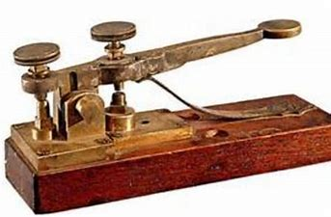
TECHNOLOGY: A CHRONOLOGICAL HISTORY.
Post 1830
THE ELECTRIC TELEGRAPH (1844)

Slide 8
TECHNOLOGY: A CHRONOLOGICAL HISTORY.
Post 1830
The TELEPHONE 1876
In 1876, the telephone was invented by
ALEXANDER GRAHAM BELL and within 50 years it
was an essential item for homes and offices.

Slide 9
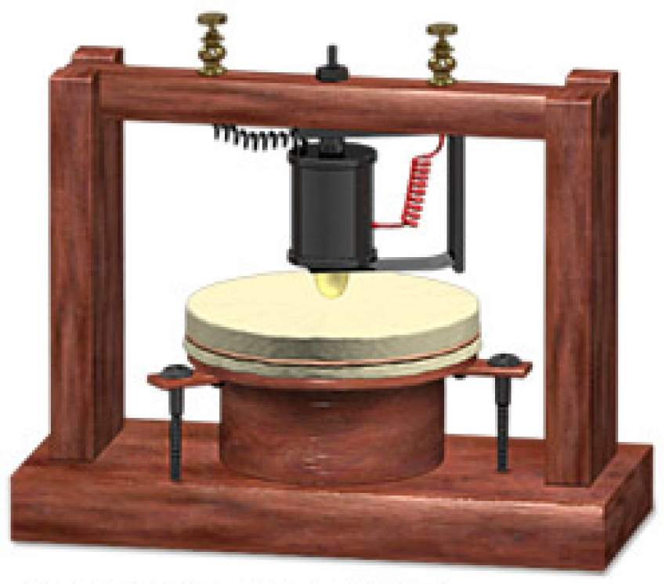
TECHNOLOGY: A CHRONOLOGICAL HISTORY.
Post 1830
Early Bell telephone

Slide 10
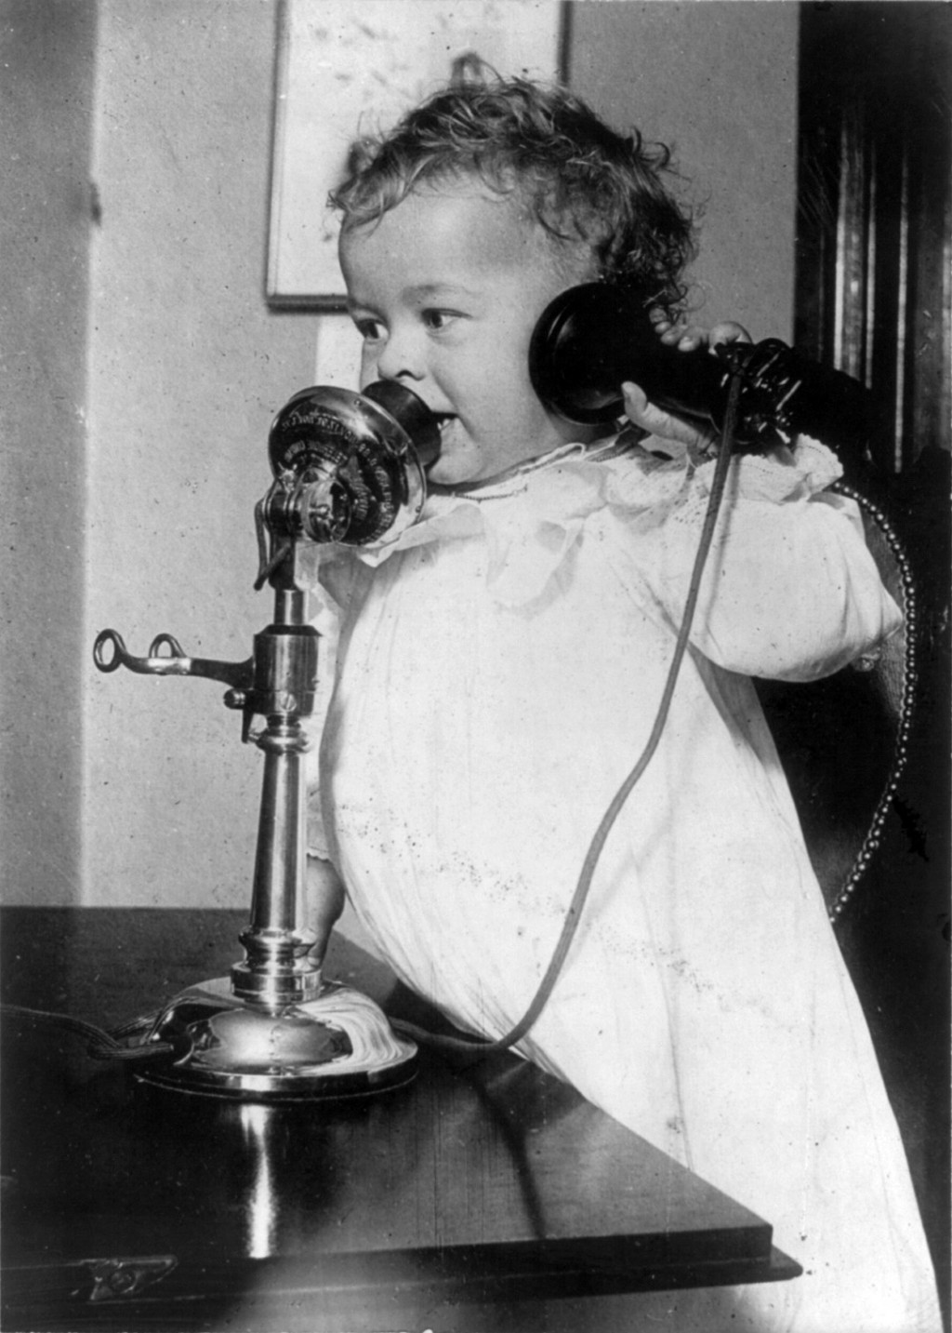
TECHNOLOGY: A CHRONOLOGICAL HISTORY.
Post 1830
LATER TELEPHONE

Slide 11

TECHNOLOGY: A CHRONOLOGICAL HISTORY.
Post 1830
Much Later Telephone

Slide 12
TECHNOLOGY: A CHRONOLOGICAL HISTORY.
Post 1830
THE MOBILE PHONE 1973
In 1973, Motorola created a mobile
phone which started a chain of
developments that transformed
communication forever.

Slide 13
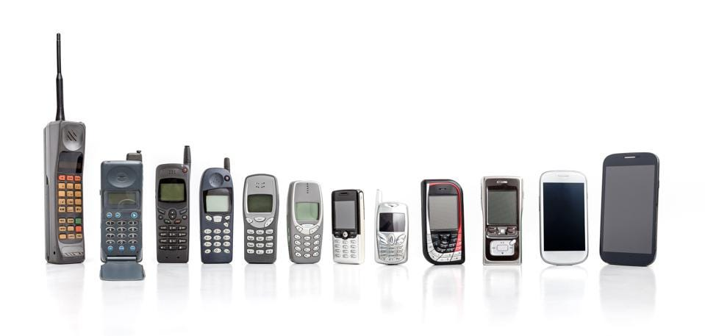
TECHNOLOGY: A CHRONOLOGICAL HISTORY
THE MOBILE PHONE 1973 -

Slide 14
TECHNOLOGY: A CHRONOLOGICAL HISTORY
The Mobile Phone
Early smartphones were bulky
and had short battery lives.
By 1996, Nokia was releasing phones with
QWERTY keyboards
and by 2010, the majority of Android phones
were touchscreen-only.

Slide 15
TECHNOLOGY: A CHRONOLOGICAL HISTORY
The Mobile Phone
In 2007, Steve Jobs revealed the first iPhone to the world..
Before the iPhone, “flip phones”, and phones with a split
keyboard and screen were the norm. A year later, a central
application store with an initial 500 downloadable ‘apps’ was
launched. Currently, there are over two million apps available in the Apple App Store.

Slide 16
TECHNOLOGY: A CHRONOLOGICAL HISTORY
The INTERNET
Internet 1990, a system architecture that has revolutionized communications and methods of commerce by allowing various computer networks around the world to interconnect. Sometimes referred to as a “network of networks,” the Internet emerged in the United States in the 1970s but did not become visible to the general public until the early 1990s. By 2020, approximately 4.5 billion people, or more than half of the world’s population, were estimated to have access to the Internet.

Slide 17
TECHNOLOGY: A CHRONOLOGICAL HISTORY
The INTERNET
The Internet provides a capability so powerful and general that it can be used for almost any purpose that depends on information, and it is accessible by every individual who connects to one of its constituent networks. It supports human communication via social media, electronic mail (e-mail), “chat rooms,” newsgroups, and audio and video transmission and allows people to work collaboratively at many different locations. It supports access to digital information by many applications, including the World Wide Web.
(https://www.britannica.com/technology/Internet)

Slide 18
TECHNOLOGY: A CHRONOLOGICAL HISTORY
E-MAIL
Email 1991
As a by-product of the World Wide Web, email was introduced
to the world in 1991. The first users of the messaging platform
were educational systems and the military
who used email to exchange information. In 2018, there were
more than 3.8 billion email users—that’s more than half the
planet. By 2022, it’s expected that we will be sending 333 billion
personal and business emails each day.

Slide 19
TECHNOLOGY: A CHRONOLOGICAL HISTORY
E-MAIL
While email is invaluable and we can’t imagine a world without
it, there are other tools that are springing up, such as SLACK (an
acronym for “Searchable Log of All Communication and
Knowledge”). The company which launched in 2014 has often
been described as an email killer. However, while Slack has
become the most popular chat and productivity tool in the world
used by 10 million people every day, email is still going strong.

Slide 20
TECHNOLOGY: A CHRONOLOGICAL HISTORY
WEARABLE TECHNOLOGY
Ten years ago, the idea that you could make a video call from an item other than a phone would have been a sci-fi dream. Now, with smartwatches, audio sunglasses, and other emerging wearable technology, these capabilities are a part of our daily lives.

