Slide 1

Reflexive counselling skills
The application of gestalt therapy
DR Beverly Cole

Slide 2

CIRCLE
TIME
OPENING ROUND

Slide 3
Locating emotion:
I feel ….
I notice …
I imagine …

Slide 4
Locating Emotion … … …
An example of this could be, "a heavy weight in my chest," or “a lump in my throat”, or “butterflies in my stomach or “my chest feels tight“.
Bringing the emotional experience to awareness in the body helps the client stay present and process their emotions more effectively

Slide 5
ASSIGNMENT 1 AND ASSIGNMENT 2
ASSIGNMENT 1 – ANY QUESTIONS?
ASSIGNMENT 2 – ANY QUESTIONS?

Slide 6
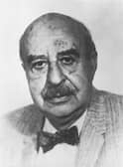

Translating Gestalt Theory into practice

Slide 7
Gestalt therapy ….
“ I and thou, here and now.”
“Now” is the zero point between the past and the future, neither of which exists; only the now exists

Slide 8
Gestalt Therapy in the consulting room
(1) Theory
(2) Practice
(3) Three ways you can use Gestalt therapy today …

Slide 9
Locating emotion:
I feel ….
I notice …
I imagine …

Slide 10
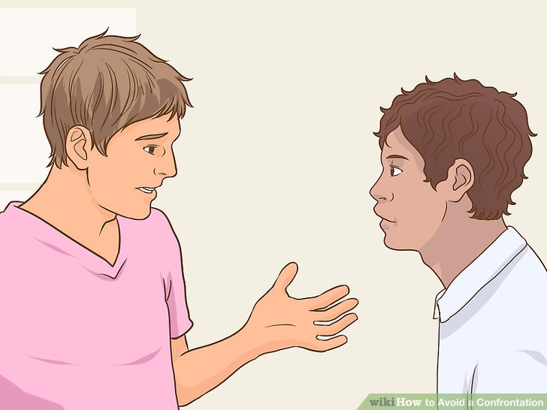
More emphasis on … … …

Slide 11
Exercise:
What does the term challenge mean to you?
Consider a time when you have been challenged:
What feeling did this invoke in me?
How did I feel about the challenger at the time?
How did I feel about the challenger later?
Was the challenge of any benefit to me?

Slide 12

SMALL GROUP DISCUSSION

Slide 13
What do we mean by this?
Skills base
The word challenge can conjure up all sorts of images
Think of “an invitation to consider something differently” rather than a “Challenge”!

Slide 14
What do we mean by this?
We mean………….
Expanding awareness of thoughts, feelings and actions
Stimulating clients to provide additional information

Slide 15
What do we mean by this?
Sensitive challenge of clients’ existing perceptions
Working together with more and better information

Slide 16
What do we mean by this?
Sensitive challenge of inconsistencies
Acknowledging choice
A search for meaning

Slide 17
Inconsistency……….
“Between verbal, voice and body messages”
“You are saying something sad, yet I notice that you are smiling”

Slide 18
Within verbal messages……..
“ You say that you are not doing very well on your course, yet also said that you had a very good mark for your last project”
“You say that your partner doesn’t care for you, yet you complain how he nags you to make sure you have taken your medication”

Slide 19
Inconsistency between words and actions……………..
“You say that you are not looking after yourself, yet you mentioned that you went to three shops after work to buy nice fruit and veg and also ended up buying a nutrition book”

Slide 20
Inconsistencies between past and present statements………
“You say that you don’t like her now, but earlier in this session you were saying how much you thought of her skills as a teacher”

Slide 21
Common ways to confront inconsistencies
On the one hand you say………, but on the other hand you……….

Slide 22
Common ways to confront inconsistencies
“On the one hand you say that you are fine, but on the other hand I notice much pain in your voice”

Slide 23
Common ways to confront inconsistencies
Can you think of one way that you have used a challenge over the last few weeks?

Slide 24
TRY SOME SENSITIVE CHALLENGES TO THESE STATEMENTS:
They are all out to get me
I have no friends
I am a terrible mother
I’m no good with people
My partner does not love me any more
I am useless
[A simple reflection can be a sensitive challenge]

Slide 25
RE-FRAMING WIDENS POSSIBLE PERCEPTIONS
“You say that your partner does not care for you, yet you complain how he insists on running you to your yoga class so that you don’t have to catch the bus”

Slide 26
REFRAMING WIDENS POSSIBLE PERCEPTIONS
“You mentioned that your mother hates your boyfriend, yet you describe how she always has a meal ready for him when he works late”

Slide 27
REFLECTING
Reflecting inconsistencies can be seen as sensitive challenge
Allows helpees to choose their own version or conclusion

Slide 28
When to use sensitive challenge…
Never early on in a helping exchange
Only when a therapeutic relationship is in place
Helpee first of all has to feel heard, understood and accepted [core conditions] – THE THERAPEUTIC RELATIONSHIP HAS TO BE IN PLACE

Slide 29
Exercise
Work out a statement that you could use to help someone slow down, which achieves the aim, but does not offend the talker or detract them from what they are saying

Slide 30
Activity
Why is sensitive challenge a helping skill?

Slide 31


‘EXERCISES’ ARE AN IMPORTANT PART OF GESTALT THERAPY

Slide 32
Exercises … … …
Exercises are used to make something happen in a therapy session, to elicit emotion, produce action, or achieve a specific goal.

Slide 33
Exaggeration exercise……
A common exercise in gestalt therapy is the exaggeration exercise. During this exercise, the person in therapy is asked to repeat and exaggerate a particular movement or expression, such as frowning or bouncing a leg, in order to make the person more aware of the emotions attached to the behaviour.

Slide 34
Exaggeration … … …
The therapist is likely to not only observe and reflect body language, they specifically mention their observation of this action and ask what is happening for the person at that moment
I’m noticing that you are tapping your foot as you say that, what is happening for you now?
Giving body language a voice

Slide 35
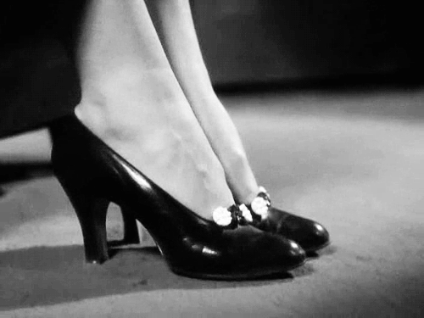
Exaggeration …. What is that tapping foot saying right now …
Let’s listen and hear the message it’s giving …

Slide 36
Role play…..
Role play helps individuals:
Experience different feelings and emotions
Better understand how they present and organise themselves.

Slide 37
Role play
Changing of one's behaviour to assume a role, either unconsciously to fill a social role, or consciously to act out an adopted role.

Slide 38
Role play … … …
Take a moment to think of a person who you find it difficult to deal with and why … … …

Slide 39
Role play … … …
In Dyads, the ‘counsellor’ asks the client to think of a person they currently find it difficult to get on with
The ‘counsellor’ asks the ‘client’ to adopt the role of a person they find it difficult to deal with and facilitates this process by using counselling skills

Slide 40
Role play … … …
Practising new behaviours
Reverse role play

Slide 41
Role play: Topdog — Underdog :
A commonly utilised Gestalt technique is that of the topdog-underdog dialogue.
This technique is used when the therapist notices two opposing opinions/attitudes within the client. The therapist encourages the client to distinguish between these two parts and play the role of each in a dialogue between them

Slide 42
USING ‘NOW’ LANUAGE…
Use a here-and-now perspective.
Task a client to talk directly to a person they are discussing in therapy.
Bringing the past into the present.

Slide 43

Research the following techniques for future discussion:

Slide 44

The Empty Chair … … …

Slide 45
The empty chair technique….
The empty chair technique is a quintessential gestalt therapy exercise that places the person in therapy across from an empty chair.
He or she is asked to imagine that someone (such as a boss, spouse, or relative), they, or a part of themselves is sitting in the chair. The therapist encourages dialogue between the empty chair and person in therapy in order to engage the person’s thoughts, emotions, and behaviours.
Sometimes the roles are reversed and the person in therapy assumes the metaphorical person or part of a person in the chair. The empty chair technique can be especially useful for helping people become mindful of the whole situation and forgotten or disengaged pieces of their own self

Slide 46
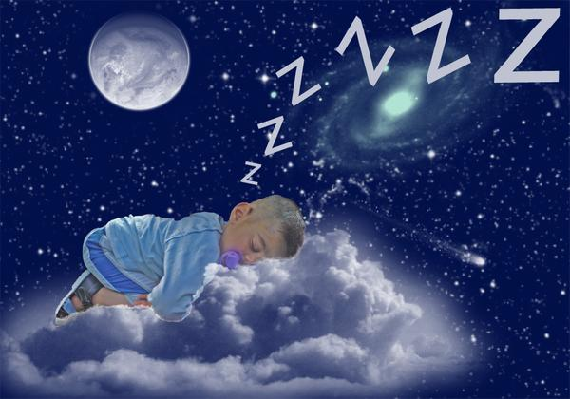
Gestalt therapists encourage their clients to talk about their dreams
Dreams contain existential messages, and each piece of dream work leads to assimilation of disowned aspects of the self.

Slide 47
Unfinished business
In Gestalt psychology when any aspect of a client’s life is left hanging, it is related to unfinished business.
This state can eat away at a client, really affecting the quality of relationships and how a client sees the world.
Some common experiences that are attached to unfinished business are abuse suffered at the hands of primary caregivers, difficult endings of romantic relationships, and deaths of important people.

Slide 48
Unfinished business:
Unexpressed feelings from the past that occur in the present, and interfere with psychological functioning. They may include feelings, memories, or fantasies from earlier life (often childhood) that can be dealt with in the present.

Slide 49
ACTING ON BODY LANGUAGE
Unfinished business can be understood by paying attention to what a client is doing with their body, and how it might contrast with their words.
A therapist might ask their client to act out what a particular body part is saying

Slide 50
Unfinished business … … …
People with unfinished business often resent the past and because of this are unable to focus on the here and now.
A major goal of Gestalt Therapy is to help people work through their unfinished business and bring about closure.

Slide 51

Expression of feelings…
Stones exercise

Slide 52
I take responsibility for that….
Encouraging clients to add "and I take responsibility for that" to the end of their statements when talking about their problems

Slide 53
I have a secret…..
Taking ownership of guilty or ashamed feelings. asking the client to predict a therapist's response if a secret of theirs was revealed.
If the secret is revealed, the secret and a response to the secret can be worked on.

Slide 54

Creative Arts … … …
Activities such as painting, sculpting, and drawing can also be used to help people gain awareness, stay present, and learn how to process in the moment.

Slide 55
In summary……
These are just some parts of gestalt therapy used to help people in therapy increase their awareness of immediate experiences.
Through exercises and spontaneous experiments, gestalt therapy also allows people to reconnect with parts of themselves they may minimize, ignore, or deny.

Slide 56

Any questions?
So, what do you think?

Slide 57
TRIADS … SO LET’S TRY SOME OF THESE SKILLS

Slide 58
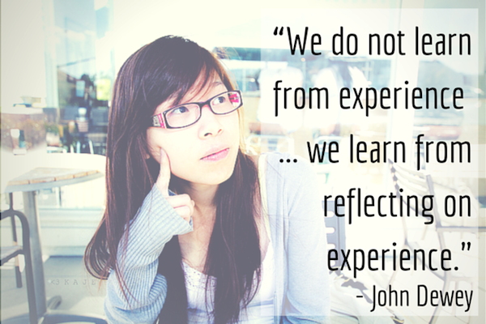
Your reflections on the research process and experience

Slide 59

REFLECTING ON THE EXPERIENCE OF THIS LESSON

Slide 60
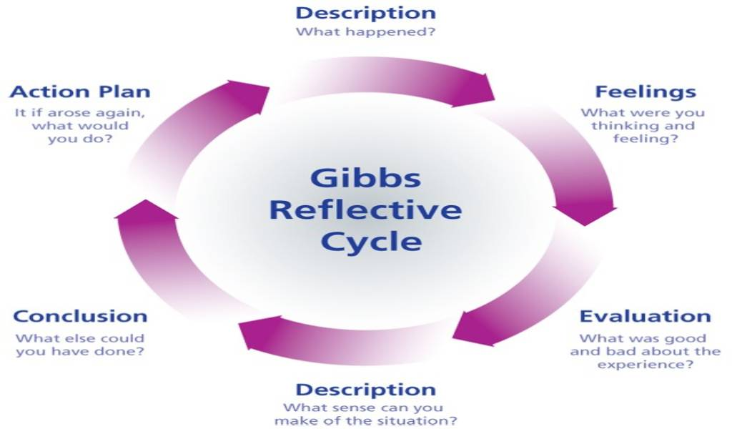
REFLECTING ON THE EXPERIENCE OF THIS LESSON

Slide 61
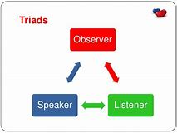
Triad work … … …

Slide 62
CIRCLE
TIME: closing round
OPENING ROUND

