Slide 1
FOOD AND BEVERAGE OPERATIONS IN MARRIOTT HOTEL
STUDENT NAME: Adelina Gusa
STUDENT NUMBER: 1816286
MODULE NAME: Food and Beverage Operations
MODULE CODE: M4X01918
LECTURER NAMES: Jazz and Olu

Slide 2
Table of Contents
INTRODUCTION
MAIN BODY
History of Marriott forest of Arden
Type of operation Marriott have
Food and Beverage operations
Types of menu or products of Kitchen
How Marriott hotel market
Heath and hygiene and food & beverage services provided by Marriott
CONCLUSION
REFERENCES

Slide 3
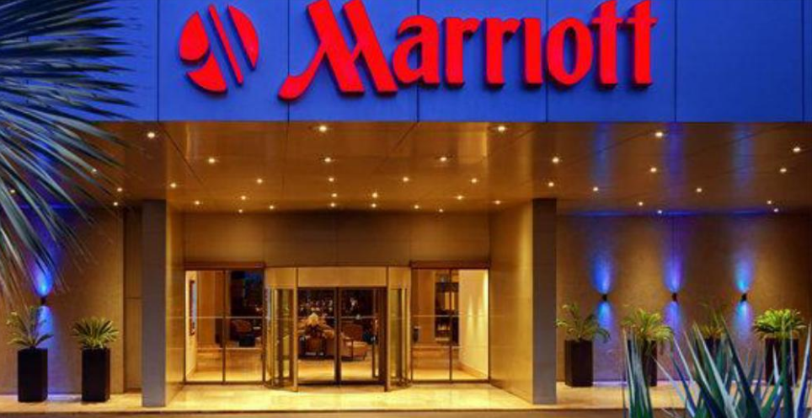
INTRODUCTION
Food & beverage broadly defined as the procedure of making, preparing, presenting and offering of F&B to consumers.
The current report is based on Marriott hotel situated in UK, operate their large chain of hotels in all around the world.
This study explains the company overview, type of operation they have and types of menu or goods of kitchen.
Furthermore, this presentation justified how hotel provide health & safety, consumers and marketing services.

Slide 4
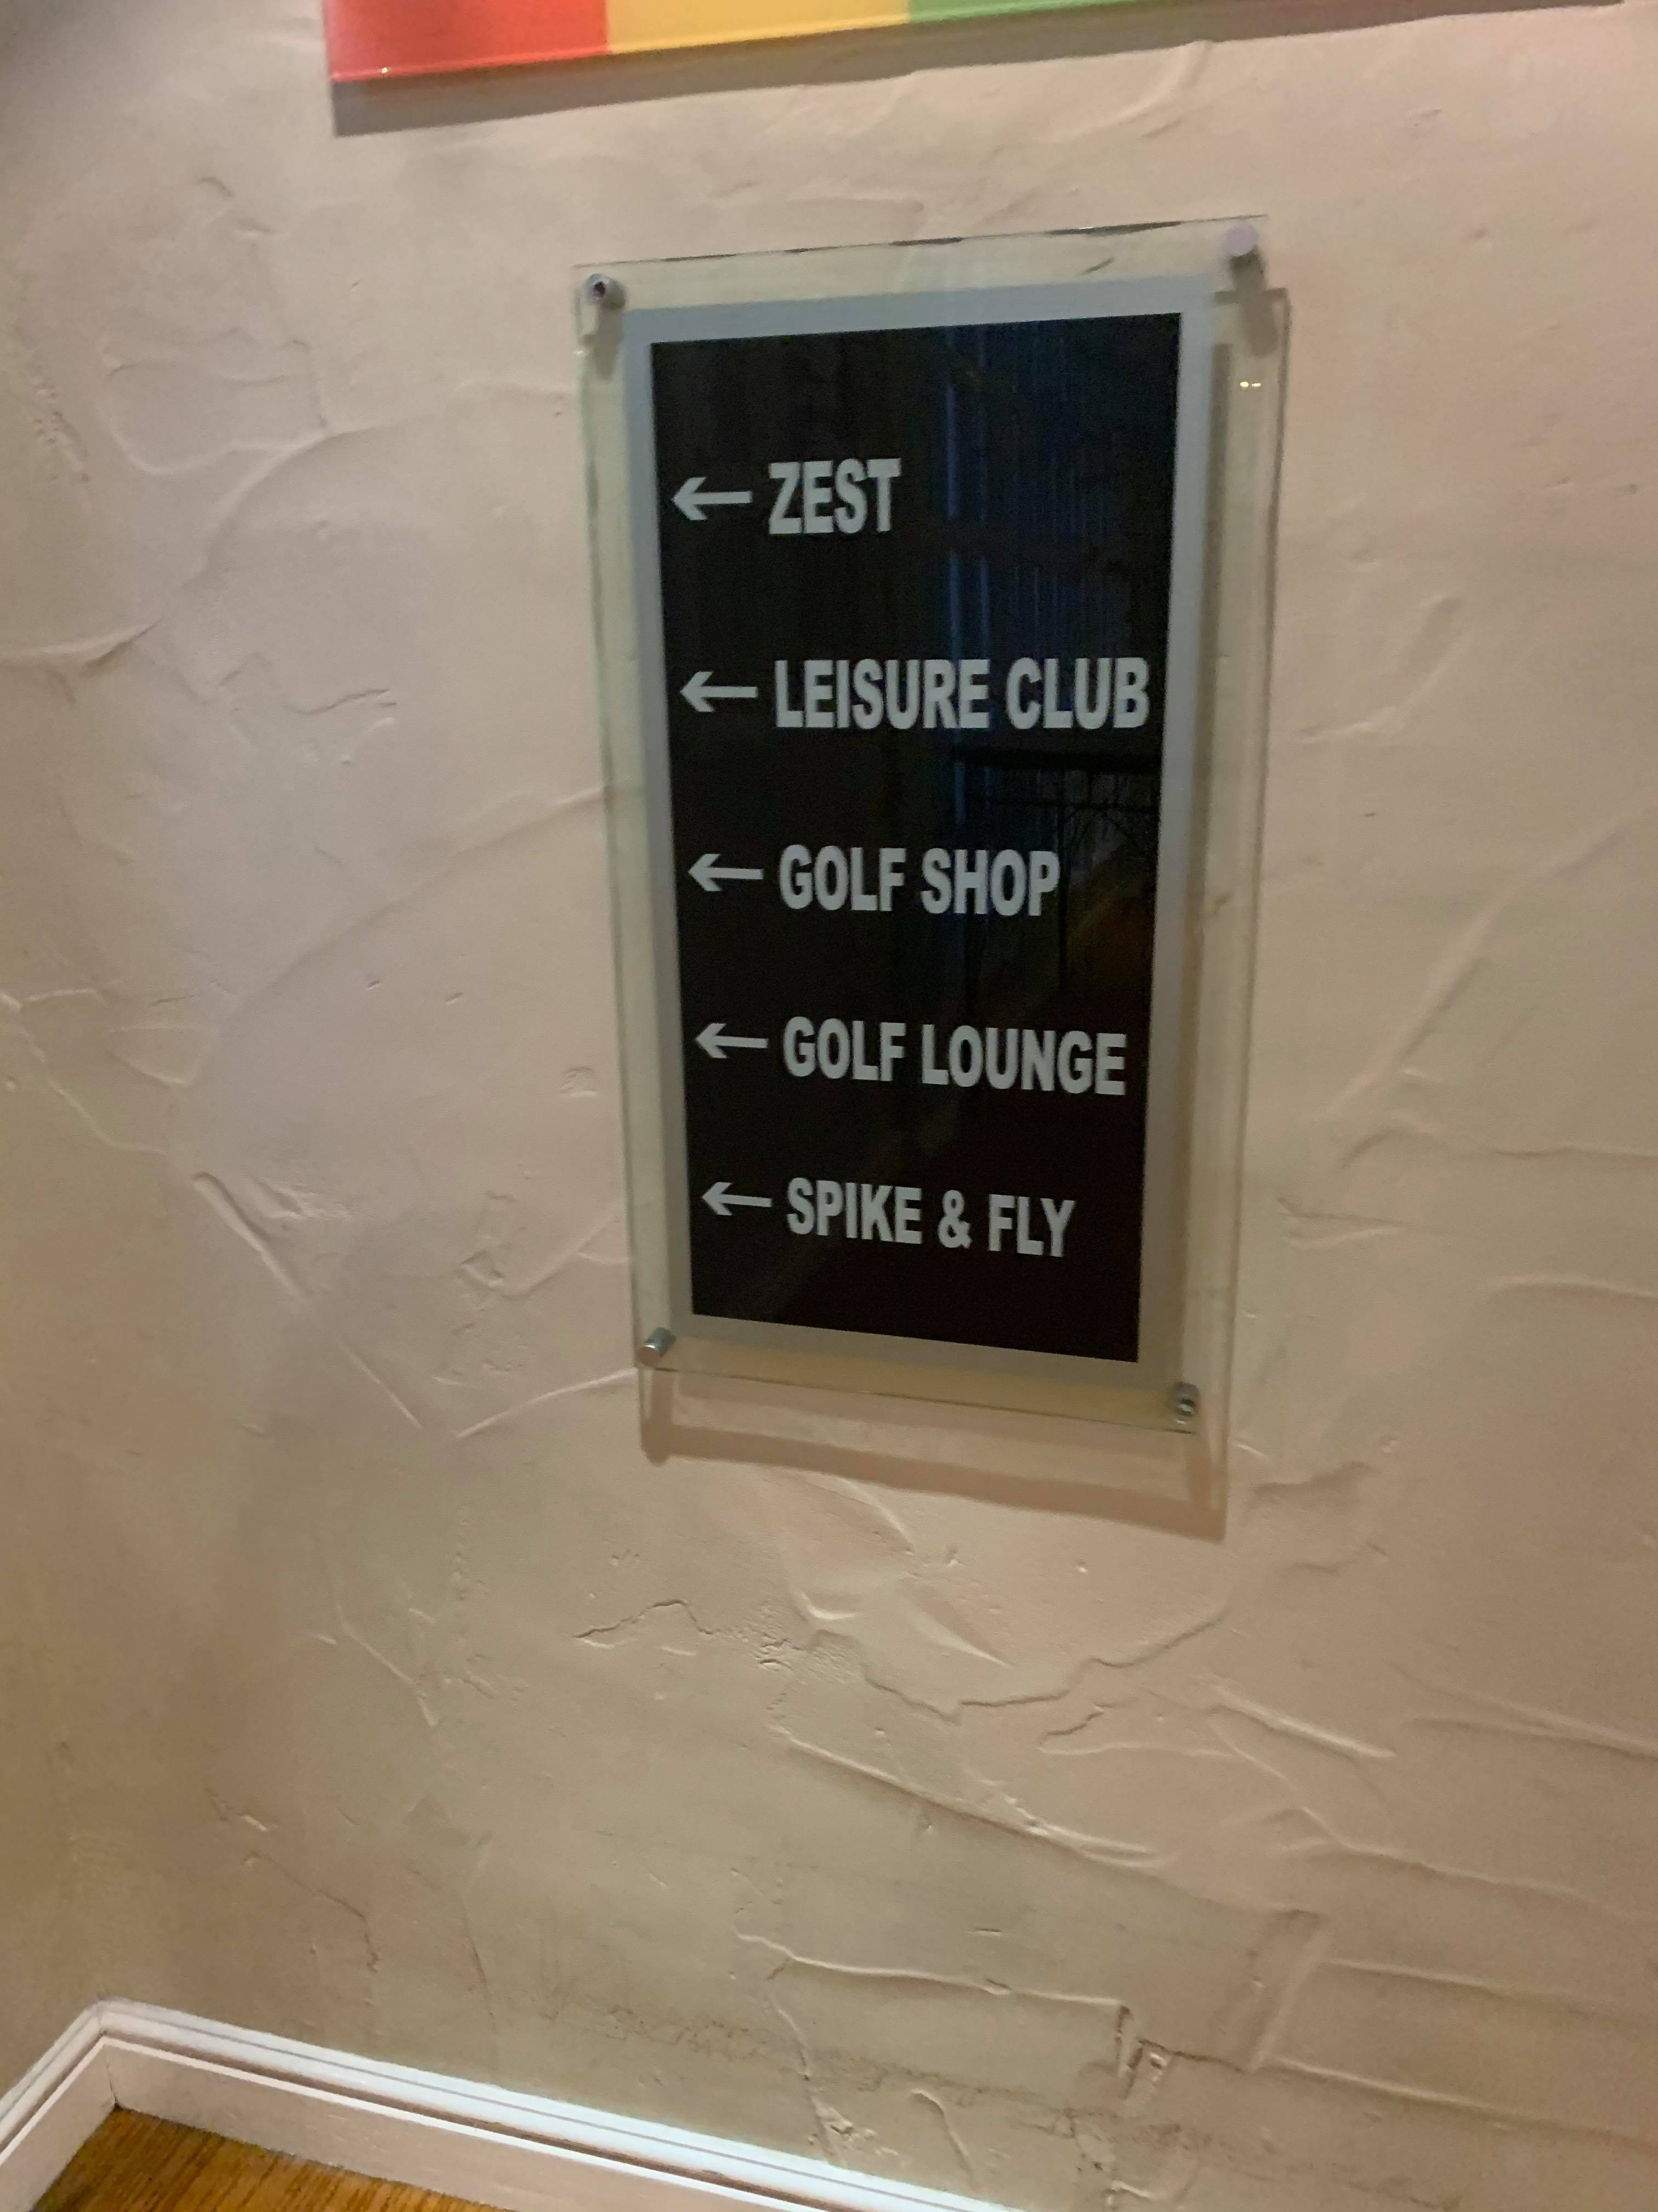
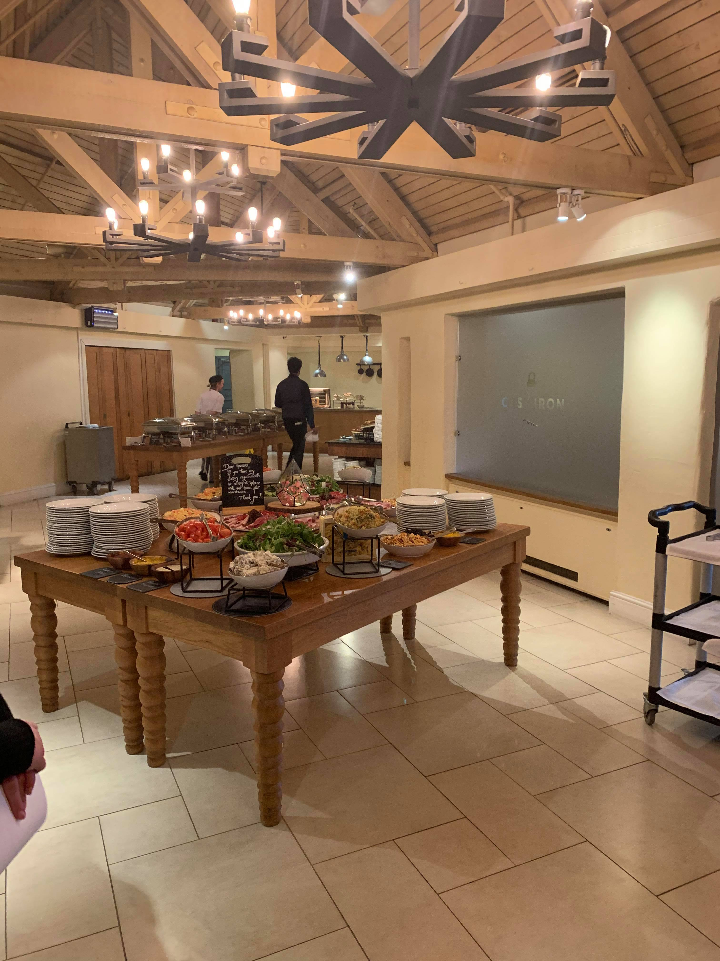
  Type of operations Marriott have
Housekeeping-
Marriott hotel operate their business along with different operations, housekeeping is one of the most essential operation that firm had.
Food and beverage-
It is the another operation that Marriott hotel have, it includes multitude of actions that engage workers right from buying raw material, presenting food, preparing F&B, maintaining service quality continuously, keeping inventory of things, managing different catered events and most essentially, examining business results to decided the future policies
Marketing-
It is the main and most important operations of Marriott hotel as it help to gain attention of new consumers and increase revenue of business rather than before
Notes:
Housekeeping-
It is an operational section in Marriott Forest of Arden which is accountable for maintenance, cleanliness and aesthetic upkeep of guest rooms. Housekeeping department efforts in providing a guest a desired room that direct bearing on its experience in hotel.
Food and beverage-
It is accountable for food costing and maintaining high quality of food services.
Marketing-
. It is wide term that collectively describes function of advertising firm, including process, people and technology that enables selling to operate effectively and to scale with consistency as well as quality.

Slide 5
History of Marriott forest of Arden
Forest of Arden Marriott hotel is appropriate setting for business travel, its conveniently located hotel in Birmingham, UK cater easy access to all modes of transportation providing navigation seamless for all travel preferences.
Forest of Arden is a set amidst trout lakes of Lord Aylesford's spread 10,000 acre estate at Packington park, designed by Donald steel and founded in 1970.
The beauty of nature around hotel location gain attention of consumers and drive them toward getting the opportunity to enjoy holidays with family & friends at that place.
Notes:
Forest of Arden Marriott hotel provide an memorable and unforgettable experiences to its consumers. With the excellent location in West Midlands, nestled between Coventry and Birmingham, firm is accessible by plane, car or train. The consumers are satisfied with the services of company, they feel happy and enjoy the journey while stay in hotel. It is located 6 KM to east of Birmingham international airport. The Marriott Forest of Arden is operated by Marriott hotel and resorts where it has two golf courses. Aylesford and Arden were designed by Donald steel, Arden is championship area.

Slide 6
  Food and Beverage operations
F&B is the main operations of Marriott forest of Arden, which play vital role as it help to prepare and provide foods according to the requirement of guest.
It includes different types of function such as purchasing, receiving, storing, issuing, preparing, presenting, serving and consuming.
Before executing and planning banquets and buffets, Food and beverage department consider varied factors like type of event, requirements of clients, menu, serving equipment and norms as well because it is very essential for business success within hospitality sector.
Notes:
F&B operation is related to service of food made in wide Kitchen area within hotel and drinks prepared in Bar to guest at F&B premises. Food and beverage servers are employed in Marriott hotel, the duties of workers work under this operation is to perform effectively behind counters to take orders of hotel guests. F&B department role is to prepare counters or tables for meals in hotel, stock service area with supplies, present menu, greet visitors and help them to chose menu items. Furthermore, the role of F&B is to sell food and beverage to guest of hotel accordant to their demands.

Slide 7
  Types of menu or products of Kitchen
Table d'Hote-
It is the another type of menu received in hotel which describes a menu similar to a Prix fix menu, but with more upscale turn of stages.
The first term refer to meals shared among guest and their hosts, who collected at individual table to enjoy same courses.
La carte menus-
In hospitality industry, this type of menu is an upscale term used in reference to menu that describe the list of food items with priced and ordered individually.
It gives people plenty of flexibility and also provide different options.

Slide 8
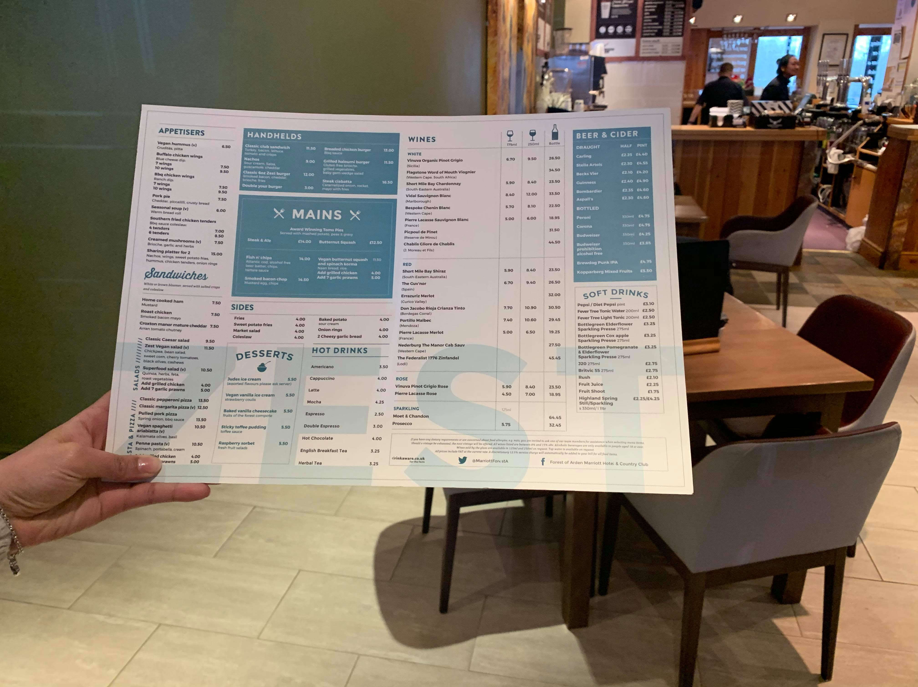
CONT…
Beverage menu-
Well known and reputed hotels such as Marriott offer different beer, cocktail and wine options to its guest, firm separate all of them into a distinct beverage menu.
Visitors who start with water can order drinks later when they have a beverage menu.
Dessert menu-
Standard menu have dessert section but because food servers take menu after entrées are ordered, people cannot be able refer to these sections after dinner.
That is why Marriott hotel offer separate desserts menus, that can be handed out after all its guests are finished eating or displayed right on dinner tables.

Slide 9
How Marriott hotel market
Marketing is the main function of business operations, marketing department of Marriott Forest of Arden create application where travel get all the information about its businesses and services that they offer to visitors.
It helps firm to create loyal consumers base, marketing team effectively prepare user generated content to gain attention of millennials or a million of consumers all around the world.
Social media marketing strategy of hotel allow them to draw attention of people, guest can see all the general information about Marriott services while using social media sites and platforms.
Marketing department creates M live, they command centre where social media professionals monitor presence of brand's on different channels. When hotel guest post about their personal experience when they are at Marriott hotel, M live system can do something special to make differences in that guest stay. For example, person might obtain a free pool side drink or group can set up an impromptu party in hotel lobby.
Marketing team give quick response to its guest and consider the trends before creating advertising plan or strategies.

Slide 10
  Health and hygiene and food & beverage services provided by Marriott
Marriott's forest of Arden focus on health and safety of its guest and workers as well, they provide clean and hygienic environment to guests that help to increase their experience level rather than before.
Before preparing food, production and food server wash each and every item to remove the germs or harmful partials over it because it is very essential to keep it health for consumers.
Notes:
Health and safety is vitally essential in hotel, personal hygiene practices will help to prevent germ from spreading to food. Food production staff always focus on personal hygiene, they wash hand and wear gloved while preparing food for hotel guest.
Marriott Forest of Arden food servers create compelling and locally relevant dining and drinking destinations as well as experiences that guest talk about.
Food production management encourage their professional chefs and Food & beverage associates to respond to international and local guest trends by inventing or innovating in taste, culture and design.

Slide 11
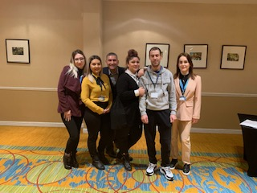
CONCLUSION
From above, analysis it has been concluded that Marriott Forest of Arden hotel provide range of food and beverage services to local and global consumers by focusing on their preferences and trends as well.
It has been summarized that Food and Beverage is the main operation of Marriott hotel along with the other one.

Slide 12
REFERENCES
Astawa, I.P., Astawa, I.P.M. and Susyarini, N.P.W.A., 2017. EFFICIENCY IN THE PURCHASE OF FOOD AND BEVERAGES IN OPERATION OF STAR HOTELS IN BALI. International Journal of Applied Sciences in Tourism and Events. 1(1). p.19.
Chopade, S.D. and Nighot, M.K., 2019. Smart Kitchen Management Using IOT Technology. International Journal of Advanced Research in Computer Engineering & Technology (IJARCET). 8(7).
Milroy, P., Wright, V.P. and Simms, M.J., 2019. Dryland continental mudstones: Deciphering environmental changes in problematic mudstones from the Upper Triassic (Carnian to Norian) Mercia Mudstone Group, south‐west Britain. Sedimentology. 66(7). pp.2557-2589.
Wijesaooriya, M.W.A.T.N., 2018. Role of the Rooms Division Operation in Hospitality Industry: Case study of Hotel “The Covanro”. 4th International Conference on Social Sciences 2018, Research Centre for Social Sciences, Faculty of Social Sciences, University of Kelaniya, Sri Lanka.

Slide 13


