Slide 1
Smart Taps
Business Plan

Slide 2
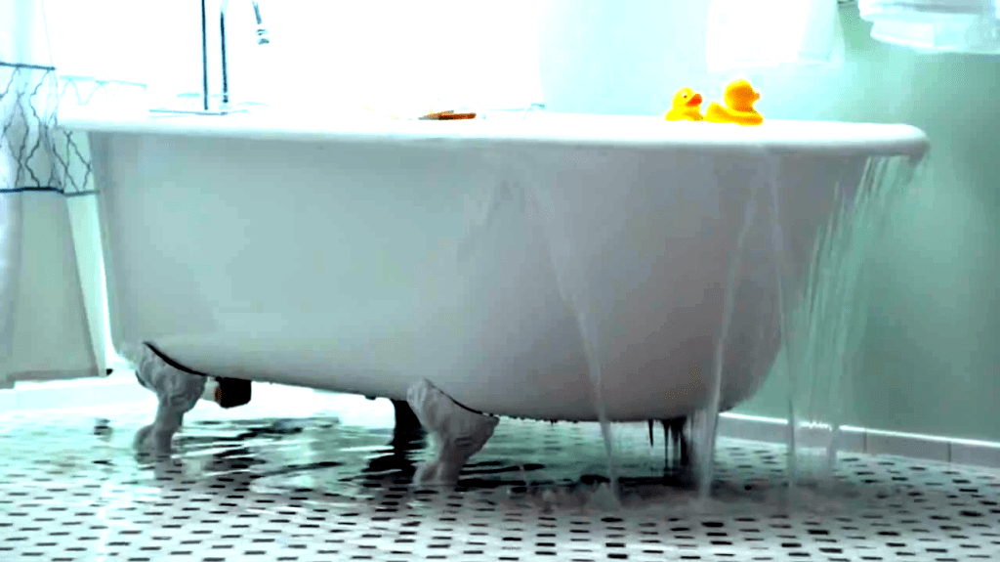
Introduction
Global Water Emergency: The world is facing significant environmental challenges, especially those related to water scarcity.
Accommodation budget risk: Hotels face significant financial risk due to water wastage when vacationers leave taps running.
Overlooked Aspects of the Water Board: Conventional installations cannot handle subsequent waste.

Slide 3

Active water storage: Unlike existing smart spigots, smart taps extend their impact past hand wash bowls to the toilet - water waste in particular
Previous Improvements: Smart Taps deals with built-in attention to maintenance, environmental considerations and good judgment.
BMJ Smart Tap

Slide 4
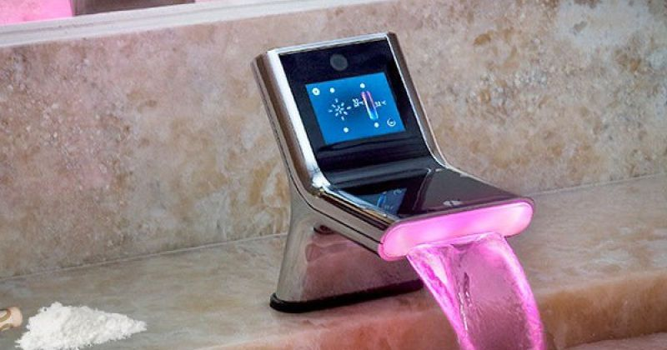
Description
Advanced Design: Smart Taps is an example of intelligent design, constantly blending evolution with convenience
Water conservation efficiency: Smart Taps target unintentional water wastage, an important issue in hotels and homes.
Enhancing Technology: At the core of Smart Taps is the innovative timing system, the success of the water board.

Slide 5

Flexiblity: Not at all like traditional smart faucet systems, smart faucets extend their functionality beyond hand wash bowls, making them a scalable and useful answer for homeowners
Easy-to-use interface and cash friendliness: Despite high-end features, smart faucets maintain the basic connection, allowing customers to control water consumption hassle-free.

Slide 6
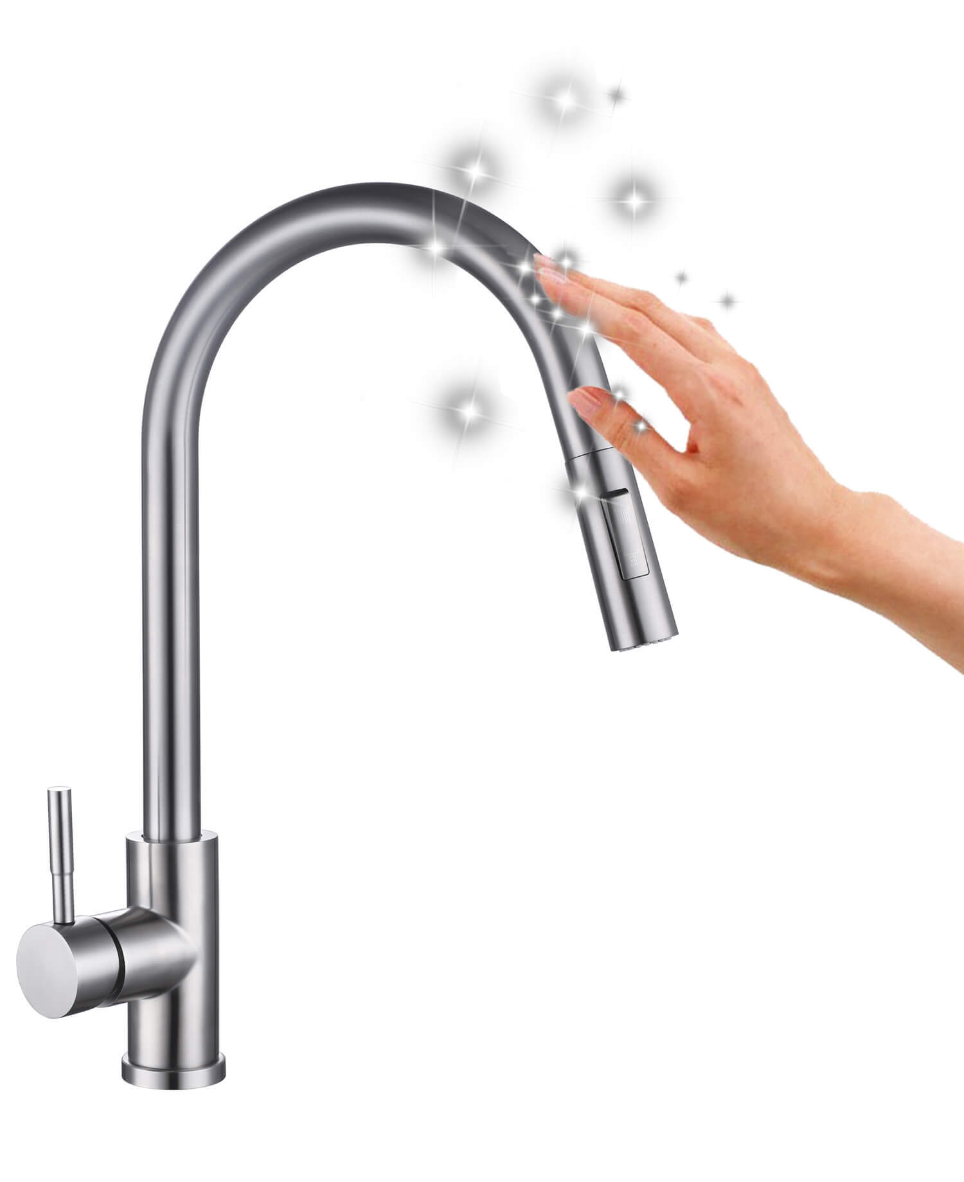
Scope
Transformation in Hotel: Smart Taps are having an unprecedented impact on the hotel industry by taking away the financial worries associated with non-stop running water when it rains
Customizable Features: Designed with customizable illusions, smart tubs can continuously integrate with bathroom and shower systems

Slide 7
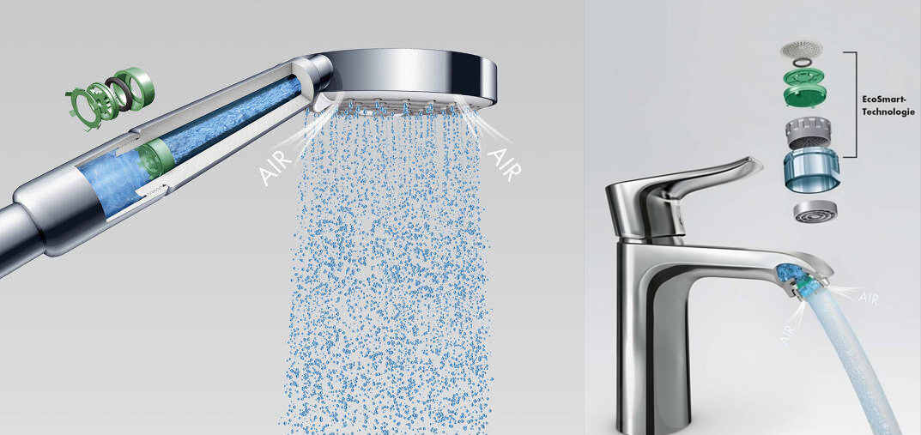
Residential Water Conservation: Smart faucets are expanding their impact past the commercial realms to address household waste.
Environmental Support Capacity: Thanks to past cost savings, the use of smart taps incorporates a more environmentally friendly future

Slide 8
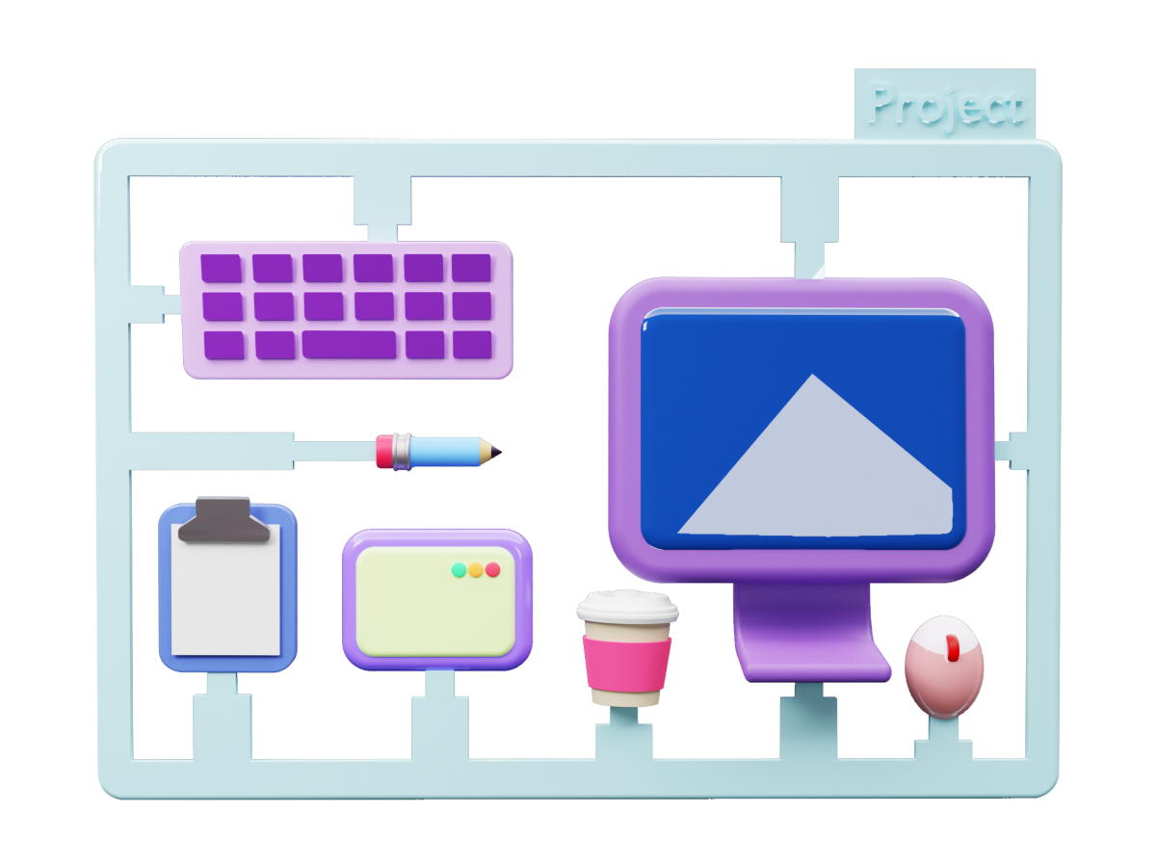
Work Breakdown Structure
Description and Outlook: List the project scope, objectives, and key organizations, assuring a strong start to project success
Analysis and analysis: Demonstrate careful analysis and analysis to capture project requirements, including complete project plans including timelines, resource allocations, and key equipment.
Team Development & Resource Management Coordinator: Mobilizes work teams, conducts activities, and provides necessary preparation and guidance, financial, and key resources.

Slide 9

Risk Assessment and Replication: Identify and analyze potential risks, critical areas of strength for board execution aiming to mitigate risk and improve project viability.
Accent on quality improvement: Enter the execution phase, promote project planning, monitor progress, and develop quality assurance and control techniques to execute the project plan.
Stakeholder Accountability, Evaluation, and Conclusion: Sketch with stakeholders, address concerns, and complete the project with documents, and reports.

Slide 10

Project Success Criteria
Goal Plan and Resource Satisfaction: Assure project goals and objectives are aligned and results are consistent with demonstrated scope.
Flexible handling and storage: Meet project time constraints and allocate resources for operations.
Potential Risk Managers: Identify, analyze, and classify all potential risks through the life of the project.

Slide 11

Strong team dynamics: Assembling and sustaining teams that actually work together to accomplish tasks.
Positive expectations and partner fulfillment: Create initial expectations and guarantee partner fulfillment through relentless growth and investment.

Slide 12
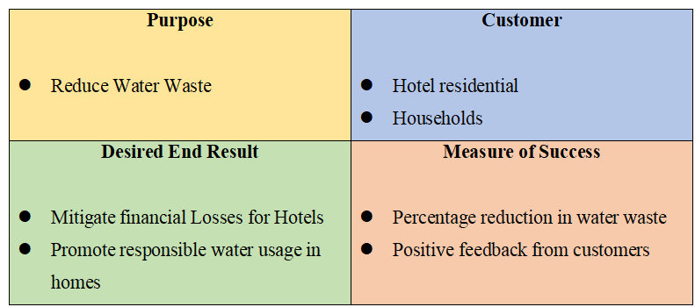
QUAD chart

Slide 13
Conclusion
Smart taps, through collaborative efforts and strategic resource allocation, are emerging as a promising answer for water conservation
The project demonstrates a comprehensive approach, which involves changing events, support, and strategic thinking, putting Smart Taps, a smart and responsive board system in the water.
The strategic allocation of human, financial, special and temporary resources adds to the efficiency of the business, reflecting a productive and coordinated operation

