Slide 1


The English Legal System
By Zita Draper

Slide 2


Content
Aims and learning objectives
The English Legal System.
Activities.
Kahoot
Summary
Thank you, any questions?

Slide 3

Aims and learning objectives
The aim of today's lesson is to recap the lecture content.
By the end of today's session students should be able to demonstrate that they understand the English Legal System.

Slide 4
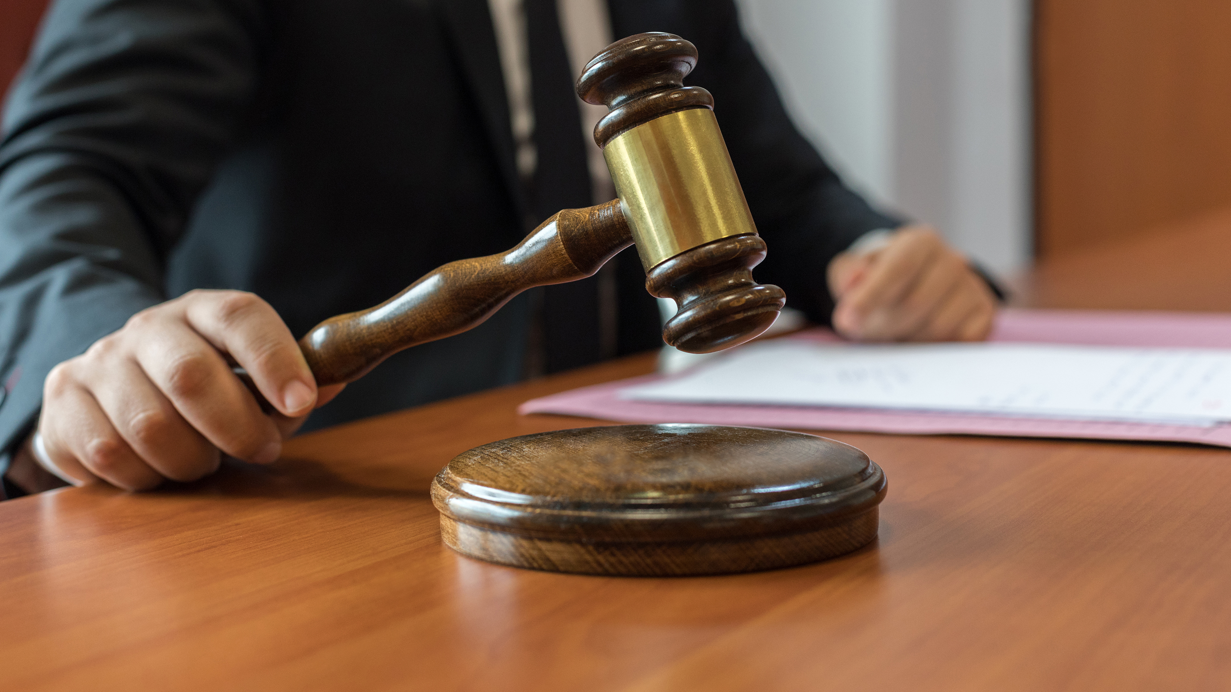
The English Legal system
Made up of a number of courts including;
The Magistrates
Crown
High court
Court of Appeal
Supreme court
And More.

Slide 5

Let's take a look
UK Law and Court - What are the different courts? | The 4 Criminal Courts explained - YouTube
We can separate out which courts hear which cases.

Slide 6

Criminal law courts
Must follow the criminal procedure rules in relation to conduct in the criminal court.
Most important is R1.1-
Which expresses the right to a fair trial and the right for the guilty party to be found guilty and the innocent party to be let free.

Slide 7
Where do we start?
Magistrates
Crown Court
Notes:
All criminal cases start in the magistrates and if needed will be passed to the crown court.
Which court depends on the severity of the case.

Slide 8
Severity of the offence
Summary
Less serious
Always magistrates
Either way offences
Intermediate
Can be heard in either court
Indictable
Serious
First Magistrates, then Crown Court
Notes:
Preliminary hearing in the magistrates for serious offences.

Slide 9
Magistrates
Every case starts here.
No jury
Three Magistrates - lay people- advised by a legal advisor
Or District Judge
What do they do?
Sentencing – 6 months for summary offence/ 12 months for 2 or more either way offences.
S.58 LASPO- unlimited fines.
Notes:
1. Preliminary hearings
2. Trials
3. Sentence offenders,
Can hear civil cases.

Slide 10

Activity 2
Watch the video “Coming to a magistrates’ court” at https://www.sentencingcouncil.org.uk/going-to-court/.
Can you list three individuals who will participate in a trial?

Slide 11

Youth Court
Youth Court - YouTube

Slide 12

Continued
Hears the cases of those who are between 10-17 years old.
However, if the case is serious, it will be sent to the crown court.
Placed within the magistrate's court and could be in a youth court room but most likely will be in an adult court room.
Less formal.
Sentencing includes elements such as rehabilitation, detention, training order ect.

Slide 13
Crown court
Hears serious and either way offences.
Includes a jury
Tier system – serious – high court judges / Less serious- circuit judges and recorders.
Crimes heard here include Murder, Manslaughter, rape, GBH, ABH, assault and battery.
If an appeal if needed they will come from the magistrate's court.
Sentencing.
Notes:
Unlimited fines.
Life imprisonment.
Life sentences; 14 years minimum before parole

Slide 14
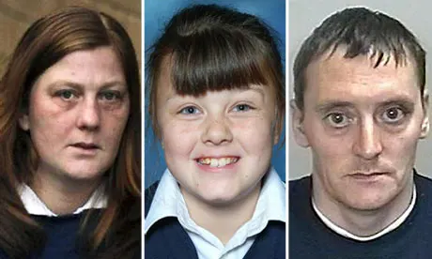
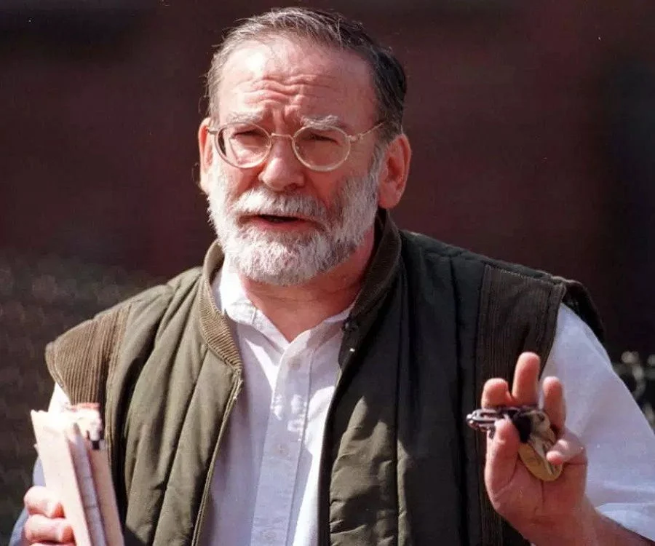
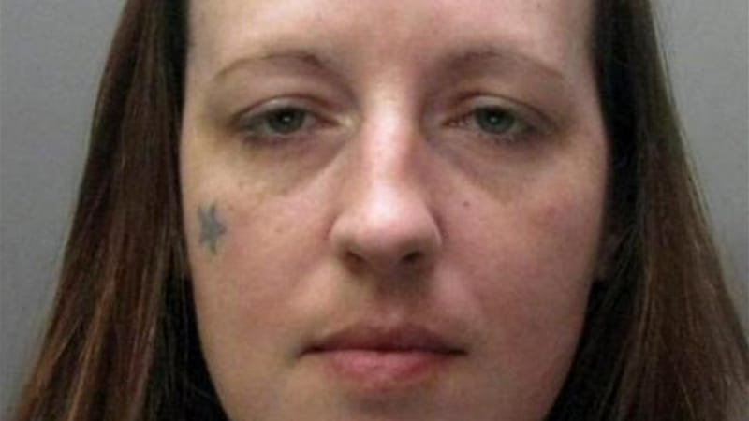
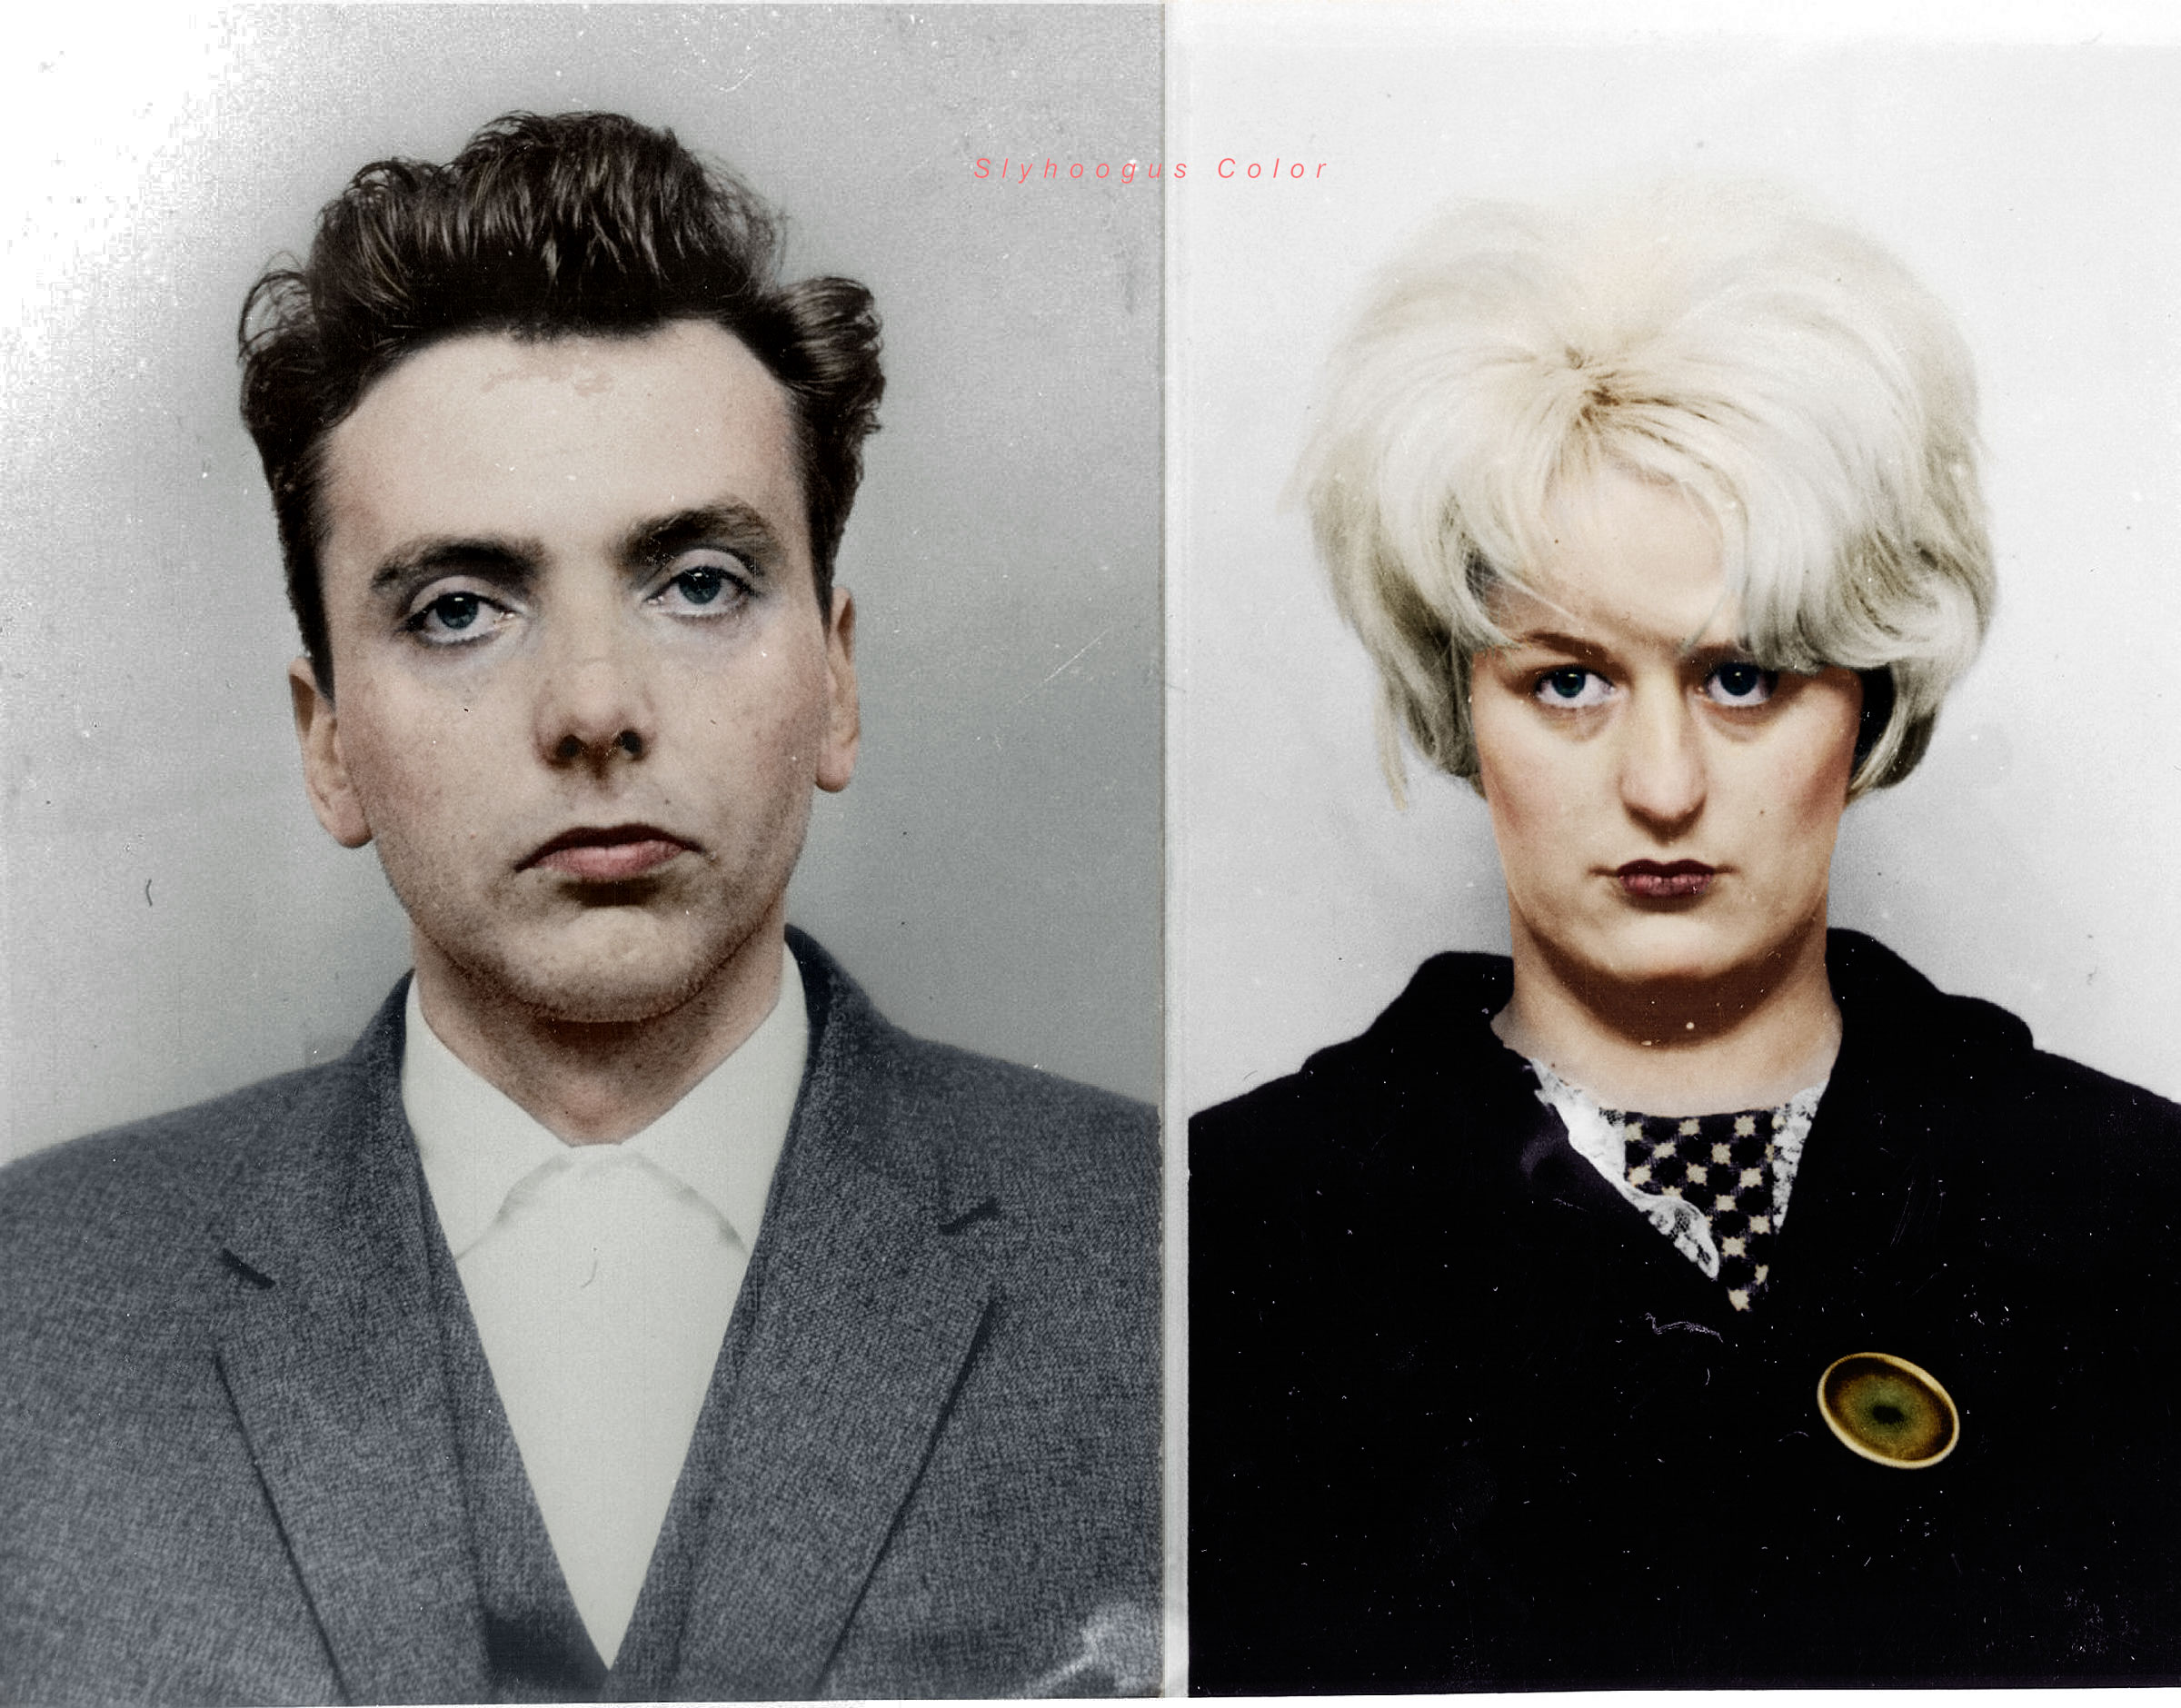
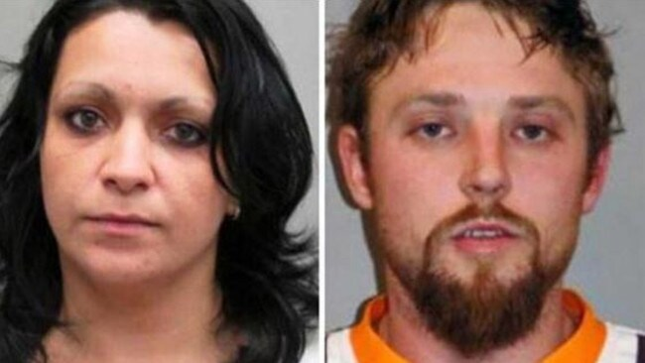
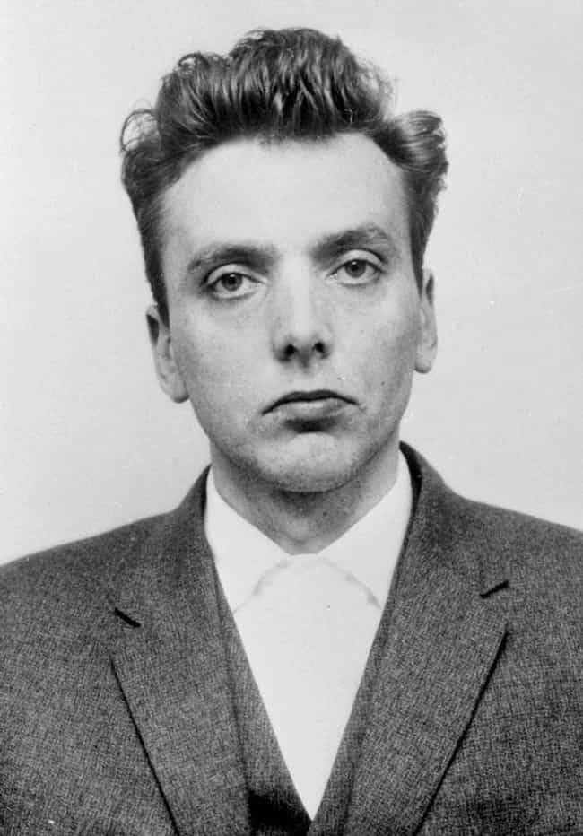
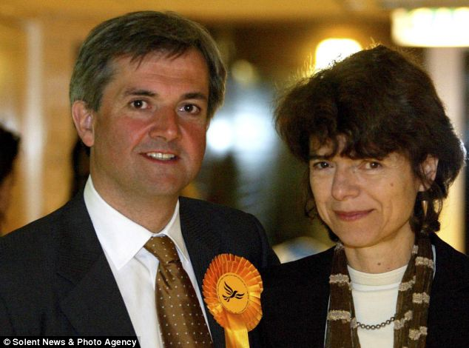

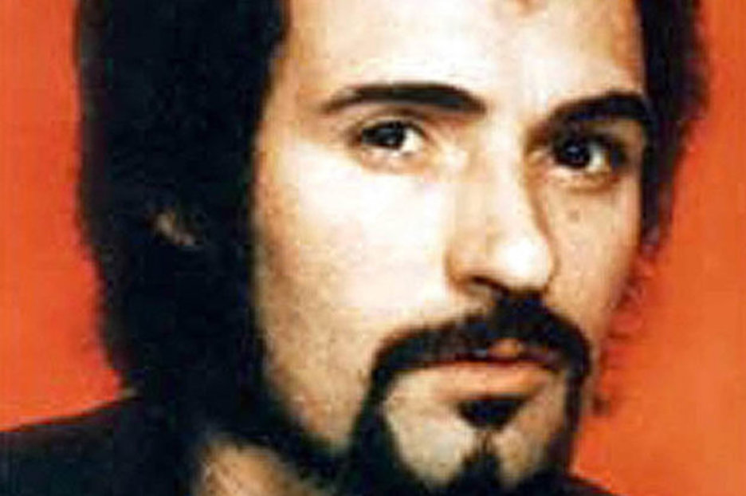
Notes:
Karen Matthews – 8 years – falsifying kidnap of her daughter
Harold Shipman- Whole life sentence
Ian Brady
Joana Denney – killed three men and attacked two.
Peter Sutcliffe-
Jeremy Mcconnell- Assault and criminal damage

Slide 15
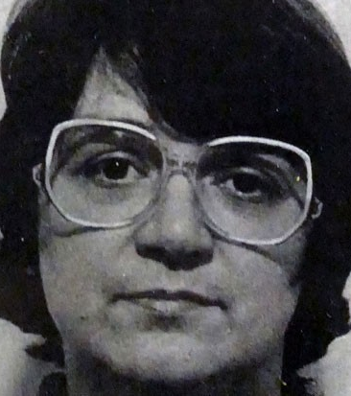
Whole life sentence
Rose west
Peter Moore
Met Police officer Wayne Couzens who murdered Sarah Everard sentenced to life behind bars| ITV News - YouTube
Notes:
Rose west – killed 9 young girls. Her and her Husband killed and tortured the children before disposing of their bodies.
Currently around 60 people serving life sentence.
Another example is wayne couzens – convicted of killing Sarah Everard.

Slide 16

Activity
Watch the Crown Court video at https://www.youtube.com/watch?v=tZYvv_s5R-s
What differences can you identify from the Magistrates’ Court?

Slide 17

Out of court
Warnings
Cautions
Conditional cautions
Penalty notice
Community Resolution

Slide 18
Appeals
Criminal -
Magistrates – Sentence- Crown court / Points of law – Divisional court of High Court.
Crown court- Court of Appeal.

Slide 19
Criminal case review
Deal with cases where the individual was wrongly accused.
Deals with miscarriages of justice.
Created by the Criminal Appeal Act 1995

Slide 20

Summary
Different courts for different crimes.
Criminal Courts.
Next week –
Civil Courts.
Tribunals.
Resolution.

Slide 21

Thank you!
Any Questions?

