Slide 1
M4X01656
Post Production 3

Slide 2
Expressionism versus Realism
So we have far looked at:
  Continuity Editing and Master Scene Technique
  Discontinuity in editing – Soviet montage, visual dissociation, elliptical montage, parallel action
Editing is not a binary choice between approaches

Slide 3
Expressionism versus Realism
Editing not simply about seamless or disruptive process
Can also consider editing as on a continuum of expressionism/realism
Purpose in editing not limited to ideas of narration
Notes:
Instead of considering editing from perspective of temporal narrative, of how it serves narration in a seamless way (master scene technique) or disrupts narration (by using discontinuity,

Slide 4
What is realism?
What is realism?
What is expressionism?

Slide 5
Expressionism versus Realism
To what extent does expressionism/realism affect the following:
  Length of shots
  Seamlessness of cuts
  Diegetic sound
  Non-diegetic sound
  Use of continuity and/or discontinuity

Slide 6
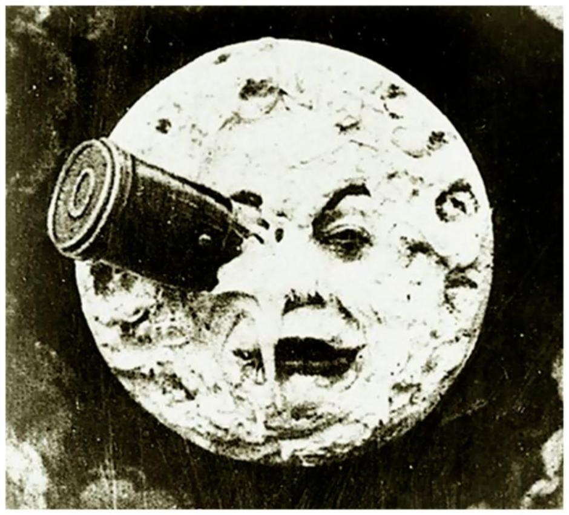
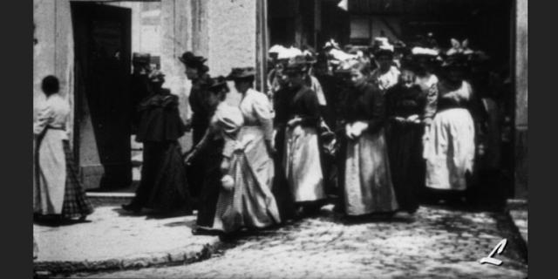
Expressionism versus Realism
Sortie d’usine (1895)
La Voyage dans la lune (1902)
Notes:
Georges Melies versus Auguste & Louis Lumieres
Melies (4-44 to 7-00)
https://www.youtube.com/watch?v=_FrdVdKlxUk
Lumieres (from 1-26)
https://www.youtube.com/watch?v=qvgPEiw_q04

Slide 7
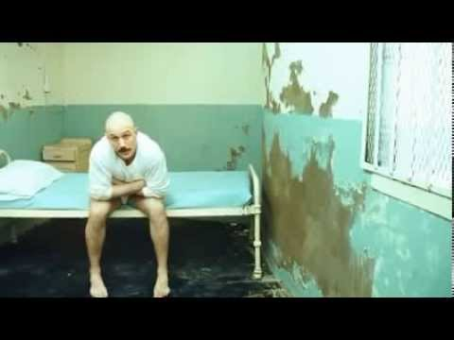
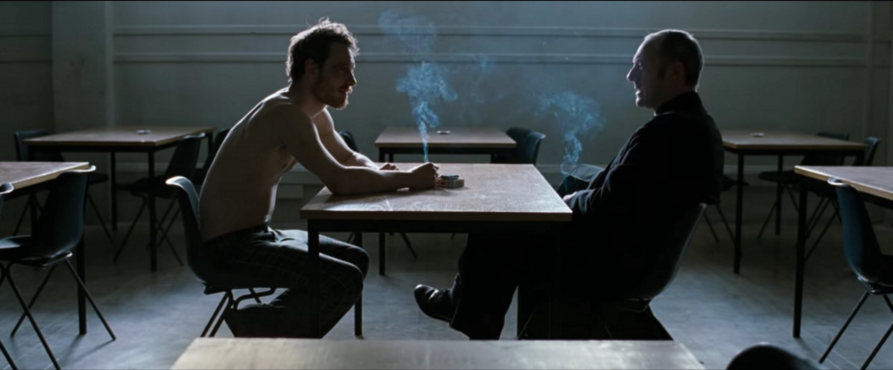
Expressionism versus Realism
Hunger (2007)
Bronson (2009)
Notes:
Hunger
https://www.youtube.com/watch?v=Bq0SETWIO8U
Bronson
https://www.youtube.com/watch?v=IZnd_uqbO7M

Slide 8
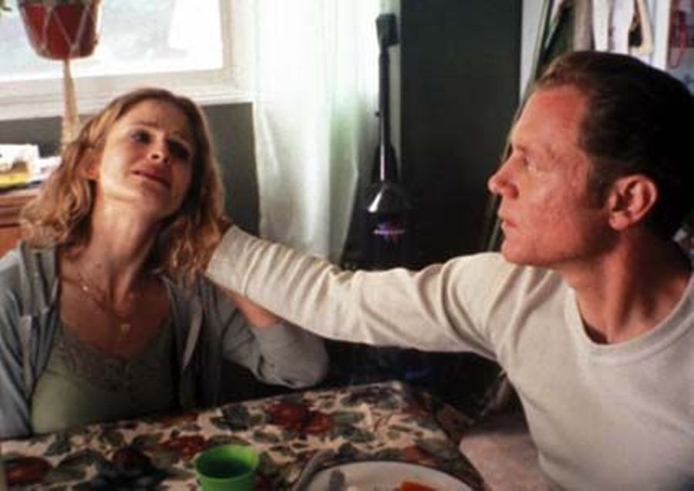
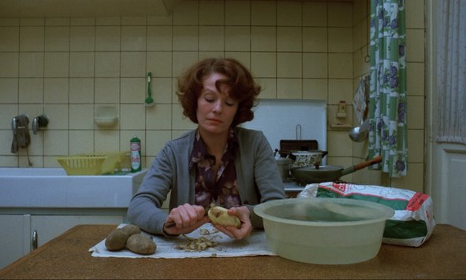
Expressionism versus Realism
Jeanne Dielman, 23 Quai Du Commerce, 1080 Bruxelles (1975)
Personal Velocity
(2002)
Notes:
Jeanne Dielman
https://www.youtube.com/watch?v=5C5Az-239uM
Personal Velocity

Slide 9
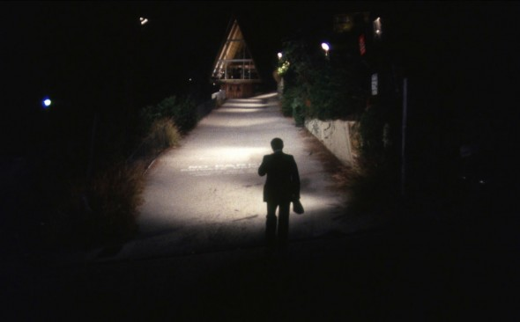
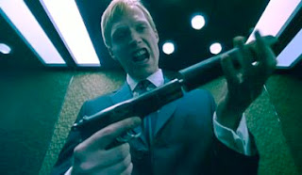
Expressionism versus Realism
The Killing Of A Chinese Bookie (1975)
Gangster No 1 (2000)
Notes:
Bookie
Chapter 12
Gangster No 1
Chapter 10 (from 57-00)

Slide 10
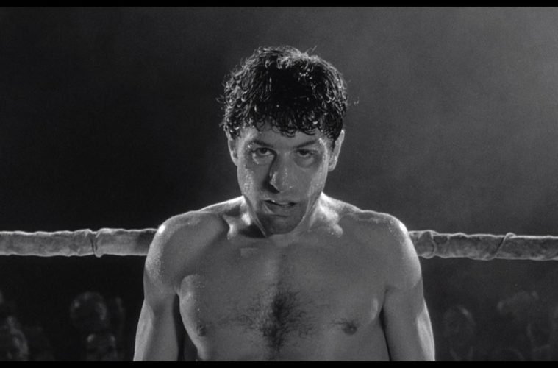
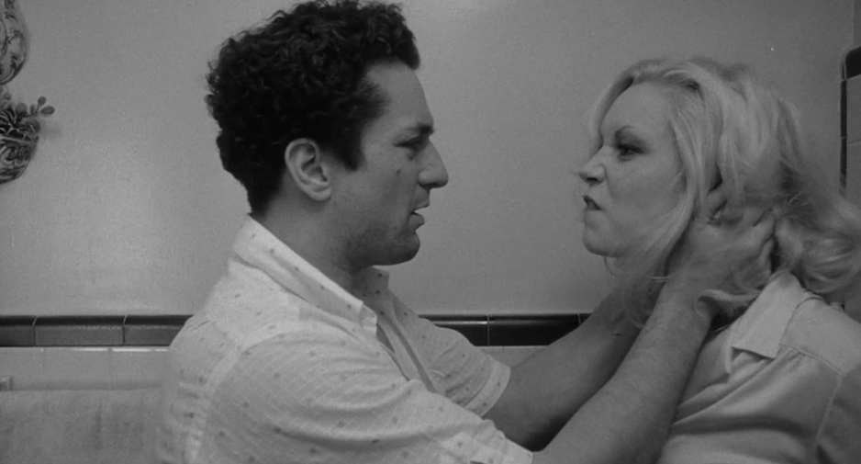
Raging Bull (1980)
Notes:
Jake versus wife & brother
https://www.youtube.com/watch?v=NOXp0ABEFC4
LaMotta versus Leonard
https://www.youtube.com/watch?v=t34MZ-Zub9c

Slide 11
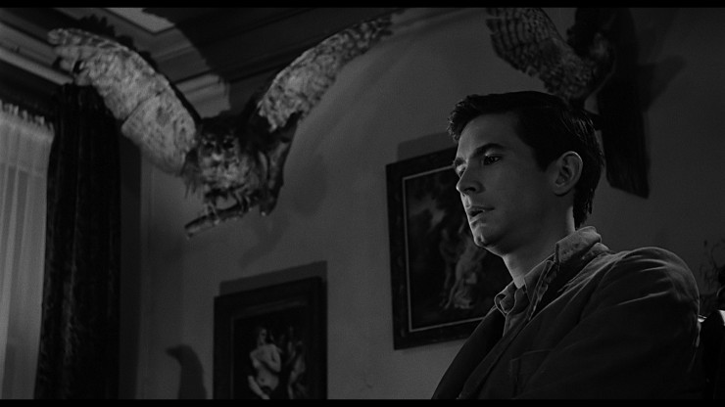
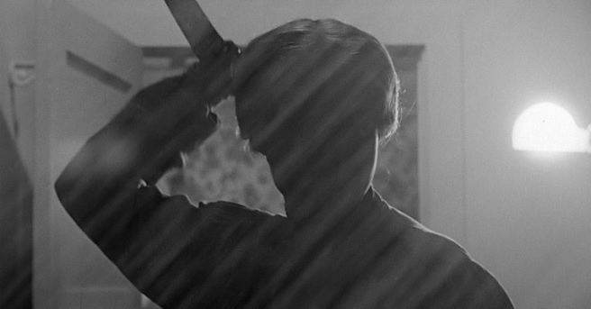
Psycho (1960)
Notes:
Bird scene
https://www.youtube.com/watch?v=I9mJ2oBONug
Shower scene
https://www.youtube.com/watch?v=0WtDmbr9xyY

Slide 12
Analysing expression and realism in editing
Select a scene that uses expression/realism or two scenes that contrast
Screencap each shot and note its duration
Use standard conventions for naming shots
Analyse why you think certain shots are used for certain moments
Analyse where key cuts are made
Analyse use of diegetic/non-diegetic sound
Assemble a short 1-2 minute video of screencaps, narration and annotation
Upload video and link via Trello

