Slide 1

Programme: MSc Public Health and Social Care in Practice
Module: Population Health and Digital Health Promotion
Module code: LCHS7009
Lecturer: Diola Bijlhout
Assignment Title: Component 3 Group Project Presentation
Student Name: Pokal Mitesh Bharatbhai
Student ID: 2528089

Slide 2
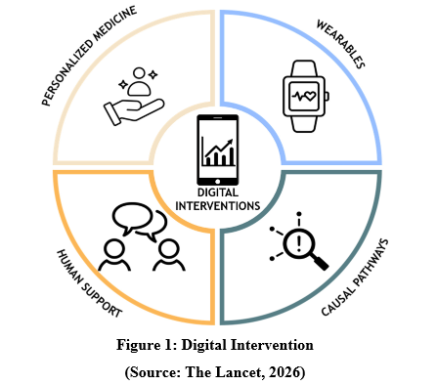
Introduction: Why Implementation Success Depends on More Than Technology
Successful implementation highly relies on the stakeholder collaboration, effective governance and organisational commitment beyond wearable technology adoption (Watson, 2024).
Digital intervention (Back Smart) will be effective by proper employee training, policy alignment and rapid organisational evaluation.
This section highlights operational barriers, key stakeholders and governance factors which lead to successful adoption of the Back Smart intervention within NHS settings.

Slide 3
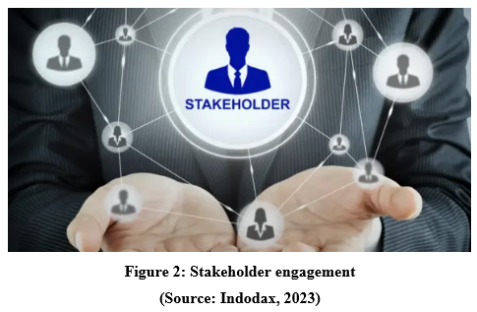
Key Stakeholders Supporting BackSmart Implementation
Healthcare staff predominantly use wearable devices to provide movement data while engaging with the personalised feedback to enhance musculoskeletal health behaviors (Jafleh, 2024).
Physiotherapists, occupational health teams and NHS leaders will coordinate implementation and promote workplace wellbeing initiatives.
IT specialist, HR and Health and Safety Executive will ensure secure and sustainable digital intervention delivery to back pain workers.

Slide 4
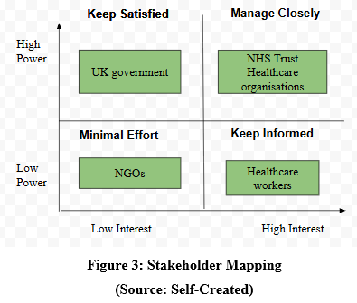
Stakeholder and Partnership Working
Keep satisfied
With high power and low interest, the UK government will facilitate BackSmart by developing national health policies and funding frameworks (Grover and Singh, 2019).
Manage closely
With high interest and high power, the NHS trust and healthcare organisations will help by providing organisational infrastructure and leadership support.
Minimal effort
NGOs will have low power and low interest, which will facilitate the intervention by increasing awareness among the target groups while collaborating with healthcare organisations and support through providing funding (Ebrahimi, Rajabi and Aryankhesal, 2024).
Keep informed
Healthcare workers will participate to check up their lower back through which they will ensure the effectiveness of BackSmart and meet their satisfaction rate.

Slide 5
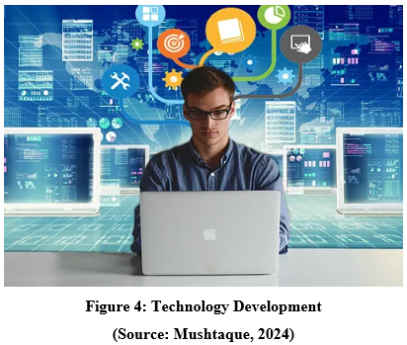
Stakeholder Roles and Responsibilities
Occupational health professionals will recognise the high-risk staff through the BackSmart by eliminating work-related musculoskeletal injuries effectively.
NHS managers will allocate resources, enhance organisational culture through providing proactive employee treatment (BackSmart wearable device) that enhances employee wellbeing.
Technology developers will ensure cyber security compliance to prevent patient data to the third party.

Slide 6
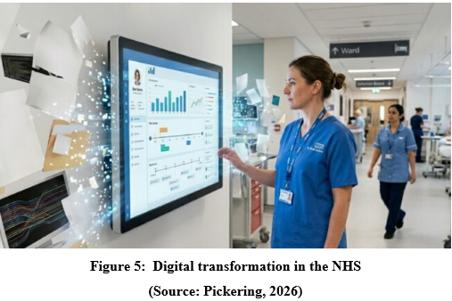
Organisational and Operational Barriers
To implement BackSmart wearable technology, the healthcare organisation faces workforce shortage, limited financial resources.
Resistance to technology adoption among the healthcare professionals will reduce intervention uptake without proper leadership training, support and organisational engagement strategies.
BackSmart technology and existing NHS digital systems will restrict efficient clinical decision-making processes and data sharing.

Slide 7
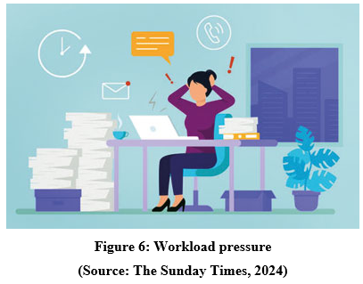
User and Workplace Barriers
Inconsistent wearable usage, limited digital literacy reduces intervention effectiveness across diverse healthcare professionals.
Workplace surveillance, privacy and continuous tracking might discourage staff participation despite potential health and wellbeing benefits.
Workload pressures and physical discomfort wearing devices will negatively reduce long term adherence and sustained behavioral change.

Slide 8
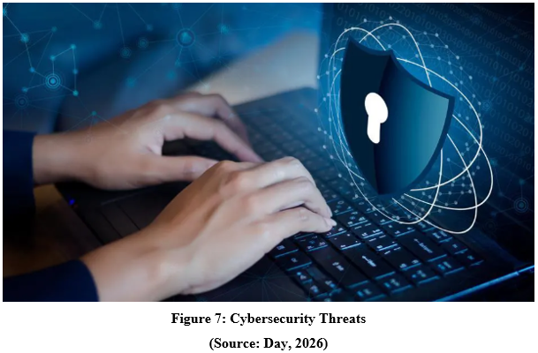
Technical Barriers
BackSmart wearable sensors will generate inaccurate movement as calibration errors, device malfunction and inconsistent usage which eliminates measurement accuracy and reliability (Zhang et al., 2025).
Wearable devices like BackSmart and NHS electronic health records will restrict seamless data sharing and coordination occupational health management.
Software failures, cybersecurity threats and algorithms limitation needs rapid system tracking to maintain secure and reliable digital healthcare delivery (Bala et al., 2024).

Slide 9
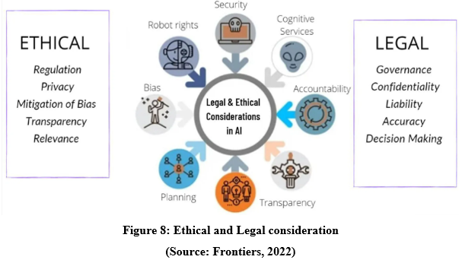
Legal and Ethical aspect
This new venture will incorporate the GDPR policy and Data protection Act 2018 which will ensure lawful processing, protection of staff health information (Di Fede et al., 2018).
Confidentiality, informed consent and transparent data governance are essential for maintaining staff trust and protecting workplace privacy throughout the implementation.
Employees should balance workplace health monitoring with staff autonomy that will ensure wearable technological support without developing unnecessary surveillance concerns.

Slide 10

Strategies to Overcome Implementation Barriers
Comprehensive digital literacy programmes, employee training and leadership engagement enhance technology acceptance and encourage participation across healthcare workers.
Transparent communication, continuous software updates and strong cybersecurity strengthen staff confidence while protecting sensitive occupational health information effectively (Abrahams et al., 2024).
Continuous stakeholder feedback, ongoing evaluation enables timely improvement and eliminates risks while supporting long term intervention sustainability.

Slide 11
Overcoming Barriers and Key Takeaways
Successful BackSmart implementation needs multidisciplinary collaboration, effective governance and organisational commitment that support healthcare organisations’ health promotion and back injury prevention.
Technical, legal and ethical challenges reduce employee confidence and enhance their stress level and deliver heavy work loads.
This presentation will highlight intervention benefits and discuss implications for healthcare policy, professional education and future research within the UK.

Slide 12
References
Day, B., (2026), What Are The Most Common Cyber Security Threats?, Forbes,Available at:https://www.forbes.com/advisor/business/common-cyber-security-threats/
Watson, J.M., (2024). Healthcare Technology Adoption: A Social-Organisational Perspective. University of Canterbury. Available at:https://ir.canterbury.ac.nz/server/api/core/bitstreams/a5d51a58-eff7-4e30-ad62-f530fdb6a768/content
Jafleh, E.A., Alnaqbi, F.A., Almaeeni, H.A., Faqeeh, S., Alzaabi, M.A., Al Zaman, K., Alnaqbi, F., Almaeeni, H. and Alzaabi, M., (2024). The role of wearable devices in chronic disease monitoring and patient care: a comprehensive review. Cureus, 16(9). Available at:https://assets.cureus.com/uploads/review_article/pdf/290934/20241008-794732-v1hocu.pdf
Zhang, Y., Fu, X. and Wu, Z., (2025). A Case Study of Big Data and Artificial Intelligence in Physical Education. Journal of Cases on Information Technology (JCIT), 27(1), pp.1-20.Available at:https://www.igi-global.com/gateway/article/full-text-pdf/386841&riu=true
Bala, I., Pindoo, I., Mijwil, M.M., Abotaleb, M. and Yundong, W., (2024). Ensuring security and privacy in healthcare systems: a review exploring challenges, solutions, future trends, and the practical applications of artificial intelligence. Jordan Medical Journal, 58(3), pp.201-223. Available at:https://www.researchgate.net/profile/Mostafa-Abotaleb-2/publication/382254421_Ensuring_Security_and_Privacy_in_Healthcare_Systems_A_Review_Exploring_Challenges_Solutions_Future_Trends_and_the_Practical_Applications_of_Artificial_Intelligence/links/6694f056b15ba55907582c90/Ensuring-Security-and-Privacy-in-Healthcare-Systems-A-Review-Exploring-Challenges-Solutions-Future-Trends-and-the-Practical-Applications-of-Artificial-Intelligence.pdf
Di Fede, O., La Mantia, G., Cimino, M.G. and Campisi, G., (2023). Protection of patient data in digital Oral and general health care: A scoping review with respect to the current regulations. Oral, 3(2), pp.155-165. Available at:https://www.mdpi.com/2673-6373/3/2/14
Abrahams, T.O., Farayola, O.A., Kaggwa, S., Uwaoma, P.U., Hassan, A.O. and Dawodu, S.O., (2024). Cybersecurity awareness and education programs: a review of employee engagement and accountability. Computer Science & IT Research Journal, 5(1), pp.100-119. Available at:https://www.academia.edu/download/117505233/896.pdf
The Lancet, (2026), Digital mental health interventions: an opportunity to enhance care while preserving human connection, Available at:https://www.thelancet.com/journals/lanam/article/PIIS2667-193X%2824%2900267-9/fulltext
Indodax, (2023), What is a Stakeholder? Types, Functions & Roles, Available at:https://indodax.com/academy/en/stakeholder-definition/
Mushtaque, (2024), What is Computer Science Technology and The importance of Computers In the World, Available at:https://medium.com/@Mushtaque1503/what-is-computer-science-and-important-of-computer-science-technology-f2a1fb2794eb
Pickering, J., (2026), Why digital transformation in the NHS is more than going paperless, Available at:https://www.techfinitive.com/opinions/why-digital-transformation-in-the-nhs-is-more-than-going-paperless/
The Sunday Times, (2024), Managing Workload Stress: Strategies For Coping And Thriving, Available at:https://www.sundaytimes.lk/240728/education/managing-workload-stress-strategies-for-coping-and-thriving-565153.html
Frontiers, (2022), Legal and Ethical Consideration in Artificial Intelligence in Healthcare: Who Takes Responsibility?, Available at:https://www.frontiersin.org/journals/surgery/articles/10.3389/fsurg.2022.862322/full
Garcia, I., (2026), Transparency in communication: the key to good leadership, Sesame,Available at:https://www.sesamehr.com/blog/internal-communication/transparency-in-communication-the-key-to-good-leadership/

