Slide 1
The core principles of coaching & their challenges
EMPL6005

Slide 2
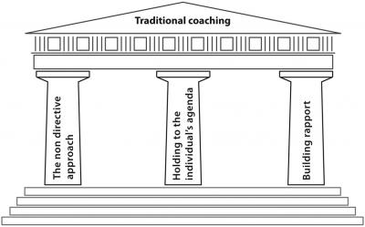
Notes:
THE NON DIRECTIVE APPROACH
Is the non directive approach the only way eg just letting the coachee respond to questioning by the coach
Is it OK to direct if the coachee get stuck and is not thinking deeper. Should more directive questions be used to kick start their thinking?
The coachee may have the ideas but not the confidence to voice them
HOLIDING TO THE INDIVIDUALS’S AGENDA
Just sticking to the coachee agenda might let them avoid issues, focus on irrelevancies or self obsession and avoid uncomfortable issues (ZOUD zone of uncomfortable debate).
Does this avoid the need of the sponsoring organisation?
Should it be linked to the organisations goal – specially if they are paying for it?
Building rapport
Does this limit the coach if they cannot entre the ZOUD ?
Does this ignore what might be the elephant in the room if the coach does not push the coachee because of concerns of not developing the rapport?

Slide 3
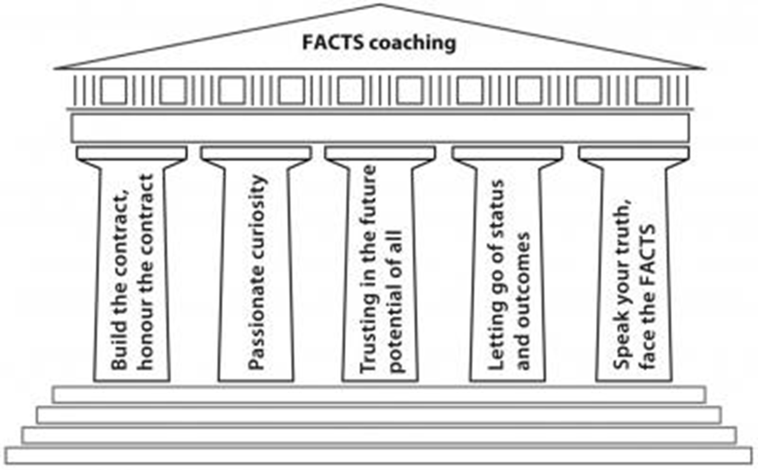
Build the contract, honour the contract
Passionate curiosity
Trust in the future potential of all
Letting go of status and outcomes
Speak your truth, face the facts

Slide 4
Build the contract, honour the contract
Coaching contracts need to be specific if they are to be honoured and include:
  No. of sessions & their duration
  Cancellation arrangements
  Ethical standards
  Confidentiality
  Boundaries
  Arrangements for ending and evaluation
  Make coaching agreements like covenants

Slide 5
Passionate curiosity
Passionate people care and curious people are interested and want to find out more
A passionately curious coach will ask and listen to understand

Slide 6
Trust in the future potential of all
Believe in the coachee's greatness
The role of a coach is to see potential where no one else sees it

Slide 7
Letting go of status and outcomes
The coach is in service of the coachee and sponsoring organisation
The coach must let go of power and status
Effective coaches do not need to know the answer

Slide 8
Speak your truth, face the facts
Speaking our truth and facing the facts will represent a key enabler
Give the coachee permission to practice direct and honest communication.

Slide 9
Reference
Blakey, J and Day, I. (2012). The core principle of Challenging Coaching- [online] Trainingzone.co.uk. Available from: http://www.trainingzone.co.uk/topic/coaching/core-principles-challenging-coaching-pt2/175349. [Accessed 1 March 2015]

