Slide 1
Lawns Consultation Service
Benefits of teamworking Student Number
Loraine Barrett 1808220
Team Roles
Sophia A Walcott 1808224
Stages of Team Development
Natasha Jones 1810156
Successful Team Development
Wesley Regis 1713352
Managing Conflicts
Adrian Joseph 1810220

Slide 2
Effective Team Working and Communication
Lorraine Barrett
BMSK4002
Student Number 1808220
12th May

Slide 3
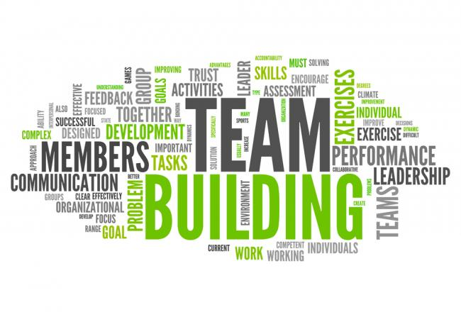

Slide 4
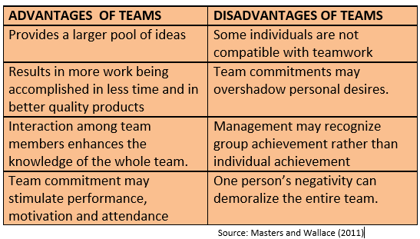

Slide 5
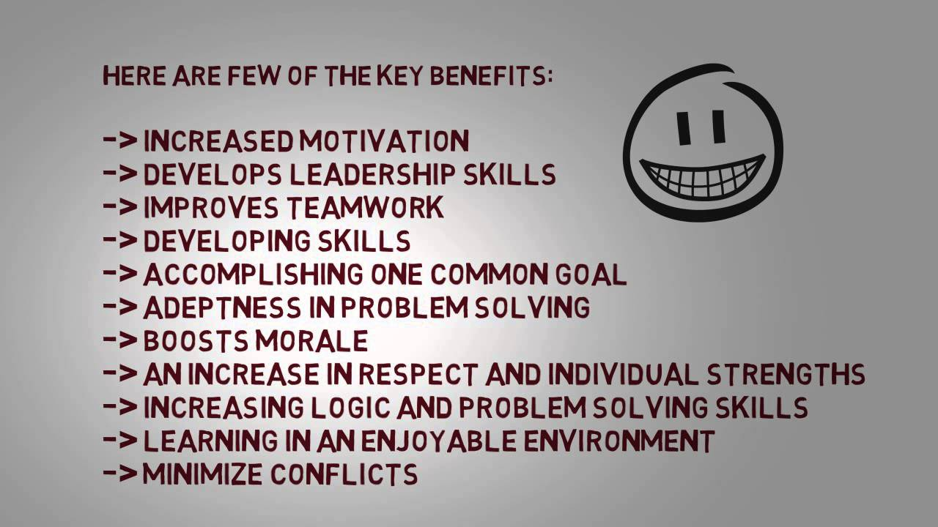

Slide 6
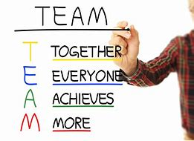

Slide 7
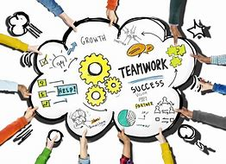

Slide 8
The difference between work groups and teams (Brounstein)
Individual accountability Come together to share information Focus on individual goals Produce individual work products Define individual roles, responsibilities and tasks Concern for personal outcomes and challenges | Individual and mutual accountability Frequently come together to problem solve, make decisions and plan Focus on team goals Produce collective work products Define individual roles, responsibilities and tasks to help the team achieve their goals; often sharing and rotating Concern for outcomes of the team, and the challenges the team faces

Slide 9
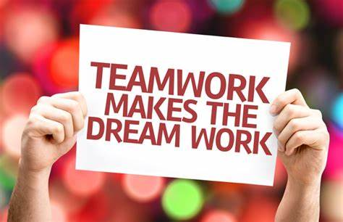

Slide 10
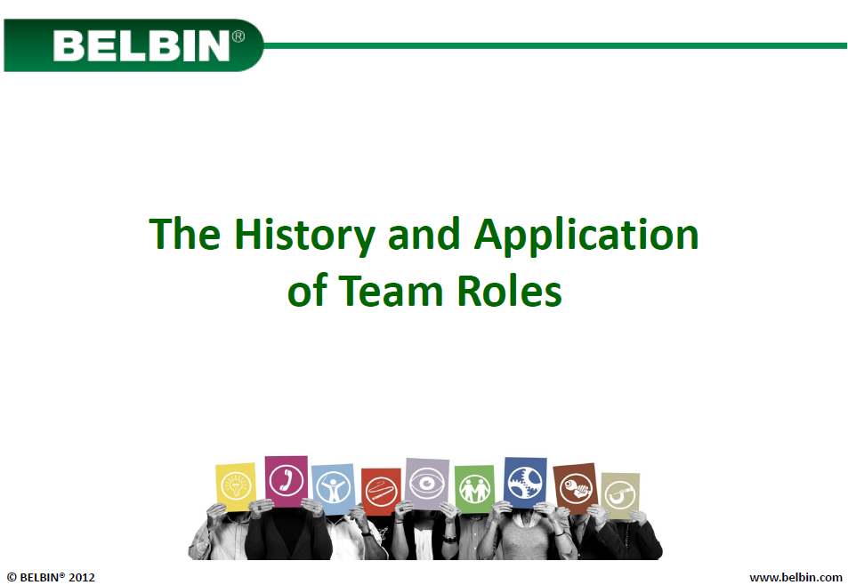
SOPHIA A-WALCOTT STUDENT NO:1808224

Slide 11
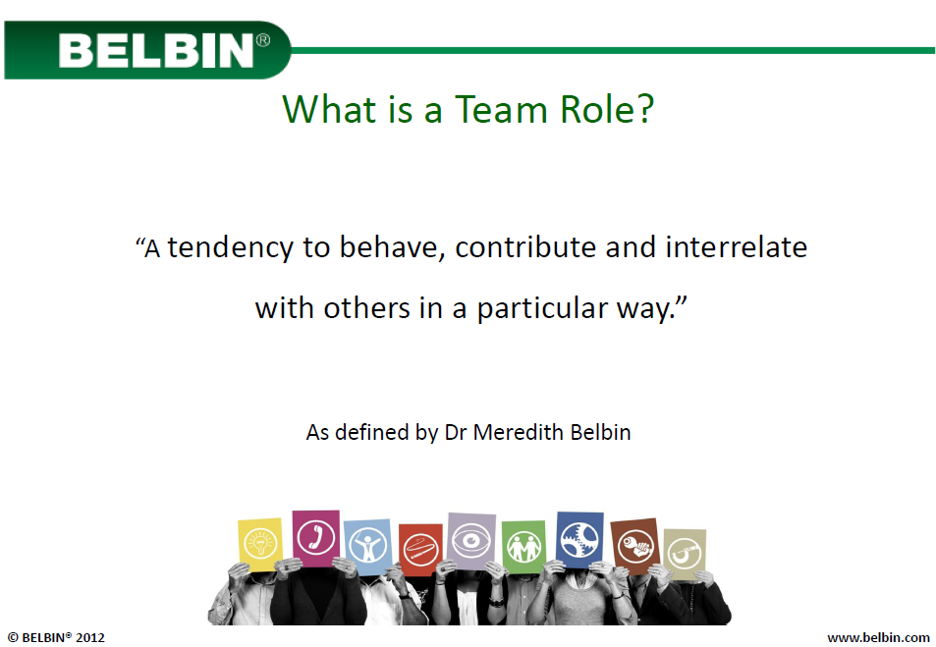

Slide 12
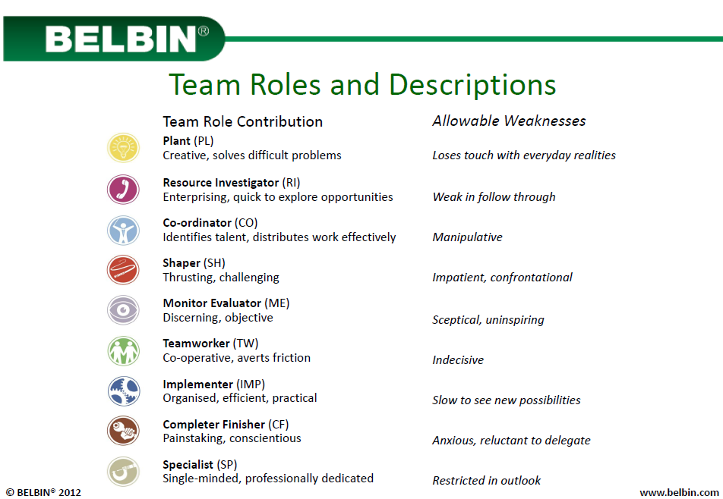

Slide 13
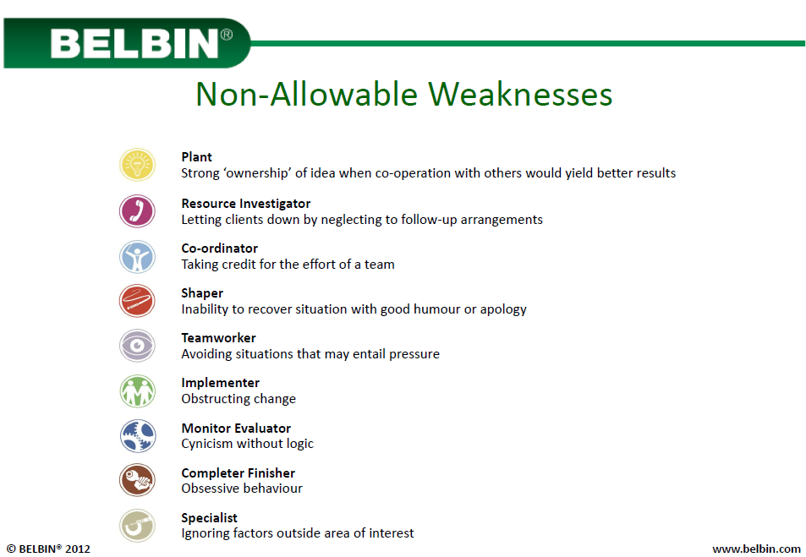

Slide 14

Successful team development
This Photo by Unknown Author is licensed under CC BY

Slide 15
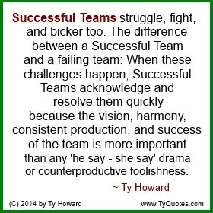

Slide 16
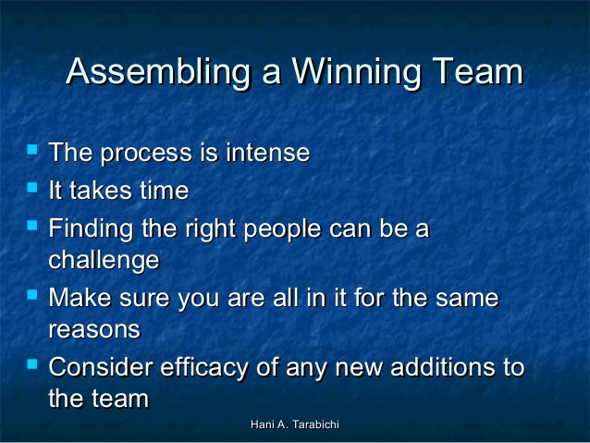

Slide 17
Conflict Management
WHAT IT IS - And How To Manage it

Slide 18
(10)
When conflict arises, embrace it
Don't run away from it. Conflict is an opportunity for growth. You will learn a lot about your team and about yourself through the process of solving the conflict. You have the power to turn a negative experience in a learning experience both for your team and yourself.

Slide 19
The following section discusses five of the most common factors that lead to conflict situations within organiSations.
1) Misunderstandings. Conflict can arise from misunderstandings about:
2) Poor communication. ...
3) Lack of planning. ...
4) Poor staff selection. ...
5) Frustration, stress and burnout.

Slide 20


