Slide 1

You Said We Did
Closing the Feedback Loop

Slide 2
Thank you
62 responses
Almost evenly split across all 3-year groups

Slide 3
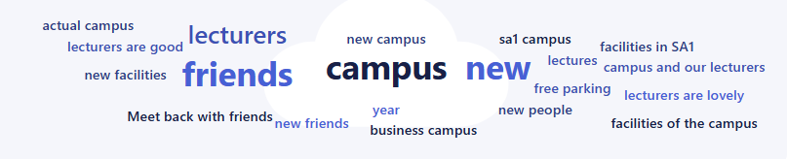
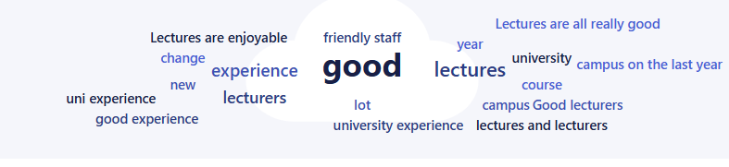
Positive Comments

Slide 4
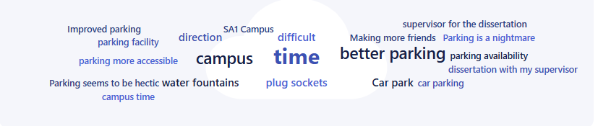
Improvement suggestions

Slide 5



Responses to the Feedback
What we can’t change for now
Working towards change
What we have changed
Issue: State of the Car Park
Car park improvements are in place. More information coming soon
ISSUE: Water fountains
There are water fountains on every floor in IQ, while some maybe old, no plans to change them just yet
Issue: food expensive in the cafes
Highlighted the 10% Students discount and the Meal Deals available at all UWTSD Cafes
Issue: More Meal options in the cafes
The space and capacity of the SA1 cafes are being reviewed. However, there are attempts to change options e.g Roast Fridays and pasta
ISSUE: dissertation supervisors
Jane and Laura have taken over and will be the main point of contact and on campus
Issue: timetabling
With the move to SA1 during the summer, many changes have been made as we settle into a new campus. Lessons have been learnt so moving forward issues will be less

