Slide 1
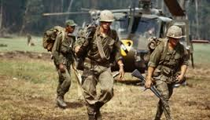
HPAN4008 Sustainable Development in an Era of Globalisation?
Case Study: Vietnam

Slide 2
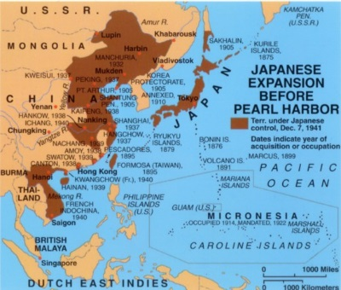
Vietnam’s long struggle for independence: against Japan, France and the USA

Slide 3
The Vietnamese struggle for independence
(in modern times)
French colonial rule and the movement for independence, led by Ho Chi Minh
1941-1945 Japanese occupation: Vietnamese resistance – origins of the Viet Minh
1945-1954 The French return: military struggle
1954-1956 Ceasefire and “temporary” partition
1956: USA backs the South Vietnamese government of Diem – and sends in military advisors to build the South Vietnamese army
1965-1975 Full-scale war between US/South Vietnamese forces v NVA and Viet Cong

Slide 4
The Vietnam War
Week 6: Case Study materials on the Vietnam War and its long-term aftermath:
Hyperlink to an excellent one and a half hour BBC documentary on the Vietnam War. The opening section summarises the impact of the war on Vietnam and on American society at home. Later sections delve further back into history, dealing with the Viet Minh struggles against French Colonialism and the battles of the North Vietnamese Army and the Viet Cong against US armed intervention 1964-1975:
https://www.youtube.com/watch?v=xx8mPlO66cM
Hyperlink to a Guardian “Long Read” feature by Nick Davies, 22 April 2015:
https://www.theguardian.com/news/2015/apr/22/vietnam-40-years-on-how-communist-victory-gave-way-to-capitalist-corruption

Slide 5
Questions:
1. The film clip talks of a “Communist victory” in 1975. What do you understand this to mean?
2. In the film clip, we saw four successive US Presidents speaking about Vietnam: Dwight Eisenhower (1953-1961), John F Kennedy (1961-1963), Lyndon Johnson (1963-1969) and Richard Nixon (1969-1974). What did they fear about Vietnam?
3. After their victory in 1975, what followed for the people of Vietnam?
4. What were the social consequences of the Vietnam war in the USA?
5. What have been the long-term consequences of the “Communist victory” in war and the reunification of Vietnam?

