Slide 1

PROBLEM SOLVING AND DECISION MAKING

Slide 2

1.INTRODUCTION
●This study aims to reveal a disruptive working context through discussion about an issue of work-related stress among the employees of ASDA in the UK.
Notes:
This study is going to summaries the possible outcomes of problem-solving as well as decision making to overcome work-related stress and reduce the anxiety and depression level of employees.

Slide 3
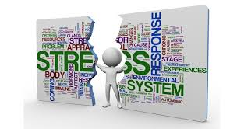
2.DEFINE THE PROBLEM
Work-related stress is listed as the most complicated issue in this ongoing working structure as the employees are not able to show their positive response in the workplace environment.
As opined by Salas, Martin & Flin (2017), work-related stress also aggressive the existing mental health issue as making the health status more difficult to control effectively due to poor working culture at the workplace during an entire working scenario.
Notes:
In the recent business record of ASDA, it can be detected that the majority of employees have faced work-related stress due to the sudden outcome of the Covid-19 era.

Slide 4
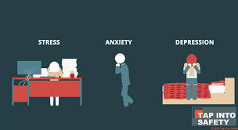
3.ITS SCOPE AND IMPACT
According to the employment status of ASDA in the UK, employees are connected from different geographical locations with different cultural backgrounds hence, work-related stress is strongly impacting the social area of the UK (Personneltoday.com.2021).
As stated by Klein & Crandall (2018), work-related stress also has the leading cause to increase the unemployment rate as it causes another issue of financial threat.
Notes:
Hence, the risk of work-related stress increases the chance of being terminated from an active work role in the workplace of ASDA as the employee failed to adjust to the numerous difficulties of excessive work pressure.

Slide 5
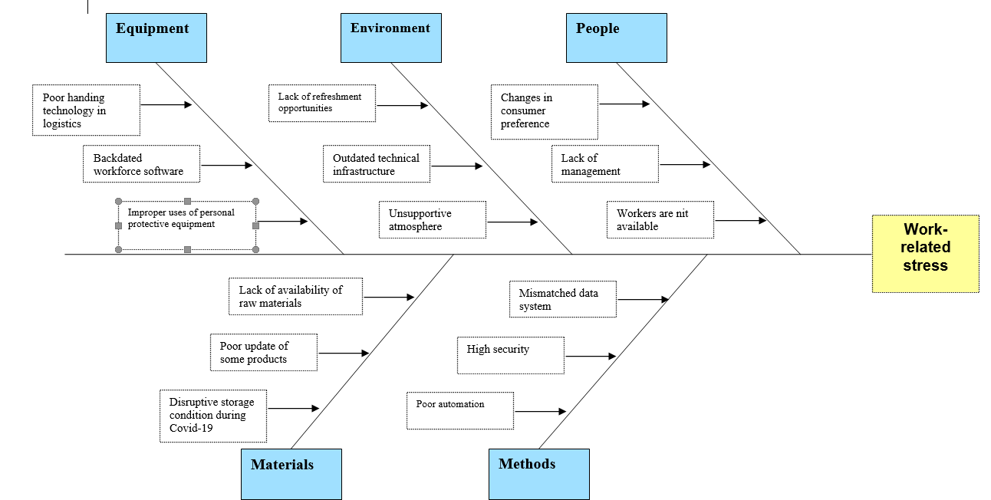
4.ANALYSIS OF THE ORGANISATION AND PROBLEM
Factors | Impact
Political | Increasing corporate tax rate by the UK government by 2023 creates a big threat for ASDA to reduce its sales as pricing of products is going to be higher than today (Klein, G., & Crandall, 2019).
Economic | Because of the winning effect of the Conservative Party, there is a big reason to increase the rate of the pound as it negatively impacts sales of domestic products and services (Personneltoday.com.2021).
Social | The social population of the UK is beneficial to reduce the work-related stress of workers as ADSA is largely concerned about consumers' tastes and fulfilling their demands.
Technological | Strong development of technical factors in the Uk create a big facility to reduce work-related stress of ASDA workers.
Environmental | Environmental effects are not so good as it creates the biggest threat for increasing work-related stress among employees of ASDA.
Legal | The covid-19 impact is to create a negative influence to maintain legal duties as workers of ASDA also faced work-related stress more positively (Personneltoday.com.2021).
Notes:
Political factors create a lot of stress on the worker's minds about the outcome of the sale of this company. Hence, ASDA workers are also affected by work-related stress as they faced the issue of sales.

Slide 6

5.PROPOSE ALTERNATIVE SOLUTIONS
Solution 1: Encourage workplace wellness
Solution 2: Provide sustainable policies for an employee to balanced workload
Solution 3: Modern technology implementation
As per the suggestion of Wami et al. (2019), problem-solving options are mostly associated with the area of a newly proposed alternative solution from a critical problem.
Notes:
The above-mentioned solutions are effectively planned to manage the risk of work-related stress through improving the moods of employees and showing their engagement to work better.

Slide 7

6.EVALUATION
In terms of using PMI (plus, minus and interesting) techniques as a suitable problem-solving tool, it is actively helping to evaluate the best alternative solution (Modecki, Zimmer‐Gembeck & Guerra, 2017).
As mentioned by Proctor (2021), PMI is valuable to detect each corner of a positive, negative and interesting aspect of a chosen solution as set a standard outcome to use the best alternative method.
Notes:
Depending on the analysis through using the PMI tool, it can be acknowledged that the implementation of modern technology helps to reduce employee workload.

Slide 8
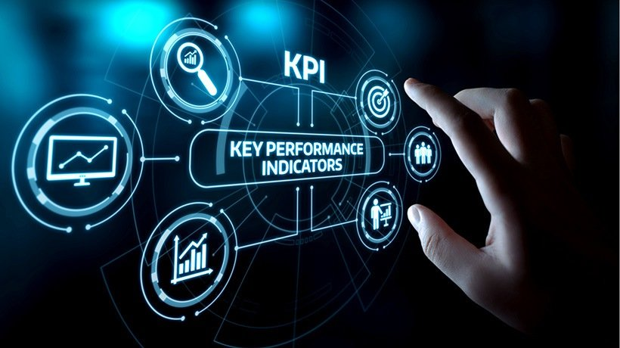
7.PLAN FOR MONITORING AND REVIEW PROCESS
Setting systematic plans to implement technology in the workplace area of ASDA is highly necessary to get workers engaged within the employment structure with the setting up of a decision-making approach by the management team.
As argued by Vallurupalli & Bose (2018), using key performance indicators specifically monitored the employment status by Average Daily Attendance can help to measure the implement solution to address the problem.
Notes:
As a result, it can be effective to work within problematic workplace scenarios as well as evaluate the employment status through getting feedback from employees on a regular basis and easily record any work-related issues.

Slide 9

8.CONCLUSION
The problem-solving option is marked as the most useful element through implementing new interventions and ideas which will effectively address the risk of problematic sources of work-related stress in the workplace.
The study concluded that implementing effective technology such as robotic and artificial intelligence can help to overcome the effects of work-related stress among UK employees.
Notes:
Hence, PMI is actively useful to evaluate best strategies that address the threat of work-related stress and KPI is also an effective way to measure the uses of modern technology.

Slide 10
REFERENCE LIST
Klein, G., & Crandall, B. W. (2018). The role of mental simulation in problem solving and decision making. In Local applications of the ecological approach to human-machine systems (pp. 324-358). CRC Press. Retrieved on: 28th October 2021, from: https://www.taylorfrancis.com/chapters/edit/10.1201/9780203748749-11/role-mental-simulation-problem-solving-decision-making-gary-klein-beth-crandall
Modecki, K. L., Zimmer‐Gembeck, M. J., & Guerra, N. (2017). Emotion regulation, coping, and decision making: Three linked skills for preventing externalizing problems in adolescence. Child Development, 88(2), 417-426. Retrieved on: 28th October 2021, from: https://srcd.onlinelibrary.wiley.com/doi/am-pdf/10.1111/cdev.12734
Personneltoday.com.2021. Asda restructure set to impact 5,000 jobs. Retrieved on: 28th October 2021, from: https://www.personneltoday.com/hr/asda-restructure-set-to-impact-5000-jobs/
Proctor, T. (2021). Absolute Essentials of Creative Thinking and Problem Solving. Routledge. Retrieved on: 28th October 2021, from: https://www.researchgate.net/profile/Tony-Proctor/publication/350108630_Absolute_Essentials_of_Creative_Thinking_and_Problem_Solving/links/60b8ac74458515218f862da1/Absolute-Essentials-of-Creative-Thinking-and-Problem-Solving.pdf
Salas, E., Martin, L., & Flin, R. (2017). Decision-making under stress: Emerging themes and applications. Routledge. Retrieved on: 28th October 2021, from: https://www.legeforeningen.no/contentassets/9096b08d619e4f2b92715a3df8b458a7/naforum2007_20-4.pdf#page=21
Vallurupalli, V., & Bose, I. (2018). Business intelligence for performance measurement: A case based analysis. Decision Support Systems, 111, 72-85. Retrieved on: 28th October 2021, from: https://www.sciencedirect.com/science/article/pii/S0167923618300848
Wami, S. D., Abere, G., Dessie, A., & Getachew, D. (2019). Work-related risk factors and the prevalence of low back pain among low wage workers: results from a cross-sectional study. BMC Public Health, 19(1), 1-9. Retrieved on: 28th October 2021, from: https://bmcpublichealth.biomedcentral.com/articles/10.1186/s12889-019-7430-9

Slide 11


