Slide 1

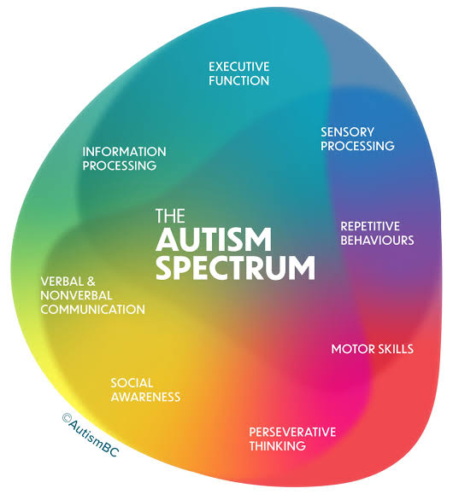
Psychological Classifications and Provisions
BMHP6029_BIRM – Component 1 – Poster Presentation
The Evolution Of Treatment, Care And Policy From Historical Perspective To Contemporary Practice
Student Name: Thaira Bano
Student Number: 2328508
Lecturer: Neale Haddon
Title of Poster: Autism Spectrum Disorder 6A02

Slide 2
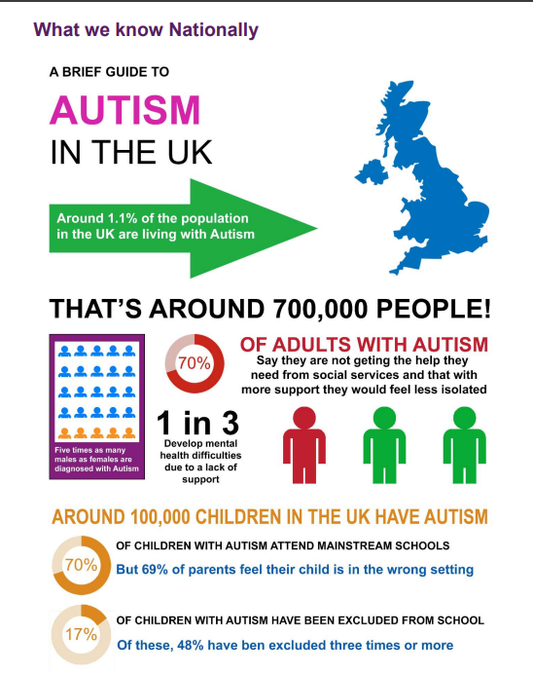
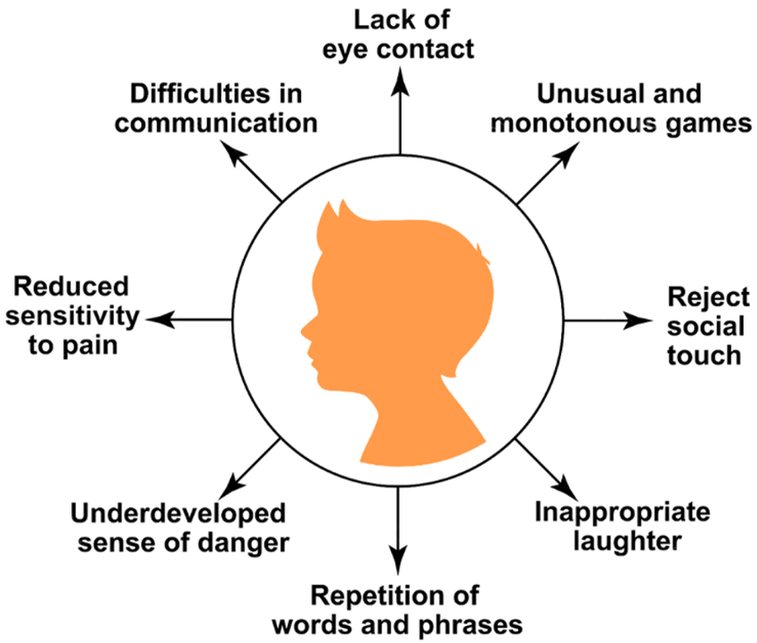
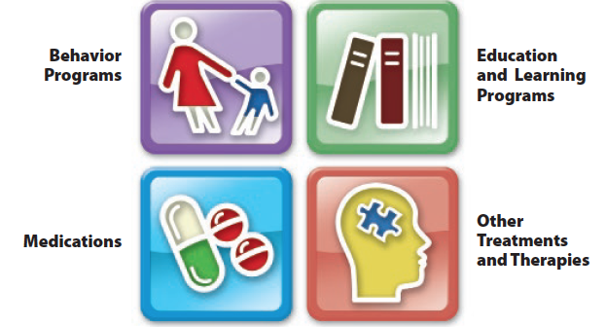
Introduction:
According to ICD-11 (2026), ASD is characterized by
Persistent differences in social communication and interaction
Restricted or repetitive behaviours interests, or activities
Preference for routines and difficulty adapting o change
Symptoms begin in early childhood
Differences significantly affect daily life, education, relationship and independence
Characteristics vary widely between individual with different levels of intellectual ability, language skills and support needs.
Autism is a lifelong neurodevelopmental condition that presents differently and require person centered approach rather than one size fits all approach .
Change in Practice
Advances in neuroscience, precision medicine, biotechnology
Increased research evidence
Neurodiversity Movements
Autistic self Advocacy
Inclusive education
National Legislation
The field of autism theory, research, and practice has seen significant socio-political changes. Treatment shifted as evidence demonstrated autism a lifelong neurodevelopmental difference requiring individualized support rather than institutional management. As the first disability-specific law in England, the Autism Act of 2009 shows a great shift. It has increased awareness of autism in society and better assistance for adults with autism across UK. People with autism faced huge barriers in living a fill life in the community before this act due to autism misinterpretation by the general public and experts.
(Qin et al., 2024; Leadbitter et al., 2021; GOV.UK, 2021)
Prevalence:
WHO statistics states that 1 in 127 people had autism in 2021 (WHO, 2023).
In the UK, there are at least 700,000 adults and children with autism, and more than one in 100 persons have the disorder (National Autistic Society, 2025).
Factors:
Genetic
Environmental
Maternal treatment with certain drugs particularly antidepressants
Exposure to toxicants like pesticides
Paternal Age
Maternal infections
Immune abnormalities
(Matelski and Van de Water, 2016).
(UK.com, 2019)
Contemporary Treatment and Management
Pharmacological treatments:
Currently, there is no pharmacological intervention that effectively addresses the basic symptoms of ASD.
Medicines are prescribed to manage related symptoms
aggression
Irritability
Anxiety
attention problems
sleep disturbances (Sclabassi et al., 2025).
Non-Pharmacological Treatments:
According to Centers for Disease Control and Prevention (2024), contemporary autism spectrum disorder (ASD) treatments target is to lessen symptoms that impair quality of life and everyday functioning. Treatments might be administered in home, community, health, education, or a combination of settings.
Evidence-based Approaches include:
ABA Therapy (Applied Behaviour Analysis) promotes desired behaviours and discourages undesirable ones.
Speech Therapy targets language and speech treatment.
Occupational Therapy enable the patient to live as independently as possible. Improved reactions to potentially limiting or overwhelming sensory input can be achieved through Sensory Integration Treatment.
(TEACCH) Method provide structured learning environment
CBT, or cognitive-behavioral therapy supports emotional regulation Centers for Disease Control and Prevention (2024).
Critical Analysis: Evidence based practice should balance clinical effectiveness with respect for autistic identity, autonomy and person-centred care, recognizing that no single intervention is appropriate for every individual (ASAN, 2021; (Øverland et al., 2025)
Benefits of Early Diagnosis
Early Diagnosis helps in increasing adaptive abilities and developmental outcomes
Enables the application of specialized interventions according to individual needs
Helps in targeting behavioural issues, language development and social communication
Signs and Symptoms of ASD
(Nasirul Mumenin et al., 2024)
(Okoye et al., 2023)
Historical Treatment and Provision of Care
Leo Kanner Early infantile Autism 1943
Confused with childhood Schizophrenia
Limited Understanding
(Harris, 2018)
Psychoanalytic Era
1950-1960
Sigmund Freud father of psychoanalysis
Refrigerator Mother theory blaming emotionally distant mothers
Families experience stigma and guilt
Psychoanalytic therapies commonly used (Tarzian, Ndrio and Fakoya, 2023; (Cohmer, 2014)
Institutionalisation 1950s-1970s
Autistic children treated in long term settings
Care is focused more on control than development
Limited social inclusion and Educational opportunities
Behaviours are seen as abnormal and needing correction (Evans, 2013).
1970s-1980 Behavioural Approaches
Behaviour modifications are targeted
Special needs schools expanded
Focus on teaching communication and living skills
Family involvement was limited
1990-2000 Recognition and Inclusion
Growing scientific evidence recognised Autism as neurodevelopmental Disorder
Early Diagnosis improved
Community-based services increased
Families become active partner in care (Chahboun, Stenseng and Page, 2022)
2010 – Present Person Centred Care
Neurodiversity movement gained influence
MDT intervention
Family centred approaches
Emphasis on autonomy, inclusion and quality of life
Policy focus equality, reasonable adjustment and lifelong support (National Autistic Society, 2026)
(Suri, 2025)

Slide 3
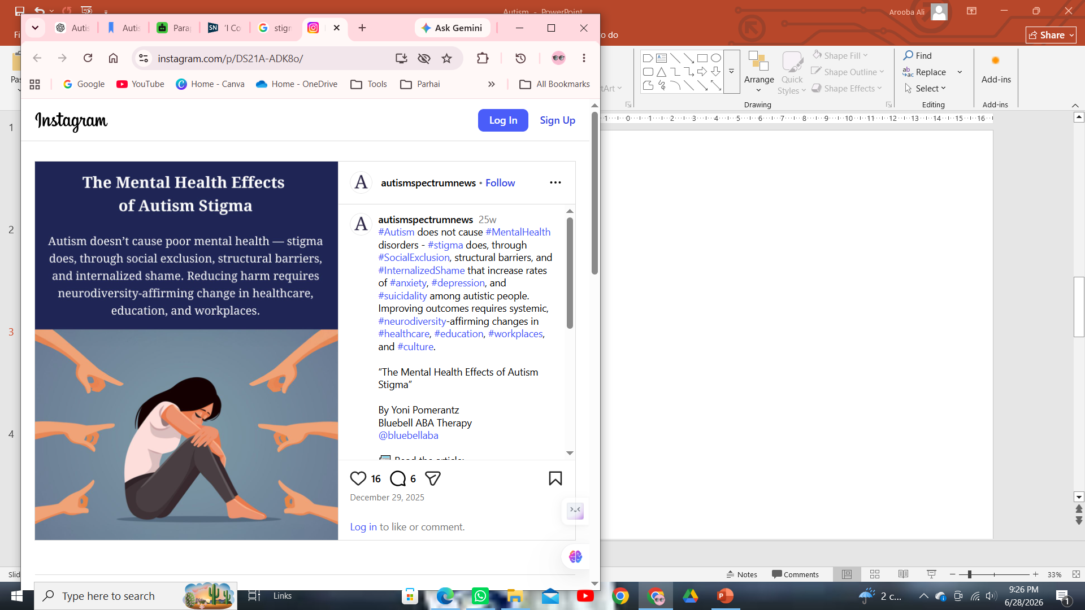
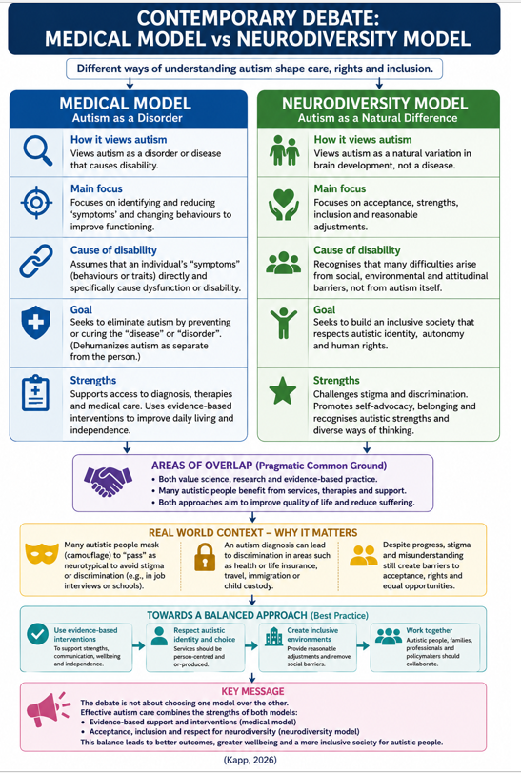
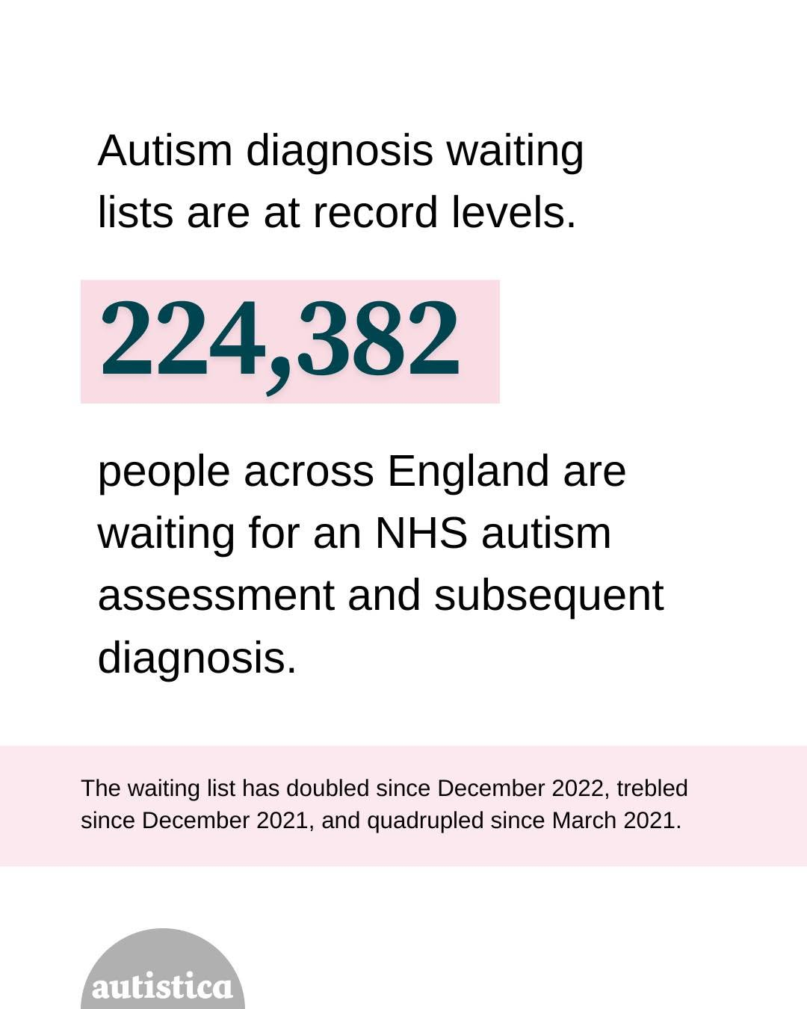
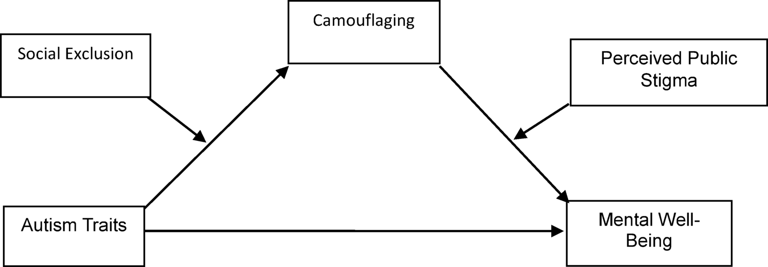
(
Social Context
Social
Stigma
Stigma continues to influence how ASD is perceived and managed, creating barriers to timely diagnosis, support and social participation. Fear of discrimination often leads autistic individual to camouflage the autistic traits which can cause distress, delay to appropriate interventions. However, reducing stigma requires not only public awareness but also systematic changes that promote neurodiversity, inclusive environments and autism-informed professional practice(Turnock, Langley and Jones, 2022).
Bullying
According to Daghustani et al. (2025), autistic people communicate and interact differently from social expectations. These differences are often misinterpreted and misunderstood contributing to discrimination and bullying. Bullying can worsen mental health outcomes and can trigger anxiety, depression and social isolation. Bullying disproportionately affects young children with autism, particularly in puberty, a time of growing social complexity and more peer scrutiny. Bullying as Ochi et al. (2020), stated is a significant cause of school avoidance in both boys and girls with autism (McNally et al., 2026).
Social Exclusion
Children and teenagers with autism spectrum disorder (ASD) face challenges that restrict their ability to engage with family members and peers. These actions may result in social isolation as a result of social exclusion. This suggests that improving outcomes require environmental adaptations and inclusive policies, rather than expecting autistic individuals to conform to societal norms (Gómez-Campos et al., 2023).
The need is to create inclusive systems and ensuring equitable access to person-centered support.
(Autism Spectrum, 2026)
Cultural context
Cultural shaped how mental disorders are perceived, how families interpret symptoms and access support.
Religious beliefs, gender roles, and societal expectations can affect care giving practices and help seeking behaviours (Doyumğaç, Söner and Arslan, 2026).
A study by Munroe, Hammond and Cole (2016), shows how African Immigrant families in UK viewed Autism as God’s Will, or Divine Test.
Delayed diagnosis often reflects cultural barriers and systematic approaches like Medical Model which view Autism as a disease which needs to be fixed , highlighting the need for culturally competent equitable care among diverse communities (Kuhlman, 2025).
(National Autistic Society, 2025a)
(Seçer et al., 2025)
Political Context
Policy and legislative steps that promoted right-based, inclusive and person-centered care in UK
Autism Act 2009
The Act protects the rights of adults with autism in England. It is the only legislation in England designed to enhance assistance for those with one specific disability (National Autistic Society, 2021)
NHS Long-Term Plan 2019
The NHS Long Term Plan places a high priority on increasing and enhancing the standard of community care for individuals with mental health issues, including those with autism and learning disabilities. As a result, more individuals than ever before are using community mental health services (NHS, 2025).
NICE Guidelines
NICE Guidelines in UK promote evidence based, multidisciplinary interventions tailored to individual strengths and needs rather than attempting to cure Autism (ADDC, 2025; National Institute for Health and Care Excellence, 2021) .
National Institute for Health and Care Excellence, 2021).
National Framework and Operational Guidelines for autism assessment services support integrated care boards in achieving better results in all-age autism assessment pathways. Additionally, it contains operational guidelines that are meant to direct strategic choices on the variety of autism assessment services that ought to be offered in each region. Dynamic support register and Care (Education) and Treatment Review policy aims to avoid needless hospitalisations for individuals with autism and learning disabilities (NHS England, 2025).
Info graph Template\; (Canva, 2026)
Content Citation: (Kapp, 2026)
Recommendations
Autism services should be provided through specialist autism teams or broader neurodevelopmental services that assess autism alongside conditions such as ADHD.
Access to timely diagnosis can be improved by increasing the knowledge of healthcare professionals using MDTs providing support before a formal diagnosis and adopting holistic approach that considers an overall need.
This could help in reducing waiting time.
Culturally competent services are needed to include wider groups.
More research is needed to bridge gender and ethnic gap.
there is need of Autism friendly Assistive Technologies according to their needs and preferences.
(Pemovska et al., 2024; National Autistic Society, 2026a; Male et al., 2026)
Gap
Although UK policies have transformed care from Medical Model to a right based community focused approach. Their impact is constrained by inconsistent implementation, diagnostic delays and unequal access to services (Doda, Kennedy and Kaur, 2024).
Conclusion
Autism has developed from institutionalised and deficit focused treatment towards evidence-based person centered and neurodiversity informed practice. This shift reflects advances in research greater recognition of human rights and increasing involvement of autistic people in shaping services. Despite progress challenges such as diagnostic inequalities , long waiting times and inconsistent services remain. Future practice should focus on equitable, culturally responsive and collaborative care that can support an autistic individual across lifespan .

Slide 4
References
ADDC (2025) Autism and ADHD Diagnostic Centre, Autism and ADHD Diagnostic Centre | Glasgow UK. Available at: https://www.autismandadhddiagnosticcentre.com/what-are-nice-guidelines-national-institute-for-health-and-care-excellence-explained/.
ASAN (2021) For Whose Benefit? Evidence, Ethics, and Effectiveness of Autism Interventions Executive Summary and Ethical Guidance Brief. Available at: https://autisticadvocacy.org/wp-content/uploads/2021/12/ACES-Ethics-of-Intervention.pdf (Accessed: 28 June 2026).
Autism Spectrum (2026) Autism Spectrum News on Instagram: ‘#Autism does not cause #MentalHealth disorders - #stigma does, through #SocialExclusion, structural barriers, and #InternalizedShame that increase rates of #anxiety, #depression, and #suicidality among autistic people. Improving outcomes requires systemic, #neurodiversity-affirming changes in #healthcare, #education, #workplaces, and #culture. “The Mental Health Effects of Autism Stigma” By Yoni Pomerantz Bluebell ABA Therapy @bluebellaba 📰 Read the article: https://autismspectrumnews.org/the-mental-health-effects-of-autism-stigma/’, Instagram. Available at: https://www.instagram.com/p/DS21A-ADK8o/ (Accessed: 28 June 2026).
Canva (2026) Canva, Canva. Available at: https://www.canva.com/design/DAGgCsdpVps/pDjnjWmAGSNwcGy57HHjHw/edit (Accessed: 28 June 2026).
Centers for Disease Control and Prevention (2024) Treatment and Intervention for Autism Spectrum Disorder, Autism Spectrum Disorder (ASD). Centers for Disease Control and Prevention. Available at: https://www.cdc.gov/autism/treatment/index.html.
Chahboun, S., Stenseng, F. and Page, A.G. (2022) ‘The changing faces of autism: The fluctuating international diagnostic criteria and the resulting inclusion and exclusion—A Norwegian perspective’, Frontiers in Psychiatry, 13(13). Available at: https://doi.org/10.3389/fpsyt.2022.787893.
Cohmer, S. (2014) Early Infantile Autism and the Refrigerator Mother Theory (1943-1970) | The Embryo Project Encyclopedia, Asu.edu. Available at: https://embryo.asu.edu/pages/early-infantile-autism-and-refrigerator-mother-theory-1943-1970.
Daghustani, W.H. et al. (2025) ‘Autism, bullying, and mental health: a comprehensive systematic review’, Frontiers in Psychiatry, 16. Available at: https://doi.org/10.3389/fpsyt.2025.1653663.
Doda, V., Kennedy, C. and Kaur, M. (2024) ‘Policies for Individuals With Autism: Gaps, Research, and Recommendations’, Cureus, 16(1). Available at: https://doi.org/10.7759/cureus.51875.
Doyumğaç, İ., Söner, O. and Arslan, G. (2026) ‘Autism, Belief, and Society: Voices of Families in Cultural and Religious Contexts’, Journal of Autism and Developmental Disorders [Preprint]. Available at: https://doi.org/10.1007/s10803-026-07289-1.
Evans, B. (2013) ‘How autism became autism: The radical transformation of a central concept of child development in Britain’, History of the Human Sciences, 26(3), pp. 3–31. Available at: https://doi.org/10.1177/0952695113484320.
Gómez-Campos, R. et al. (2023) ‘Comparison of social isolation in autistic children and adolescents according to age, marital status and number of siblings’, Journal of Education and Health Promotion, 12, p. 316. Available at: https://doi.org/10.4103/jehp.jehp_1837_22.
GOV.UK (2021) The national strategy for autistic children, young people and adults: 2021 to 2026, GOV.UK. GOV.UK. Available at: https://www.gov.uk/government/publications/national-strategy-for-autistic-children-young-people-and-adults-2021-to-2026/the-national-strategy-for-autistic-children-young-people-and-adults-2021-to-2026 (Accessed: 28 June 2026).
Harris, J. (2018) ‘Leo kanner and autism: A 75-year perspective’, International Review of Psychiatry, 30(1), pp. 3–17. Available at: https://doi.org/10.1080/09540261.2018.1455646.
ICD-11 (2026) ICD-11 for Mortality and Morbidity Statistics, Who.int. Available at: https://icd.who.int/browse/2026-01/mms/en#437815624 (Accessed: 28 June 2026).
Kapp, S.K. (2026) ‘The neurodiversity movement vs. the medical model of autism’, World Psychiatry, 25(2), pp. 322–323. Available at: https://doi.org/10.1002/wps.70076.
Kuhlman, C.A.N. (2025) ‘Exploring Cultural Perspectives on Autism Spectrum Disorder: A Literature Review’, Journal of Undergraduate Research at Minnesota State University Mankato, 25(1). Available at: https://doi.org/10.56816/2378-6949.1230.
Leadbitter, K. et al. (2021) ‘Autistic Self-Advocacy and the Neurodiversity Movement: Implications for Autism Early Intervention Research and Practice’, Frontiers in Psychology, 12(12), pp. 1–7. Available at: https://doi.org/10.3389/fpsyg.2021.635690.
Male, I. et al. (2026) ‘How can we improve the timeliness and quality of diagnostic assessment for children with possible autism? Qualitative findings and recommendations from a Realist Evaluation of Autism Service delivery in the United Kingdom’, Autism [Preprint]. Available at: https://doi.org/10.1177/13623613261430914.
Matelski, L. and Van de Water, J. (2016) ‘Risk factors in autism: Thinking outside the brain’, Journal of Autoimmunity, 67, pp. 1–7. Available at: https://doi.org/10.1016/j.jaut.2015.11.003.
McNally, S. et al. (2026) ‘“I Couldn’t tell the Teachers About it”: Autistic Students’ Experiences of Bullying and Exclusion in Post-Primary Schools’, International Journal of Bullying Prevention [Preprint]. Available at: https://doi.org/10.1007/s42380-026-00352-6.
Munroe, K., Hammond, L. and Cole, S. (2016) ‘The experiences of African immigrant mothers living in the United Kingdom with a child diagnosed with an autism spectrum disorder: an interpretive phenomenological analysis’, Disability & Society, 31(6), pp. 798–819. Available at: https://doi.org/10.1080/09687599.2016.1200015.

Slide 5
Nasirul Mumenin et al. (2024) ‘ASDNet: A robust involution‐based architecture for diagnosis of autism spectrum disorder utilising eye‐tracking technology’, IET computer vision [Preprint]. Available at: https://doi.org/10.1049/cvi2.12271.
National Autistic Society (2021) Not Enough, www.autism.org.uk. Available at: https://www.autism.org.uk/what-we-do/campaign/not-enough (Accessed: 28 June 2026).
National Autistic Society (2025a) Autism assessment waiting times November 2025, Autism.org.uk. National Autistic Society. Available at: https://www.autism.org.uk/what-we-do/news/autism-assessment-waiting-times-november-2025 (Accessed: 29 June 2026).
National Autistic Society (2025b) What Is Autism?, National Autistic Society. Available at: https://www.autism.org.uk/advice-and-guidance/what-is-autism.
National Autistic Society (2026a) Strategies and interventions, Autism.org.uk. Available at: https://www.autism.org.uk/advice-and-guidance/strategies-and-interventions (Accessed: 29 June 2026).
National Autistic Society (2026b) The neurodiversity movement, Autism.org.uk. Available at: https://www.autism.org.uk/advice-and-guidance/identity/the-neurodiversity-movement (Accessed: 28 June 2026).
National Institute for Health and Care Excellence (2021) Autism spectrum disorder in adults: diagnosis and management | Guidance | NICE, Nice.org.uk. NICE. Available at: https://www.nice.org.uk/Guidance/CG142 (Accessed: 28 June 2026).
NHS (2025) NHS England» Mental Health, Learning Disability and Autism Inpatient Quality Transformation Programme, www.england.nhs.uk. Available at: https://www.england.nhs.uk/mental-health/mental-health-learning-disability-and-autism-inpatient-quality-transformation-programme/.
NHS England (2025) NHS England» National framework and operational guidance for autism assessment services, www.england.nhs.uk. Available at: https://www.england.nhs.uk/publication/autism-diagnosis-and-operational-guidance/ (Accessed: 28 June 2026).
Ochi, M. et al. (2020) ‘School refusal and bullying in children with autism spectrum disorder’, Child and Adolescent Psychiatry and Mental Health, 14(1). Available at: https://doi.org/10.1186/s13034-020-00325-7.
Okoye, C. et al. (2023) ‘Early Diagnosis of Autism Spectrum Disorder: a Review and Analysis of the Risks and Benefits’, Cureus, 15(8). Available at: https://doi.org/10.7759/cureus.43226.
Øverland, E. et al. (2025) ‘“One must think autism in everything one does”: Clinicians’ Experiences of Supporting Autistic Patients’, Journal of Autism and Developmental Disorders [Preprint]. Available at: https://doi.org/10.1007/s10803-025-07070-w.
Pemovska, T. et al. (2024) ‘Approaches to improving mental health care for autistic children and young people: a systematic review and meta-analysis’, Psychological medicine, 54(10), pp. 1–31. Available at: https://doi.org/10.1017/s0033291724001089.
Qin, L. et al. (2024) New advances in the diagnosis and treatment of autism spectrum disorders, ResearchGate. Springer Nature. Available at: https://www.researchgate.net/publication/381315415_New_advances_in_the_diagnosis_and_treatment_of_autism_spectrum_disorders.
Sclabassi, E. et al. (2025) ‘Pharmacological Interventions in Autism Spectrum Disorder: A Comprehensive Review of Mechanisms and Efficacy’, Biomedicines, 13(12), pp. 3025–3025. Available at: https://doi.org/10.3390/biomedicines13123025.
Seçer, I. et al. (2025) ‘Autism traits and mental well-being: the mediating role of social camouflaging and the moderating role of social exclusion and public stigma’, Scientific Reports, 15(1). Available at: https://doi.org/10.1038/s41598-025-20569-7.
Suppo, J. (2017) The History of Behavioral Treatments in Autism: From the Punitive to the Positive. Available at: https://files.eric.ed.gov/fulltext/EJ1164503.pdf.
Suri, S. (2025) Autism Spectrum Disorder Treatment, Types & Symptoms, What nature can’t, Nurture will! Available at: https://www.nurturers.in/blog/autism-spectrum-disorder-treatment-in-india/.
Tarzian, M., Ndrio, M. and Fakoya, A.O. (2023) ‘An introduction and brief overview of psychoanalysis’, Cureus, 15(9), pp. 1–13. Available at: https://doi.org/10.7759/cureus.45171.
Turnock, A., Langley, K. and Jones, C.R.G. (2022) ‘Understanding Stigma in Autism: a Narrative Review and Theoretical Model’, Autism in Adulthood, 4(1), pp. 76–91. Available at: https://doi.org/10.1089/aut.2021.0005.
UK.com (2019) Norfolk’s All Age Autism Strategy 2019-2024 , https://norfolkcc.cmis.uk.com/.
WHO (2023) Autism Spectrum Disorders, World Health Organization. World Health Organization. Available at: https://www.who.int/news-room/fact-sheets/detail/autism-spectrum-disorders (Accessed: 28 June 2026).

