Slide 1
1. Factors affecting Permeability and Seepage flow of water in SOILS
Allan Nantel
July 2024

Slide 2
What is a Soil composed of ?
Soil is a complex mixture of weathered rock, minerals, organic material (both living & decaying), water, and air.
Different soils have different amounts of each of these elements.
On average, soil has the following ratios:
  45% mineral content
  25% water
  25% air
  5% organic material
Coal Tip Research……..

Slide 3
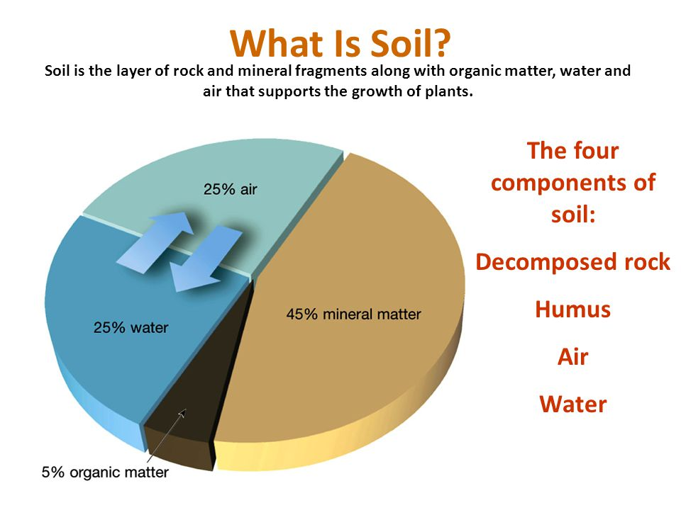

Slide 4
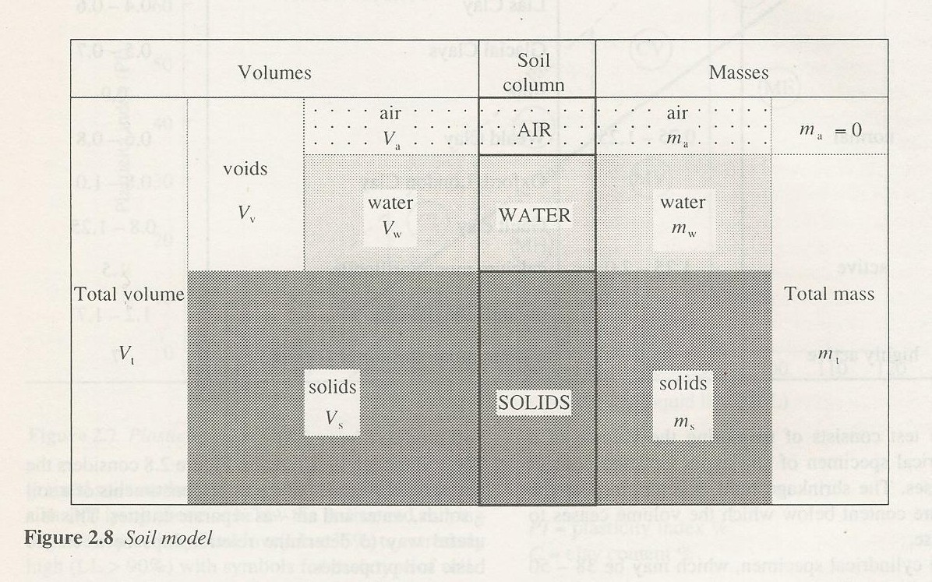
SOIL MODEL
SOIL
COLUMN
Soil Model – Volume and Mass relationships
Density = m / V
Weight = m x g
Mass = How much matter (atoms) it contains

Slide 5
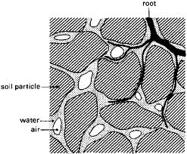
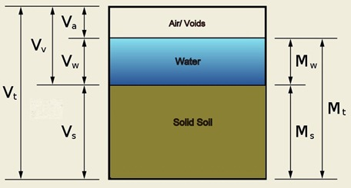
Concept of Soil Elements
COPY

Slide 6
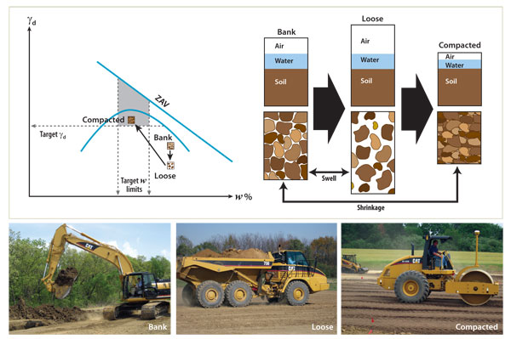
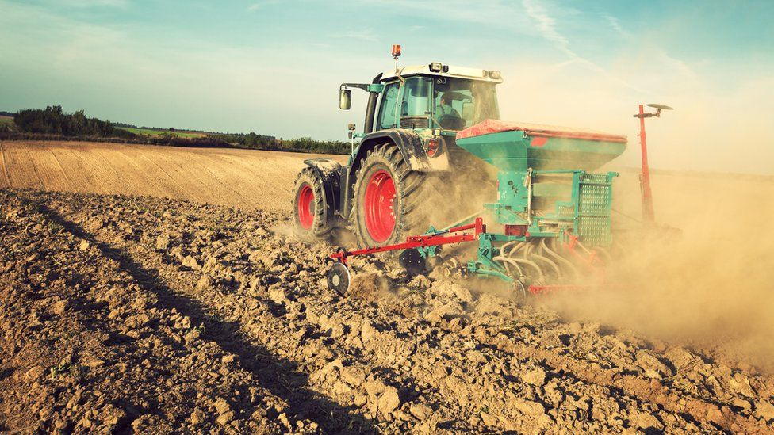
Soil
THIS ‘PROPORTIONALITY’ OF CONTENT FOR THESE ELEMENTS IS EXAMINED IN WHAT IS TERMED…
‘Phase relationships’
Relationship here to Porosity, Permeability, Densification in compaction.

Slide 7
Concept of Soil Phases
Fundamentally, Soil can either be a ‘two –phase’ or ‘three phase’ composition….so…..
In a completely dry soil, there are two phases, namely the solid soil particles and pore air (no water)
A ‘fully saturated’ soil is also two-phase, being composed of solid soil particles and pore water (no air)
A ‘partially saturated’ soil is three-phases being composed of solid soil particles, pore water and pore air.

Slide 8
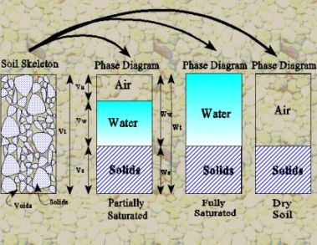
Concept of Soil Elements
‘TEXTURE’
THE ‘DEGREE OF SATURATION’
has substantial impact on soil characteristics of strength.
Void
Solid

Slide 9
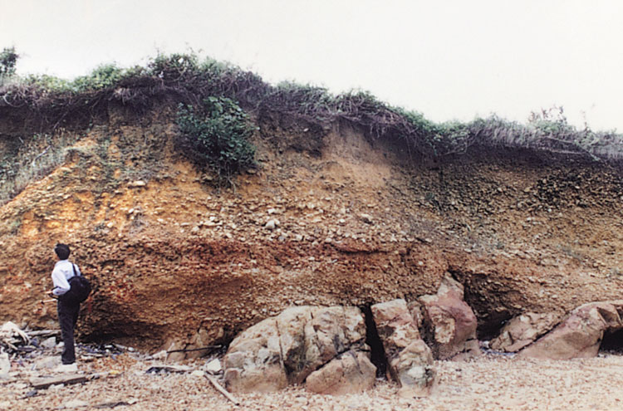
SOIL HORIZONS (‘PROFILES’)

Slide 10
What changes a Soil Profile section?
What determines the composition of a soil??
Mostly the parent material, erosion, chemical changes and organic materials percentage…but what is the driving force that determines these?
Climate, and depositional environment.
Climate mostly affects the presence of a soil ‘horizons’ (layers with depth) present to view in a cut vertical section, but not to the same extent the materials found in the soil.
In general, geographic climates that have all 4 seasons represented during a calendar year have all the 4 horizons exhibited when we take a cross section.

Slide 11
Weathering of Rock
Soil mineral content:
This disintegration into soil is caused by external agents:
Weathering- Natural decay and the breakdown of ‘solid rock or fragments’ …..Sources ??
‘Drift’ – Transported, superficial sediment deposited on top of the rock strata, mostly unconsolidated clay, sand and coarse clastic debris, generally ‘Quaternary’ in geologic age, from flood conditions.
‘Colluvium’ (scree) – Slope debris, moved downslope by gravity generally – debris from creep and downwash. Increases greatly if there is loss of vegetation on the slope surface.
‘Regolith’ (‘Parent Rock-head’) – not sharply defined. Generally, around 1 to 7m deep in UK.
‘There is an intersection of ‘drift’ and ‘re-deposition’ with a proportion of Parent rock
sub strata contribution’.
Soils, in most cases, are blends or mixtures of particles of many sizes and different parent rock materials….hence different chemical composition…
…making it very difficult to predict its behaviour without full analysis.

Slide 12
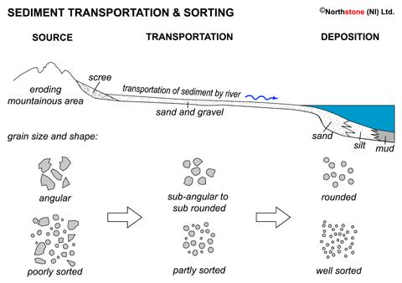
‘There is an intersection of ‘drift’ and ‘re-deposition’ with a proportion of Parent rock sub strata Contribution’.
Colluvium
Stokes Law
‘IMMATURE’ SEDIMENT
‘MATURE’ SEDIMENT
‘DRIFT’
In the process of transportation, particles will grind bedrock by ‘ABRASION’ and abrade each other by collision ‘ATTRITION’.

Slide 13
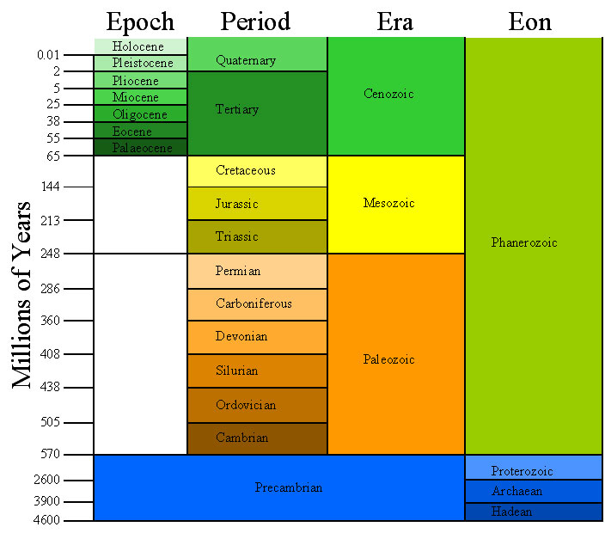
UN-CONSOLIDATED
SEDIMENT
MINERAL CONTENT FOR SOIL FORMATION BY
‘RE-DEPOSITION’

Slide 14
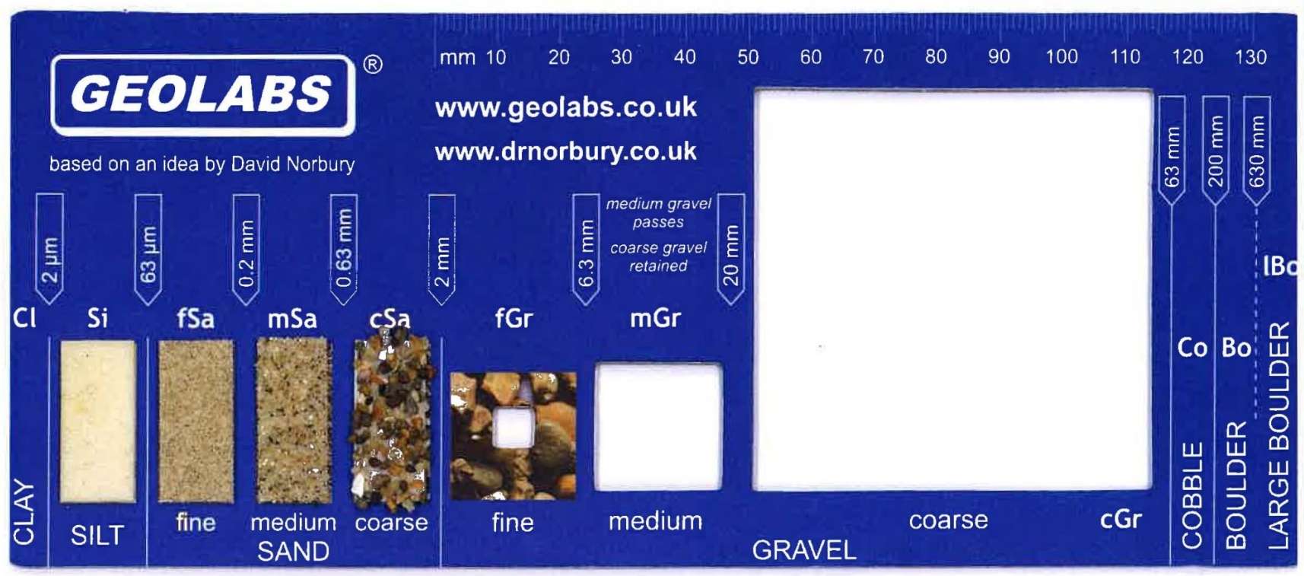
SEDIMENT SIZE – Standard Definitions

Slide 15

Soil Characteristics
The size of soil particles affects the characteristics of a soil. (Texture)
Soils are usually ‘categorised’ by the amounts of each type of particle that they have.
Particles are:
  Clay: 0.002mm and below
  Silt: 0.002mm – 0.063mm
  Sand: 0.063mm –2 mm
  (Gravel: 2mm to 20mm (medium))

Slide 16
Extent of weathering
timescales, ‘parent rock’ type and climatic conditions
Depends on ?..........
Sedimentary rock types weather to greater extent and depth than igneous or metamorphic, so Shales, Sandstones and Limestones greatly affected….(Cementitious nature of the particle bond – Calcareous in nature)
Deepest weathering is under severe climatic conditions…
(periglacial frost action or rain forest climate)
Three types of weathering?
  Mechanical
  Chemical
  Biological
10 Minutes

Slide 17
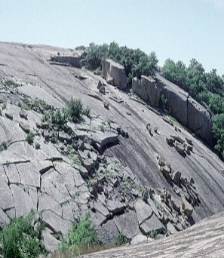
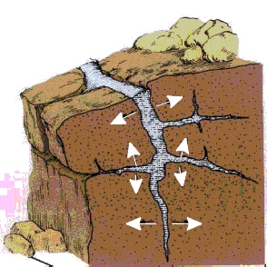
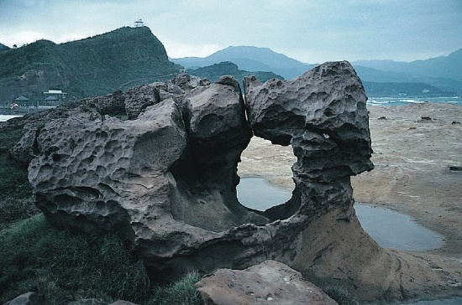
Weathering by Mechanical breakdown
Weathering loosens grains... Erosion carries them away.
is achieved by the action of several processes:
Freezing of water : within cracks/fissures forces bedding planes apart.
Alternate freeze and thaw cycles on surfaces
With water acting on the surface, the sun’s heating of the rock by day and
cooling by night is an important weathering agent. (Exfoliation)
Wind action – by abrasion in high wind velocity environments
Water Flow - Wave action or river, undercutting cliff faces or washing away
loose banks and till.

Slide 18
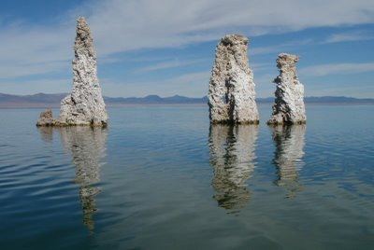
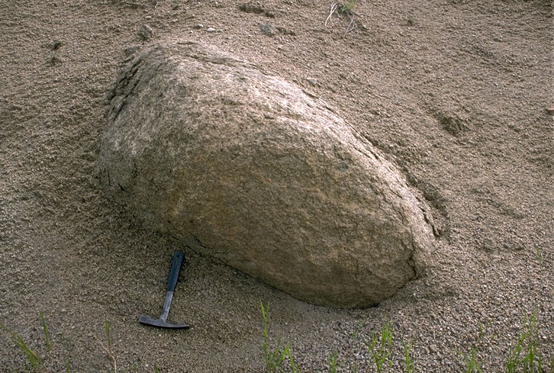
Weathering by Chemical breakdown
Solution: Soluble materials dissolve and are carried away in solution.
Carbonation : Rainwater containing carbon dioxide from the air and soil reacts with carbonates to form soluble hydrogen carbonates.
Hydrolysis : Water reacts with minerals breaking them down (Feldspars)
Hydration : The addition of water molecules to the rock’s atomic structures.
Oxidation : The addition of oxygen to the rock’s atomic structure.
Chelation : Organic compounds from the soil remove metals from minerals

Slide 19
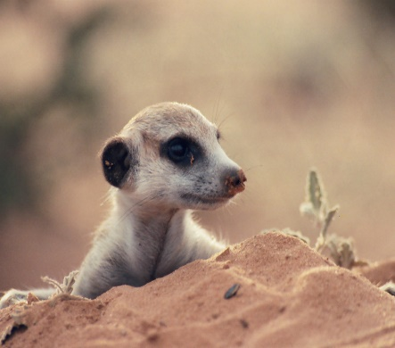
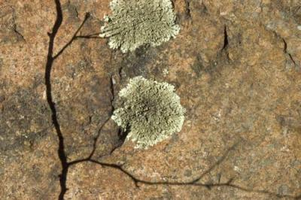
Weathering by Biological breakdown
Bacteria : Organic matter in soils is broken down by micro-organisms to give water and either Carbon Dioxide or Methane and small quantities of Ammonia and Nitric Acid (Lichens).
Plant Roots : Roots growing through fractures force the rocks apart.
Soil Processes : Organic activity increases weathering rate dramatically, for example by providing Carbon Dioxide for carbonation,
Animals : Heavily grazed hillside can be significantly disturbed in its stability.
What about Human Activities ?

Slide 20
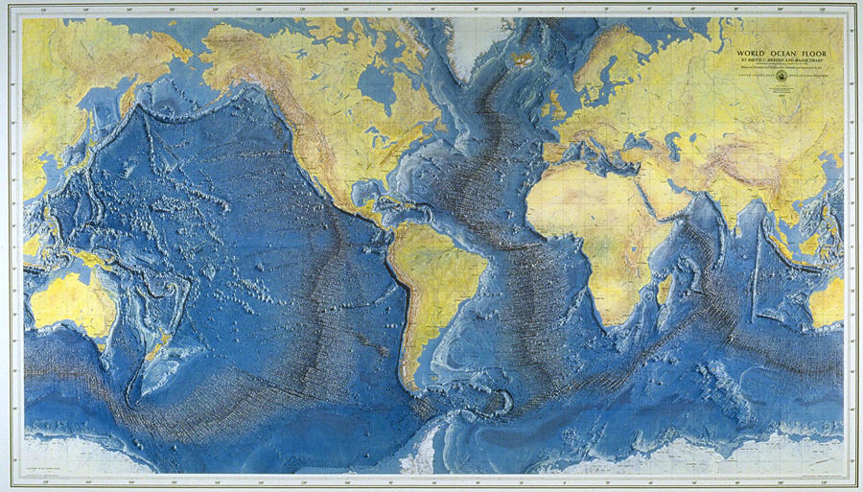
THE ROCK CYCLE BEGINS at Mid Oceanic Ridges.
Pacific Ridge
Mid Atlantic Ridge
Notes:
Basaltic lava being developed at Mid oceanic ridge – SEA FLOOR SPREADING

Slide 21
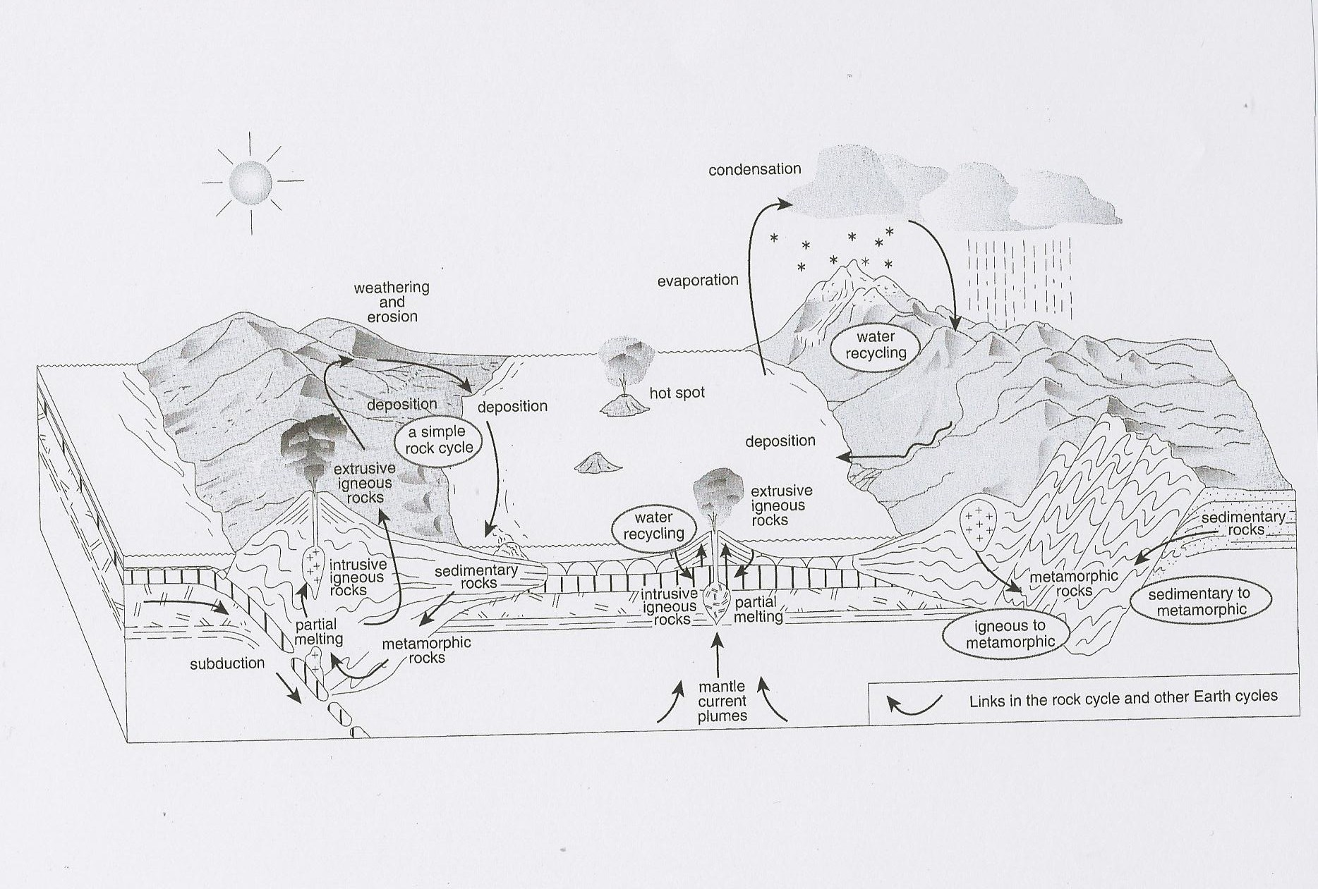
THE ROCK CYCLE – The interaction between strata and climate
Creation of ‘Crust’ (Constructive Plate Margin) at mid-oceanic ridge
Subduction Zone
(destructive plate margin)
Notes:
Basic differences in definition of Igneous, Metamorphic and Sedimentary rock.
Depth of around 100m below crust, melting is sufficient to allow magma to move back upward through crust
As it rises it melts ‘country rock’ and incorporates some of its chemical composition.

Slide 22
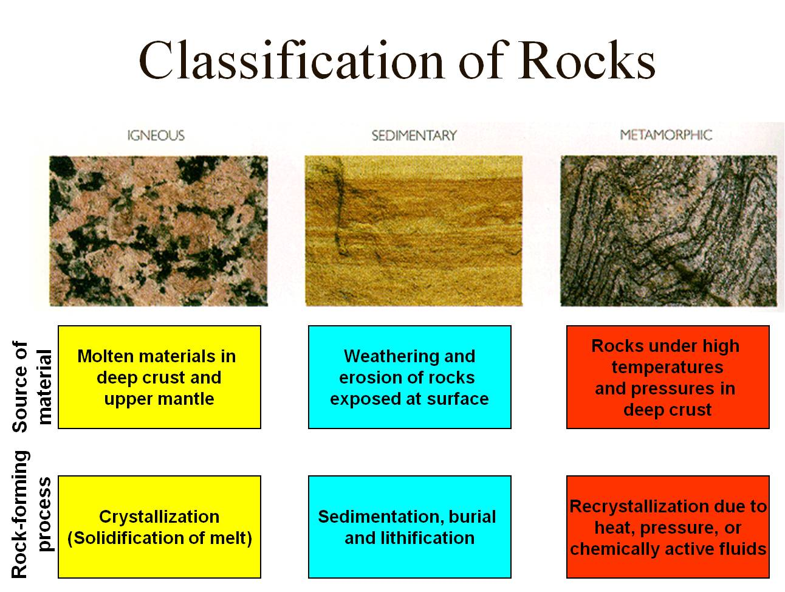
Classification of Rocks – Mineral Origins
Most types of rock can be placed into one of three broad groups, according to how the rock originated,
as follows:
1. IGNEOUS
2. SEDIMENTARY
3. METAMORPHIC
All are aggregations
(collections) of one
or more minerals.
SOURCE
PROCESS of Formation
Lithification (also called Diagenisis) is the consolidation of a
loosely deposited sediment into a hard sedimentary rock

Slide 23
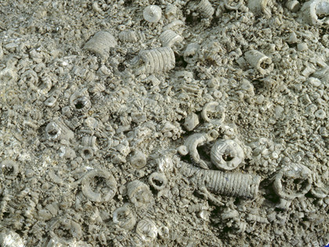
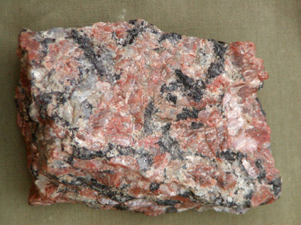
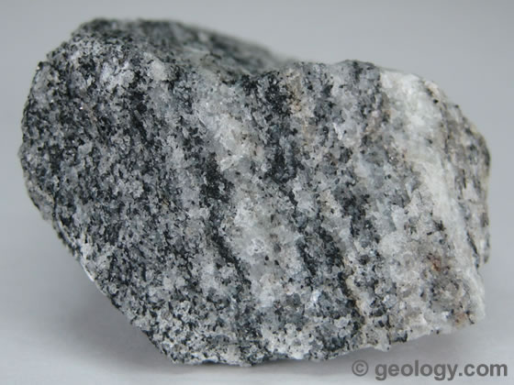
IGNEOUS
SEDIMENTARY
METAMORPHIC
LIMESTONE
GRANITE
GNEISS
Silica
Ferric Oxides
Calcite
Clay minerals
Silica
Potassium
Sodium

Slide 24
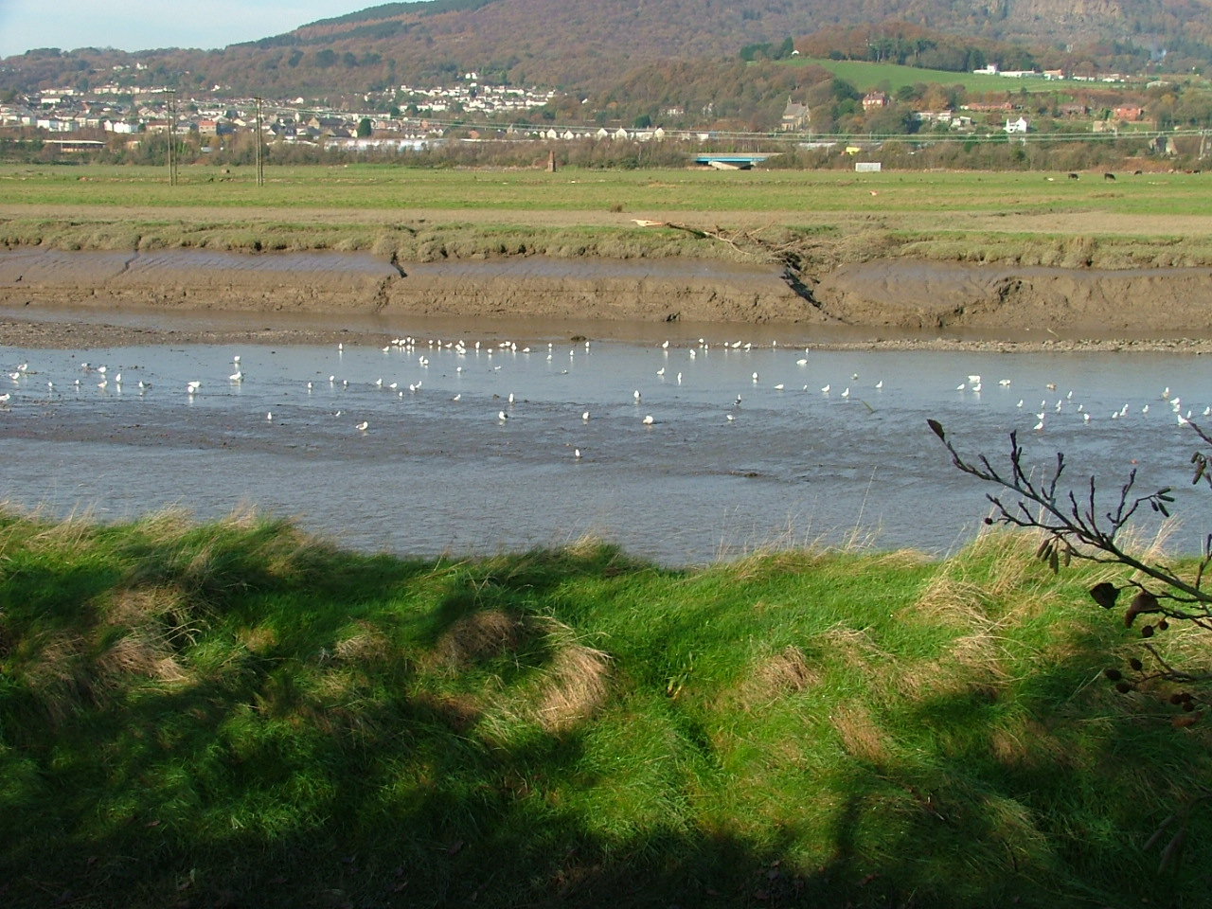
Alluvial Flood Plain – River Neath – An example of a wide valley filled with Alluvial silts and clays.

Slide 25
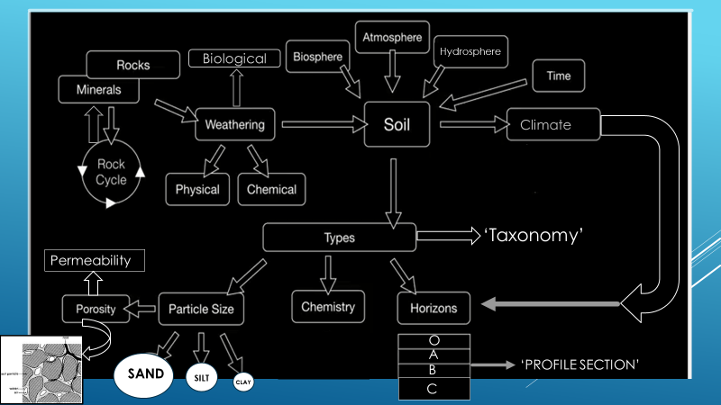
Flow Chart - Sediment and mineral content relationship to type and properties

Slide 26
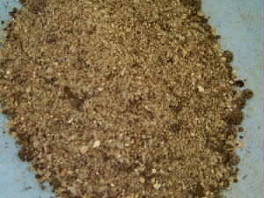
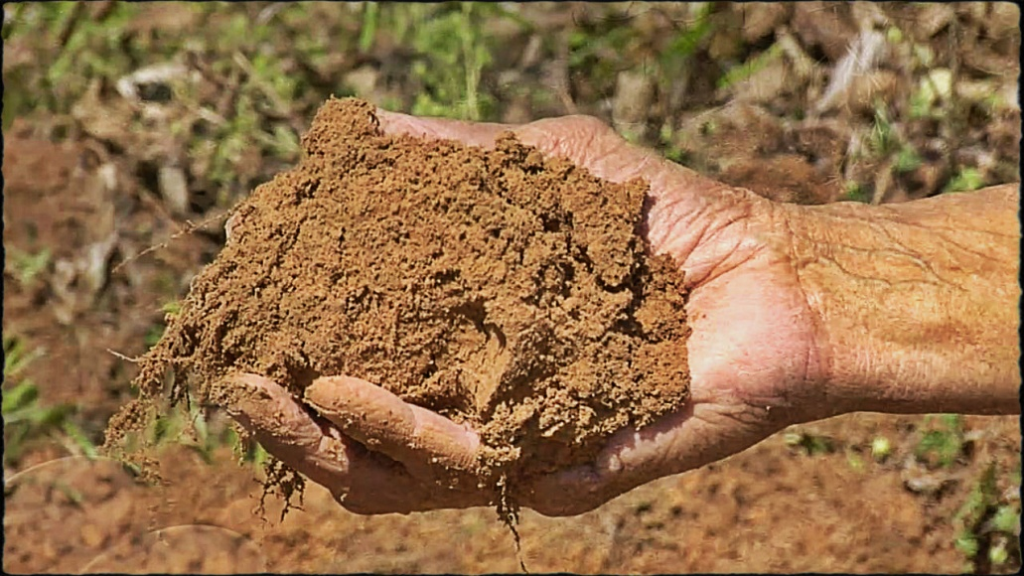
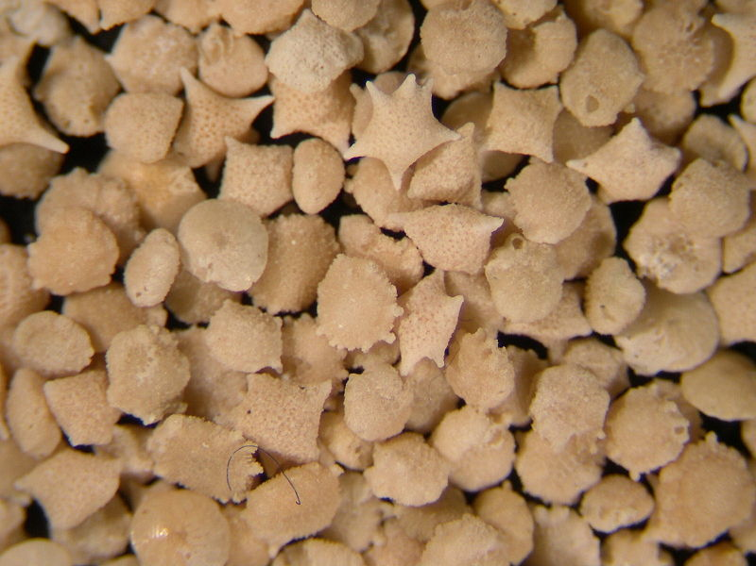
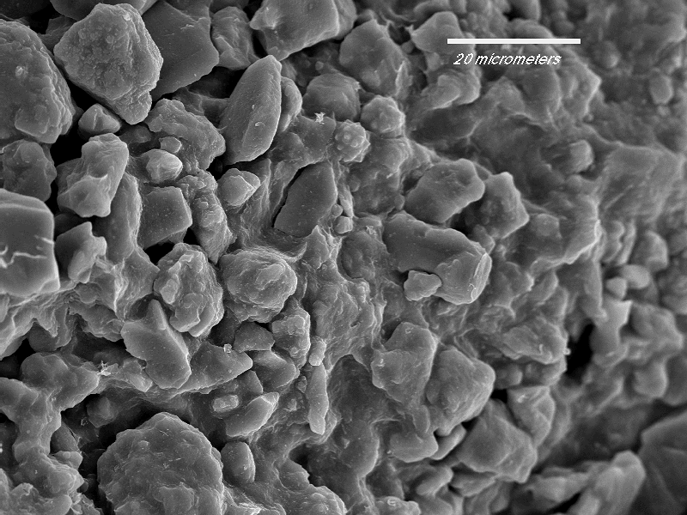
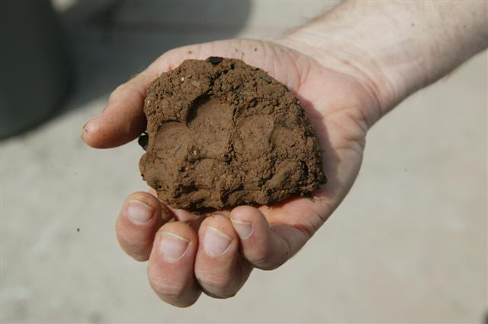
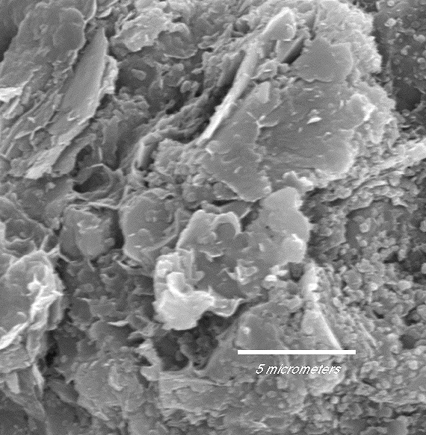
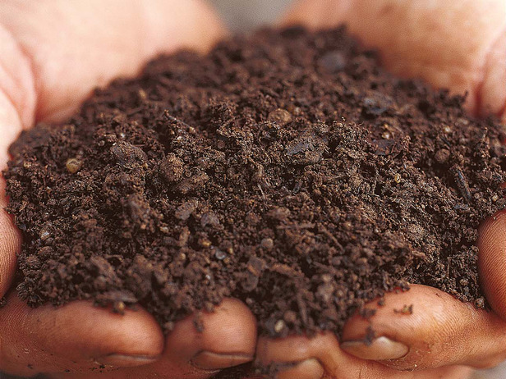
SANDY SOIL
SILTY SOIL
LOAMY SOIL
CLAY SOIL
Illustrated Progression of Soil texture with associated electron microscope grain size image

Slide 27
Soil Characteristics
The size of soil particles affects the characteristics of a soil. (Texture)
Soils are usually ‘categorised’ by the amounts of each type of particle that they have.
Particles are:
  Clay: less than 0.002mm
  Silt: 0.002mm – 0.063mm
  Sand: 0.063mm –2 mm
  (Gravel: 2mm to 20mm (medium))

Slide 28
‘TEXTURE’ …This categorisation is termed ‘Gradation’:
Gradation is a measure of the
‘Textural distribution of a particular soil sample’.
Larger gradation means a wider particle size distribution.
‘Poorly sorted’ indicates wide range of sizes (e.g., glacial till)
‘Well sorted’ indicates a narrow range (e.g., beach sand)
The size of soil particles and the textural grading affects how much water & air the soil can hold (therefore it’s Relative Density, propensity for expansion and contraction, porosity, permeability)
The smaller the particles, the less water and air the soil can hold and the less the flow of water through it.
If larger particles predominate, the water flow is generally faster through the soil.
This is the basis of the ‘Granular’ or ‘Cohesive’ textural definition.

Slide 29
What properties of the soil can be estimated from this process of determining ‘TEXTURE’?
1.We measure water flow, and its relationship to particle size, by measuring Porosity (by calculation) and …
2.Permeability - by apparatus, data collected and analysis –
utilising comparison to Darcy’s Laws of hydrology and fluid flow

Slide 30
Soil / Water related subjects
•Soil ‘Classifications’ in Texture
•Soil Consistency limits / cohesion
•Permeability/hydraulic conductivity
‘Index properties’ describe the observable physical
characteristics with significant influence on a soil’s behaviour.
Index properties include the descriptions of:
1. Soil Texture - The description of the grain size distribution of soil particles according to their texture (particle size, shape, and gradation).
2. Soil Consistency - The relative ease with which a soil can be physically altered with increasing water content.
3. Soil Density

Slide 31
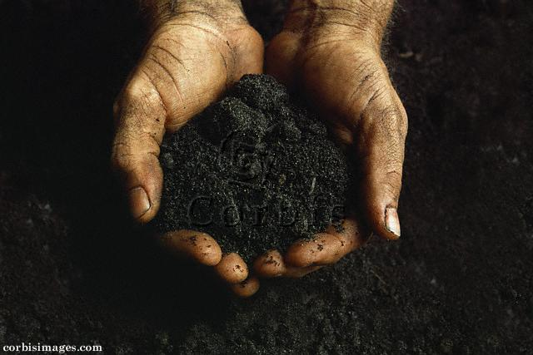
1.Soil Texture = % Sand, Silt & Clay in a soil.
Soil texture is the single most important physical property of the soil. Knowing the soil texture alone will provide information about:
1) Water flow potential
2) Water holding capacity
3) Fertility potential
4) Stability in high moisture content and de-hydrated condition (our ‘phase relationships’)

Slide 32
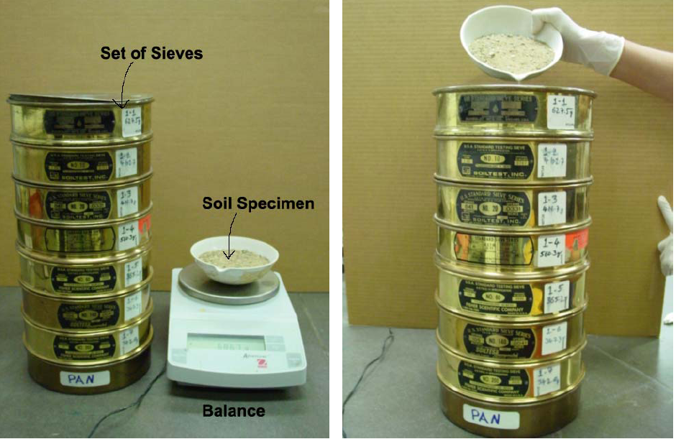
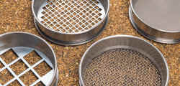
Particle Diameter Size
TEXTURE TEST - SIEVE ANALYSIS
Soil particle diameters range over 6 orders of magnitude
  2 m boulders
  Coarse fragments > 2 mm
  Sand < 2 mm to 0.05 mm
  Silt < 0.05 mm to 0.002 mm
  Clay < 0.002 m

Slide 33
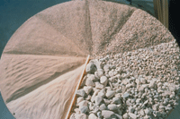
Sieve Analysis
The sample is dried in a kiln, cooled and weighed.
The sample is then passed through a series of sieves of reducing mesh size by mechanical vibration (2 minutes)
When this is complete, the amount retained on each sieve is weighed and expressed as a percentage of the original sample weight.
The cumulative percentage by
weight of the sample % passing
each sieve is recorded
graphically.
5. The Silt in the sample is retained
within a solid dish at the bottom
of the stack.

Slide 34
Example 1:
A sieve analysis was carried out on a soil and gave the results shown below.
Determine the percentages passing each sieve and hence draw the particle size distribution curve.
The original sample was of mass 350g
Sieve size | 2 mm | 1.18mm | 600 Mic | 425 Mic. | 300 Mic. | 150 Mic. | 63 Mic. | 40 Mic. | 2 Mic. | 1 Mic.
Mass retained | 12 | 54 | 60 | 25 | 63 | 39 | 28 | 25 | 30 | 12
Sand
Silt
Clay

Slide 35
Example 1:
The original sample was of mass 350g
SIEVE | MASS retained | % on Sieve | % Passing
2 mm
1.18mm
600 micron
425 micron
300 micron
150 micron
63 micron
40 micron
2 micron
1 micron
PAN

Slide 36
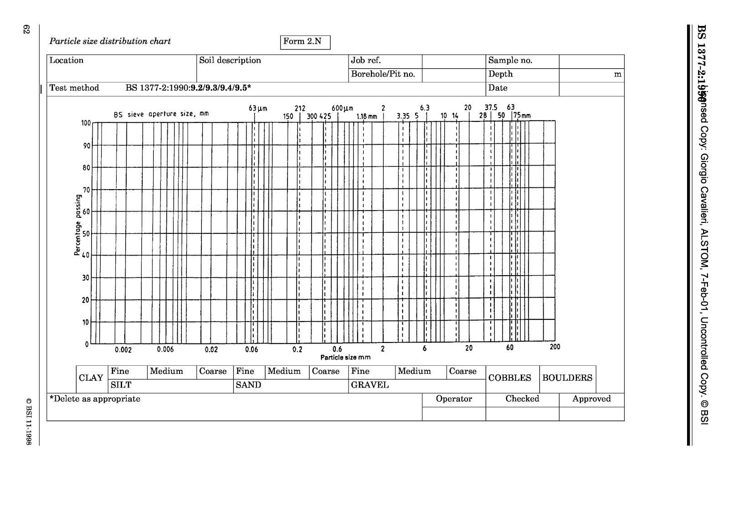

Slide 37
SEDIMENT SIZE – Standard Definitions
Proportional % of SAND, Silts and Clays ??

Slide 38
From our data we can work out the % of sand, silt and clay in the sample
Particles are:
  Clay: 0.002mm and below
  Silt: 0.002mm – 0.063mm
  Sand: 0.063mm – 2mm

Slide 39
Soil TEXTURE
The Textural Classification of Soil is based purely on the grain size distribution and is classified into three groups, namely sand, silt and clay.
The position of every point inside the ‘Soil Triangle’ represents the sieve analysis of soil of particular grading.
After determining the grain size of a sample, the chart is read as follows:

Slide 40
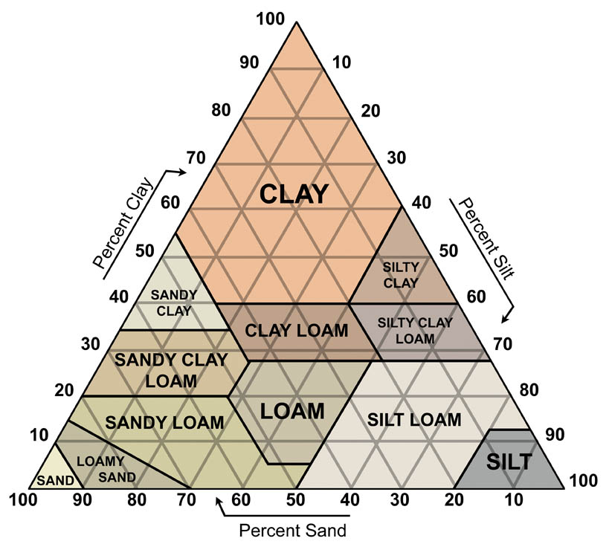
Triangular graph of Soil Texture
1. Spaces vertically upward starting from zero at the bottom represent clay percentage.
2. Spaces from left to right diagonally downward starting with zero at the left, represents silts.
3. Spaces from right to left diagonally downward starting with zero at the left, represents sand.
Mark on the graph a soil sample with:
30% Sand, 50% Clay and 20% Silt.
Indicates …
30% sand
50% clay
20% silt
Particles are:
  Clay: less than 0.002mm
  Silt: 0.002mm – 0.063mm
  Sand: 0.063mm – 2mm

Slide 41
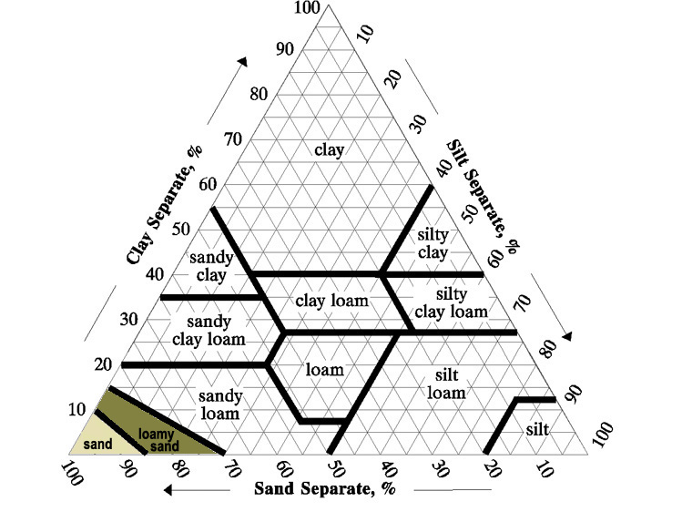
Sandy Soils
Coarse texture
  Sands
  Loamy sands

Slide 42
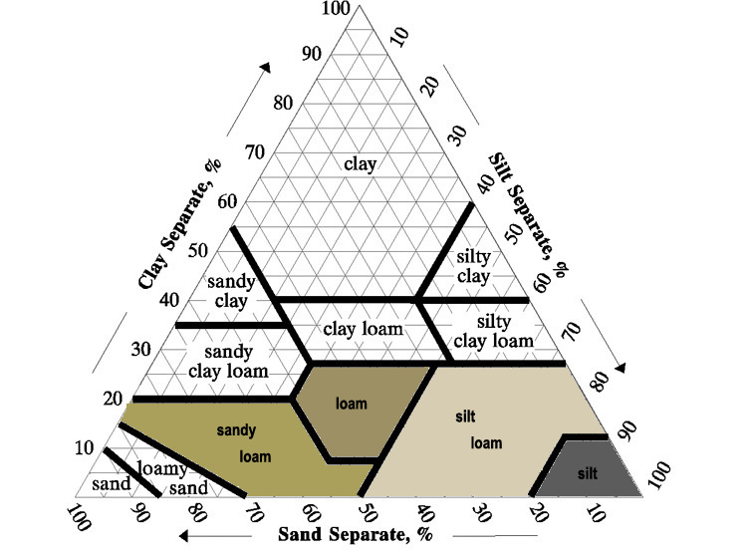
Loam / Silt Soils - Medium
Medium texture
  Very fine
  sandy loam
  Loam
  Silt loam
  Silt

Slide 43
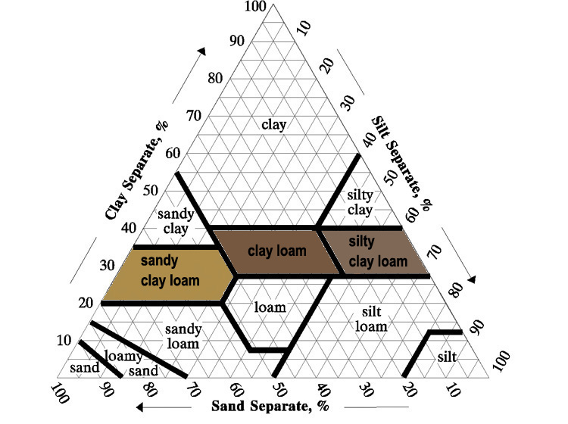
Loam - Silt Soils - Fine
Moderately
fine texture
  Sandy
  clay loam
  Clay loam
  Silty
  clay loam

Slide 44
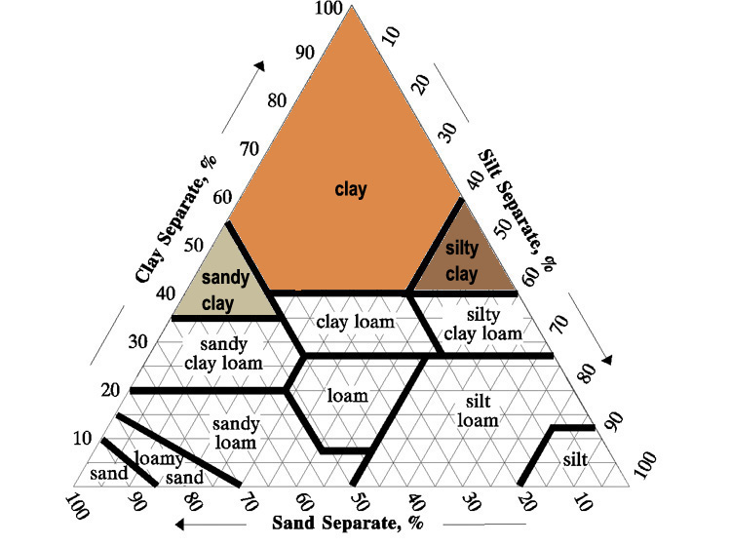
Clay Soils
Fine texture
  Silty clay
  Clay
  Sandy clay

Slide 45
Summary…..Effects of Particle Size
The granular size of soil particles affects how much water & air the soil can hold.
The smaller the particles, the less water and air the soil can hold.
However, if the soil is made entirely of larger particles, the water will run right through the soil at a much faster rate.
We measure water flow by measuring Porosity and Permeability…This relates to particle size.

Slide 46
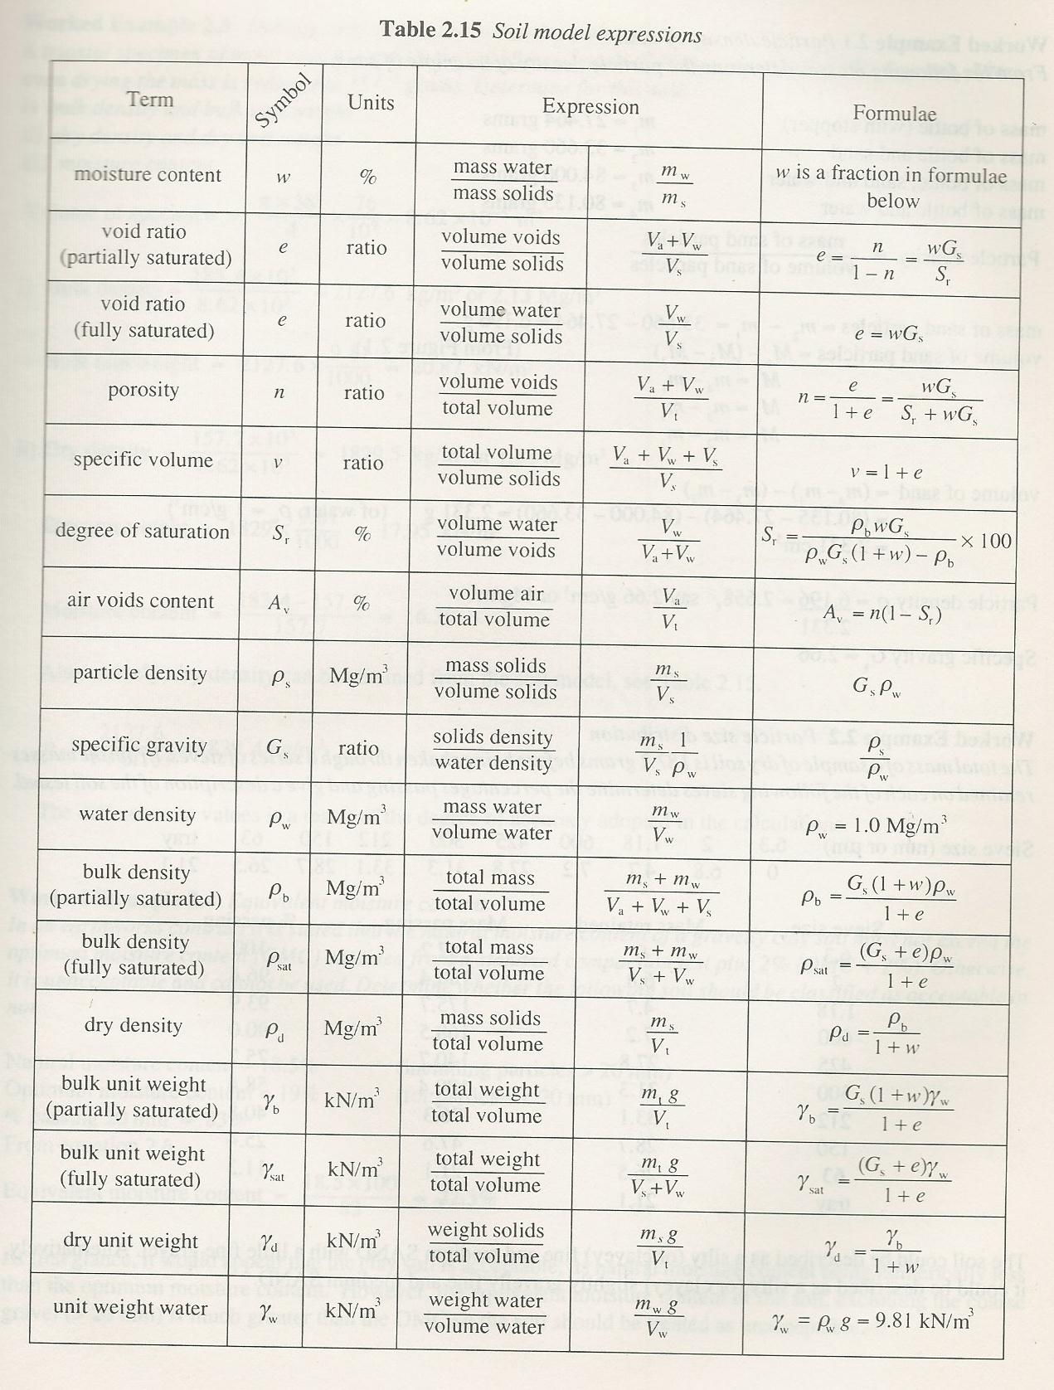
Soil
Model
Expressions
Density = m / V
Weight = mg
Mega-grams (metric tons) per cubic metre (Mg/m3) – Water has density of 1000kg/m3

Slide 47
Water content
The water content (w) is the ratio of mass of water to the mass of solids in the soil i.e.
        w = Mass of water = Mw
Mass of solids Ms
This is the percentage of the oven dried mass of the sample
Units = %
Water content is determined by weighing a wet sample of soil and then drying the sample in an oven at a temperature of around 105-110 degree C

Slide 48
The Void Ratio (e)
Is the ratio of volume of the voids to the volume of the solids.
VOID RATIO (e) =
        Volume of voids = V_{v}
Volume of solids V_{s}
e =
w G_{s}
ρ_{w}
ρ
e = (G_{s} (1 + w)
)
-1
or
S_{T}
Where: G_{s} = Specific Gravity
w = water content
ρ =
ρ
bulk density
w
=
density of water

Slide 49
The Porosity (n)
Is the ratio volume of the voids to the total volume of the soil sample.
        Volume of voids = Vv
Total Volume V_{T}
POROSITY (n) =
Units = Ratio
The Void ratio and Porosity are inter related as follows:
e
Void ratio
Or n = e
1 + e
Porosity

Slide 50
Bulk Density (ρ)(roe)
The bulk density of the soil is the ratio of the total mass to the total volume.
ρ
= MASS
VOLUME
Convenient units for density are kg/m³ or Mg/m³.
The density of water is 1000 kg/m³ or 1 Mg/m³ and is denoted by ρ w
The specific gravity of soil particles (Gs) is given by :
Gs
=
ρ
s
Where ρs is particle density
ρ
w

Slide 51
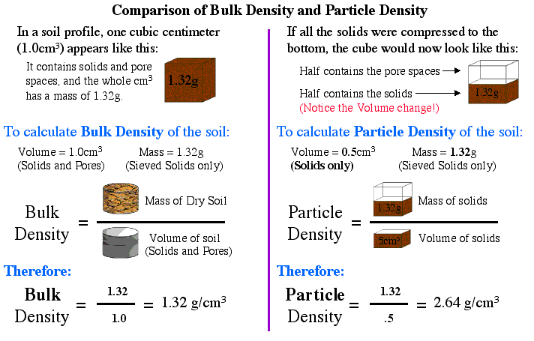
Comparison of Bulk Density and Particle Density

Slide 52
Degree of Saturation
The degree of saturation, S_{T} , has an important influence on soil behaviour.
It is defined as
T
Unit = Ratio
And is the ratio of the volume of water to the total volume of the void space.
The degree of saturation can range from zero for a completely dry soil, to 1 (or 100%) for a fully saturated soil (our ‘phase relationships)

Slide 53
Degree of Saturation
The degree of saturation, S, has an important influence on soil behaviour
It is defined as
The degree of saturation can be derived with other elements to be expressed as :
S_{T} = w G_{s}
e
T
x
Water Content x Specific Gravity
=
Void Ratio

Slide 54
Air Content or Air voids (A_{v})
The air content or air voids (A_{v}) is the ratio of the volume of air to the total volume of the soil.
It is defined as: Air voids (A_{v} ) = V_{a}
V_{T}
Units = %
A_{V} = n (1-ST)
or
Where ST = Degree of Saturation
n = Porosity

Slide 55
Exercise
In its natural condition, a soil sample has a mass of 2290g and a volume of 1.15 x 10 ⁻³ m³.
After being completely dried in an oven, the mass of the sample is 2035g.
The value of G_{s} for the soil is 2.68. Determine the following:
The bulk density
2) Water content
3) Void ratio
4) Porosity
Degree of saturation
Air content.

Slide 56
1) Bulk density ρ = M = 2.290 = 1990 kg/m³
V 1.15 x 10⁻³
2) Water content w = M_{w} = 2290-2035 = 0.125 (or 12.5%)
Ms 2035
3) Void ratio e = G_{s} (1 + w) ρ_{w} - 1
ρ
= (2.68 x 1.125 x 1000 ) - 1
1990
= 1.52 -1
= 0.52

Slide 57
4) Porosity n = e = 0.52 = 0.52 = 0.34 (or 34%)
1+ e 1+ 0.52 1.52
5) Degree of saturation S_{T} = wG_{s} = 0.125 x 2.68 = 0.645 (or 64.5 %)
e 0.52
6) Air content A = n(1- S_{T} ) = 0.34 x (1 - 0.645)
= 0.34 x 0.355
= 0.121 (or 12.1 %)

