Slide 1

Effective Team Working
And Communication
Marius Tascu
Student nr: 2121173

Slide 2
Introduction
To improve teamwork, one must first address communication style. The good news is that one can achieve excellent team communication even if he/she work with a team of talented but uncommunicative people (Tarricone and Luca, 2020).
An atmosphere of openness, cooperation, and politeness should be established as a first step. As with so many other initiatives in the workplace, this needs to be spearheaded by management.
Managers and mentors are the go-to sources for direction among staff members. Therefore, there are a variety of things that leaders may do to facilitate effective team communication.

Slide 3

advantages of efficient communication for Tom
Fostering Trust
Fostering Loyalty
Team Engagement
Enhancing Teamwork
Productivity Boost
Communication stimulates innovation
Fixing Problems
Relationship with Client

Slide 4
Communication Theories and model(s) should Tom employ
Fixed Structures in Weber's Classic Organizational Theory
Because roles and responsibilities are well defined, communication inside organizations is hierarchical, structured, and clear. Organizations have constricted, machine-like assemblies where each worker pays through well-defined occupations and obligations in the meantime there is no opportunity for indistinctness in top-down communications.
The organizational control theory of Tompkins and Cheney
Tompkins and Cheney's organizational theory is a Weberian approach that can be used by businesses that are poignant away from a bureaucratic model but are not yet entirely decentralized (Wesis, D. H. 2017).
Managerialism Theory of Deetz
Going beyond the traditional concepts of organizations, Deetz proposes an substitute visualization of administrations that takes into version both the control centers of the group and the independent ambitions of its members. This alternative vision of organizations goes outside the traditional concepts of organizations (Wellins et. al, 2021).

Slide 5
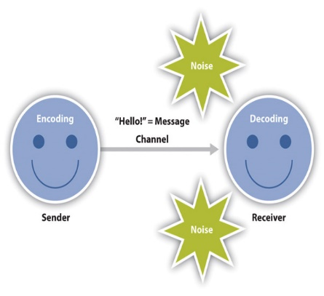
Communication Models
Linear model of communication
The linear model of communication, repeatedly known as the transmission model, shows a sender handover a message to a receiver (Ellis & mcclintock, 1990). This strategy places an weight on both the messenger and the message. Although the receiver is considered to be a part of the model, their role is more of a stopping point than an current process.

Slide 6
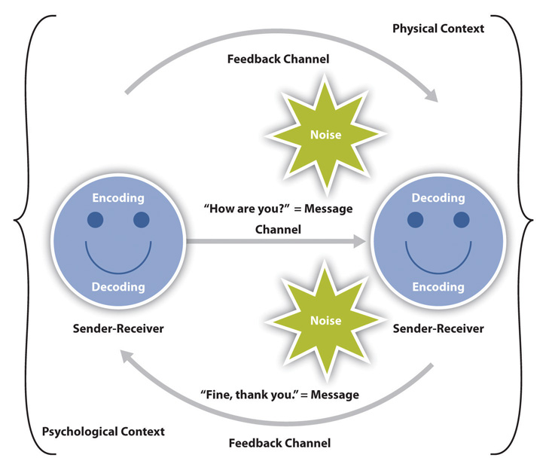
Interactive model of communication
The model of communication known as the interactive or interaction model, in which individuals take turns acting as sender and receiver and construct meaning by replacing messages and getting responses from one another (Beyerlein et. al, 2019). Because the interactive method incorporates feedback, communication is enhanced to be more participatory and two-way as a result. The term "feedback" also include "reply messages." It's possible that your professor will respond to a point you raise during a class discussion, or that you might point to the couch if your roommate asks you for the remote (Fisher, 2018).

Slide 7
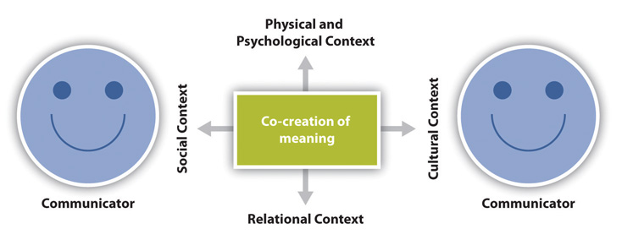
Transaction model of communication
These settings place a premium on communication in both instructions (transmission and reception). Because the transaction model of communication considers communication to be a factor that encouragements our experiences both before and after we communicate with others, it is necessary for this model to take into consideration variables of context that are not exclusive to a single transaction. In order to accomplish this, the transaction model conducts research on social, relational, and cultural factors (Manion et. al, 2020).

Slide 8

Communication hurdles have negatively impacted the project team
Conflicts in workplace related to communication
Collaboration
Unchecked rumors
Closed loops

Slide 9

The communication channels Tom will utilize to improve communication-interpersonal communication
Interpersonal communication is required for many activities, such as brainstorming sessions, for example, because it is essential for all participants to feel valued and to have the opportunity to voice their thoughts.
1. Interpersonal communication Skill
2. Alignment with corporate objectives
3. Trust

Slide 10

Written communication formats
All written communications should be simple, plain, straightforward, and easily comprehended (Beyerlein et. al, 2019).
avoid omitting vital information, written messages should be concise. The clarity of a statement is enhanced by concision.
Maintaining A professional and formal tone
There should be no omissions from a written letter

Slide 11

Conclusion
It is necessary for individuals to have faith that they can talk openly and honestly with one another in order for there to be exceptional communication within a team. In the event that this is not already taking place, leadership should work to establish conditions in which it can embellishment (Manion et. al, 2020).

Slide 12
Teamwork Evaluation | Team responses.
Who made up your squad? | 5 Members
What were your team's main advantages? | communication, collaboration, adaptability, creativity, and empathy
What were the difficulties that your group overcame? | minimal or non-existent leadership skills. Team members are having trust concerns. Having trouble understanding and communicating. Conflicts, tension, and office politics. dull workplace conditions confusion on the roles.
What would you change if you had the chance to work in a team once more? | Turn potential weaknesses into learning opportunities Talk about how you'd handle the situation now
How effective do you think your team is? Out of 10? | 8

Slide 13
References
Scarnati, J. T. (2020). On becoming a team player. Team Performance Management: An International Journal, 7(1/2), 5-10.
Tarricone, P., & Luca, J. (2020). Successful teamwork: A case study.
Sheard, G., Kakabadse, A. & Kakabadse, N. (2019). Leadership Teams: Developing and Sustaining High Performance. Illustrated: Palgrave Macmillan.
Wellins, R., Byham, W., Wilson, J. (2020). Empowered Teams: Creating Self-Directed Work Groups That Improve Quality, Productivity, and Participation. New: Jersey: Jossey-Bass.
Wesis, D. H. (2013). Effective Team Building: The Successful office skills series. Illustrated: AMACOM
Quick, T. L. (2022). Successful Team Building. America: AMACOM Div American Mgmt Assn.
Sheard, G., Kakabadse, A. & Kakabadse, N. (2019). Leadership Teams: Developing and Sustaining High Performance. Illustrated: Palgrave Macmillan.
Wellins, R., Byham, W., Wilson, J. (2021). Empowered Teams: Creating Self-Directed Work Groups That Improve Quality, Productivity, and Participation. New: Jersey: Jossey-Bass.
Wesis, D. H. (2017). Effective Team Building: The Successful office skills series. Illustrated: AMACOM
Sheard, G., Kakabadse, A. & Kakabadse, N. (2018). Leadership Teams: Developing and Sustaining High Performance. Illustrated: Palgrave Macmillan.
Wellins, R., Byham, W., Wilson, J. (2021). Empowered Teams: Creating Self-Directed Work Groups That Improve Quality, Productivity, and Participation. New: Jersey: Jossey-Bass.
Wesis, D. H. (2020). Effective Team Building: The Successful office skills series. Illustrated: AMACOM. Adair, J. E. (2019). Effective team building: how to make a winning team. Illustrated. Pan Macmillan.
Beyerlein, M. M., Douglas A. Johnson, D. A. & Beyerlein, S. T. (2019) Virtual Teams. Volume 8, Illustrated: Emerald Group Publishing.
Cole, G. A. (2013). Management Theory And Practice.6, Illustrated. Cengage Learning EMEA.
Fisher, K. (2018). Leading self-directed work teams: a guide to developing new team leadership skills.2, Illustrated, Revised: McGraw-Hill Professional.
Manion, J., Lorimer, W. & Leander, W. J. (2020). Team-based health care organization: blue print for success. Illustrated: Jones & Bartlett Learning.

