Slide 1

Preparing for the Role of Constable
Week 2 Part 1

Slide 2
Session Topics
Criminal Attempts Recap
Assaults Recap

Slide 3

Aims and Objectives
Describe the points to prove relating to a Criminal Attempts offence.
Identify when a Criminal Attempts offence has taken place.

Slide 4
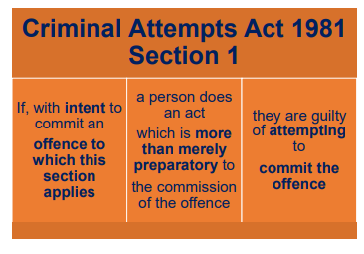
Criminal Attempts
Notes:
The police have to provide evidence that the act was immediately, and not remotely, connected with the commission of the crime as well as more than merely preparatory. Intent is looked at in more detail in the following slide; Offence to which this section applies includes indictable or triable either way offences, it does not apply to summary offences. This means you cannot ‘attempt to commit’ a summary offence (e.g. depositing litter or taking a vehicle without the owner’s consent

Slide 5
Offence to which this section applies includes indictable or triable either way offences, it does not apply to summary offences.
This means you cannot ‘attempt to commit’ a summary offence (e.g. depositing litter or taking a vehicle without the owner’s consent)

Slide 6
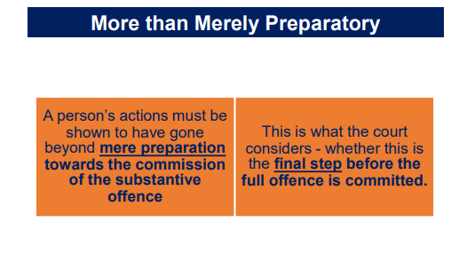
Notes:
The question as to whether an act is more than merely preparatory to the commission of an offence is ultimately one for the jury to decide. However 2 tests have been set out over the years and have been accepted by the Appeal Courts: 1) The test set out in R v Eagleton 1855 (Dears 515) states: Whether there was any further act on the defendant’s part remaining to be done before the completion of the crime.

Slide 7
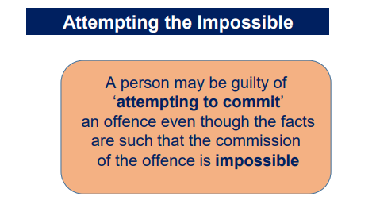
Notes:
It does not matter, for the offence of criminal attempt, whether the attempted offence would actually have been impossible to carry out. Section 1(2) of the Criminal Attempts Act 1981, makes it is possible for someone to attempt the impossible

Slide 8
Example:
A woman tries to steal property from an open bag: she gently puts her hand into another person’s open bag whilst standing next to them on a bus.
The woman intends to steal a purse, wallet or mobile phone but when she feels around inside the bag, she realises the bag is empty.
Even though the full offence of theft is impossible, she has still attempted to commit the offence of theft.

Slide 9
Preparing
Talking/thinking about committing an offence of burglary.
No attempt to commit an offence.

Slide 10
Next step
Drive to a property to be burgled and get out of the car with a bag of tools.
No attempt to commit an offence.
HOWEVER - Consider what other offences may have been committed here?

Slide 11
Attempt
Go to a rear window and start to jemmy the window open.
This is more than merely preparatory.
This is an attempt to commit an indictable offence.

Slide 12

Task
Notes:
Class to get into pairs. Pairs to attempt the multiple choice questions that appear on the next few slides. Pairs to shares their answer and views with the rest of the class

Slide 13
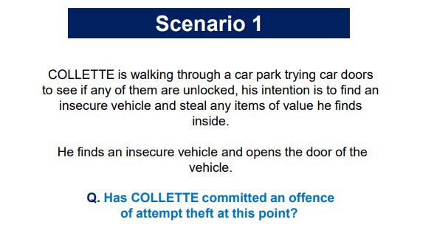
Notes:
Yes - When the car door has been opened

Slide 14
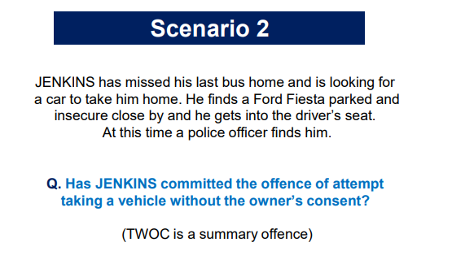
Notes:
No - TWOC is a summary offence therefore there is no criminal attempt

Slide 15
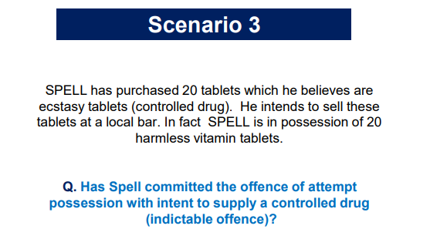
Notes:
Yes - Even though SPELL cannot commit the full offence as these were not ecstasy tablets it was his INTENT to sell these as ecstasy tablets (controlled drugs)

Slide 16
Offences Against the Person Act 1861
What are the offences within the scale of assaults?

Slide 17

The Scale of Assaults
.
Homicide: Murder, Manslaughter
.
G.B.H with intent - Section 18 OAP Act 1861
.
G.B.H - Section 20 OAP Act 1861
.
A.B.H - Section 47 OAP 1861
.
Common Assault - Section 39 CJA 1988

Slide 18
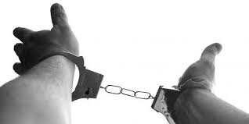
Key Points
Common Assaults:
The most minor form of assault
ABH: Where actual harm is caused, normally refers to physical injury.
Assault Police: Provided they are acting in the execution of their duty.
More Serious Assaults: Section 20 G.B.H or Section 18 causing G.B.H with Intent.
Homicide: Murder and Manslaughter

Slide 19
Section 39 Criminal Justice Act 1988
Assault and battery remained a common law offence until they became summary offences by S.39 Criminal Justice Act 1988.
There are TWO offences under S39 of the Criminal Justice Act 1988:
Common Assault
Assault by Beating (Battery)
Discuss – what does ‘Assault’ and ‘Battery’ mean?

Slide 20

Common Assault & Assault by Beating (Battery)
1. Although any injury can be classified as actual bodily harm, the appropriate charge will generally be contrary to section 39 where the injuries amount to no more than transient or trifling, for example;
grazes; scratches;
abrasions; minor bruising;
swellings; reddening of the skin;
superficial cuts; or a "black eye".
2. Assault and battery remained a common law offence until they became summary offences by S39 Criminal Justice Act 1988.
3. Common Assault – Triable summarily only– Maximum penalty
6 months imprisonment and/or fine on conviction.

Slide 21
Definition of Assault
Any act which a person intentionally or recklessly
Causes another person to apprehend
Immediate and unlawful personal violence

Slide 22
Definition of Assault – Key Words…
There is no legal definition of assault.
However this definition has been referred to in a court of law: R v Brown 1993
Any act – The act could be words in a letter, or a telephone call including threatening silences
No contact is required

Slide 23
Definition of Assault – Key Words…
Words alone
Can constitute an offence, however other criminal offences could be possibly be considered such as Section 4, 4A or 5 Public Order Act
Causes another person to apprehend – The action of the suspect leave the victim in no doubt of what he is about to face.
To apprehend is to anticipate or fear a certain act or consequence.
Apprehension can come from words, silence or conduct.

Slide 24
Definition of Assault – Key Words…
Immediate – Not necessary instantaneous but within a minute or two e.g. if a threat is made from outside a house to a victim inside a house, it would take a few moments before it could be carried out.
A future or conditional threat is not an assault. e.g. “I’ll punch your lights out next week”

Slide 25
Definition of Assault – Key Words…
Unlawful – A person who threatens another by shaking their fist at them or using some other threatening gesture commits an assault if they put the other in fear of immediate unlawful personal violence. It is the act of putting someone in fear rather than the injury that must be intended.
A “conditional threat” will not constitute an assault – e.g. a conditional threat would be a person saying to another “I’d chin you if there wasn’t a copper over there”
Personal violence – The person should fear a violent act being committed against him.

Slide 26
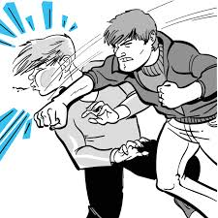
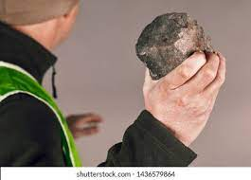
Intentionally vs Recklessly - What’s the difference?
Intentionally
Means a deliberate or purposeful act
Recklessly
Described as being aware of the existence of risk but nonetheless had gone on and taken it

Slide 27

Common Assaults by Beating
Definition of Battery
A person is guilty of battery if they intentionally or recklessly apply unlawful force on another person
Recklessly
The suspect foresaw that the consequence of their conduct might be the application of unlawful force against another person, but continued.
Intentionally
The suspect purposely takes part in some kind of conduct which applies unlawful force on another person.

Slide 28
Common Assaults by Beating
Unlawful force – Force can be applied in many ways, it involves contact but only the slightest degree of force is required. Force can be applied DIRECTLY
e.g. A applies force to B or INDIRECTLY e.g. A applies force to B who knocks into C (thereby applying force to C)
It can include a simple punch or kick, a blow with a stick or the throwing of a stone at someone. Technically mere touching is a battery
On another – the force can be applied indirectly e.g. a suspect punches a man carrying a baby, causing him to drop the baby. Force is applied to the baby.

Slide 29
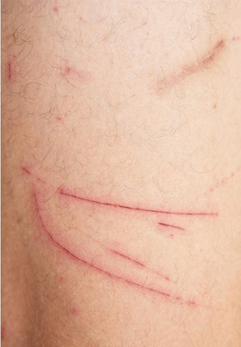
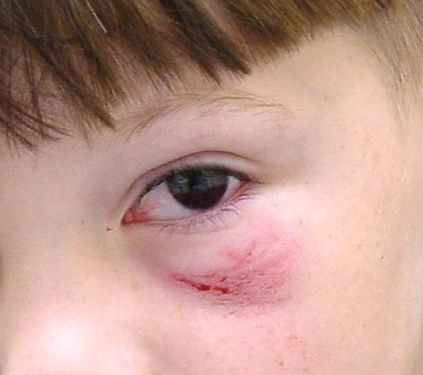
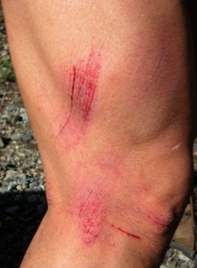
Examples of Injuries Consistent with Battery
Minor bruising or swelling e.g. black eye
Grazes; scratches; abrasions; swellings; reddening of the skin; superficial cuts;
Swellings; reddening of the skin; superficial cuts;

Slide 30
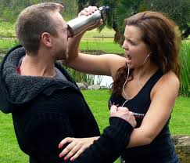
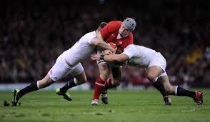

Defences
Self Defence
Consent
Implied Consent
Notes:
Lawful right or duty
The police are not above the law and must carry out their duties exercising reasonable force.
For use of reasonable force by any person see S.3 Criminal Law Act 1967.
For constables powers to use reasonable force see Section 117 PACE
Consideration will be made as to what was reasonable in the circumstances.
Since 21 March 2022, physically punishing children has been illegal in Wales.
The change in law does not create a new offence, rather it removes a 160-year old legal defence which sent the message that it was acceptable for children to be physically punished by their parents or those with parental authority.

Slide 31
S.47 - Actual Bodily Harm (ABH)
The main factor which distinguishes common assault by beating from ABH is the degree of injury.
Section 47 Offences Against the Person Act 1861
A person is guilty of an offence if he intentionally or recklessly uses unlawful force on another, thereby occasioning him actual bodily harm
Bodily harm – includes any hurt or injury calculated to interfere with the health or comfort of the victim. Such injury or hurt need not be permanent but must be more than merely transient. (lasting for only a short time)
The injury must be real and must be able to be seen and felt by the victim.
What do you think the definition of ABH is?
Intention or recklessness are the same for ABH as they are for common assault by beating, it only needs to be proved the assault was intended or carried out recklessly.

Slide 32
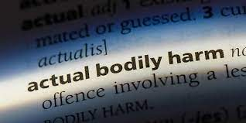
Actual Bodily Harm (ABH)
Actual Bodily Harm means :
Any hurt or injury calculated to interfere with a person’s health or comfort & includes physical harm or shock & mental injury
This definition is from case law
R v Chan-Fook (1994)
Harm can be permanent or temporary.
Harm includes both physical harm and shock or mental injury. It can include a loss of consciousness.

Slide 33
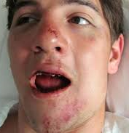
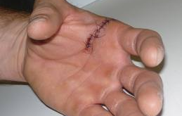
Examples of Actual Bodily Harm
Loss or breaking of a tooth
Temporary loss of sensory functions
Extensive of multiple bruising
Minor fractures and cuts requiring stitches
  These injuries may need not be visible or permanent, e.g. minor fractures such as a broken nose, bruising or abrasions.
Actual bodily harm has been held to include shock , psychiatric (i.e. mental) injury , a momentary loss of consciousness and there is even a stated case, DPP v Smith 2006, the deliberate cutting of a person's hair was found to be ABH
However it does not include mere emotions such as fear, distress or panic.

Slide 34
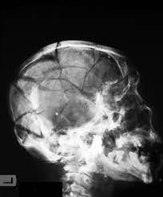
S.20 - Grievous Bodily Harm (GBH)
Whosoever shall unlawfully & maliciously wound or inflict any grievous bodily harm upon any other person, either with or without any weapon, or instrument, shall be guilty of an offence
The suspect must know that the actions would result in some kind of jury , but does not necessarily have to foresee the degree of the injury.
The injuries can be caused either with or without a weapon.

Slide 35
S.20 - Grievous Bodily Harm (GBH)
Unlawfully – means ‘without lawful justification’
Maliciously – includes intentionally or recklessly - the defendant must realise that there is a risk of some harm being caused to the victim.
It is only necessary to prove that the suspect FORESAW a RISK of SOME HARM and went on to use force against the victim regardless.
It is not necessary to prove that the suspect foresaw the EXTENT of the actual harm caused as a result – which may have been far more severe than anticipated
Wounding - is the breaking of the whole skin.
Inflict - there does not need to be a physical contact and it must be shown that the behaviour of the defendant brought about the resulting harm

Slide 36
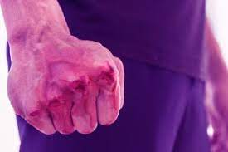
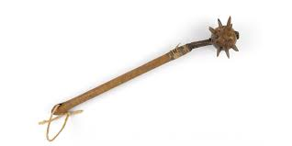
S.18 Grievous Bodily Harm (GBH) with Intent
Whosoever shall unlawfully & maliciously by any means whatsoever wound or cause any grievous bodily harm to any person
With INTENT to do some grievous bodily harm to any person
Or with intent to resist or prevent the lawful apprehension or detainer of any person shall be guilty of an offence

Slide 37
S.18 Grievous Bodily Harm (GBH)
with Intent
By any means whatsoever – harm can be produced in any way but a connection between the means and the harm must be proved.
Wound - the breaking of the whole skin e.g. a cut which goes right through all the layers of the skin whether externally or internally.
Cause – is to make something happen it is a wider term than inflict.
Intent – there requires a specific intent to wound or cause GBH. This is sometimes difficult to prove, although some obvious examples are
-a weapon is used
-repeated or planned attacks
-deliberate selection of a weapon or article adapted to cause injury – breaking a glass before an attack
-prior threats

Slide 38
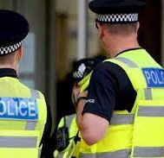
S.18 Grievous Bodily Harm (GBH) with Intent
Resist lawful apprehension – 2 elements are needed:
the arrest is lawful
the person knows arrest is being made
For example: if a suspect pushes a store detective who is trying to arrest them and causes them serious injury (as a result of the push) the offence has been committed
Detainer – is anyone acting in the detention of the suspect i.e, store detective, police, customs officer etc

Slide 39

Any Questions

