Slide 1
Effective team work and Communication
Student ID:1813025
Student Name: Domnica Iacoban
Assignment
Module cod: BMSK4002

Slide 2
Table of contents:
Benefits of team work
Team development stages
Importance of team roles
Conflict management

Slide 3
Benefits of team work:
CREATIVITY
EFFICIENCY
DISTRIBUTION OF WORK
BBUILDS TRUST

Slide 4
According to Tuckman’s theory, team development strategies are:
FORMING
STORMING
NORMING
PERFORMING
ADJORMING

Slide 5
  T together
  E everyone
  A achieves
  M more

Slide 6
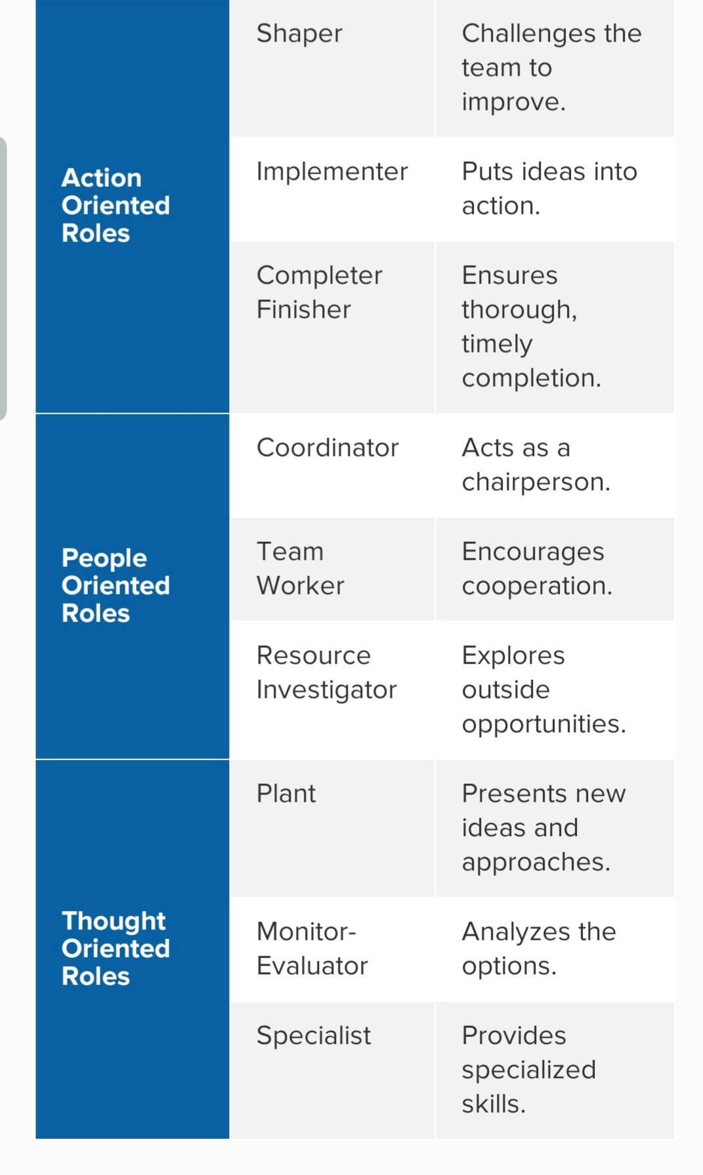
M . Belbin (1970) team roles Theory:

Slide 7
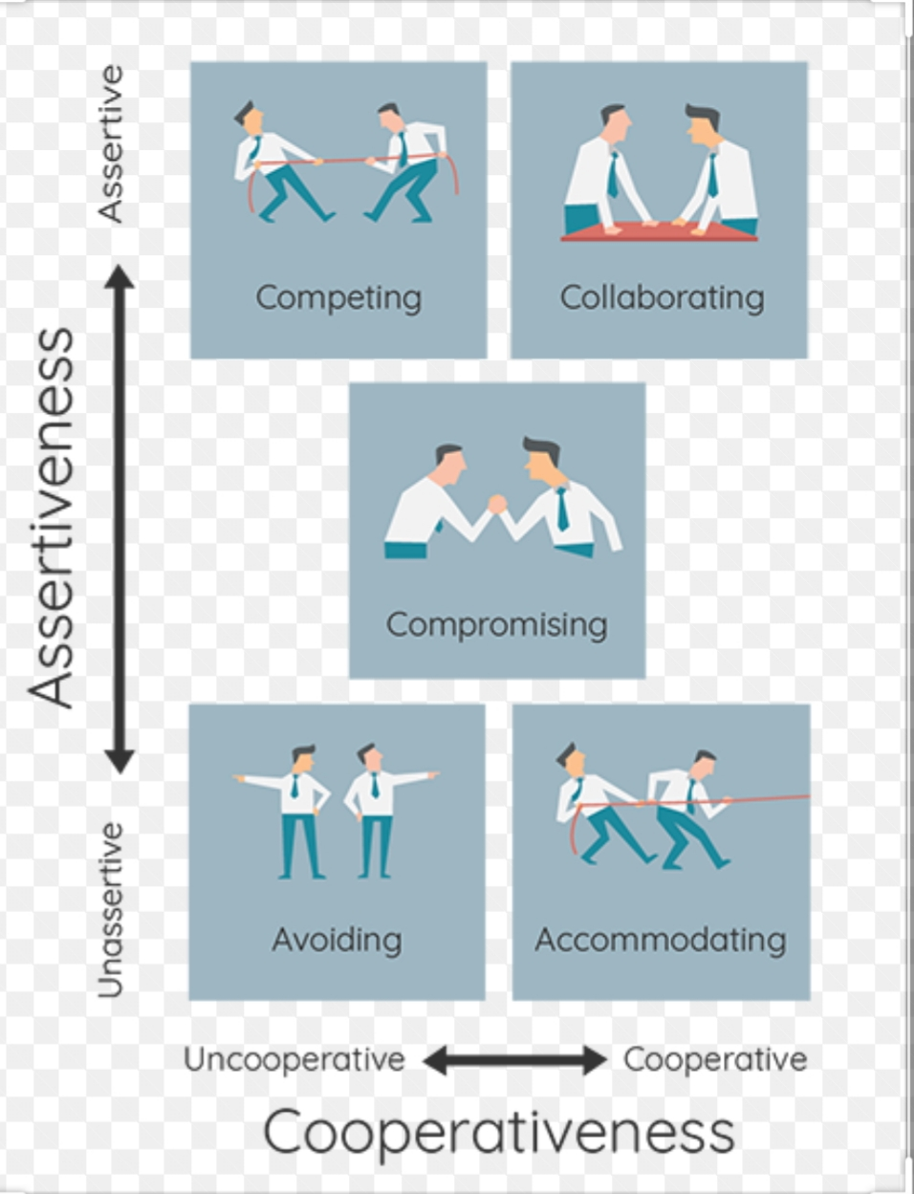
Thomas Kilmann Managing Conflict
Model:

Slide 8
Methods for managing conflict
Avoiding conflict
Controling conflict
Resolving conflict

Slide 9
References
Mindtools.com. (2019). Forming, Storming, Norming, and Performing: Understanding the Stages of Team Formation. [online] Available at: https://www.mindtools.com/pages/article/newLDR_86.htm [Accessed on 23 Nov. 2019]
M. Belbin (1970) Team Roles: How Understanding Team Roles Can Improve Team Performance. [online] Available at: https://www.mindtools.com/pages/article/newLDR_83.htm [Accessed on 10 Nov. 2019].

