Slide 1

NAME: Andreea Scarlat
STUDENT ID: 2128314
MODULE: BMSW4004
LECTURED NAME: Muhammad Islam

Slide 2
Introduction
It is observed that the Torque Brand (shirt-maker) employs 50 employees, encountered issues caused by the decline of purchases because of pandemic restrictions and consumers performed from home.
Earlier to COVID-19, the organisation had expanded to run over 150 shops around the globe.
Over the COVID, the formalwear and apparel of men particularly was one of the big hit of retailer industry, as restriction of events and work-from-home meant demand for formal tailoring and suits waned. But, the organisation undergoing a substantial restructuring at the commence of COVID, the effect on this British company has been severe.

Slide 3


PESTEL 1
Politic:
Pandemic
Staying at home
People died
Economical:
Inflation
Rate has gone up
Profit of loss

Slide 4

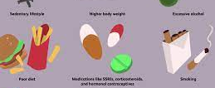
PESTEL 2
Social:
Lifestyle factors
Population
Work from home
Technological:
Innovation
Social networking
Security

Slide 5


PESTEL 3
Legal:
Health and safety
Employment low
Consumer safety
Environmental:
Restriction
Government regulations
Workplace health

Slide 6

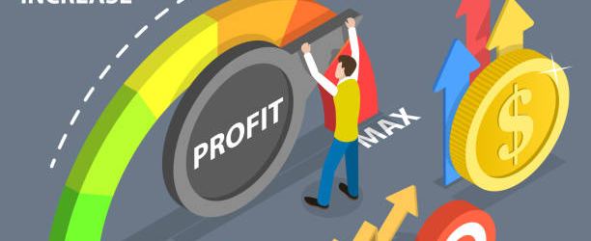
SWOT 1
Strengths:
High profit margins
Management team
Experience
Weaknesses:
Single brand strategy
Inexperienced staff
High setup cost

Slide 7
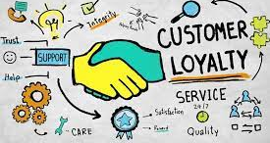

SWOT 2
Opportunities:
Customer loyalty
Growing market
Support
Threats:
Strong competition
High taxes
Obstacles (Inflation)

Slide 8
MATERIAL
MEASUREMENTS
METHOD
RESTRICTIONS ON EVENTS
COST INCREASES
FABRIC COST
NON-ESSENTIAL GOODS
SUPPLY CHAIN
RESOURCES LIMITED
LIMITED MAINTENANCE BUDGET
JOB INSECURITY
COVID-19
DISSATISFACTION WITH SALARY PAYMENT
DISAPPOINTING CUSTOMER SERVICE
INFLATION
LACK QUALIFIED STAFF
RISING INFLATION
MACHINE
EMPLOYEE
ENVIRONMENT

Slide 9
Alternative solution
The best bet for Torque Brand to overcome the issues is to ask pertinent queries, keep mind clear, and execute useful strategies.
As a consultant in company, it is suggested company to make effective collaboration and communication with suppliers, consumers, customers, and employees during pandemic.
It may facilitate Torque to have concise and clear message to them using digitalisation to take regular updates.
By using social media platforms company can recover the issue of supply chain and retailer may satisfy and deliver the resources and products timely and effectively.
To solve their problems about customer service because 21% on reviews are negative.

Slide 10

Conclusion
Get Organized. To achieve business success you need to be organized.
Be creative, always come up with new offers.
Improve your website, get active on social media.
Encourage feedback to your staff

Slide 11

References
Balgova et al., 2021
Quarries Regulation 1999
Homeniuk and Collins, 2021

