Slide 1
UML
Behavioural Models #2

Slide 2
Behavioural Diagrams
Use-Case Diagrams
Sequence Diagrams
State Charts
Activity Diagrams

Slide 3

Use-Case Diagrams
Represent the processes within the system
Highlight the functional components of a process
Show the dependency between functions in the system

Slide 4
Sequence Diagrams
Show sequence of events throughout a given process in a system
Outline in some granularity communication between different entities within the system.
Provide a greater level of detail, outlining alternative, optional and loop flows through sub-frames

Slide 5

Okay we have static, what about dynamic
This far we have represented our system from static perspective
Whilst this is perfectly sensible, sometimes we may want to utilise representative filler structures
This represents the fluid nature of the system and its tendency to change

Slide 6
How do we evidence dynamic ?
The simplest and easiest way of doing so is through a diagram
  Collaboration diagram
A collaboration diagram is very basic but shows the progression of each instantiated object in the system

Slide 7
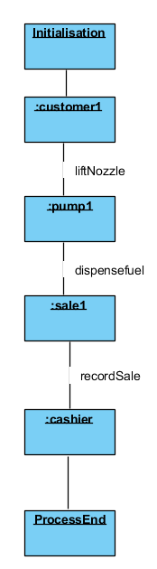
Collaboration Diagram
Consider the blue elements here, what are they
Showing us ?
Why are they named in the way that they are ?
What is the purpose of the links between each of
The elements ?

Slide 8

The purpose of such a basic diagram
Works as a technical equivalent to a sequence diagram
Used in place of the sequence diagram if the representation of operation timing is not required
Outlines the organisational structure if of the objects

Slide 9

Is there another way of representing my system ?
Sometimes it is necessary to represent a system in a way that exhibits the system’s behaviour under certain conditions
If a system is currently in operation, a snapshot of this operation is often referred to as:
  A state

Slide 10
System State Transition
Start
Login – Unauthorised
Login – Authorised
Enter Data –Data entry
Confirm Entry – Confirmation State
  Error Screen – Error State
  Success screen – Success State
End

Slide 11
Fuel Pump
What sort of states do you think occur in a fuel pump ?

Slide 12
Okay so we have an idea of the states in a system….
How do we use this information ?
To show the differences in instances that the system may reside in
How does this link to behaviour ?
Representation of the system at a given point evidencing the properties of the system at this point
How do we represent this ?
Yet more diagrams – in this case; state charts

Slide 13
State-Chart
A state-chart allows for the representation of a system whilst in a given state.
What are the benefits of visualising a system in a given state ?
What are the detriments of visualising a system in a given state ?

Slide 14
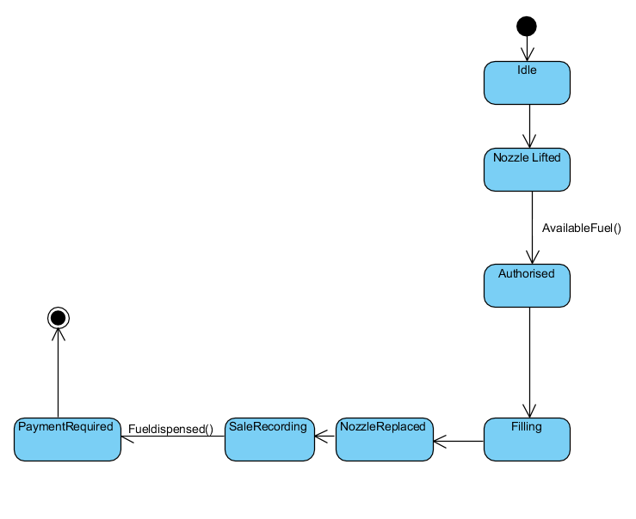
Fuel Pump State-Chart

Slide 15
So what does this show us ?
The fuel pump exists in many states
This can be represented by the containers that convey each state in much the same way as the use-cases within a use-case diagram
The transition between each of the states
The criteria for transition

Slide 16
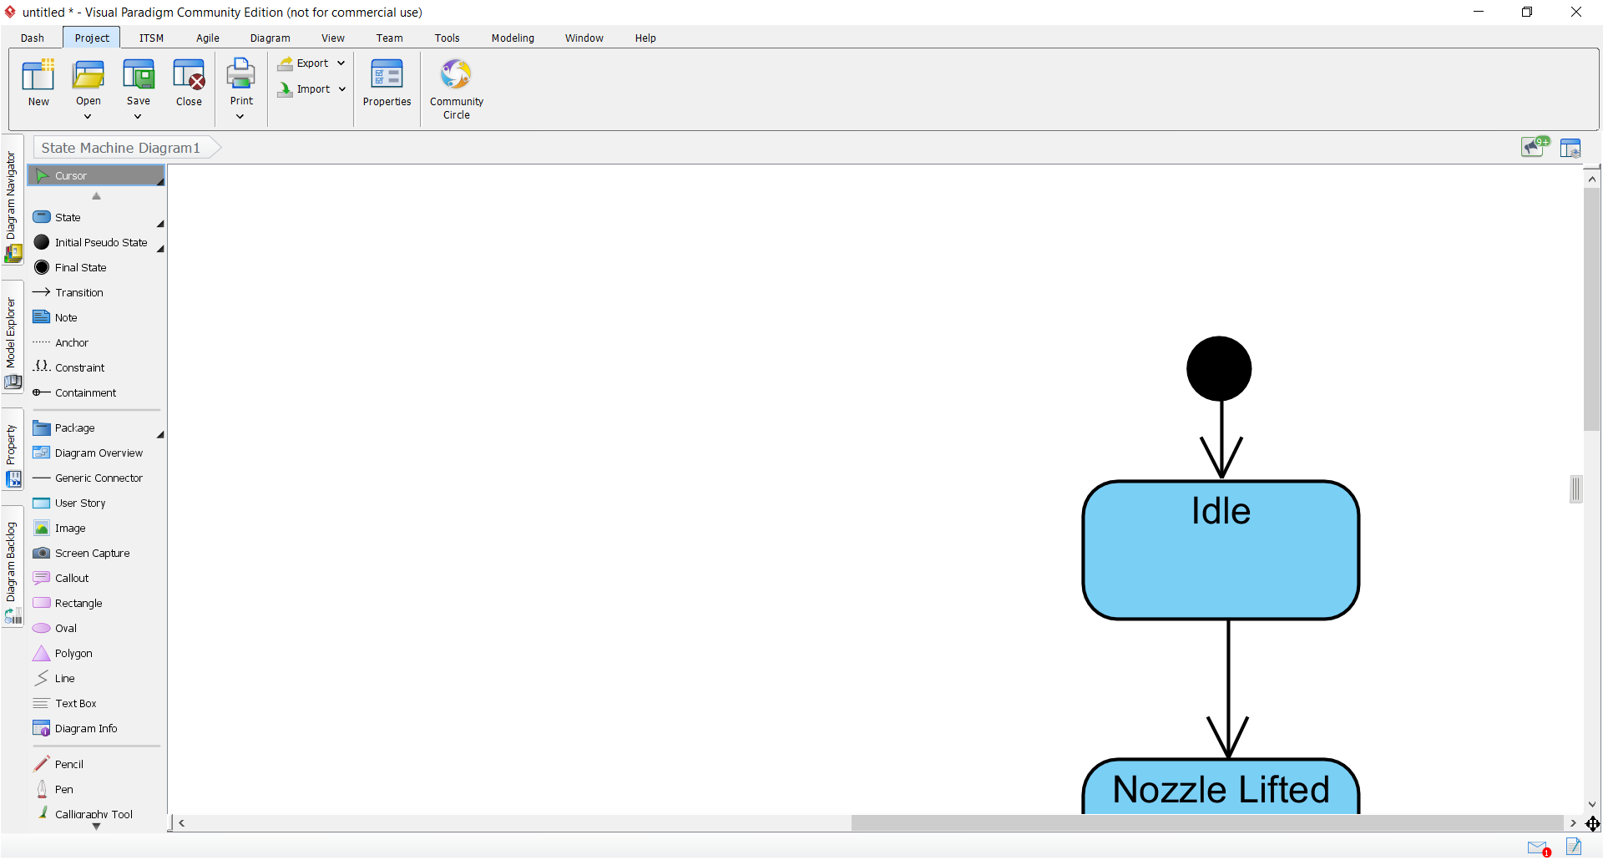
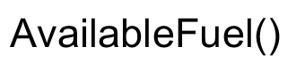
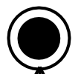
State-Chart Notation
Initial State
The state itself
Transition
Conditions
Terminal state

Slide 17

How many states are there ?
Dependent on interpretation
Make your states clear – define everything and note the transition conditions and actions

Slide 18
Surely that’s it for diagrams ?
Sadly No
  There is one more semi-important diagram
Luckily we have covered this diagram but in another form

Slide 19
This seems familiar
Sometimes its necessary to map the actions within the system and not the transition of objects
Where have we seen this sort of thing before ?

Slide 20
Why is it always flowcharts ?
Enter Vin
Is valid VIN ?
Display Invalid Message
No
Yes
Update Vin
Display Updated Message

Slide 21
Activity Diagram
An activity diagram is very similar in nature to a flow chart
It represents the progression of activity through the system
This diagram differentiates itself from the others in that it focuses on activity transition not specifically the objects.

Slide 22
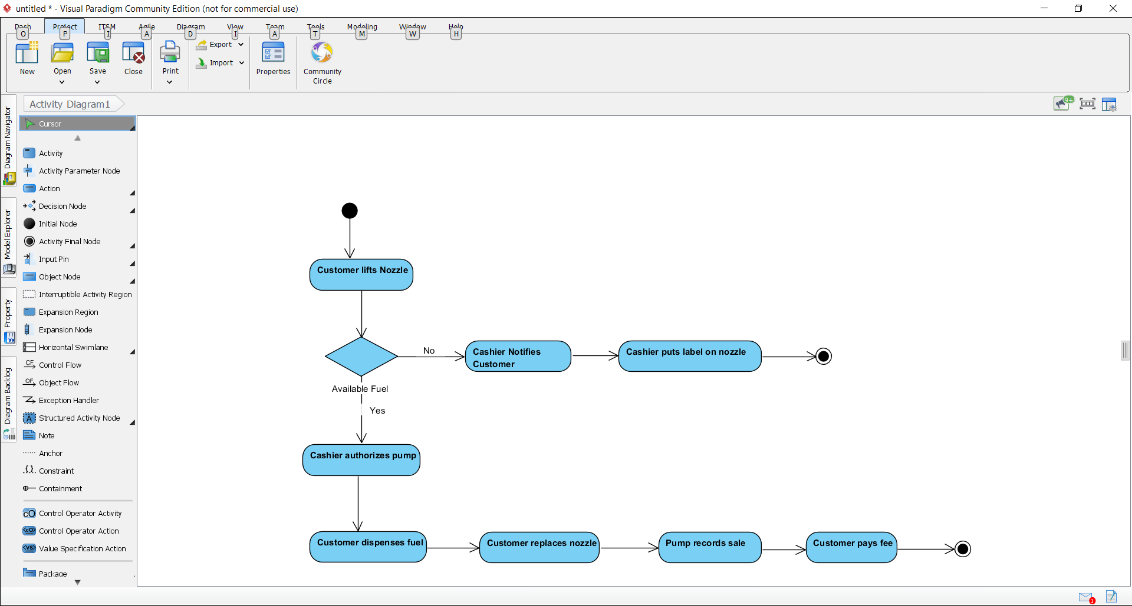
Activity Diagram

Slide 23
Activity Diagram Notation
Initial Node
Activity
Decision
Terminal Node

Slide 24
Contrast to flowcharts
What are the main differences between an activity diagram and flow chart ?
  Represents the system’s activities, not just a process
Why is this diagram different to a state chart ?
  Again represents activities not just transition between state, so provides a differing perspective

Slide 25
Structural vs Behavioural
What are the main differences between the diagram classifications ?
What are the purposes of both classifications ?
How do I know when I need to use structural diagrams or behavioural diagrams ?

Slide 26
When do we use specific diagrams ?
Structural
  Modelling the overall system structure
Behavioural
  Modelling how the systems components interact with one another and external entities

Slide 27
More detail please ?
The nature and purpose of the project will always influence the decision of which diagram to choose
The level of detail you include in each of your diagrams is informed by the scale and depth of the project
Sometimes diagrams will be utilised specifically because the represent a particular perspective
  Sequence
  Collaboration

Slide 28
What is the point in all of these diagrams ?
Provides a holistic view of the system
Allows for representation of the system from many perspectives
Theoretically facilitates communication

