Slide 1
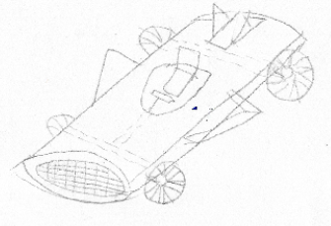
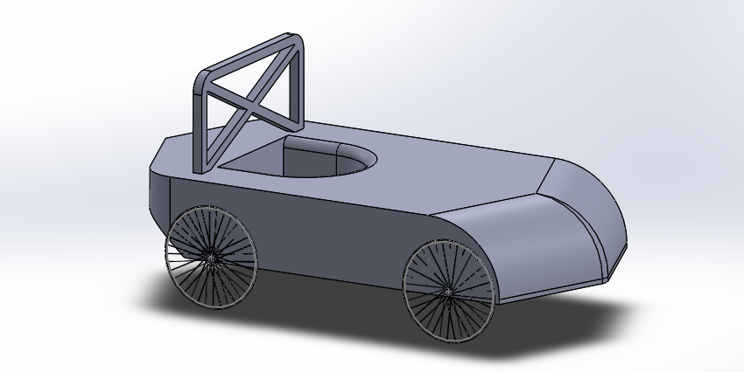
Integrating project review
James Holliman, Michael Reeves, Nye Evans, Aryan Adibmehr

Slide 2
Team members and communication
We lost 2 team members. One left the University to get a job. The other one, we met once and then we don’t know what happened to him.
Of the 4 other team members, 3 members of the team are still active (James, Michael and Nye). We are still waiting for correspondence from our 4th team member who we haven’t heard from since the end of the first project
Communication was good between the rest of the team
After the team leader left in semester 1, we worked together as equals

Slide 3
Project part 1 (first report)
Due to the loss of two team members, assignments had to be redistributed to other people in the team. So the remaining team members picked up the additional tasks so we knew everything would be covered
  James - Design, materials and costing
  Nye – environmental impact and conclusions
  Aryan – meeting minutes and GANNT
  Michael – introduction and driving dynamics
Most parts were done before the Christmas holidays
Meetings were easy to set up

Slide 4
Project part 2 (second report)
The team of 3 (James, Nye and Michael) worked well together
There were problems with Solidworks when all students became confined to their houses as none of the team owned Solidworks
One of the team members had to download Solidworks to finish the CAD drawing of the soapbox
While the team was apart, there were no problems with the groups’ work ethic and team work.

