Slide 1
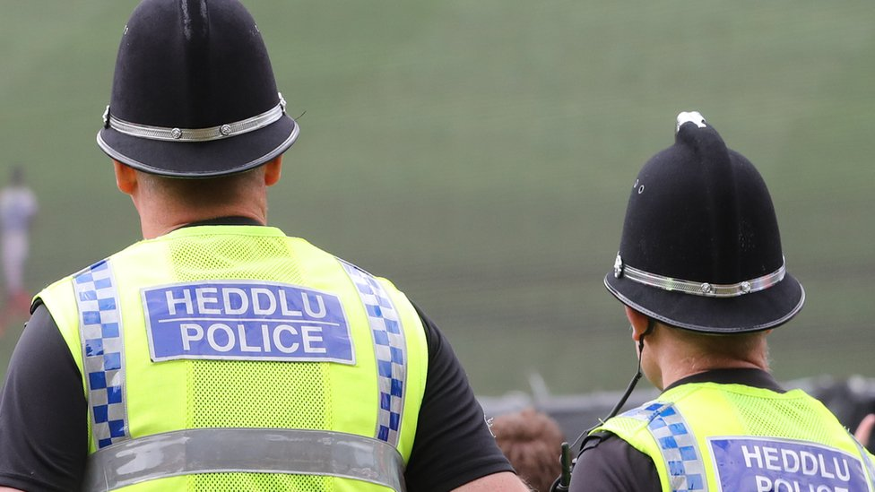

FORCE STALKING COORDINATOR – ELINOR SPIERS-MORGAN

Slide 2
ABOUT ME
Force Stalking Coordinator – Elinor Spiers-Morgan
Elinor.spiers-morgan1@south-wales.police.uk
Notes:
About me

Slide 3
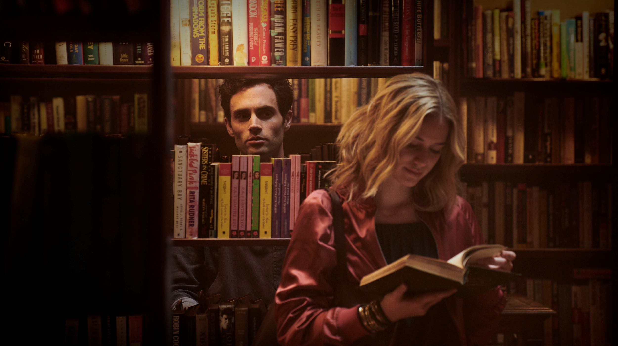
What is stalking?

Slide 5
F
IXATED
O
BSESSIVE
U
NWANTED
R
EPEATED

Slide 6
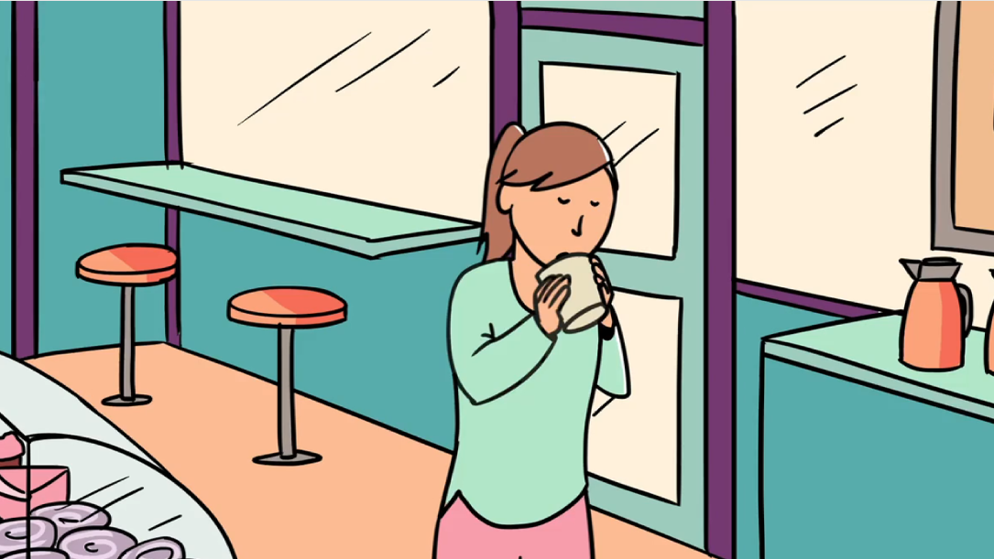

Slide 7
STALKING BEHAVIOURS

Slide 8
Following the victim
Vexatious applications to the courts
Surveillance
Sending gifts
Calling the victim's number
Use of devices to track movements
Criminal damage
Sending messages
Monitoring contact with others

Slide 9
Following the victim
Vexatious applications to the courts
Surveillance
Sending gifts
Calling the victim's number
Use of devices to track movements
Criminal damage
Sending messages
Monitoring contact with others

Slide 10
Following the victim
Vexatious applications to the courts
Surveillance
Sending gifts
Use of devices to track movements
Calling the victim's number
Criminal damage
Sending messages
Monitoring contact with others

Slide 11
Following the victim
Vexatious applications to the courts
Surveillance
Sending gifts
Calling the victim's number
Use of devices to track movements
Criminal damage
Sending messages
Monitoring contact with others

Slide 12
Following the victim
Vexatious applications to the courts
Sending gifts
Surveillance
Calling the victim's number
Use of devices to track movements
Criminal damage
Sending messages
Monitoring contact with others

Slide 13
Following the victim
Vexatious applications to the courts
Surveillance
Sending gifts
Calling the victim's number
Use of devices to track movements
Criminal damage
Sending messages
Monitoring contact with others

Slide 14
Following the victim
Vexatious applications to the courts
Surveillance
Sending gifts
Calling the victim's number
Use of devices to track movements
Criminal damage
Sending messages
Monitoring contact with others

Slide 15
Following the victim
Vexatious applications to the courts
Surveillance
Sending gifts
Calling the victim's number
Use of devices to track movements
Criminal damage
Sending messages
Monitoring contact with others

Slide 16
According to the ONS, the Crime Survey for England and Wales (CSEW) estimates that there were around 1.5 million victims of stalking in the year ending March 2020
Around half if not more of stalking cases involve ex intimate partners. According to the National Stalking Helpline cases of ‘stranger’ stalking only account for 7% of cases handled by their service.
Notes:
in a meta-analysis of existing stalking research completed by Cupach and Spitzberg (2004), it was found that of the 51 studies reviewed, 75% of victims were female, and 77% of perpetrators were male.
).
There does exist some discrepancy within research as to the percentage of cases where women are victims that can be attributed to (ex) intimate partners, with one study putting the estimate at approximately 50-60% of cases (Douglas and Dutton, 2001) but with other studies producing numbers closer to 30% (Budd et al., 2000).

Slide 17
In the UK, around 1 in 5 women as compared with 1 in 10 men will experience stalking in their lifetimes.
Notes:
in a meta-analysis of existing stalking research completed by Cupach and Spitzberg (2004), it was found that of the 51 studies reviewed, 75% of victims were female, and 77% of perpetrators were male.
).
There does exist some discrepancy within research as to the percentage of cases where women are victims that can be attributed to (ex) intimate partners, with one study putting the estimate at approximately 50-60% of cases (Douglas and Dutton, 2001) but with other studies producing numbers closer to 30% (Budd et al., 2000).

Slide 18
Around half if not more of stalking cases involve ex intimate partners. According to the National Stalking Helpline cases of ‘stranger’ stalking only account for 7% of cases handled by their service.
Notes:
in a meta-analysis of existing stalking research completed by Cupach and Spitzberg (2004), it was found that of the 51 studies reviewed, 75% of victims were female, and 77% of perpetrators were male.
).
There does exist some discrepancy within research as to the percentage of cases where women are victims that can be attributed to (ex) intimate partners, with one study putting the estimate at approximately 50-60% of cases (Douglas and Dutton, 2001) but with other studies producing numbers closer to 30% (Budd et al., 2000).

Slide 19
Prolonged victimisation is also far too common, with 77% of victims suffering 100 incidents of stalking or more before they contact the police
Notes:
in a meta-analysis of existing stalking research completed by Cupach and Spitzberg (2004), it was found that of the 51 studies reviewed, 75% of victims were female, and 77% of perpetrators were male.
).
There does exist some discrepancy within research as to the percentage of cases where women are victims that can be attributed to (ex) intimate partners, with one study putting the estimate at approximately 50-60% of cases (Douglas and Dutton, 2001) but with other studies producing numbers closer to 30% (Budd et al., 2000).

Slide 20
Research conducted by the National Stalking Helpline found that stalking most commonly lasted between 2-5 years for victims (19.4%) but in some cases a victim could be targeted for in excess of 20 years.
Notes:
in a meta-analysis of existing stalking research completed by Cupach and Spitzberg (2004), it was found that of the 51 studies reviewed, 75% of victims were female, and 77% of perpetrators were male.
).
There does exist some discrepancy within research as to the percentage of cases where women are victims that can be attributed to (ex) intimate partners, with one study putting the estimate at approximately 50-60% of cases (Douglas and Dutton, 2001) but with other studies producing numbers closer to 30% (Budd et al., 2000).

Slide 21
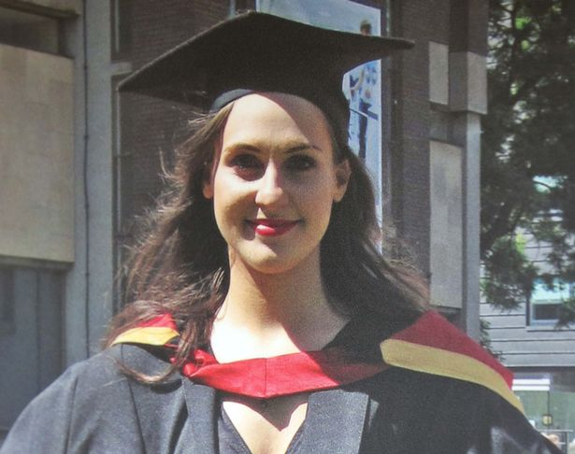

Slide 22
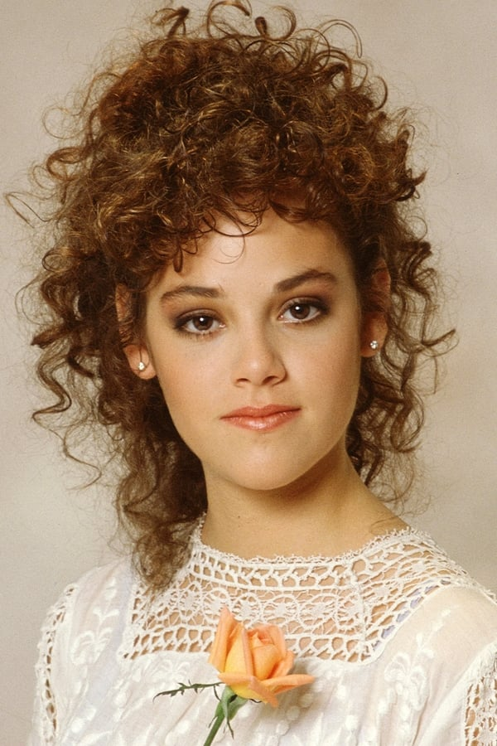
REBECCA SCHAEFFER

Slide 23
REBECCA SCHAEFFER
Rebecca was an actress and model, best known for her portrayal of Patricia "Patti" Russell in the CBS comedy My Sister Sam.
It was during her time on this show that Robert John Bardo first became obsessed with her.
He sent her letters and unwanted gifts, he even resorted to paying a private investigator to track her down.
On the 18th July 1989 he turned up to her apartment and shot her in the chest.
Her death sparked a national movement for anti-stalking legislation – which was subsequently passed in California in 1990.

Slide 24

Notes:
The Act resulted from the efforts of Evonne Leonora Von Heussen. A stalking victim herself, she launched the National Association for Victims of Stalking and Harassment (NASH) in 1993, when her then teen-age daughter was stalked by a dangerous character who was known to carry a knife.
Evonne von Heussen, a British woman now in her early forties, was stalked from 1975 to 1991. For the first three years she received silent phone calls, envelopes with photographs of herself and her two young daughters, pornographic literature and underwear. Bouquets of dead flowers were left on her doorstep and on top of her car.
She only recognised the man responsible when he turned up at her door one Sunday afternoon in 1978. As a medical student in London, she had attended two of his psychology lectures. They had communicated once: he had bumped into her on the stairs of the college library and apologised politely.
After Von Heussen found that she could get no help from the police, lawyers, or her local Member of Parliament she began researching anti-stalking laws in other countries. She opened a help line on which she eventually took tens of thousands of calls. She pursued each call with each victim's MP, and attracted a large amount of media attention. After several years of effort she persuaded the Home Office under Prime Minister John Major to take the issue on as a matter of government policy. She wrote the first draft of the Act and worked closely with ministers and senior civil servants in the Home Office and the Lord Chancellor's Department as the final version took shape.

Slide 25

Protection from Harassment Act 1997 1)A person must not pursue a course of conduct— (a)which amounts to harassment of another, and (b)which he knows or ought to know amounts to harassment of the other | Protection of Freedoms Act 2012 – PHA 1997 Section 2(a) 1)A person is guilty of an offence if— (a)the person pursues a course of conduct in breach of section 1(1), and (b)the course of conduct amounts to stalking. | Protection of Freedoms Act 2012 – PHA 1997 Section 4(a) A person pursues a course of conduct that amounts to stalking causing another to - Fear the use of violence - Cause the victim serious alarm of distress.
Notes:
Following the widescale criticism of the Protection from Harassment Act (PHA) 1997 in terms of its protection of victims of stalking, there were amendments made to legislation in the form of the Protection of Freedoms Act 2012. The Protection of Freedoms Act 2012 introduced two new offences that sort to address the gaps in current criminal law around stalking that now feature under sections 2A and 4A of the PHA 1997, which can be seen in the below table:

Slide 26
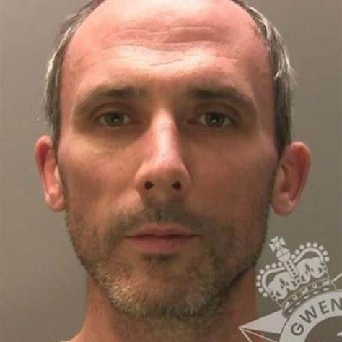
Issues with the stalking legislation – Case Study
Notes:
Thomas Baddeley – Dr Ian Hutchinson

Slide 27
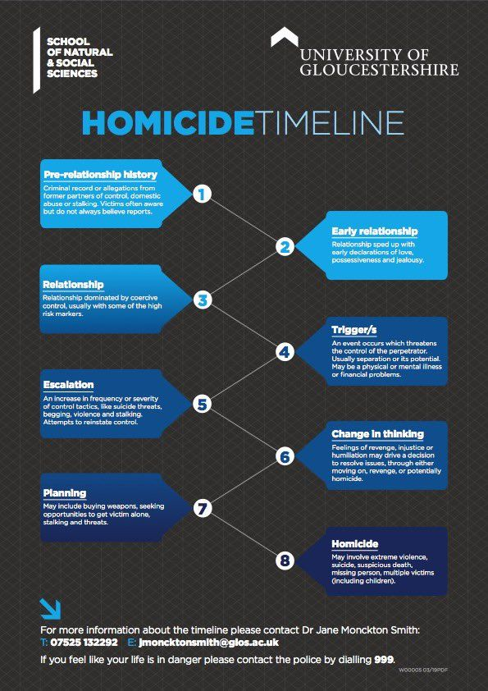
Notes:
The link between stalking and homicide is one that has previously been explored in a report published in association with the Suzy Lamplugh Trust. In this report, 358 criminal homicides (that took place between 2012-2014) were analysed, and it was found that in 94% of the cases, stalking behaviours were present. Furthermore, in 71% of cases, there was evidence of a current or previous intimate relationship, with half of these relationships ongoing at the time of the murder (Monckton Smith et al., 2017).
​​​​​​Resea​rch published this week and carried out by Dr Jane Monckton Smith looked at 372 cases of intimate partner homicide through interviews with bereaved families and public protection professionals. Through her study, published in the Violence Against Women Journal (VAW), Dr Jane Monckton Smith, Senior Lecturer in Criminology at the University of Gloucestershire, found an emerging pattern that could be broken down into eight separate stages.

Slide 28
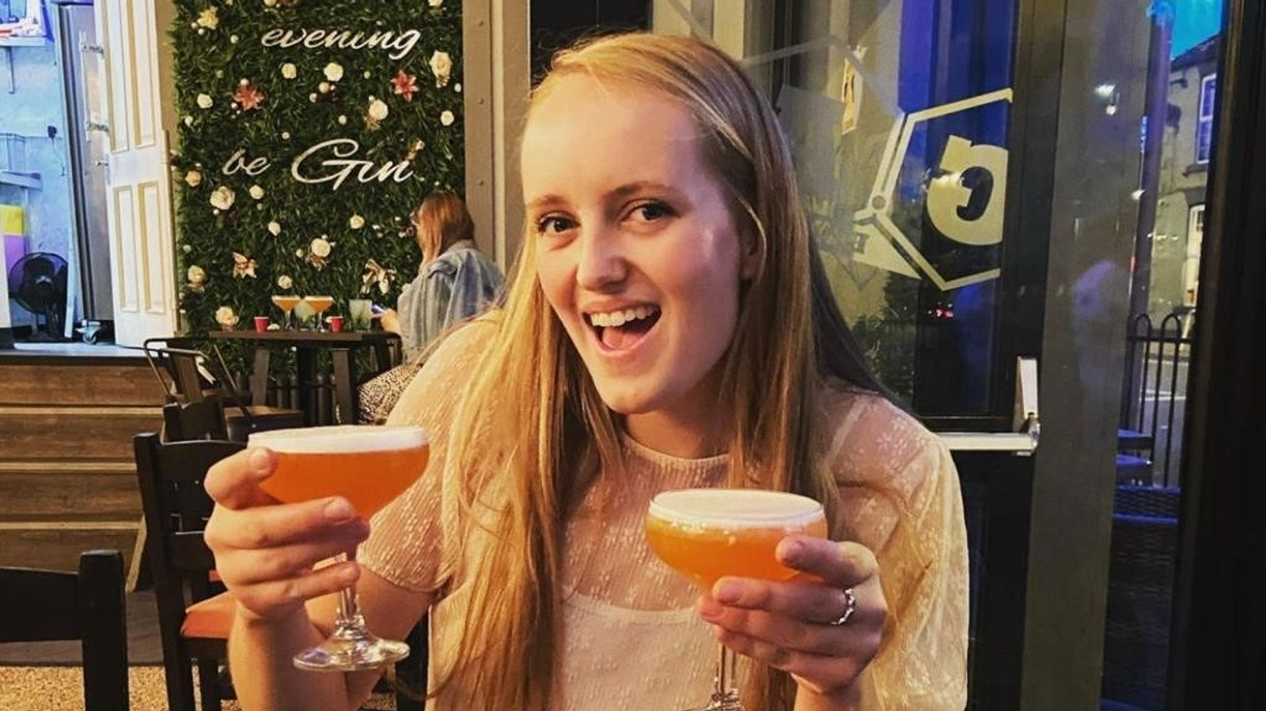
This is Gracie Spinks
She was murdered by her stalker in July 2021, the inquest into her murder has only recently concluded.
Gracie’s case serves as a reminder that stalking behaviour (regardless of whether there is a prior intimate relationship) can pose a significant risk.
Coroner Kewley said: “On June 18 2021, Michael Sellers murdered Gracie Spinks as she arrived at the horse field. It is most likely that he lay in wait for her arrival. This was not a spur-of-the-moment act of violence. Michael Sellers engaged in significant planning and preparation in the weeks leading up to the murder. His actions were premeditated and carefully planned. He effectively removed himself from any form of accountability for his actions towards Gracie Spinks. I am certain that he died by suicide.”
Notes:
Gracie’s case and the impact on policing.
Call to the police - Audio recording of Gracie Spinks reporting Michael Sellers to police released (yahoo.com)

Slide 29

Understanding the psychology of a stalker…

Slide 30
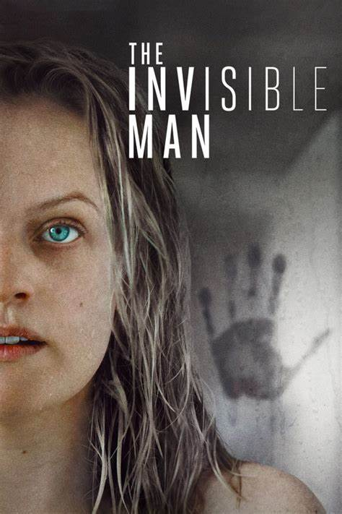



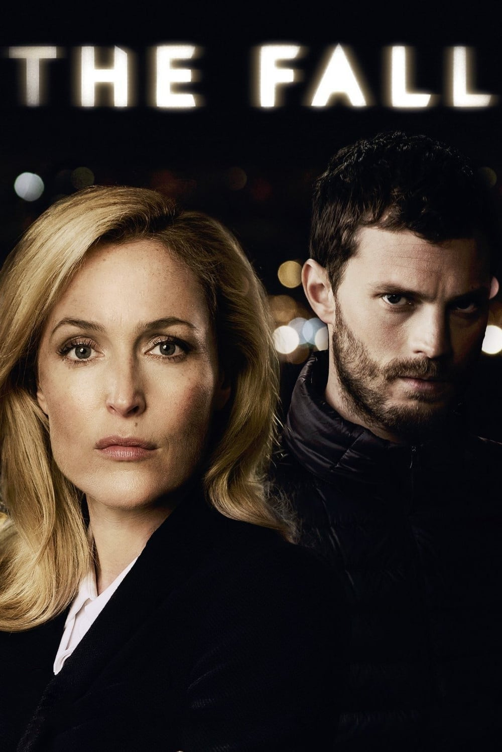
PREDATORY
Deviant sexual practices and interests
Usually, male perpetrator and the victims are usually female strangers
Gratification linked to voyeurism and
Linked to sexual violence (the stalking may be an information gathering exercise prior to a sexual assault)
Rejected Stalker
Breakdown of a close or intimate relationship
Looks for reconciliation or revenge for the perceived rejection or a mixture of both
Behaviour tends to last the longest and they are thought to be the most dangerous.
INTIMACY SEEKER
Usually as a result of loneliness and a lack of a close confidante
Victims are usually strangers
Half of the subjects truly believed their feelings of affection were mutual
Often their behaviour is fuelled by mental illness (delusional disorder)
RESENTFUL STALKER
They feel that they have been mistreated, a victim of injustice or humiliation
Their goal is to frighten the victim
Their victims can be strangers or acquaintances who the stalker perceives has mistreated them
They have a desire for revenge and feel justified in their actions and will often present themselves as the victim
INCOMPETENT SUITOR
Poor social skills
Stalks in the context of lust or loneliness
Unlike the Intimacy seeker, the motivation is not to seek a loving relationship but to get a date or a short-term relationship
Usually stalk for short periods and they are often indifferent to the distress of the victim.
Notes:
The five typologies - Mullen et al.'s (1999)

Slide 31
PREDATORY
Deviant sexual practices and interests
Usually, male perpetrator and the victims are usually female strangers
Gratification linked to voyeurism and
Linked to sexual violence (the stalking may be an information gathering exercise prior to a sexual assault)
Rejected Stalker
Breakdown of a close or intimate relationship
Looks for reconciliation or revenge for the perceived rejection or a mixture of both
Behaviour tends to last the longest and they are thought to be the most dangerous.
INTIMACY SEEKER
Usually as a result of loneliness and a lack of a close confidante
Victims are usually strangers
Half of the subjects truly believed their feelings of affection were mutual
Often their behaviour is fuelled by mental illness (delusional disorder)
RESENTFUL STALKER
They feel that they have been mistreated, a victim of injustice or humiliation
Their goal is to frighten the victim
Their victims can be strangers or acquaintances who the stalker perceives has mistreated them
They have a desire for revenge and feel justified in their actions and will often present themselves as the victim
INCOMPETENT SUITOR
Poor social skills
Stalks in the context of lust or loneliness
Unlike the Intimacy seeker, the motivation is not to seek a loving relationship but to get a date or a short-term relationship
Usually stalk for short periods and they are often indifferent to the distress of the victim.

Slide 32
PREDATORY
Deviant sexual practices and interests
Usually, male perpetrator and the victims are usually female strangers
Gratification linked to voyeurism and
Linked to sexual violence (the stalking may be an information gathering exercise prior to a sexual assault)
Rejected Stalker
Breakdown of a close or intimate relationship
Looks for reconciliation or revenge for the perceived rejection or a mixture of both
Behaviour tends to last the longest and they are thought to be the most dangerous.
INTIMACY SEEKER
Usually as a result of loneliness and a lack of a close confidante
Victims are usually strangers
Half of the subjects truly believed their feelings of affection were mutual
Often their behaviour is fuelled by mental illness (delusional disorder)
INCOMPETENT SUITOR
Poor social skills
Stalks in the context of lust or loneliness
Unlike the Intimacy seeker, the motivation is not to seek a loving relationship but to get a date or a short-term relationship
Usually stalk for short periods and they are often indifferent to the distress of the victim.
RESENTFUL STALKER
They feel that they have been mistreated, a victim of injustice or humiliation
Their goal is to frighten the victim
Their victims can be strangers or acquaintances who the stalker perceives has mistreated them
They have a desire for revenge and feel justified in their actions and will often present themselves as the victim

Slide 33
PREDATORY
Deviant sexual practices and interests
Usually, male perpetrator and the victims are usually female strangers
Gratification linked to voyeurism and
Linked to sexual violence (the stalking may be an information gathering exercise prior to a sexual assault)
Rejected Stalker
Breakdown of a close or intimate relationship
Looks for reconciliation or revenge for the perceived rejection or a mixture of both
Behaviour tends to last the longest and they are thought to be the most dangerous.
INTIMACY SEEKER
Usually as a result of loneliness and a lack of a close confidante
Victims are usually strangers
Half of the subjects truly believed their feelings of affection were mutual
Often their behaviour is fuelled by mental illness (delusional disorder)
RESENTFUL STALKER
They feel that they have been mistreated, a victim of injustice or humiliation
Their goal is to frighten the victim
Their victims can be strangers or acquaintances who the stalker perceives has mistreated them
They have a desire for revenge and feel justified in their actions and will often present themselves as the victim
INCOMPETENT SUITOR
Poor social skills
Stalks in the context of lust or loneliness
Unlike the Intimacy seeker, the motivation is not to seek a loving relationship but to get a date or a short-term relationship
Usually stalk for short periods and they are often indifferent to the distress of the victim.

Slide 34
PREDATORY
Deviant sexual practices and interests
Usually, male perpetrator and the victims are usually female strangers
Gratification linked to voyeurism and
Linked to sexual violence (the stalking may be an information gathering exercise prior to a sexual assault)
INTIMACY SEEKER
Usually as a result of loneliness and a lack of a close confidante
Victims are usually strangers
Half of the subjects truly believed their feelings of affection were mutual
Often their behaviour is fuelled by mental illness (delusional disorder)
Rejected Stalker
Breakdown of a close or intimate relationship
Looks for reconciliation or revenge for the perceived rejection or a mixture of both
Behaviour tends to last the longest and they are thought to be the most dangerous.
INCOMPETENT SUITOR
Poor social skills
Stalks in the context of lust or loneliness
Unlike the Intimacy seeker, the motivation is not to seek a loving relationship but to get a date or a short-term relationship
Usually stalk for short periods and they are often indifferent to the distress of the victim.
RESENTFUL STALKER
They feel that they have been mistreated, a victim of injustice or humiliation
Their goal is to frighten the victim
Their victims can be strangers or acquaintances who the stalker perceives has mistreated them
They have a desire for revenge and feel justified in their actions and will often present themselves as the victim

Slide 35

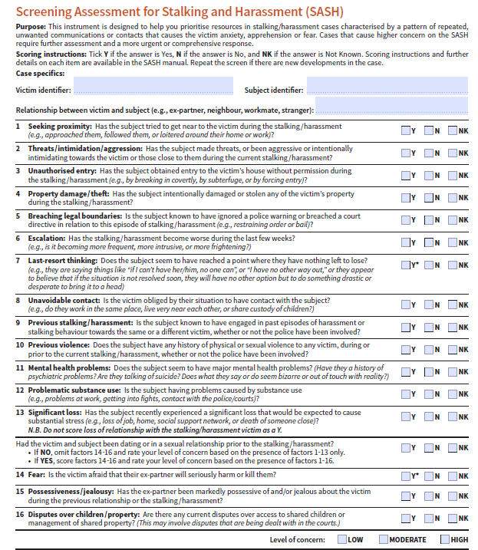
SAFEGUARDING
This is a copy of the SASH (Screening assessment for Stalking and Harassment.
It is a list of questions based off research conducted into what indicates as higher level of risk in a stalking case.
This particular assessment is conducted regularly in Dyfed Powys Police
South Wales use DASH, S-DASH and their own risk identification tool for non-da cases.
Notes:
In the police there are a few steps we take in order to safeguard victims.
These include – arrest of the suspect
Warning markers to assist with fast deployment
Bail conditions
DVPO/DVPN’s
SPO’s
Offender management

Slide 36

STALKING SUPER COMPLAINT
Notes:
Ten years since the stalking legislation was brought into force, the Suzy Lamplugh Trust, on behalf of the National Stalking Consortium, launches a super-complaint against the police finding systemic issues in the response to stalking across England and Wales.
The Consortium, which is comprised of 21 stalking specialists including frontline services, victims and academics, has collated evidence that suggests there are deep-rooted systemic issues across police forces that are putting many victims at risk. Only 5% of reports of stalking to the police in the year ending March 2022 resulted in a charge by the Crown Prosecution Service (CPS). It is our expert opinion that in many cases police are failing to identify stalking behaviours as a course of conduct at an early stage, contributing to them being mischarged by the CPS.
Issues of concern include a lack of understanding among officers as to what behaviours constitute stalking, as well as treating behaviours as single incidents as opposed to recognising the wider pattern of behaviour. It is common for the crime to be investigated as a ‘lower-level’ offence, such as malicious communications or criminal damage, or to be misidentified as harassment, thus setting a course for an incorrect pathway through the criminal justice system.
The Consortium is also highly concerned that in the cases where stalking is identified, too often police are not investigating the crime appropriately, erroneously dropping cases due to a perceived lack of evidence; for example, incidents of unwanted online behaviour such as the use of social media, emails and phone calls. In the year ending March 2022, a quarter of all stalking reports were dropped due to issues relating to evidence, in cases where the suspect had been identified and where the victim supported action.
The Consortium therefore puts forward several recommendations to implement systemic change to improve the police response to stalking, including:
The College of Policing must mandate that all officers that deal with cases of stalking complete training by a specialist stalking training provider, in order to adequately identify, investigate and risk assess cases of stalking;
Police must work with the Crown Prosecution Service, Home Office, Ministry of Justice and National Probation Service to implement a unified recording system which allows one to follow the journey of a victim through the criminal justice system, and track attrition rates from reporting stage through to conviction, including sentencing;
Police forces should consider investment in improving digital evidence retrieval for cyberstalking (e.g., in cases of online spyware and hacking);
SPOs should be applied for at the earliest opportunity that best protects the victim – a maximum of 4 weeks between recognising the need for an SPO and its application; meanwhile an interim SPO should be put in place within 48 hours of a report by a victim or the arrest of perpetrator, with the victim’s consent;
Police must treat 2 or more breaches of any order (including a Stalking Protection Order, Restraining Order, Non-Molestation Order or bail conditions) as a separate offence of stalking as set out in the CPS Guidance;
Any statutory guidance on the police response to stalking (including guidance on the identification and investigation of stalking) should be developed in consultation with experts from the National Stalking Consortium.
Stalker who held his ex-girlfriend at gunpoint to be freed from jail despite Parole Board saying he's not safe to live in the community | Daily Mail Online

Slide 37
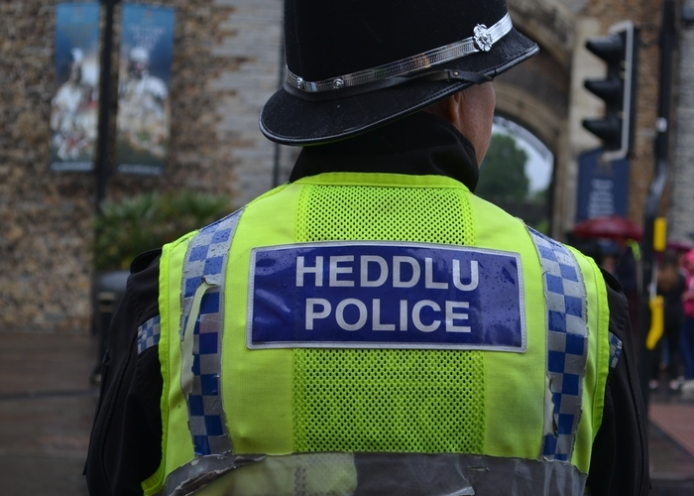
Notes:
BBC iPlayer - Stacey Dooley - Stalkers: Episode 2
06:26 -32:40

Slide 38
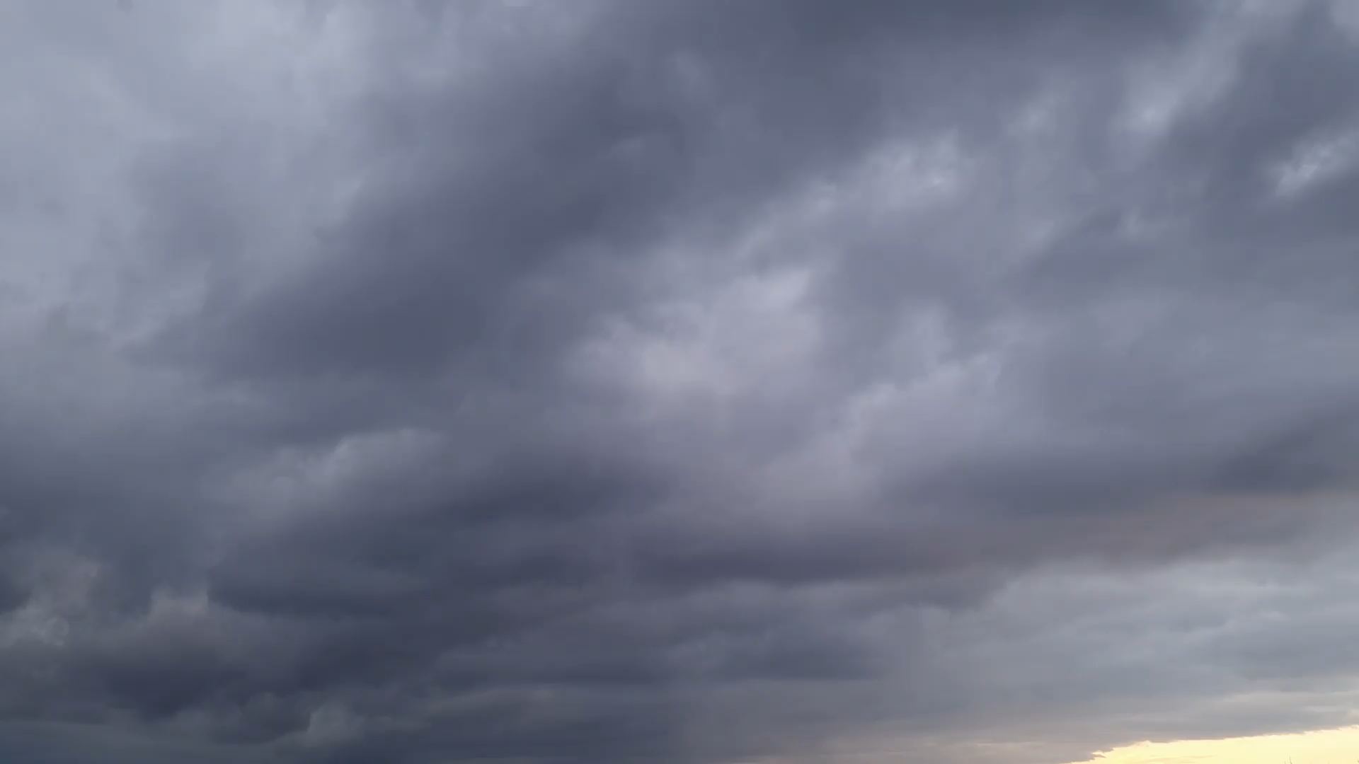
STALKING PROTECTION ORDERS
The Stalking Protection Act 2019 gave police new powers to safeguard victims and disrupt stalkers | The Act introduced ‘Stalking Protection Orders’ – these civil orders allowed police to impose prohibitions on those who have been found to engage with acts of stalking. | In addition to prohibitions these orders can mandate ‘positive requirements’. These are things police want offenders to do in order to tackle the pattern of behaviour. | These orders can be applied for at any stage of an investigation, and they can be used regardless of whether there is a domestic element to the stalking.

Slide 39
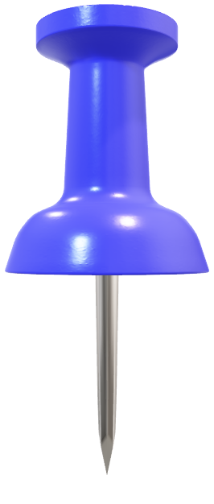
RESOURCES/SUPPORT

Slide 40
PALADIN SAFETY ADVICE
🔍 Google yourself to check your digital footprint frequently
🔏 Change passwords often and do not use the same password for everything
❤️ Be aware of tagging on social media and have a look at your default and privacy settings on social media platforms and apps.
💻 Keep your software on phones, laptops up to date
📲 Download Hollie guard app:
The app for your smart phone enables you to link it up with safe people, when frightened/feeling uneasy you can shake your device which will set off an alert to your safe people advising them of where you are, it also starts to video record.
👏 Trust your instincts (We find that there is no such thing as coincidence with stalking).
💬 Tell people who are SAFE to tell, as it helps protect you and evidence the stalking (e.g. neighbours, friends, work colleagues, tutors, family)
✍ Keep a diary and record the impact the stalking is having on you (you can use the Paladin diary template available on their website)
🕵️‍♀️ Keep the evidence – as much evidence as you can, including call logs, images, message chats, screenshots, etc.
📞 Paladin advise not to change your number or block on social media as this may increase the risk to you and impact evidence gathering.
💡 Park/walk in well-lit areas.
📍 Vary your routes to and from work/college/Uni & be vigilant.

Slide 41




RESOURCES
AIRGUARD
Notes:
Bright Sky is a safe, easy to use app and website that provides practical support and information on how to respond to domestic abuse. It is for anyone experiencing domestic abuse, or who is worried about someone else.
Bright Sky helps you to spot the signs of abuse, know how to respond, and help someone find a safe route to support.
Hollie Guard is a smartphone app that helps you protect yourself, a friend or a family member with a panic button, a meeting timer, evidence gathering and more.
ourney feature - Ideal for travelling from one location to another. It also allows you to set a time of expected arrival and if you don’t reach your journey by the expected time, an alert will automatically be raised.
Meeting feature - can help you in situations with a risk factor, for example when meeting an estranged partner, going on a blind date or working alone.
Accident feature - when enabled, it allows Hollie Guard to automatically detect if you have had a sudden fall or stopped moving for a period of time.
Professional 24/7 alert monitoring – Hollie Guard directs all alerts to a specialised monitoring centre that will respond to your alerts accordingly. The average response time is only 11 seconds.

Slide 42






