Slide 1

Programme: Master of Business Administration
Module: Marketing Management
Module Code: LCMB7024
Assignment Title : Sustainable Brand Extension Poster Presentation
Student Name: Amishaben Bhikhabhai Panchal
Student ID Number: 2537875

Slide 2
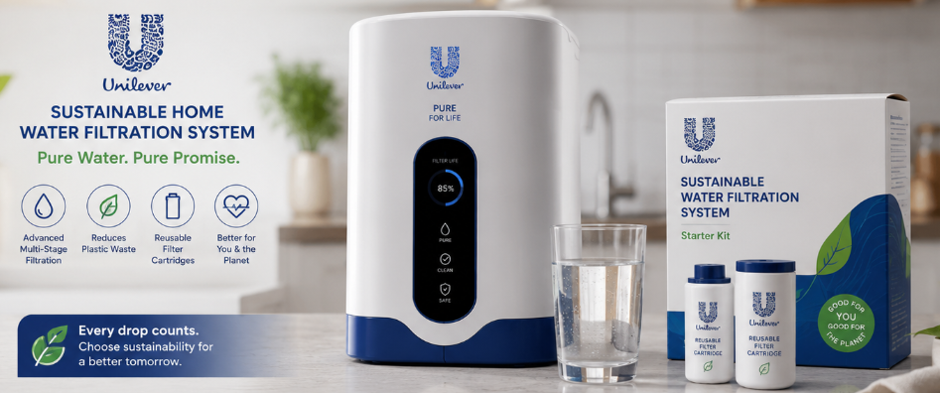
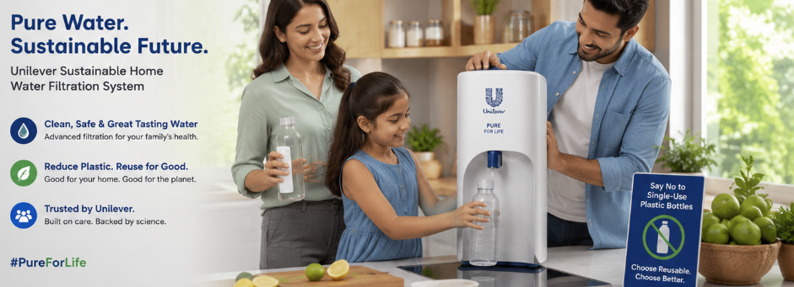
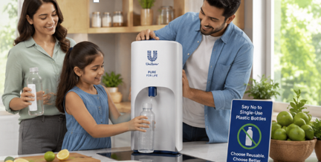
Marketing Strategy Pitch – Unilever Sustainable Home Water Filtration Systems
New Brand Development
Unilever is extending its FMCG portfolio by launching Unilever Sustainable Home Water Filtration Systems, a range of eco-friendly countertop and under-sink water purifiers with reusable filter cartridges. The global residential water purifier market is expected to reach US$40 billion by 2030, driven by increasing demand for clean and safe drinking water (Unilever PLC, 2025).
How is the New Brand Aligning with Customer Trends?
The new brand aligns with rising consumer demand for health, sustainability, and plastic reduction. According to NielsenIQ, 73% of global consumers are willing to change their consumption habits to reduce environmental impact. Additionally, more than 2 billion people worldwide lack access to safely managed drinking water (WHO and UNICEF, 2025). The reusable filtration system reduces dependence on single-use plastic bottles while supporting healthier lifestyles, making it highly relevant to environmentally conscious consumers.
Marketing Mix
Product Strategy
Multi-stage filtration technology for superior water purification.
Reusable and recyclable filter cartridges.
Smart filter replacement indicator.
Modern, energy-efficient design with sustainable packaging.
Promotion Strategy
Social media campaigns highlighting health and sustainability benefits.
Partnerships with eco-conscious influencers and environmental organizations.
In-store demonstrations and free product trials.
Loyalty rewards and subscription plans for replacement filters.
Conclusion
The Unilever Sustainable Home Water Filtration Systems brand extension strengthens Unilever's sustainability positioning while entering a high-growth market. By combining trusted brand equity with innovative, eco-friendly technology, the company can meet evolving consumer needs, reduce plastic waste, and create long-term competitive advantage.
References
Unilever PLC (2025) Annual Report and Accounts 2025. London: Unilever PLC. Available at: https://www.unilever.com/files/esef-nl-2025.html
World Health Organization (WHO) and United Nations Children's Fund (UNICEF) (2025) Progress on Household Drinking-water, Sanitation and Hygiene 2000–2024: Special Focus on Inequalities. Geneva: World Health Organization. Available at: https://www.who.int/publications/i/item/9789240115149
Segmentation
Geographic: Urban and suburban households in developed and emerging markets.
Demographic: Adults aged 25–55, middle- and upper-income families, homeowners, and professionals.
Psychographic: Environmentally conscious, health-focused consumers who value sustainability and premium home products.
Behavioural: Consumers seeking safe drinking water, long-term cost savings, and eco-friendly household solutions.

