Slide 1
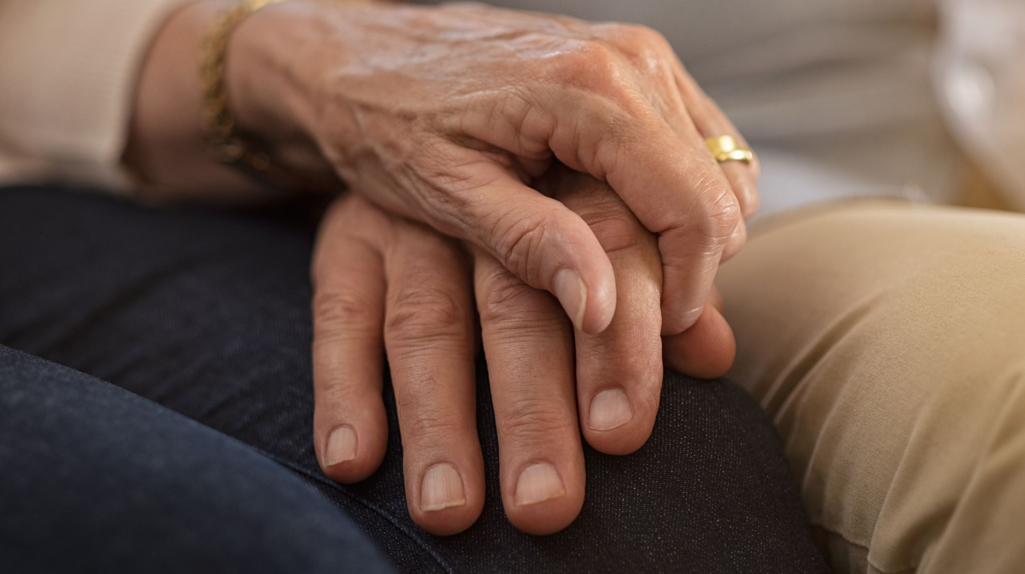
BMHP6027: Empowering the Older Person
Introduction to Ageing

Slide 2
Contents Page
Ageing Population
Trends in ageing population
Perception of ageing
Theory of Ageing
Implications and challenges of ageing population

Slide 3

Lecture Aim
To explore the demographic, social, and theoretical dimensions of population ageing, and to critically examine the implications, challenges associated with an ageing society.

Slide 4
Learning Objectives
Define
Define key terms such as ageing, older person, and healthy ageing.
Describe
Describe the main factors contributing to population ageing.
Explain
Explain the differences in ageing trends across geographic regions and genders.
Summarize
Summarize the major theories of ageing (e.g., Disengagement, Activity, Reconstruction).
Create
Create a visual or written blueprint for health ageing

Slide 5
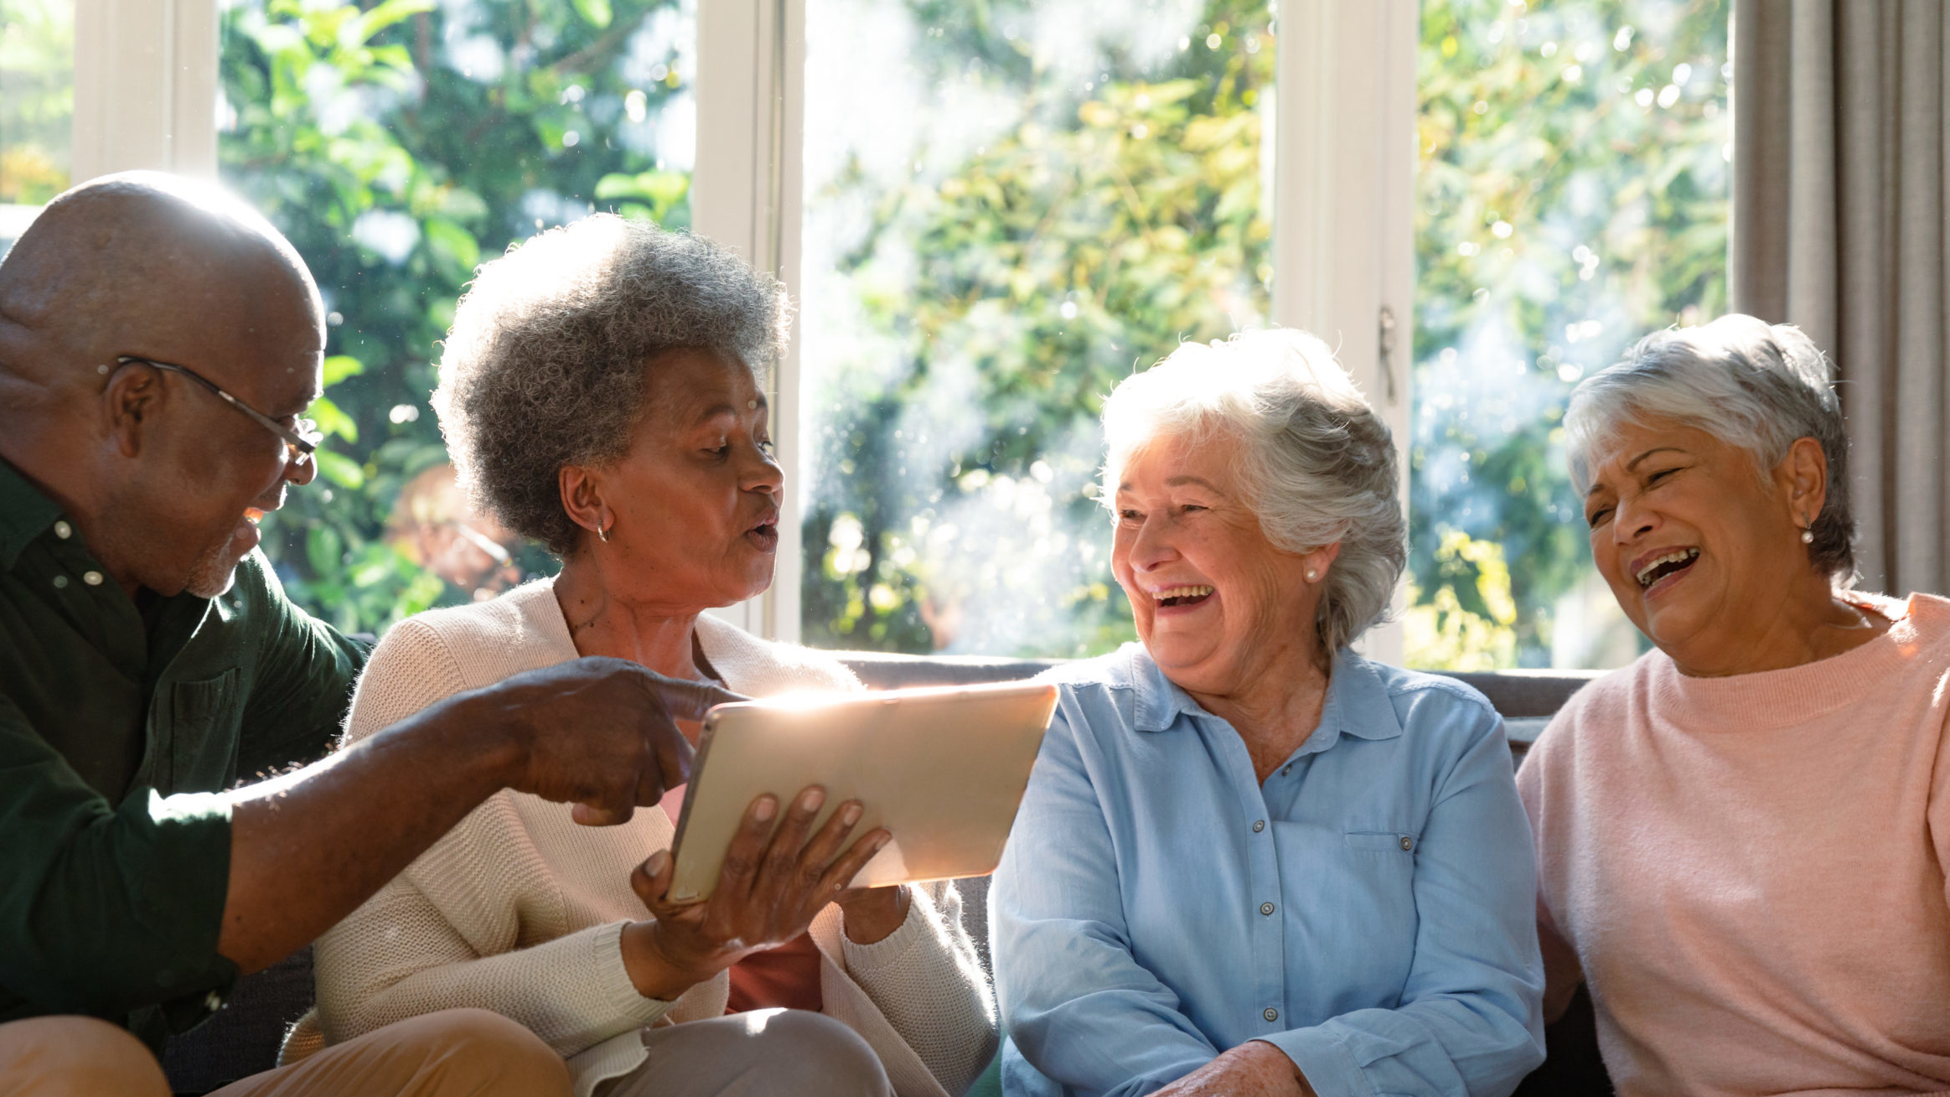
What comes to mind when you hear ‘older person’?
Notes:
Here I would like you to think about:
Any stereotypes, or connotations associated with the term “ the older person”.
The reasons behind your views
Any reasons that has shaped your view on the older person.

Slide 6
Activity: What comes to mind when you hear ‘older person’?
Step 1: Write down five words or phrases they associate with “older person”.
1
Step 2: In small groups, categorise terms as: Neutral, Positive, or Deficit-based / Stereotypical
2
Step 3: Where do these perceptions come from, and how might they influence care practice and policy?
3

Slide 7

Demographics of Ageing:

Slide 8
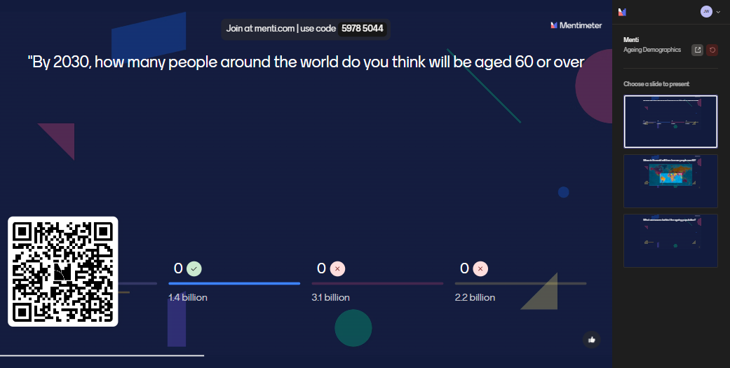

Slide 9
Ageing Forecast
By 2030:
1 in 6 people globally will be aged 60 or over.
The global population aged 60+ will rise from 1 billion in 2020 to 1.4 billion in 2030
By 2050:
The number of people aged 60+ will double to 2.1 billion.
The population aged 80+ is expected to triple between 2020 and 2050, reaching 426 million.
(World Health Organization, 2024)

Slide 10
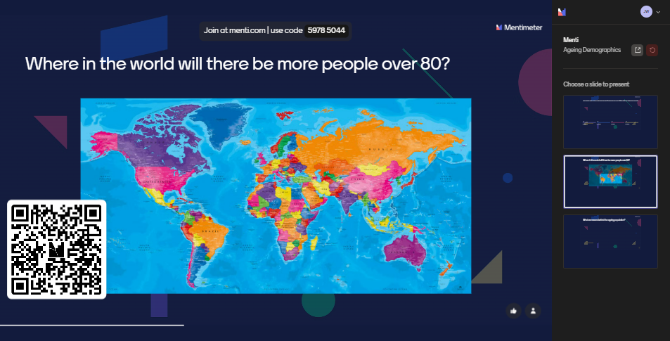

Slide 11
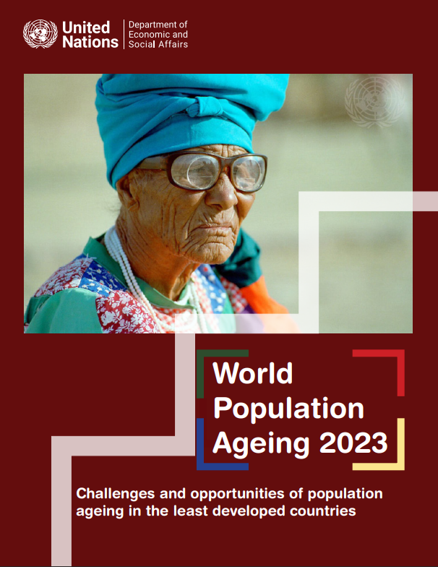
Ageing Population: Geographically
In 2023, older persons (aged 65+) made up 3.7% of the LDC population.
By 2050, this is projected to rise to 6.1%, representing a 180% increase in the number of older persons—from 42.6 million to 118.6 million.
The number of LDCs with over 1 million older persons will grow from 10 in 2023 to 27 in 2050.
Two LDCs—Bangladesh and Ethiopia—will each have over 10 million older persons by 2050.

Slide 12
Ageing population, developing nations regional differences
Africa (Sub-Saharan and Haiti) | Asia Pacific
Ageing accelerate post-2050. | Ageing is more pronounced and will continue to rise.
The number of older persons will increase by over 400%, from 63 million to 340 million by 2100. | Older population will more than double from 55 million to 122 million by 2100.
Proportion of older persons will rise from 4% to 14% by 2100 | Proportion of older persons will increase from 12% to 25% by 2100.

Slide 13
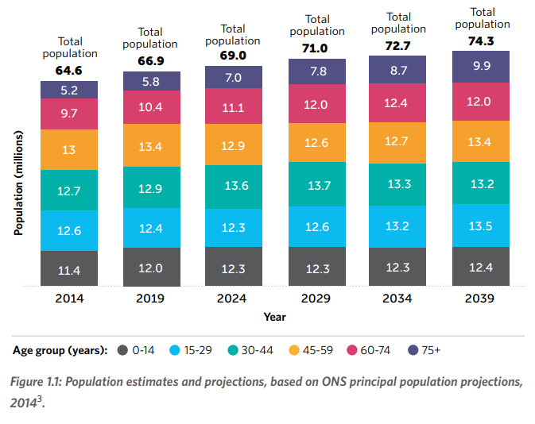
Ageing population: United Kingdom
In mid-2014, the median age of the UK population exceeded 40 for the first time.
Between 2014 and 2039, over 70% of UK population growth will be in the over-60 age group.
This group will grow from 14.9 million to 21.9 million people.
The proportion of the working-age population aged 50 to State Pension Age (SPA) will rise from 26% in 2012 to 34% in 2050
This represents an increase of over 5.5 million people in that age group.
By 2037, there are projected to be 1.42 million more households headed by someone aged 85 or over.

Slide 14
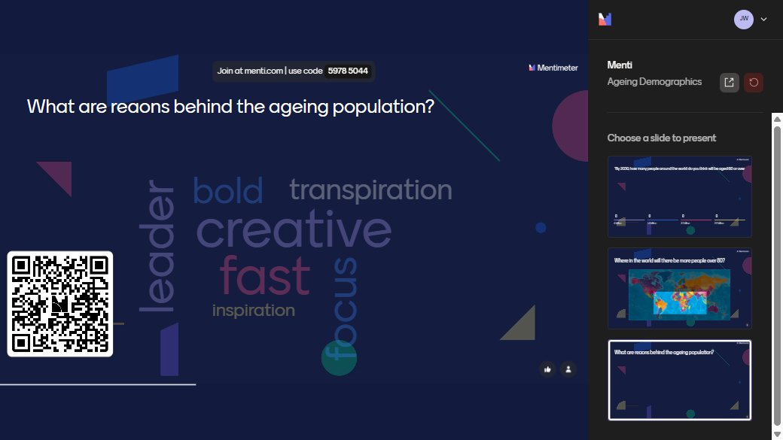

Slide 15
Factors of Ageing Population
Increased life expectancy
01
Declining birth rates
02
Economic and social development
03
Migration
04
Notes:
Life expectancy: Advances in healthcare, nutrition, and overall living conditions have significantly increased life expectancy. People are living longer due to better medical treatments and preventive care.
Declining Births: here has been a consistent decline in birth rates over the past few decades. Smaller family sizes mean fewer young people relative to the number of older individuals.
Economic and social development: Higher levels of education and economic development often lead to lower fertility rates. People tend to have fewer children as they prioritize careers and personal development
Migration: Migration can also influence the age structure of a population. Younger people may migrate for work or education, leaving a higher proportion of older individuals in certain areas.

Slide 16


Slide 17
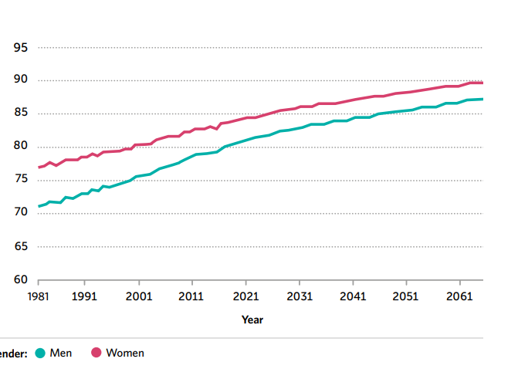
Ageing Population: Gender Differences
Women live longer compared to men
Men live more of their life in good health compared to women
(Government Office of Science, 2016)

Slide 18
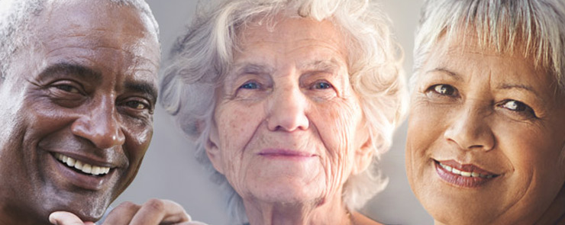
At what age is considered as ‘old’?

Slide 19
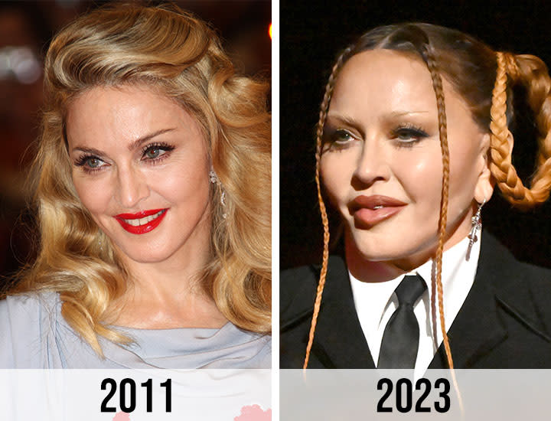
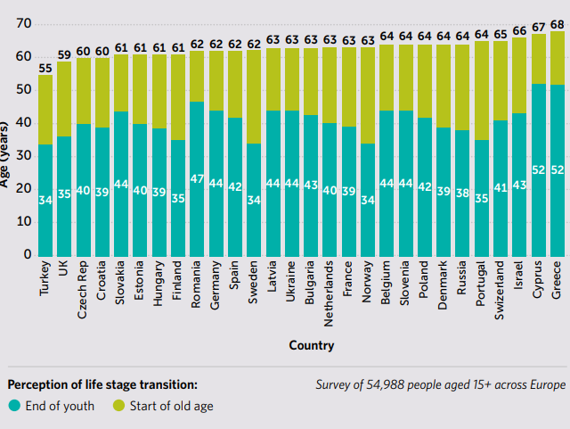
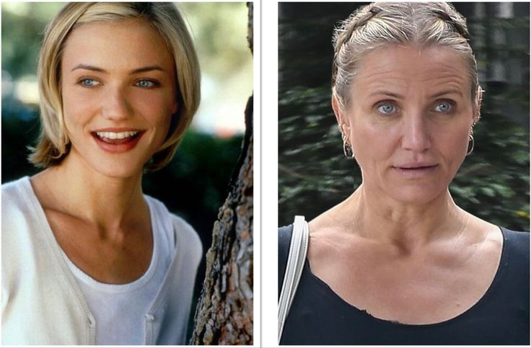
Perception of old age?

Slide 20
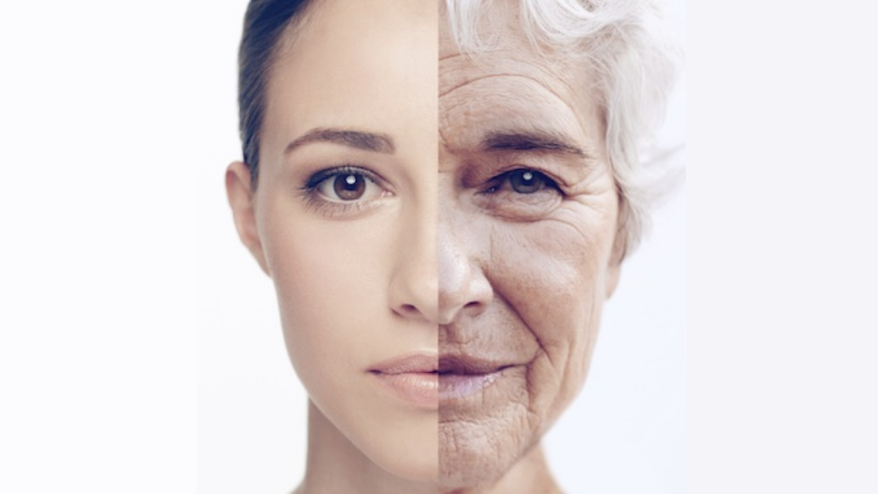
What is ageing?

Slide 21
Definitions
Ageing | Older Person | Elderly
Aging is the progressive accumulation of diverse, deleterious changes” |  | Generally, refers to individuals who are older or aging, typically past middle age.
“Accumulation of damage as a primary characteristic of aging” |  | Describes people who are 65 years old
(cited in Keshavarz et al, 2023)

Slide 22
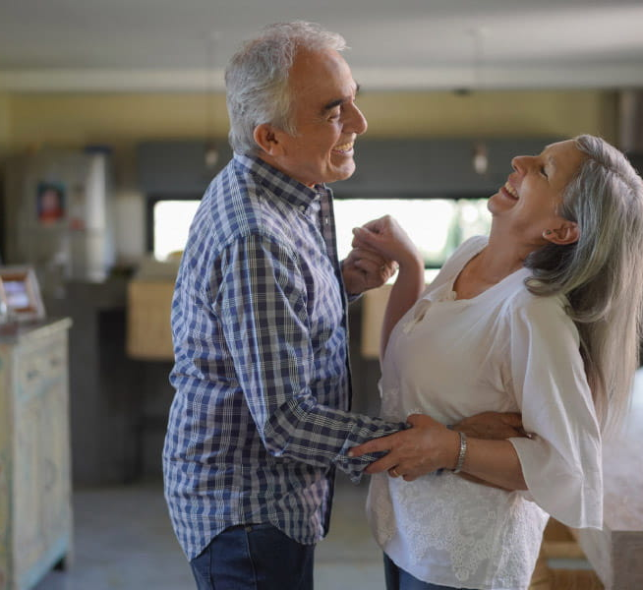
"What do you think influences how people experience ageing — is it mainly biological, psychological, or social factors?"
Notes:
Groups map factors influencing ageing experiences across:
Biological
Psychological
Social domains

Slide 23
Types of Ageing
Biological
Chronological

Slide 24
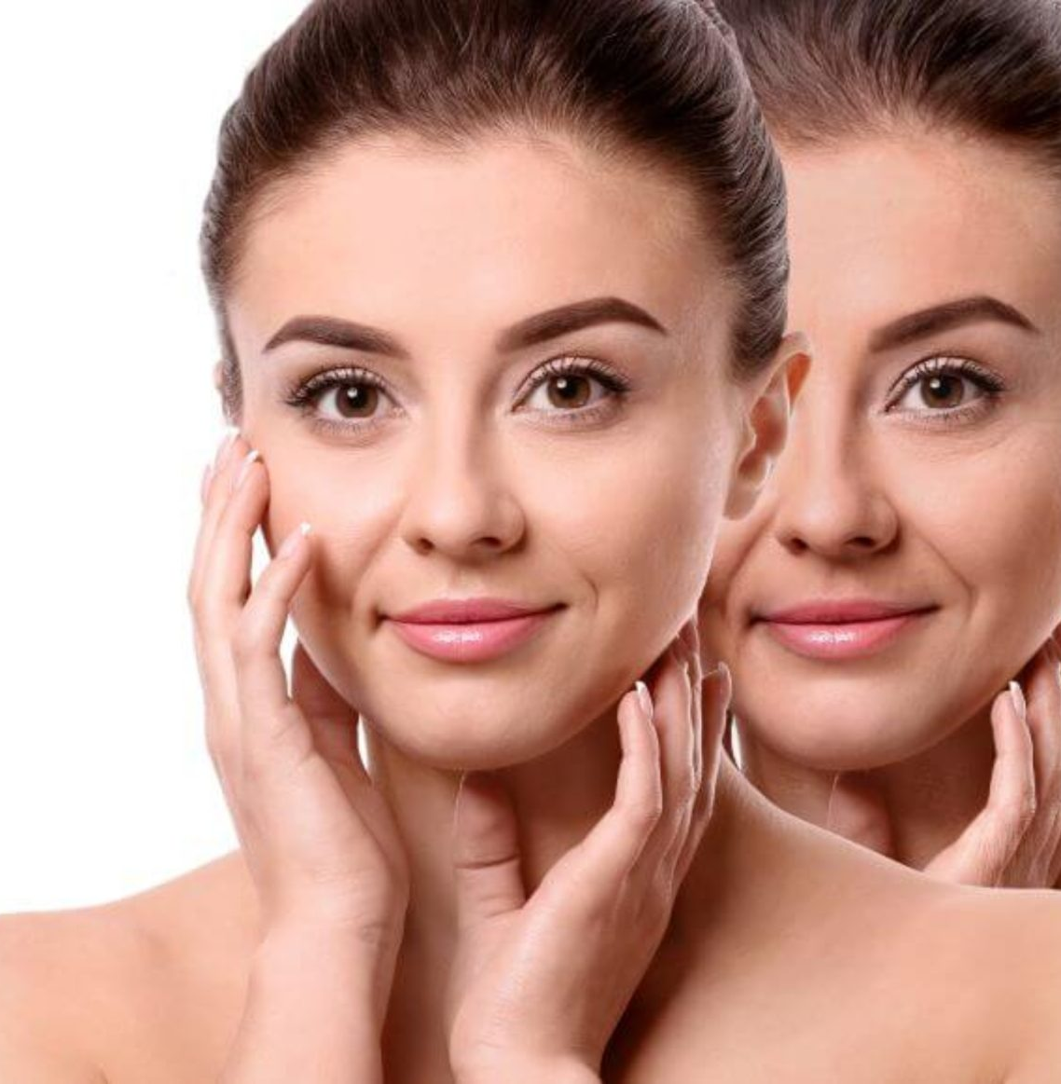
Theory of Ageing
Disengagement theory
Activity theory
Reconstruction theory (Social Breakdown)
Life Course Theory
Human Needs Theory

Slide 25
Disengagement Theory:
Hypothesis
Developed by Elaine Cumming and William Earle Henry in 1961
1
Proposes that ageing involves a natural withdrawal from Social roles
2
Relationships leads to a decrease in social interaction as individuals age
3
Seen as a mutual process between the individual and society
4
Notes:
In the 1950’s it was the view that as older people slow down , they gradually withdraw from the society Disengagement is a mutual activity in which the older person not only disengaged from the society, but the society disengages from the older person.
As individuals near death, social ties weaken and engagement with others decreases.
Disengagement frees individuals from social norms, which further reinforces the process.
The process differs by gender due to different social roles: Men: Instrumental roles (e.g., work)Women: Socioemotional roles (e.g., marriage, family)

Slide 26
Disengagement of Ageing
Disengagement involves ego change, leading to the decline of knowledge and skills.
Modern society values competence; age-grading expect (Younger people to be skilled and assume authority)
Older adults to retreat from formal roles before decline.
Disengagement occurs when Individuals or organizations recognize a decline in ability.

Slide 27
Consequences
Abandoning central roles (e.g., work or family) leads to:
Loss of social space
Potential crisis and demoralization unless new roles are adopted.
Lack of motivation

Slide 28
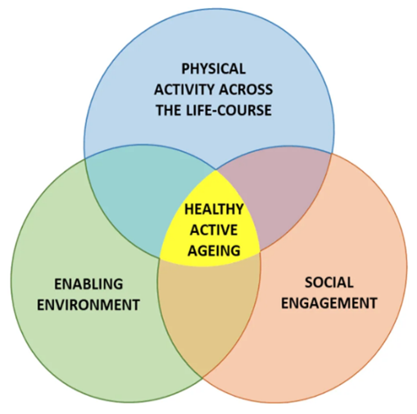
Activity Theory
Suggests positive ageing is linked to continued activity and social interaction
Proposes that older adults experience a higher quality of life when they stay physically, socially, and mentally active
Engage in meaningful personal and community activities
Emphasizes the importance of purpose and connection in later life
Developed as a counterpoint to the Disengagement Theory
Challenges the idea that older adults should naturally withdraw from society

Slide 29
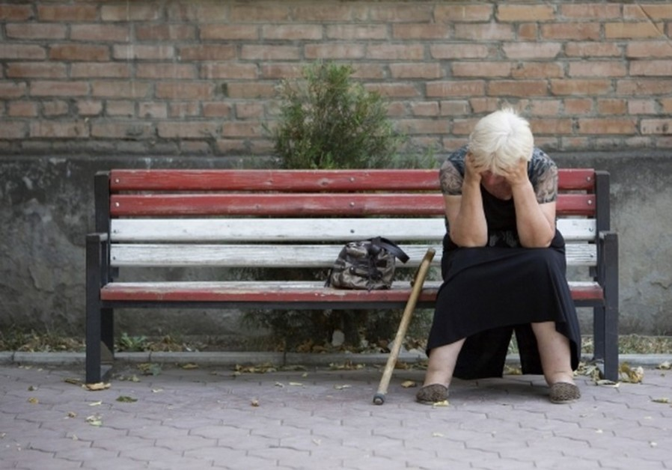
Reconstruction Theory
Suggests that negative psychological outcomes in ageing are influenced by Society’s negative views of older people
Inadequate services and limited opportunities for older adults
Ageing is not just a biological process, but one shaped by social attitudes and structures
Improved ageing experiences can occur through social reconstruction, including changing societal perceptions of older adults
Providing adequate, enabling services and meaningful opportunities

Slide 30
Theory Breakdown
Social Labelling
Internalization
Role Loss
Dependence on external feedback
Notes:
Social Labelling:
Society views the older person as : incompetent , obsolete
Society develops labels for the older person (stereotyping): useless, ineffective, helpless
Internalization:
These negative labels are internalized by older adults, leading to a diminished sense of self-worth and competence
Role Loss:
As individuals age, they often experience a loss of social roles (e.g., retirement, loss of family roles), which can contribute to a lack of purpose and identity
Dependence of external feedback:
Older adults become more dependent on external feedback for their self-concept, and negative feedback can lead to a breakdown in their ability to cope with life change

Slide 31
Consequences
Loss of Coping Abilities: The internalization of negative labels can lead to a decrease in coping abilities and an increased sense of incompetence
Psychological Impact: This can result in a cycle of declining mental health and social withdrawal

Slide 32

Break time

Slide 33
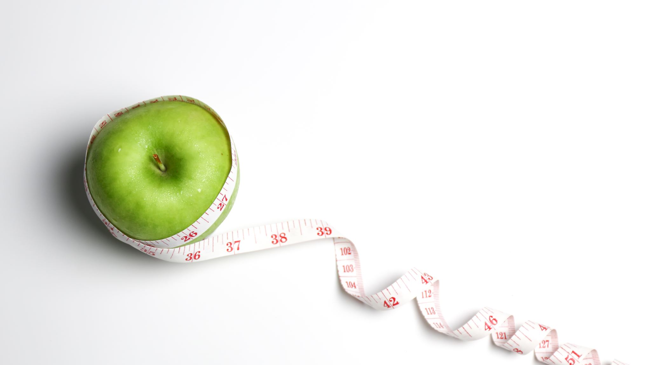
What do you think healthy ageing means?

Slide 34
Healthy Ageing
WHO (2020) defines healthy ageing as “the process of developing and maintaining the functional ability that enables wellbeing in older age.” Functional ability is about having the capabilities that enable all people to be and do what they have reason to value. This includes a person’s ability to:
meet their basic needs
learn, grow and make decisions
be mobile
build and maintain relationships
contribute to society.

Slide 35
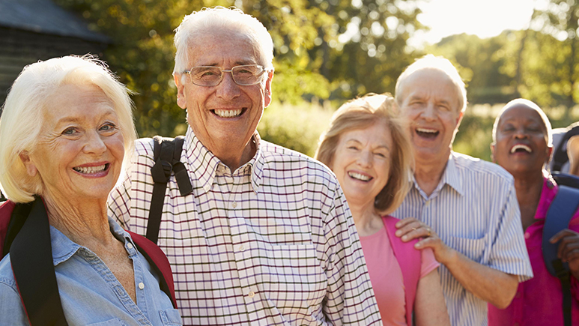
What are the Implications of an ageing population

Slide 36
Implications
Housing
Healthcare
Cost of living
Employment
Notes:
Housing: There is a housing crisis in the UK where there are not enough homes for people, especially for those who are elderly.
Healthcare: As people are living for longer, there is a likelihood of people developing chronic conditions which costs.
Cost of living: Pensions are typically the sole income for the elderly, and they rely on government support like the winter fuel payments to help them with their health and wellbeing
Employment: As people get older, and with perceptions being negative, those who are older find it difficult to find employment opportunities therefore making them economically inactive.

Slide 37
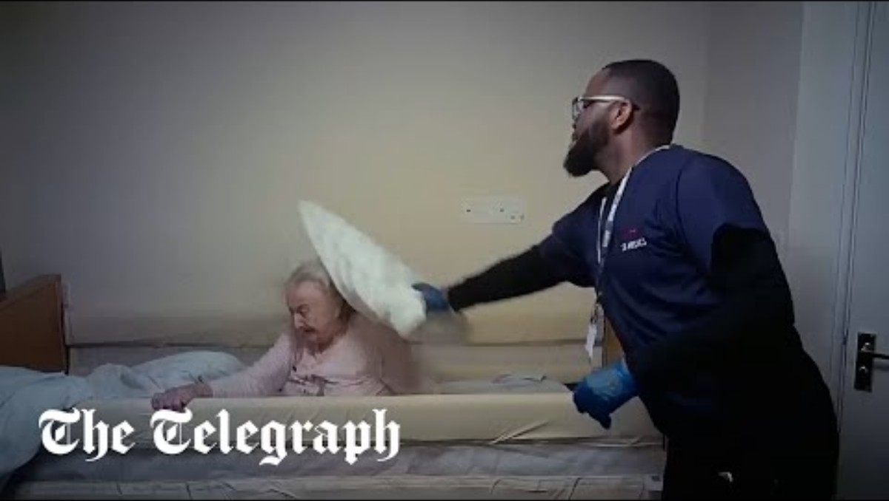
The older person: Issues
Abuse:
It can happen in the family
In care environments
It could be physical or psychological ( verbal, named , threatened, taken advantage of)
One form of abuse is neglect - when people who are supposed to care for them ignore their needs and concerns
Notes:
From watching the video, why would you think that this is a form of abuse?
According to Age UK (2023) 3.2% of respondents aged 60-74 and 1.4% of those aged 75+ reported that they had experienced domestic abuse in the year spanning April 2022 to March 2023 (Age UK, 2023). This number could be argued as an underestimate due to fear of reporting.

Slide 38

Loneliness
940,000 older people [aged 65+] in the UK are often lonely
270,000 older people (aged 65+) in England go a week without speaking to a friend or family member (3%, or around 1 in 40 people aged 65+)
People who go a week without speaking to a friend or family member are almost three times more likely to be lonely than people who speak to friends and family more often
(Age UK, 2024)

Slide 39

Drivers of Loneliness
Life Transition
Social Mistrust
Bereavement and Loss
Environment
Social connections
Health inequalities
(Age UK, 2024)

Slide 40
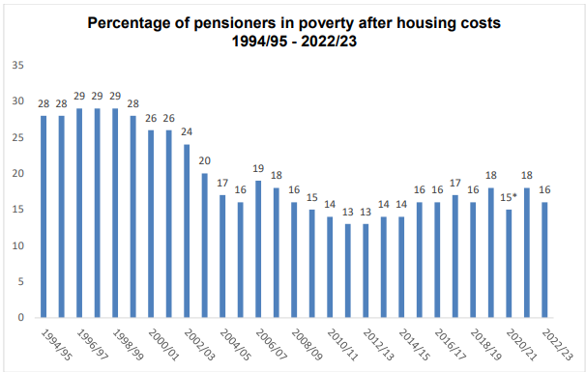
Poverty
1.9 million (16%) of pensioners in the UK live in relative poverty.
35% of private tenants and 34% of social rented sector tenants, live in poverty compared to 12% of older people who own their home outright
25% of Asian/Asian British pensioners and 26% of Black/Black British pensioners are in poverty compared to 16% of White pensioners.
23% of single older women live in poverty compared to 20% of single older men and 13% of pensioner couples.
(Age UK, 2024)

Slide 41
Poverty: Worries
2024 findings include:
• 48% were worried about heating their home.
• 43% said they had cut back on heating and power recently.
• 23% said they had cut back spending on food and groceries.
• 22% had cut back on transport or their vehicles.
(Age UK, 2024)

Slide 42

Healthy Living Blueprint
In groups or pairs, you are going to create a blue-print poster for ‘healthy ageing’ detailing:
What does healthy ageing mean?
What helps people age in a healthy way?
What might make healthy ageing difficult? And what can be done to overcome these.
What role do lifestyle, community, environment, and services play?

Slide 43
Reference List
World Health Organization (2024) Ageing and Health. [Online] Available at: https://www.who.int/news-room/fact-sheets/detail/ageing-and-health. Accessed 12th June 2025
Government Office of Science (2016) Future of an Ageing Population. London: Government Office of Science
United Nations (2023) World Population 2023: Challenges and opportunities of population ageing in the least developed countries. New York: United Nations
Teerawichitchainan, B. and Low, T. (2021). Causes of Population Aging. In: Gu, D., Dupre, M.E. (eds) Encyclopedia of Gerontology and Population Aging. Springer, Cham. https://doi.org/10.1007/978-3-030-22009-9_654
Keshavarz, M., Xia, K., Bano, D. and Ehninger, D. (2023) ‘Aging – What it is and how to measure it’. Mechanisms of Ageing and Development. 213. https://doi.org/10.1016/j.mad.2023.111837
World Health Organization (2020) Healthy ageing and functional ability. [Online] https://www.who.int/news-room/questions-and-answers/item/healthy-ageing-and-functional-ability. Accessed 13th June 2025

