Slide 1
Terrorism and Public Service Responses
Week 3 – Terrorism and Emergencies

Slide 2
Session 1

Slide 3
Definition of a Major Incident?
Discuss

Slide 4
Task
The Civil Contingencies Act 2004
The Joint Emergency Services Interoperability Principles (JESIP) Joint Doctrine

Slide 5
Definition of a major incident
The Civil Contingencies Act 2004 defines an emergency (major incident) as:
an event or situation which threatens serious damage to human welfare;
an event or situation which threatens serious damage to the environment; or war, or terrorism, which threatens serious damage to security

Slide 6
The Joint Emergency Services Interoperability Principles (JESIP)
The Joint Emergency Services Interoperability Principles (JESIP) Joint Doctrine defined a major incident as:
An event or situation with a range of serious consequences which requires special arrangements to be implemented by one or more emergency responder agency: https://www.jesip.org.uk/doctrine

Slide 7
Civil Contingencies Act 2004

Slide 8
Introduction
The introduction of the Civil Contingencies Act 2004 formalised the way in which we plan for and deal with emergencies/major incidents by creating a legislative robust methodology together with supporting structures.
The public perception of what a major incident is, may be limited to believing that a terrorist act, major road, rail or air accidents involving large numbers of fatalities and injured constitute a major incident.

Slide 9
Background to Civil Contingencies Act 2004
At the turn of the century, the UK experienced a number of events in a relatively short timeframe. These events included:
Fuel Crisis 2000
Foot and Mouth breakout 2001
Fire Service Strike 2002 / 2003
Flooding
The UK Government commissioned a review into current legislation and deemed that 21st Century threats were not adequately addressed through the current statutory provision

Slide 10
Take a break!

Slide 11
Existing Legislation (Pre 2004)
In two groups, research the following two Acts:
Group 1: Emergency Powers Act 1920
Group 2: The Civil Defence Act 1948

Slide 12
Existing Legislation (Pre 2004)
Emergency Powers Act 1920
The Emergency Powers Act of 1920 enabled Government to make emergency provisions in circumstances where other legislation would not suffice.
It was introduced by Prime Minister Lloyd George.
It was enacted twelve times in 84 years.
It was repealed on the introduction of the CCA in 2004.
The Civil Defence Act 1948
This act placed duties on Local Authorities and Police Forces in respect of civil defence matters
It aimed to protect the population from military attack and natural disasters
It followed broadly Integrated Emergency Management (IEM) principles, which will be discussed later.
It was repealed on the introduction of the CCA in 2004.

Slide 13
The Reason for Change
The introduction of the CCA 2004 was to replace outdated legislation to ensure that appropriate fit for purpose arrangements were in place to meet the challenges of the 21st Century.
The new Act called the Civil Contingencies Act 2004 received Royal Ascent on 18 November 2004.
The new Act replaced the 1920 Emergency Powers Act and the 1948 Civil Defence Act.

Slide 14
Category 1 and Category 2 Responders
These are the of Category 1 and Category 2 Responders in the Schedule 1
Category 1:
Police
Fire
Ambulance
HM Coastguard
Local Authorities
NHS Bodies- Public Health Wales, Health Board.
Natural Resources Wales
Port Health Authorities
Category 2:
Health and Safety Executive
Transport for Wales
Network Rail
Train Operating Companies
Highways Wales
Airport operators
Harbour Authorities

Slide 15
Research Task
Research the two following roles:
Local Resilience Forums (LRFs)
Welsh Government Liaison Officer (WGLO)

Slide 16
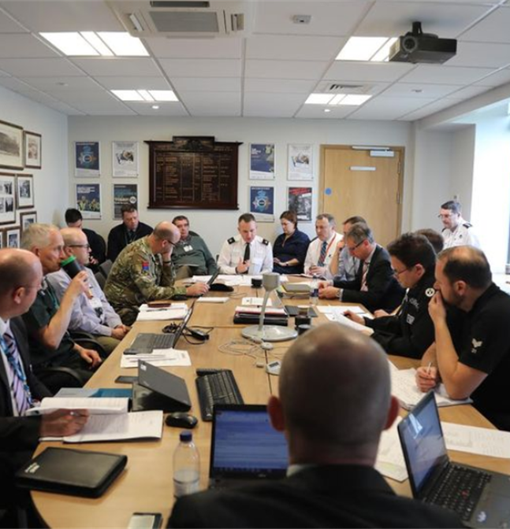
Local Resilience Forums (LRFs)
Local Resilience Forums (LRFs) are multi-agency partnerships made up of representatives from local public services, including the emergency services, military, local authorities, the NHS, the Environment Agency and others. It is the forum which many of the duties of the Civil Contingencies Act 2004 are delivered collectively.

Slide 17
The role of the Welsh Government Liaison Officer (WGLO)
An officer from the Welsh Government who liaises with UK Government or other UK Government Departments and Strategic Co-ordination Groups.
Their role is primarily to advise and provide a link to the Emergency Co-ordination Centre Wales (ECCW).
In some circumstances, the WGLO may be temporarily based in London and attend UK Government/COBR meetings.

Slide 18
National Risk Register (NRR)
The National Risk Register 2020 outlines the key malicious and non-malicious risks that could affect the UK in the next two years, and provides resilience guidance for the public.
National Risk Register 2020 - GOV.UK (www.gov.uk)
This public facing document is supported by the National Security Risk Assessment (NSRA) which is not public facing.
The NSRA is used by civil contingencies professionals to undertake community risk assessments, as required by the Act, to meet their risk assessment duties.
The NRR categorises risks into six thematic groups, with a number of sub categories under each thematic group

Slide 19
National Risk Register Key Points
The National Risk Register categorises risks in the following groups:
Malicious Attacks – Manchester Arena Attack 2017
Serious and Organised Crime – 39 Vietnamese migrants deaths in Essex 2019
Environmental Hazards – Storm Dennis 2020
Human and Animal Health – Covid-19 2020/2021
Major Accidents – Ladbroke Grove Rail Crash 1999
Societal risks – Bristol riots 2021

Slide 20
Session 2

Slide 21
Task
Research the following roles:
Counter Terrorism Security Coordinator
Police Search Advisor
Licensed Search Officer (LSO)
Prevent Officer

Slide 22
Police National Search Centre (PNSC)
Police National Search Centre (PNSC) is a world leader in counter terrorism search, missing person search and crime search.
Based at our Ryton site, it was set up after the Brighton bomb attack at the Conservative party conference in 1984 and has delivered specialist licensed search training since 1985.

Slide 23
Preparing for the Coronation | What does the Police National Search Centre do? - YouTube

Slide 24
Counter Terrorism Policing

Slide 25
What is Counter Terrorism Policing?
Counter Terrorism Policing is a collaboration of UK police forces working with the UK intelligence community to help protect the public and our national security by preventing, deterring, and investigating terrorist activity.

Slide 26
PREVENT

Slide 27
Group Work
In 4 groups, research each element of Prevent.
Group 1: Prevent
Group 2: Pursue
Group 3: Protect
Group 4: Prepare

Slide 28
Prevent – Prevent vulnerable people from being drawn into Terrorism
Pursue – Pursue terrorists and bring them to justice
Protect – Protect public and places from terrorist attacks
Prepare – Prepare to respond to attacks and reduce their impact

Slide 29
Any Questions?

