Slide 1
My Personal SWOT Analysis and Professional Development as a Healthcare Assistant (HCA), NHS London
Module: LCHS4009 – Professional Development Within Health And Social Care
Module Number: LCHS4009 (LON)
ASSIGNMENT NUMBER : Assignment 1
Student: MARGARET WILSON
Student ID: 2416220
Lecturer: LOU WELLS

Slide 2
Introduction
Understanding self-awareness supports personal and professional growth in health and social care.
SWOT analysis helps identify strengths and areas for development.
Focus: Becoming a Healthcare Assistant (HCA) within NHS London.
Notes:
Self-awareness is a vital part of reflective practice in health and social care. Through this SWOT analysis, I will reflect on my current strengths, weaknesses, opportunities, and threats related to my career goal of working as a Healthcare Assistant. This process helps me set realistic goals and plan for continuous improvement.

Slide 3
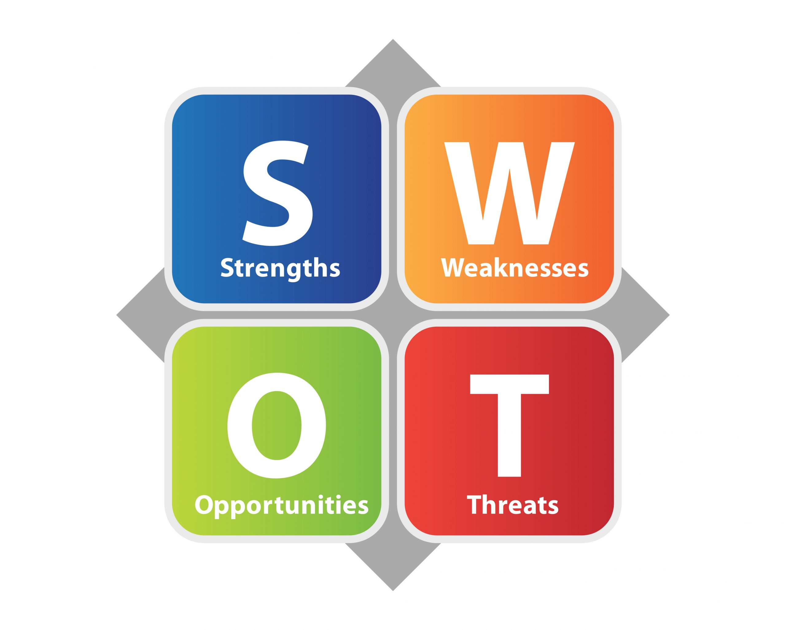
SWOT Analysis
SWOT Analysis is a self-evaluation tool used to identify your Strengths, Weaknesses, Opportunities, and Threats.
It helps to understand where you currently are and what areas you need to develop in order to grow personally and professionally.
It is commonly used in health and social care to support reflective practice, career planning, and professional development.

Slide 4
SWOT Importance For My PPD
Helps increase self-awareness, which is essential for reflective practice in health and social care.
Allows me to identify my best qualities (e.g., empathy, teamwork, communication) and use them effectively in my role.
Highlights areas where I need improvement, such as clinical confidence or stress management.
Guides me to plan realistic career goals, such as completing NHS training or progressing towards nursing.
Enables me to respond proactively to challenges in my training or workplace.
Supports development of a clear Personal Development Plan (PDP).

Slide 5

Strengths
Empathy and compassion improve patient-centred care (Byrne et al., 2023).
Strong communication promotes teamwork and safety.
Reliable, organised, and attentive to detail.
Notes:
Empathy allows me to connect with patients and understand their needs, supporting emotional wellbeing. Effective communication is essential for accurate reporting and collaboration within the multidisciplinary team. These strengths align with the NHS London values of compassion, respect, and integrity.

Slide 6

Weaknesses
Limited hands-on clinical experience.
Nervousness in unfamiliar environments.
Perfectionism under pressure may increase stress (Page et al., 2018).
Notes:
One area I need to develop is clinical confidence, as I have limited real-world experience. I also notice that in new settings I become anxious, which affects my communication. Perfectionism can be positive but may also cause stress if I overthink mistakes. Recognising these weaknesses is the first step toward improvement through reflection and mentorship.

Slide 7

Opportunities
NHS training and mentorship programmes.
Continued Professional Development (CPD) and learning modules.
High demand for HCAs in London.
Opportunities for progression to nursing or senior roles.
Notes:
The NHS London framework provides access to ongoing training and professional development. Shadowing senior staff and engaging in CPD activities can help me build clinical knowledge and confidence. The growing demand for HCAs across London offers long-term job security and potential career progression into registered nursing.

Slide 8
Threats
Workload and emotional stress can lead to burnout (Lilly et al., 2019).
Competition for NHS posts.
Maintaining work–life balance can be challenging
Notes:
A key threat is the emotional pressure that comes with supporting patients in distress, which can lead to burnout if not managed properly. Other challenges include competition for roles and balancing shift work with personal commitments. Developing coping strategies such as mindfulness and reflective journaling will help protect my wellbeing.

Slide 9

Using Strengths to Grow
Use communication to overcome anxiety (Weiner and Cole, 2004).
Apply reflection to improve confidence.
Use teamwork and reliability to build mentorship opportunities.
Notes:
I can use my strong communication skills to overcome anxiety by focusing on patient interaction rather than my nerves. Through structured reflection using models, I can identify what went well and what needs improvement. Building professional relationships will also open mentorship and learning opportunities within my workplace.

Slide 10
Conclusion
Self-awareness enhances personal and professional growth (London, Sessa and Shelley, 2023).
Reflection and CPD build competence and confidence.
My action plan: continuous reflection, mentorship, and learning.
Notes:
In conclusion, self-awareness and reflection are key to lifelong learning in health and social care. My SWOT analysis shows I have a strong foundation in empathy, teamwork, and communication. By actively addressing my weaknesses through CPD and reflection, I can continue developing as a compassionate and competent Healthcare Assistant.

Slide 11
References
Byrne, M., Eduardo, C., Daly, S., Lok, B. and Miles, A. (2023). The Current State of empathy, Compassion and person-centred Communication Training in healthcare: an Umbrella Review. Patient Education and Counseling, [online] 119(108063), pp.108063–108063. doi:https://doi.org/10.1016/j.pec.2023.108063.
Lilly, C.M., Cucchi, E., Marshall, N. and Katz, A. (2019). Battling Intensivist Burnout. Chest, [online] 156(5), pp.1001–1007. doi:https://doi.org/10.1016/j.chest.2019.04.103.
London, M., Sessa, V.I. and Shelley, L.A. (2023). Developing self-awareness: Learning processes for self- and interpersonal growth. Annual Review of Organizational Psychology and Organizational Behavior, 10(1), pp.261–288.
Page, M.J., Hill, A.P., Kavanagh, O. and Jones, S. (2018). Multidimensional perfectionism and cortisol stress response in non-clinical populations: A systematic review and evaluation. Personality and Individual Differences, 124, pp.16–24. doi:https://doi.org/10.1016/j.paid.2017.11.037.
Weiner, J.S. and Cole, S.A. (2004). Three Principles to Improve Clinician Communication for Advance Care Planning: Overcoming Emotional, Cognitive, and Skill Barriers. Journal of Palliative Medicine, 7(6), pp.817–829. doi:https://doi.org/10.1089/jpm.2004.7.817.

