Slide 1
ECAD6005/C
Cyfrifoldebau Trawsgwricwlaidd: Llythrennedd, Rhifedd a Chymhwysedd Digidol
Cross Curricular Responsibilities: Literacy, Numeracy and Digital Competence
Lefel/Level 6

Slide 2
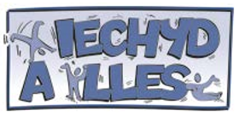
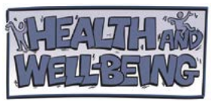
Llythrennedd ym
Maes Dysgu a Phrofiad
Darlith 3
Lecture 3
Literacy in
Area of Learning & Experience

Slide 3
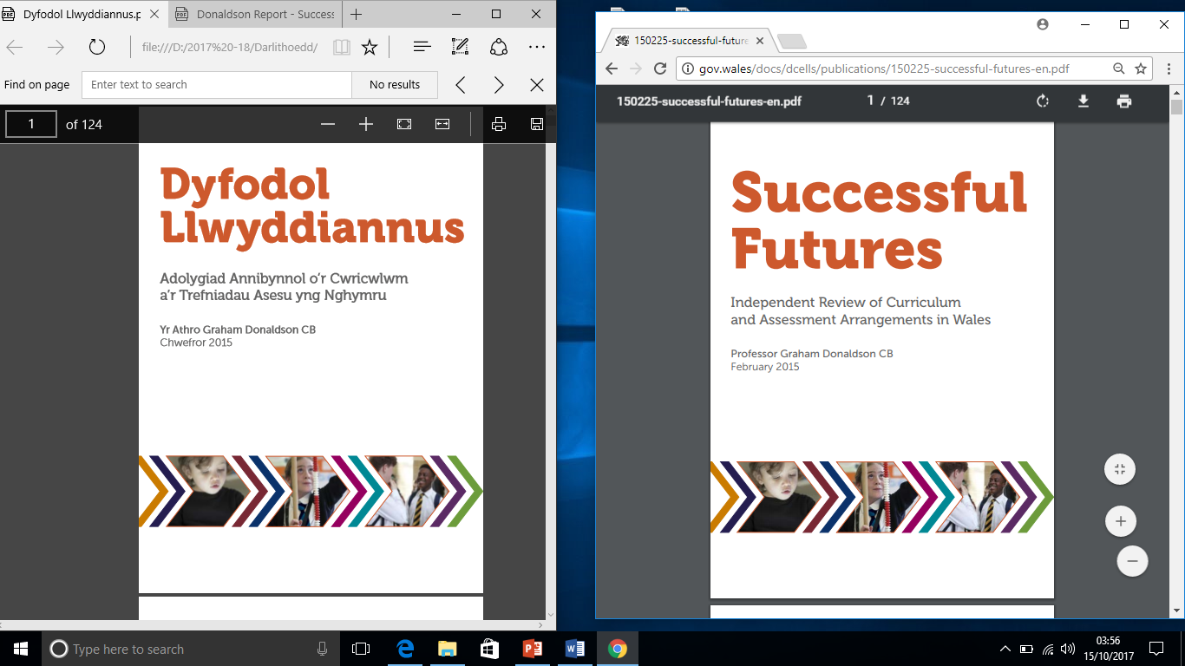
Drwy Faes Dysgu a Phrofiad Iechyd a lles, bwriedir helpu i ymdrin â phryderon ynghylch gweithgarwch corfforol, deiet a bwyta’n iach.
The Health and well-being Area of Learning and Experience aims to help to address concerns about physical activity, diet and healthy eating.
Mae’n gwneud defnydd o bynciau a themâu sy’n ymwneud ag addysg gorfforol, lles meddyliol, corfforol ac emosiynol, rhyw a pherthnasoedd, rhianta, bwyta’n iach a choginio, camddefnyddio sylweddau, dysgu a phrofiad cysylltiedig â gwaith, a dysgu i fyw.
It draws on subjects and themes from PE, mental, physical and emotional well-being, sex and relationships, parenting, healthy eating and cooking, substance misuse, work-related learning and experience, and learning for life.

Slide 4
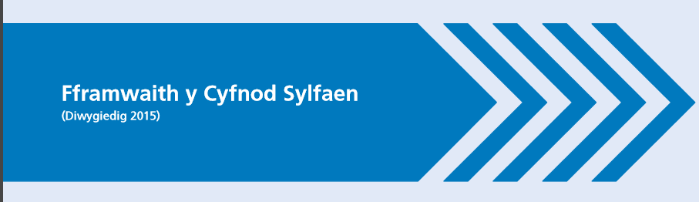

Iechyd a Lles
Cwricwlwm Presennol
Health & Well-being
Present Curriculum
ITEA5002/C
CS
2015
FPh
Sgiliau Datblygiad Personol a Chymdeithasol, Lles ac Amrywiaeth Diwylliannol
Personal and Social Development,
Well-being & Cultural Diversity Skills
+ Sgiliau
Llythrennedd
Sgiliau Datblygiad Corfforol
Physical Development Skills
+
Literacy Skills
Notes:
Rhannu’r sgiliau/ Distribute curriculum skills.

Slide 5
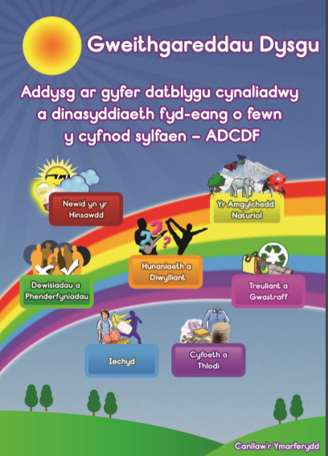
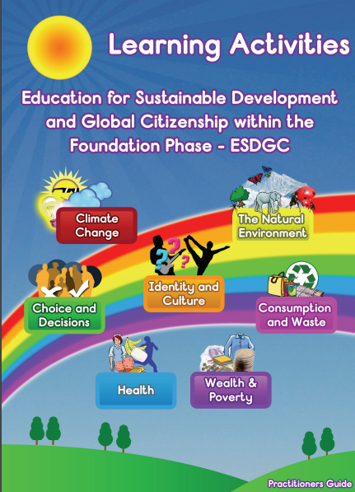
Notes:
Rhannu copi o’r adran yma. / Distribute a section of the resource related to ‘Health’ (author: Sioned V. Hughes).
Using a theme based approach, which ‘theme’ would best incorporate both curriculum ‘Health & well-being’ and literacy skills? OR
Consider which ‘model of cross-curricular learning’ (Barnes page 66) can be applied to the planning? (see next slide)

Slide 6

Model o ddysgu trawsgwricwlaidd:
Symbolaidd
Hierarchaidd
Pwnc unigol trosglwyddadwy
Thema seiliedig
Aml ddisgyblaethol
Rhyng ddisgyblaethol
Oportiwnistaidd
Ffocws dwbwl
Model of cross-curricular learning:
Tokenistic
Hierarchical
Single transferable subject
Theme-based
Multi-disciplinary
Inter-disciplinary
Opportunistic
Double-focus

Slide 7


Sgil Lles: Datblygu dealltwriaeth o’r ffaith bod ymarfer corff a hylendid a’r mathau cywir o fwyd a diod yn bwysig er mwyn cael corff iach.
Sgil Cymdeithasol:Datblygu ymwybyddiaeth o ddiwylliannau gwahanol ac anghenion, safbwyntiau a chredoau amrywiol pobl eraill sy’n perthyn i’w diwylliant hwy a diwylliannau eraill
Well-being skill: Develop an understanding that exercise and hygiene and the right types of food and drink are important for healthy bodies
Social skill: Develop an awareness of different cultures and the differing needs, views and beliefs of other people in their own and in other cultures
Notes:
Task: Can you think of thematic activities promoting a national event in Wales which can incorporate cross-curricular literacy skills? What ‘starting point’ would you choose? As a result, what ‘mode/model’ of cross –curricular teaching would this reflect?

Slide 8
Model o ddysgu trawsgwricwlaidd:
Symbolaidd
Hierarchaidd
Pwnc unigol trosglwyddadwy
Thema seiliedig
Aml ddisgyblaethol
Rhyng ddisgyblaethol
Oportiwnistaidd
Ffocws dwbwl
Model of cross-curricular learning:
Tokenistic
Hierarchical
Single transferable subject
Theme-based
Multi-disciplinary
Inter-disciplinary
Opportunistic
Double-focus

Slide 9

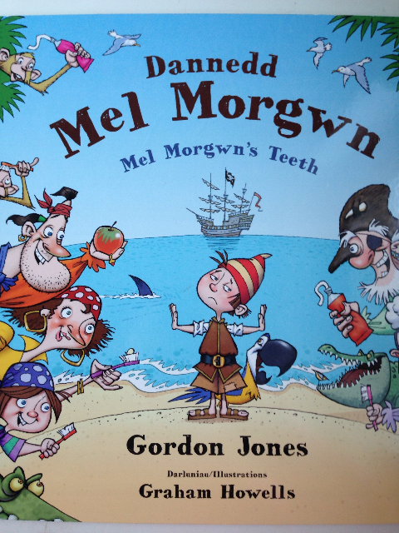
Meddylfryd
o
Dwf
A witty book on perspective. Lola won’t eat healthy foods until her brother creatively renames them, calling carrots Orange Twiglets from Jupiter, and mashed potatoes Pointy Peaks of Mount Fugi. After reading, have your students come up with other creative fun names for commonly disliked foods or write a story about a time they ate something new and were surprised by it’s taste.

Slide 10
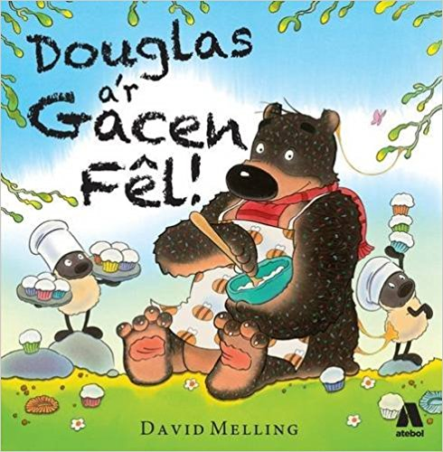

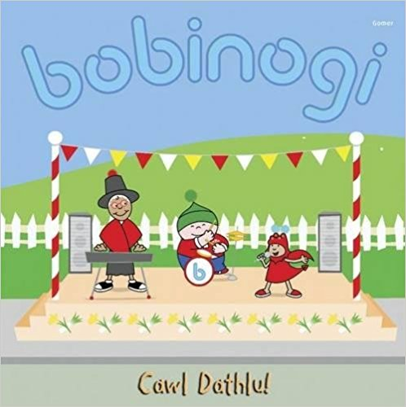


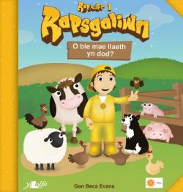


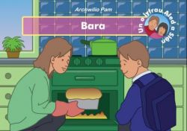

Slide 11

One of the best parts of a young child’s day is opening a lunchbox and diving in. But how did that delicious food get there? From planting wheat to mixing dough, climbing trees to machine-squeezing fruit, picking cocoa pods to stirring a vat of melted bliss, here is a clear, engaging look at the steps involved in producing some common foods. Health tips and a peek at basic food groups complete the menu.
An apple pie is easy to make…if the market is open. But if the market is closed, the world becomes your grocery store. This deliciously silly recipe for apple pie takes readers around the globe to gather ingredients. First hop a steamboat to Italy for the finest semolina wheat. Then hitch a ride to England and hijack a cow for the freshest possible milk. And, oh yes! Don’t forget to go apple picking in Vermont! A simple recipe for apple pie is included. (Amazon Description)
A witty book on perspective. Lola won’t eat healthy foods until her brother creatively renames them, calling carrots Orange Twiglets from Jupiter, and mashed potatoes Pointy Peaks of Mount Fugi. After reading, have your students come up with other creative fun names for commonly disliked foods or write a story about a time they ate something new and were surprised by it’s taste.

Slide 12


“The Boy Who Loved Broccoli” is a humorous tale about Baxter, a boy who enjoys eating broccoli so much that it gives him super powers. After jumping over mountains and splashing through lakes, he goes on to perform superhero good deeds and convinces others to indulge in the delicious green veggie, only to find out that they become filled with super powers as well. Find out what happens next when Baxter finds himself in a bit of trouble! (Amazon Description)
After reading this book, even your pickiest eater students will think meatloaf and mashed potatoes sounds pretty good. Boys especially will love this wacky book on some of the crazy things people from around the world eat. It’s educational, entertaining, and down right disgusting.

Slide 13
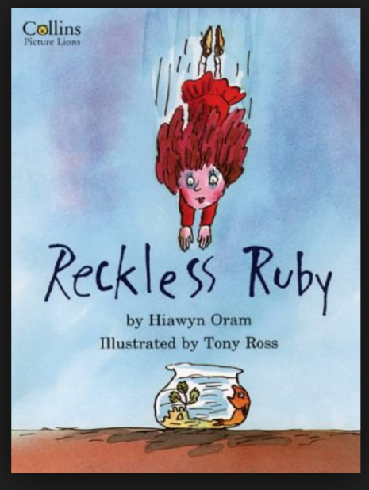



Books for younger children: Pre-school to 12 years (click on book).

Slide 14
Essential to any consideration of a more thematic or cross-curricular approach towards curriculum opportunity is the idea that one theme may offer wide opportunities for quality learning in several subject areas, thus supposedly saving time and repetition, while allowing for wider and more cohesive learning experiences, with greater consideration of how children learn.
Rowley, C. a Cooper, H. (2010) Cross-curricular Approaches to Teaching and Learning. London: Sage Publications.

Slide 15
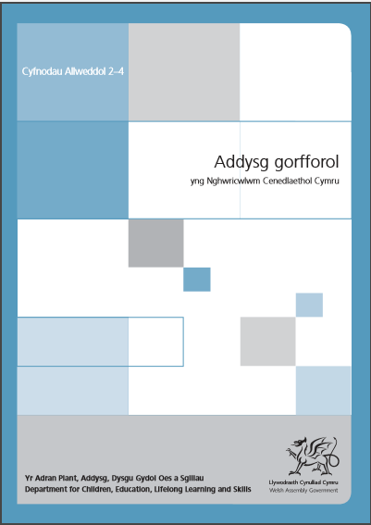

Cwricwlwm Presennol
Present Curriculum
2008
CA2
KS2
ITEA5002/C
Mewn addysg gorfforol, bydd y dysgwyr yn cyfathrebu trwy ddewis a defnyddio geiriau allweddol sy’n gysylltiedig â’u gweithgaredd i’w cynorthwyo i ddadansoddi a gwella eu gwaith eu hunain a gwaith eraill. Byddan nhw’n gofyn cwestiynau ac yn cyfleu eu syniadau trwy ddefnyddio gwahanol ffurfiau yn ôl y gynulleidfa a diben eu gweithgaredd. Byddan nhw’n gwrando ar gyfraniadau gan eraill, yn nodi problemau posibl, yn awgrymu dulliau eraill, ac yn helpu i ddatblygu gweithgaredd grŵp.
In physical education, learners communicate through the selection and use of key words related to their activity to help them analyse and improve their own and others’ work. They ask questions and communicate their ideas using different forms depending on the audience and purpose of their activity. They listen to others’ contributions, identify possible problems, suggest alternative approaches, and help to develop group activity.
Physical education Guidance for Key Stages 2
Canllawiau Addysg gorfforol ar gyfer CA2
+ Literacy Skills
+ Sgiliau Llythrennedd
Notes:
Highlight: Focus on ‘Oracy’ Strand within this subject. (‘Dance’ is incorporated with ‘Creativity’ area of learning).
Literacy and numeracy skills may be explicitly taught first in English, Welsh and mathematics lessons before being applied across the broader curriculum or in other subjects and themes e.g. responding to national events such as the Olympics or Roald Dahl centenary. (Literacy & Numeracy: Your Questions Answered).
Highlights cross-curriculua links (i.e. integration of subjects)
http://learning.gov.wales/docs/learningwales/publications/140626-food-and-fitness-in-the-curriculum-cy.pdf
http://learning.gov.wales/docs/learningwales/publications/140626-food-and-fitness-in-the-curriculum-en.pdf
Can you think of examples of how to include ‘oracy’ skills within a ‘physical education’ lesson based either a competitive, creative, outdoor adventurous activities. Also a note to remind you that within your lesson you should try to include an element of ‘health & wellbeing’ e.g. water post lesson. You may refer to ideas provided in modules ITSP Level 4 and ITCM Level 4 and ITEA Level 5 and both PTE’s.

Slide 16
Research shows that ineffective group work is highly problematic in terms of achieving learning outcomes yet it also clarifies that the fundamental skills needed for successfully working in groups can be fostered and practiced through effective classroom work (Baines et al., 2008).
Baines, E., Blatchford, P., Kutnick, P., Chowne, A., Ota, C., & Berdondini, L. (2008). Promoting effective group work in the primary classroom: A handbook for teachers and practitioners. Abingdon: Routledge.
…..promotion and valuing of dialogue (both between teachers and children and among the children themselves) as a fundamental basis for learning (Mercer & Howe, 2012).
Mercer, N., & Howe, C. (2012). Explaining the dialogic processes of teaching and learning: The value and potential of sociocultural theory. Learning, Culture, and Social Interaction, 1, 12-21.
Notes:
Use as a reminder whilst undertaking the previous task.

Slide 17
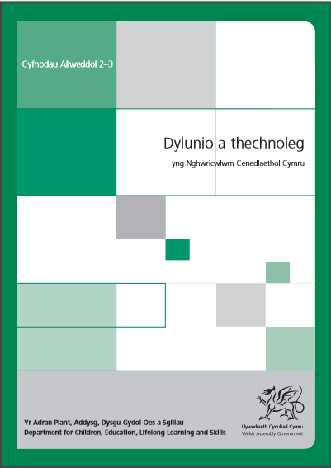
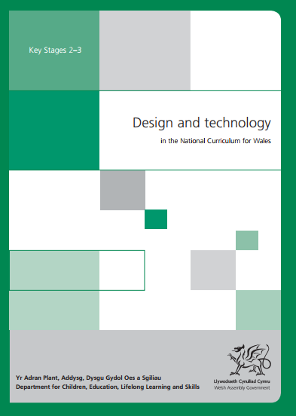
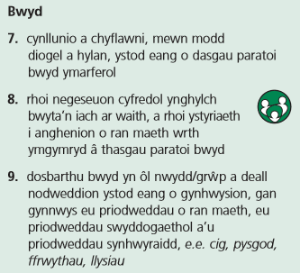
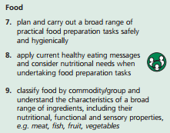
Cwricwlwm Presennol
Present Curriculum
2008
CA2
KS2
+ Sgiliau Llythrennedd
+ Literacy Skills
Notes:
Have you planned, or seen good practice, incorporating these skills and relevant literacy skills during PTE? Discuss in pairs. Cross reference the literacy skills to check whether those observed were ‘age related’.

Slide 18
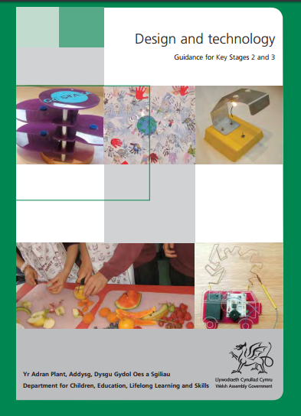
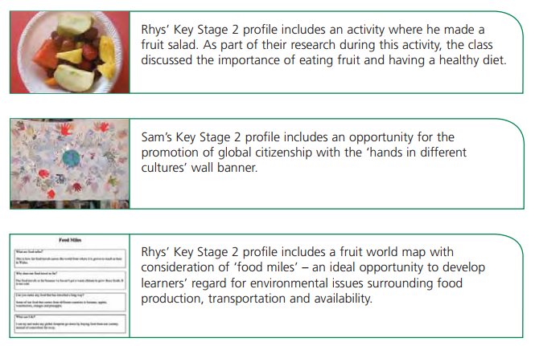
Design and technology contributes to learners’ awareness of the importance of food and fitness by encouraging them to apply current healthy eating messages and consider nutritional needs when undertaking food preparation tasks (KS2)
2009
Notes:
Activity: Relate (Language) strand, aspect, area and literacy curriculum skill (non bold) related to each activity. Note on post its.

Slide 19
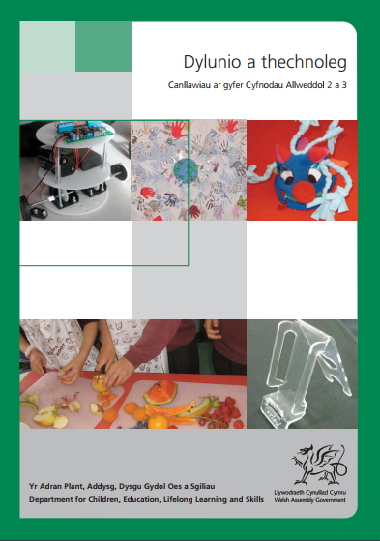
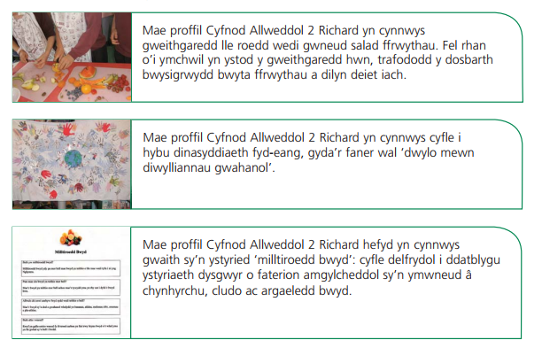
Mae dylunio a thechnoleg yn cyfrannu at ymwybyddiaeth dysgwyr o bwysigrwydd bwyd a ffitrwydd drwy eu hannog i roi negeseuon cyfredol ynghylch bwyta’n iach ar waith, a rhoi ystyriaeth i anghenion o ran maeth wrth ymgymryd â thasgau paratoi bwyd (CA2).
2009
Notes:
Activity: Relate (Language) strand, aspect, area and literacy curriculum skill (non bold) related to each activity.

Slide 20
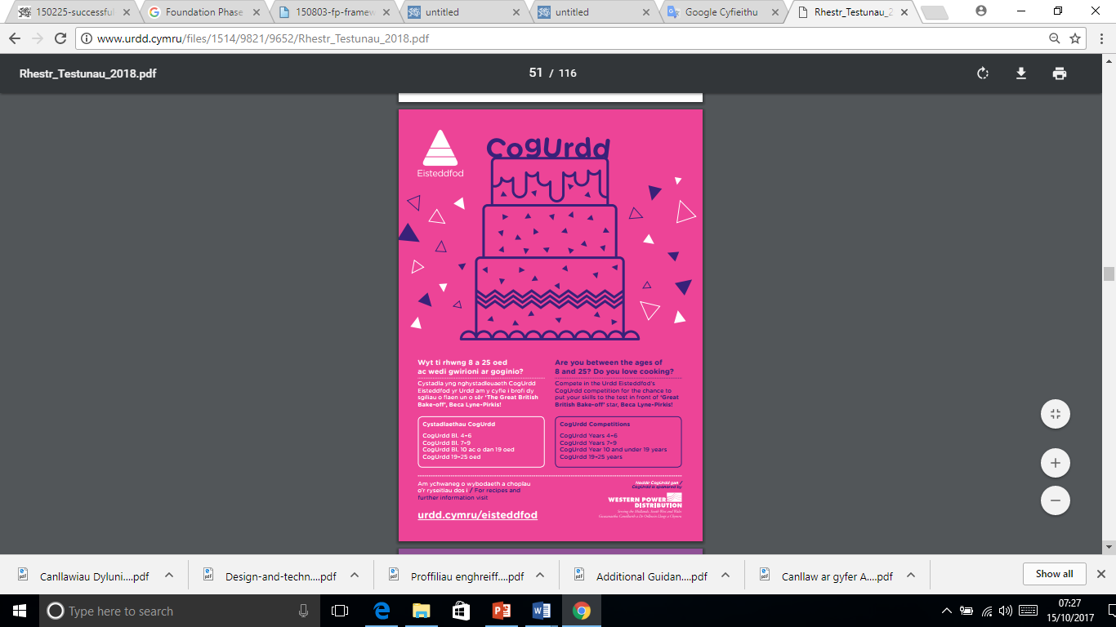
Notes:
An examples of how to include ‘literacy’ skills within the ‘Heath & Well-being’ area of learning based on a ‘national event’ (Eisteddfod Urdd Gobaith Cymru: National Youth Movement of Wales) (Range of skills could include: oracy: presenting choice of menu to adjudicator, cost of ingredients (numeracy) , write a three course menu board).

Slide 21
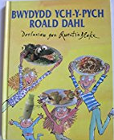

Notes:
Roald Dahl’s books are often chosen to support children’s ‘language skills’ i.e. Literacy and numeracy skills explicitly taught first in English, Welsh and mathematics lessons before being applied across the broader curriculum or in other subjects and themes (Literacy & Numeracy: Your questions answered). Here is an opportunity to teach and apply literacy and numeracy skills across the curriculum. (Link to following stories: Charlie & Chocolate Factory; The Witches; The Twits; The BFG; James & the Giant Peach; Fantastic Mr Fox; The Giant Crocodile; George’s Marvellous Medicine; Boy; Rhyme Stew; Matilda).

Slide 22
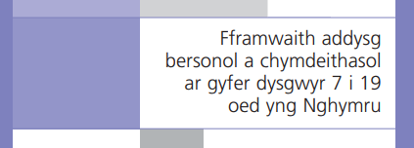

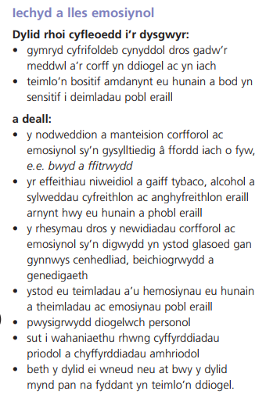
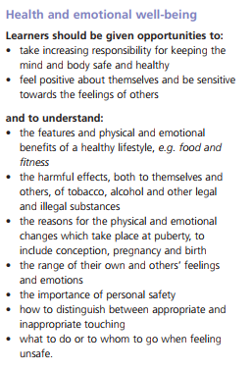
CA2
KS2
2008

Slide 23
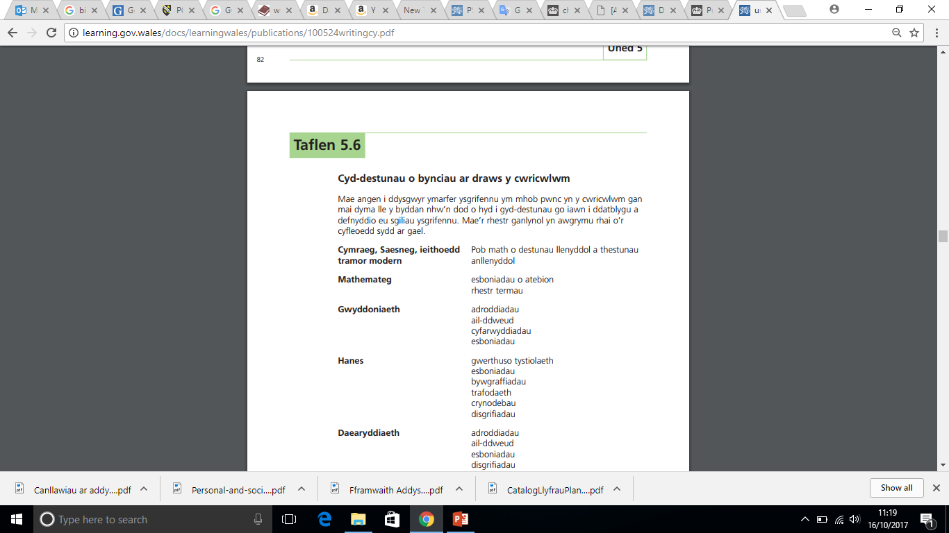
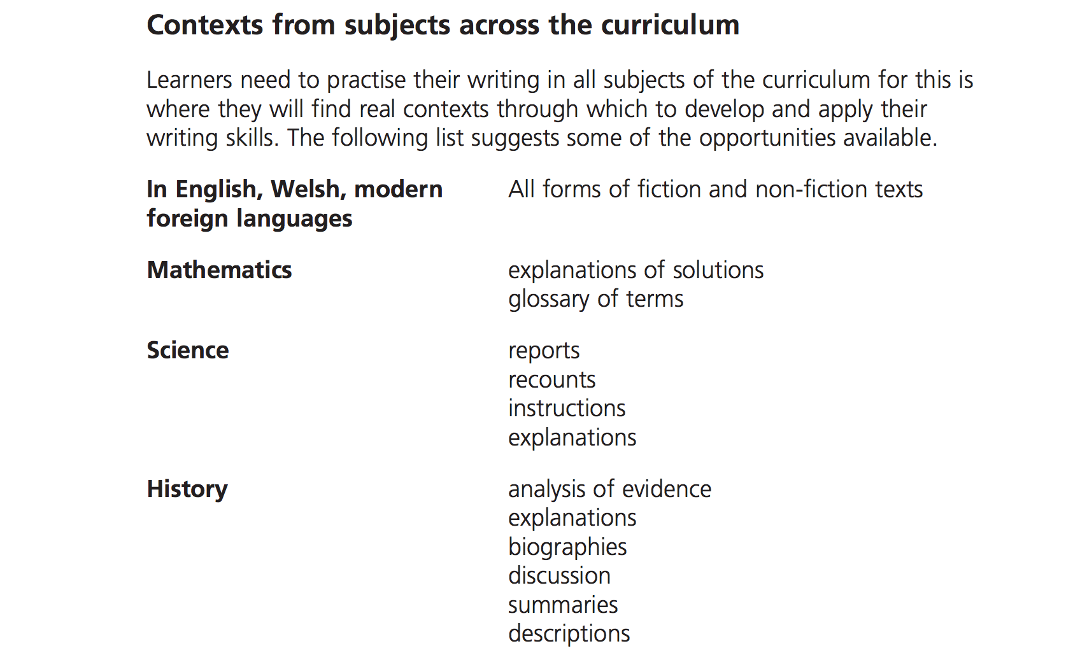
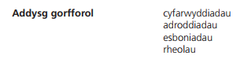
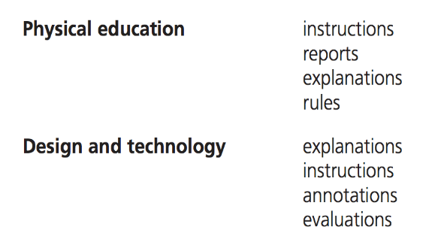
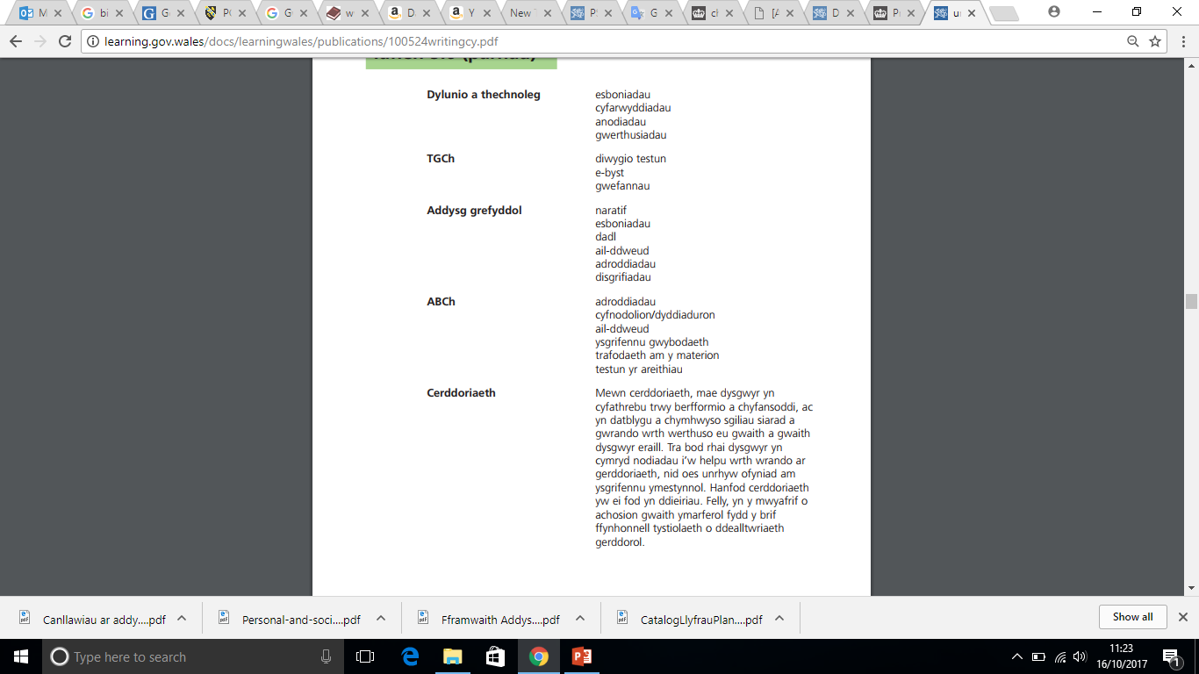
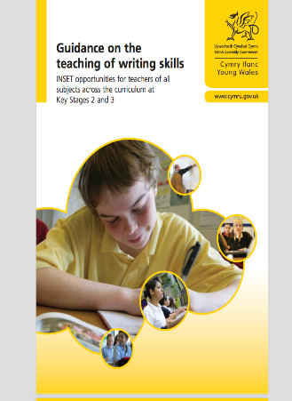
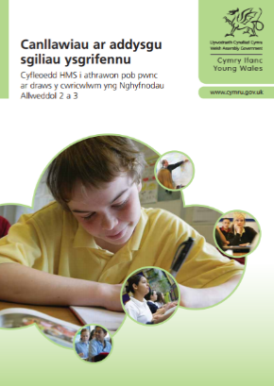
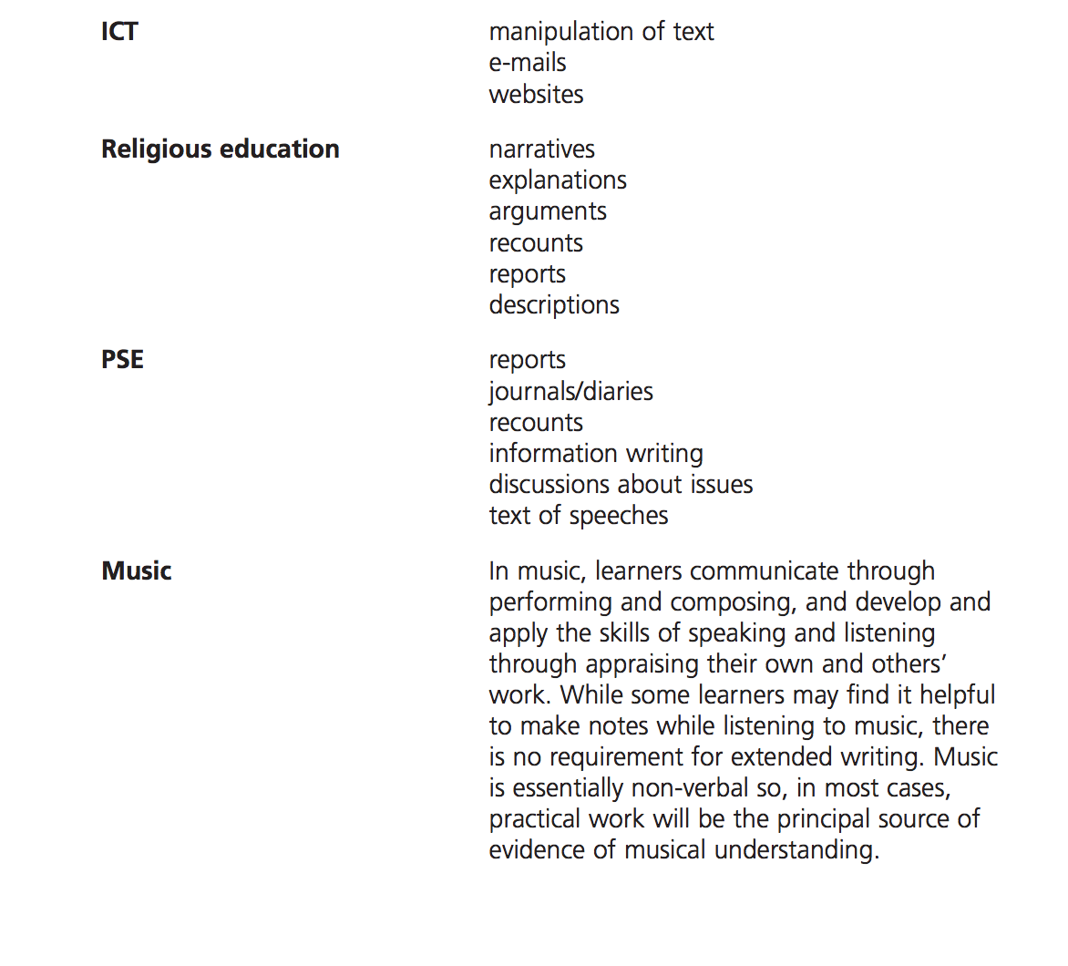

Notes:
Share full list with students. Paper copy.
Tudalen 84/85 neu 85/86

Slide 24
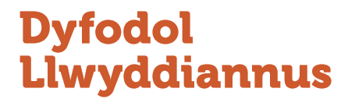
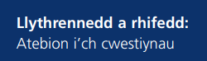
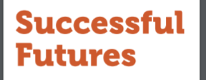
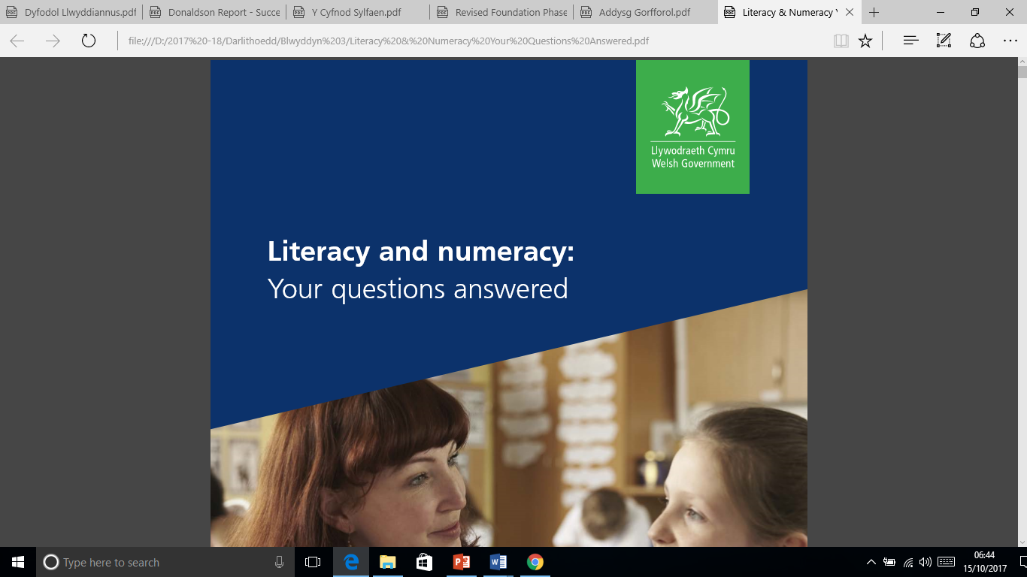
Wrth gynllunio …
As you plan your lessons …
Oes cyfle i ddatblygu sgiliau
llythrennedd mewn cyd-destun ystyrlon, diddorol ac amrywiol sy’n adeiladu ar wybodaeth blaenorol ac yn ennyn diddordeb?
Is there opportunity to develop literacy skills in meaningful, interesting and varied contexts, building on previous knowledge and experience and engage interest?
t40
Oes cysylltiadau rhwng
Meysydd Dysgu a Phrofiad?
Are there connections between
Areas of Learning and Experience?
Ydy’r cyd-destun yn gyfoethog lle y gellir cryfhau, hymestyn a chymhwyso sgiliau llythrennedd y dysgwyr?
Do you provide rich contexts within which literacy skills can be reinforced, extended and applied?
Oes lle hanfodol i iaith wrth feddwl?
Is there a fundamental role of language in thinking?

Slide 25
Radnor (1994) refers to cross curricular skills as those skills that ‘ are transferable, ...... independent of content and thus able to be developed in different contexts across the whole curriculum:
- communication
numeracy
study,
problem-solving
personal and social, and
information technology (IT)’ (p24/5)
Radnor, A. (1994) Across the Curriculum. Guildford & King’s Lynn: Biddles Ltd.

Slide 26
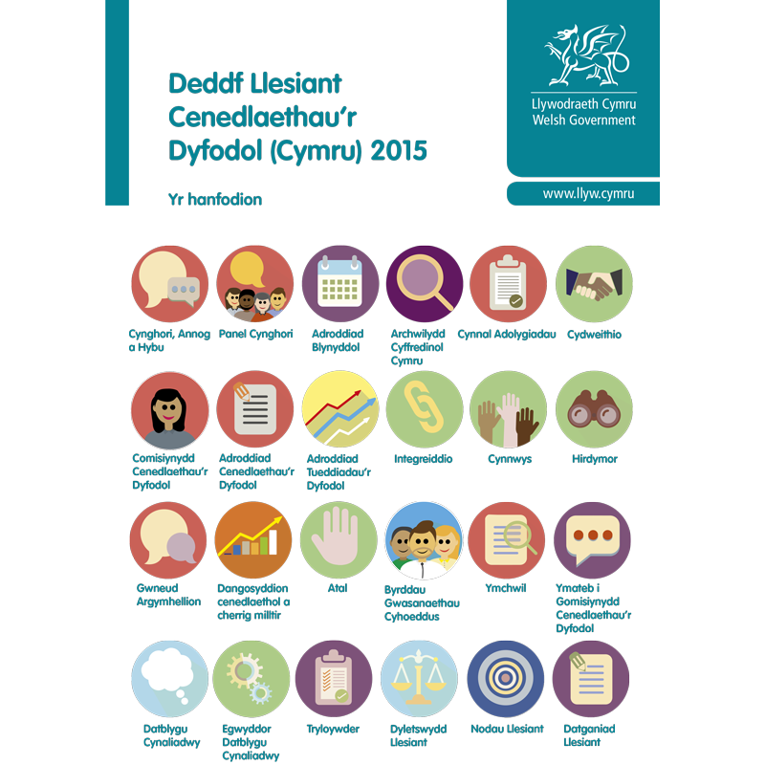
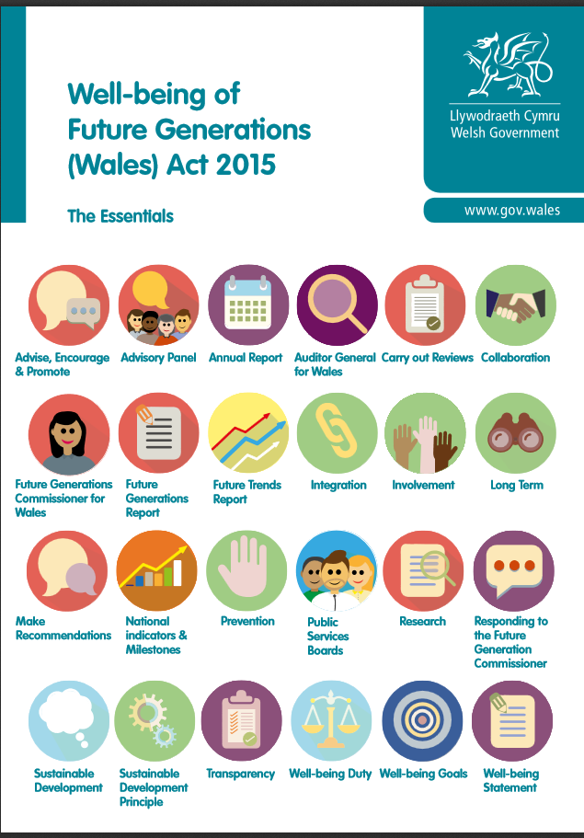
The Well-being of Future Generations (Wales) Act 2015
Deddf Llesiant Cenedlaethau’r Dyfodol (Cymru) 2015
http://thewaleswewant.co.uk/about/well-being-future-generations-wales-act-2015
Notes:
Watch Video What is it? The Well-being of Future Generations Wales Act 2015 is all about IMPROVING the social, economic, environmental and cultural WELL-BEING of WALES There are 7 goals, including resilient Wales biodiversity

Slide 27
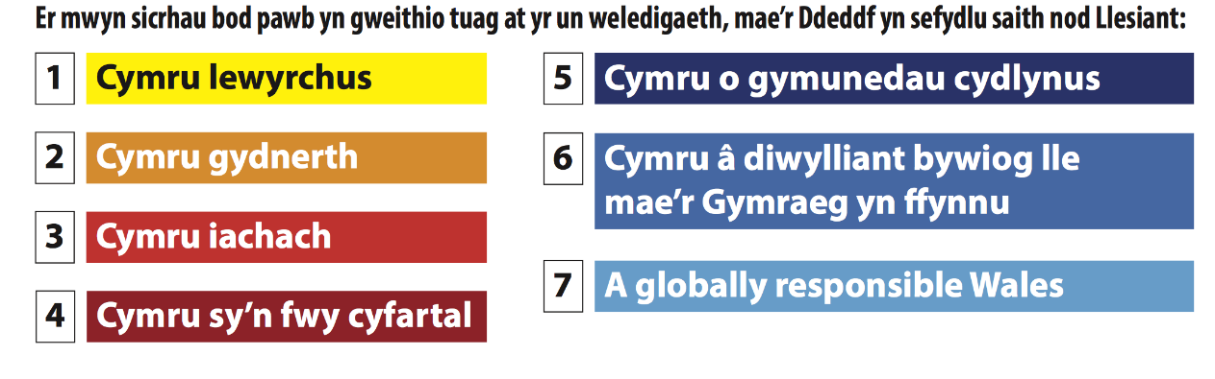
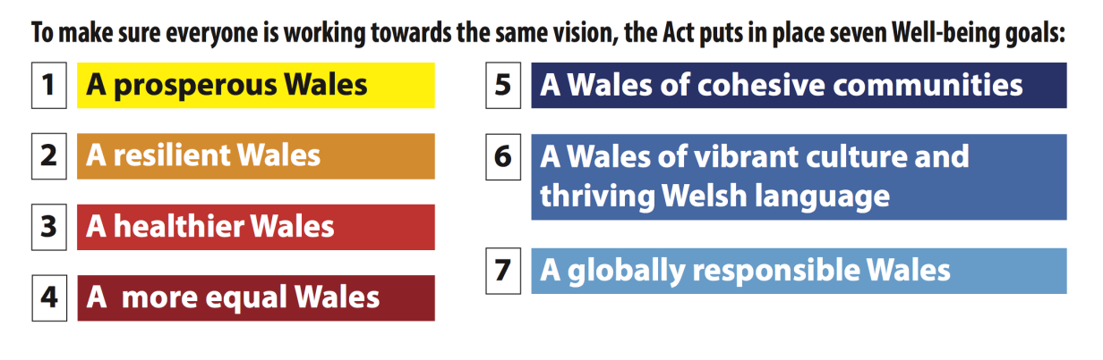
The Well-being of Future Generations Act (Wales) 2015
The Well-being of Future Generations (Wales) Act is about improving the social, economic, environmental and cultural well-being of Wales
Deddf Llesiant Cenedlaethau’r Dyfodol (Cymru) 2015
Mae Deddf Llesiant Cenedlaethau’r Dyfodol (Cymru) yn ymwneud â gwella llesiant cymdeithasol, economaidd, amgylcheddol a diwylliannol Cymru.

Slide 28



Mae llawer o Fentrau Cenedlaethol hyd yn hyn ...
~ Cynlluniau Ysgolion Iach – Rhwydwaith Cymru (Iechyd Cyhoeddus Cymru)
~ Cynradd: Agweddau Cymdeithasol ac Emosiynol ar Ddysgu – Cymru (ACEDd Cymru)
~ Meddwl yn gadarnhaol Iechyd a lles emosiynol mewn ysgolion a lleoliadau Blynyddoedd Cynnar (LlC 2010)
~ Every Child Matters (DfE, 2003)
Many National Initiatives so far…
~ National Healthy Schools (DoH/DfEE, 1999)
~ Every Child Matters (DfE, 2003)
~ Social and Emotional Aspects of Learning (DCSF, 2007)
~ Targeted Mental Health in School (DCSF, 2010)
~ In Wales, the Thinking Positively - Emotional health and well-being in schools and Early Years settings
good practice document (Welsh Government, 2010),
~ Welsh Network of Healthy Schools Scheme (Public Health Wales, 2015).
http://gov.wales/topics/educationandskills/publications/guidance/thinkingpositively/?lang=cy
http://gov.wales/topics/health/improvement/schools/?lang=en
http://llyw.cymru/topics/educationandskills/publications/guidance/thinkingpositively/?lang=en

Slide 29
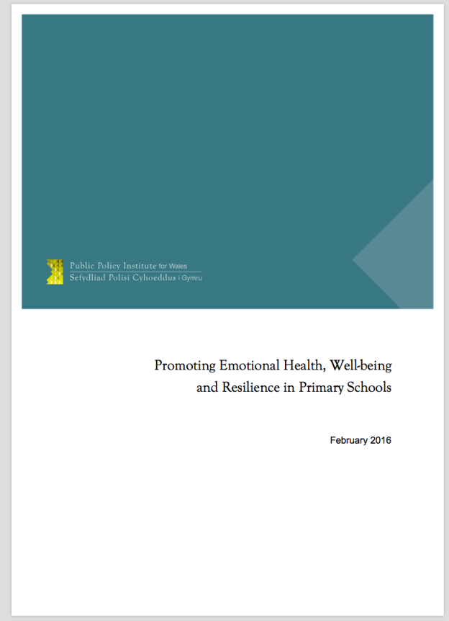
‘….there is an obvious connection between SEL* and the development of the skills needed for pupils to work with each other in groups, which is so often the context for learning in primary schools….’
(2016:38)
‘….work on emotional health, well- being and resilience is unequivocally not a peripheral add-on to primary education, but rather must be viewed as lying at the core of effective teaching and learning….’ (2016:40)
Banerjee, R., McLaughlin, C., Cotney, J. L., Roberts, L. & Peereboom, C. (2016). Promoting emotional health, well-being, and resilience in primary schools. Cardiff: Public Policy Institute of Wales.
…oracy is KEY in order for children to become more competence in communicating their thoughts, ideas and emotions.
SEL* Social Emotional Learning

