Slide 1
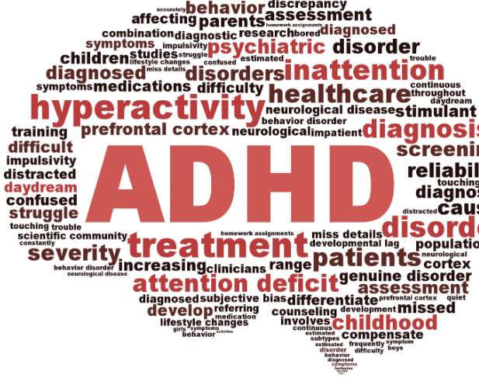
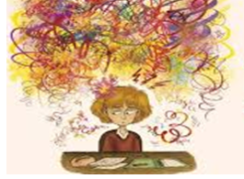
Silent cry
Naeed khan :2228648
Lecturer: Irina Neaga and Nathan Morgan
Intergrated Project

Slide 2
Abstract
ADHD is common worldwide
Difficult for many people to understand ADHD
ADHD is form of disability
ADHD is in children and adults
Signs of ADHD can be ignored at early stages
Many people have been diagnosed with ADHD in adulthood

Slide 3

Introduction
Everyone is born different
Don’t compare a misbehaving child to a child with ADHD
ADHD does not mean the child is naughty
Adults with ADHD are often mistaken for having mental illness
ADHD can't be controlled the child/adult is not at fault.

Slide 4

Signs of ADHD
Struggling in daily tasks
Comes across as loud and disruptive
Finding it difficult to focus
Struggling to do work pen to paper
Using screentime a lot
Fidgeting with anything
Can not sit sill or concentrate

Slide 5

Sign of ADHD
Hands on work is better and prefer it
Shouts and talks loud often
Change is difficult to adapt to
For adults it seems as if they going through mental illness
Difficult to sit exams become more anxious

Slide 6
Dealing with ADHD
How a ADHD brain works
Increased screentime
Support in place
Send worker is needed for care plan

Slide 7

Addiction to screentime
Screentime is what they feel helps them
Focus on screentime
Not able to focus on reading story book
They become demanding for screentime

Slide 8

screentime
Helps keep the child calm
Difficult to part from screen time
They gain comfort in screentime

Slide 9
Decrease screentime
Use
Use tool apps to lock the screen
Take
Take they gadget away from them but gradually
Become
Their behavior will become difficult at first
Try
Try using other things such as jigsaw, cooking anything hands on

Slide 10

Aim of the project
Over 6 million have been evaluated and diagnosed with ADHD
Look out for the early signs
Difference in ADHD and a misbehaving child
ADHD is not a naughty child causing trouble
ADHD exists in adults and signs should be made aware for everyone
Understanding the need of someone with ADHD

Slide 11
ADHD awareness
All staff teaching and employers should have care plans in place for a person with ADHD
Sharing enough information between staff and workers that need support this child/adult
ADHD does not go away it for life like any form of disability
With correct support and medication ADHD can be treated to help the indvidual

Slide 12

Conclusion
People who not getting support for ADHD are victims of been labeled naughty, misbehaving, causing trouble
Understanding, and awareness to someone with ADHD is important
An individual may look normal nut you don’t know how their brain is functioning compared to others
Stop, think , before you judge an individual

