Slide 1
BMSK4002
Effective Team Working and Communication
Session 10
CertHE Skills for the Workplace

Slide 2
Overview of Session 10
Reflection on Last Session
Preparation for Assignment
Assignment Discussion
Summary

Slide 3

Reflection
What were your key learning points from the last Session?
How will you apply the knowledge gained?
What did you find out about the Context of Communication Model?
Notes:
Lead a brief recap discussion of the last session and the research undertaken by the students. Highlight any key learning points as the discussion develops.

Slide 4

Assignment Prep.
Prepare an outline plan for a 10-minute presentation on Effective Team Working.
What are the key things you want to cover?
What do you want to say?
Identify some slide headings
Record all this information in your Notes on the Team site as you can use it as the basis for your Assignment Presentation.
Notes:
The key thing here is to get the students thinking about how they are going to approach the activity. Ask people to shout out their headings or put them on flipchart to show everyone! Lead a plenary and ask them what were the challenges? What went well? What didn’t go so well? Did they agree on the headings? What was the discussion like? Good communication skills? Cooperation? Did people listen to each other? Or did the ‘pressure of the clock’ put too much stress on the teams? How will they avoid this sort of stress in future?

Slide 5


Presentation
You WILL be doing a presentation, as it is part of your…

Slide 6


What is a Lesson Plan?
=
Notes:
They will need to do a Lesson Plan as part of the assignment – a copy of this will be submitted by each team on the day of the presentations. It’s the route map that gets you from the start of the Presentation to the finish line…..the end. The better and clearer the plan, the better the chances of success, and the lower the stress levels!

Slide 7
What is a Lesson Plan?
A lesson plan is a document used to structure the content for a particular session
It should be prepared in advance and referred to during the session
It’s a bit like an ‘agenda’ of what will be covered, when and how
It should state what you want your learners to be able to know or do by the end of the session
Notes:
Discuss with the group – do they understand the need for this? It is essential!

Slide 8
Preparing a Lesson Plan
Each plan should have an introduction, development and conclusion/summary
In other words, a beginning, middle, and end, with times allocated to the activities within each
A pro forma or template should be used to structure the content

Slide 9
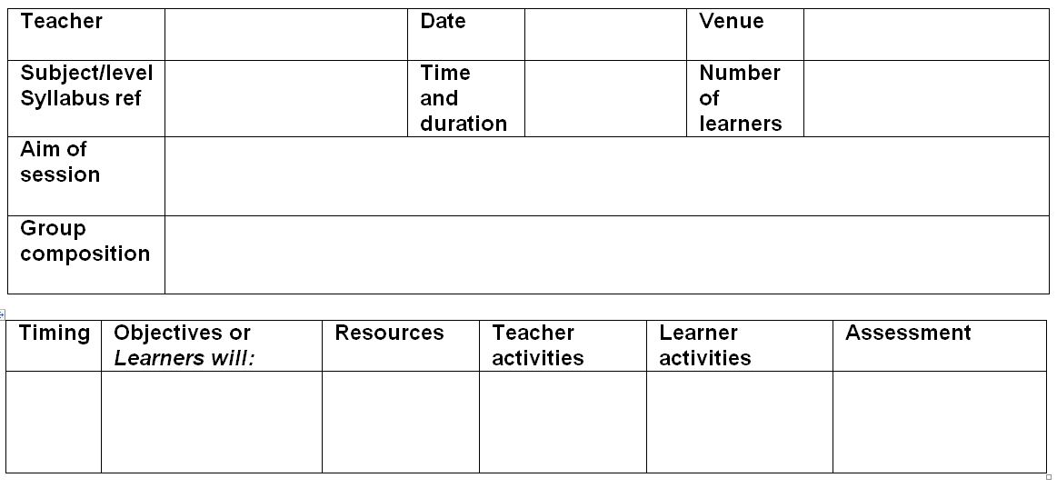
Example Lesson Plan Headings
Notes:
Each presenter within the team should have their own notes for the section that they will be presenting – these notes can be prepared by the team…..and everyone should be happy with them. The individuals then have the responsibility to LEARN their sections, as well as understanding the whole presentation. Reading from notes, is not a good idea, and loses marks.

Slide 10

Questionnaire
Notes:
Tell the group that they WILL be doing a presentation, and at that presentation they will be asking for feedback on their performance as ‘communicators’. They need to design a questionnaire for the audience to complete after their presentation.

Slide 11
Example Feedback/Critique Headings
Self Evaluation and Reflection of Micro-Teach Delivery
Session Title | Response
Justify the selection of learning and teaching approaches used during the micro-teach and how it met the needs of your learner.
Reflect on your own approach to deliver inclusive learning and teaching.
Identify areas for improvement in your own area of practice using your own reflections and your teacher and peer feedback
Notes:
Discuss these example with the group…..emphasise that they can research or design their own questinnaires!

Slide 12
Example Feedback/Critique Headings
Peer Observation and Feedback
Title of Session:
Name of Observer:
Name of Presenter
Did the learners: | Yes/No | Describe and give examples
Introduce themselves and create a rapport with the learners?
Prepare materials which met the needs of the learners?
Include the entire group during the session?
Give positive feedback to the group when opportunity was presented to do so?

Slide 13
Example Feedback/Critique Headings
Peer Observation and Feedback (cont.)
Strengths
Areas for development

Slide 14
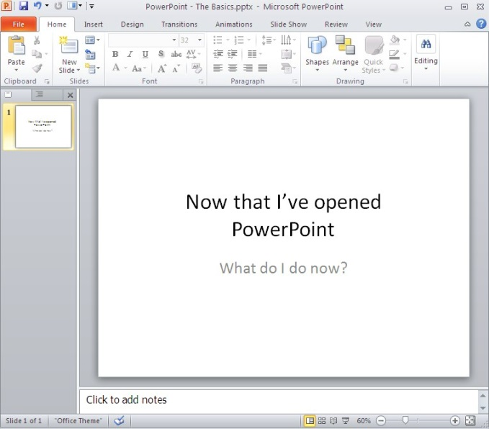
Presentation Basics
Notes:
Take the group through the presentation skills slides 14 to 33. Make use of the screen if you use PowerPoint, or the paper, if you use flipchart at all! COMMUNICATE clearly!

Slide 15
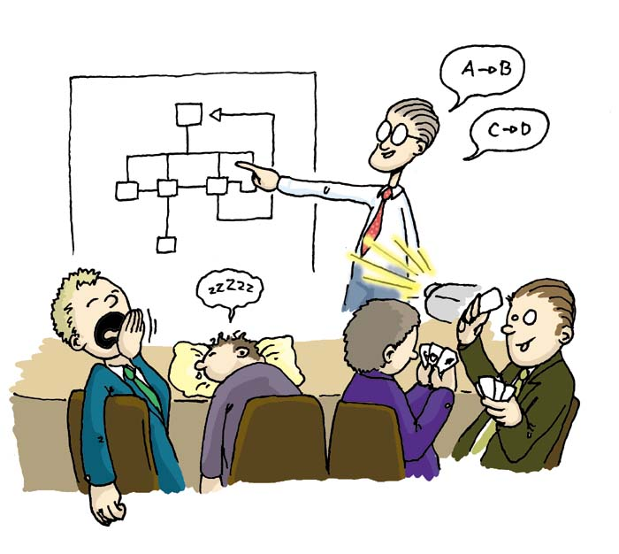
Identify the Intended Audience, Aim and Objectives of the Presentation
Who is your audience?
What does your audience want?
Why are you presenting?
When/where is your presentation?
Notes:
They need to think about this – their audience will understand the topic, so they might want to make their own presentation ‘stand out’ from the crowd. How would they do this?

Slide 16

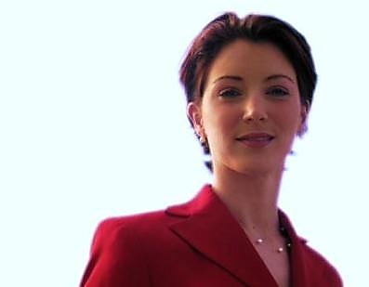
What Do The Audience Want From You?
Or
Notes:
They want confidence, professionalism, clear voice, good diction, eye-contact, clear message…….engagement and resonance!

Slide 17

What Do The Audience Want From You?
A good first impression
Good eye contact
Organised personal traits
A good voice
A positive attitude
Confidence (including body language)

Slide 18
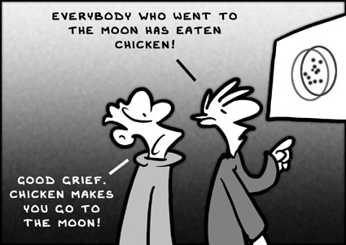
Research and Evaluate Information
What information do you require?
Where can you get it from?
How do you evaluate its validity?
Who gets the credit?
Notes:
Who is going to do what? Where will you research? Are you clear on the objective? Discuss the points above – you do not want to be presenting information you are uncertain of! It will stress you out!

Slide 19

Plan the Content of the Presentation and Prepare Visual Aids
What is the purpose of the session?
What content can be used?
Make notes
Plan how it is to be delivered?
Prepare the support material
Notes:
Be methodical and leave nothing to chance. This means spending time on the assignment…as a team and individually.

Slide 20
Common PowerPoint Errors No. 1
People tend to write everything they are going to say on their PowerPoint slides. Although this eliminates the, ummmm, need to memorise your talk, ultimately it makes your slides, uhhhh, crowded, wordy and boring. You will lose your audience’s, yawn, attention before you reach the bottom of your …
Notes:
Use professional language – you will be presenting to professionals!

Slide 21
Common PowerPoint Errors No. 1
………. first line.
Notes:
Keep their attention – clear points delivered concisely with energy, passion and belief…..congruence of verbal and non-verbal communication!

Slide 22

Common PowerPoint Errors No. 2
Avoid
excessive
bullet
pointing,
only
use
them
for
key
points,
otherwise
your
key
messages
will
be
lost
on
a
bullet
riddled
page.
Notes:
Discuss

Slide 23
Common PowerPoint Errors No. 3
Avoid bad colour schemes
Notes:
Discuss

Slide 24
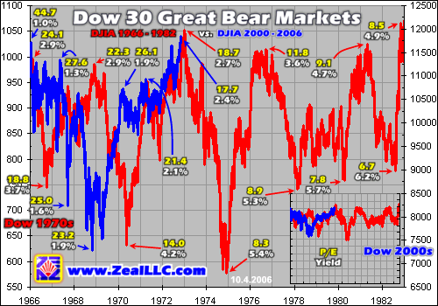
Common PowerPoint Errors No. 4
Notes:
Discuss

Slide 25
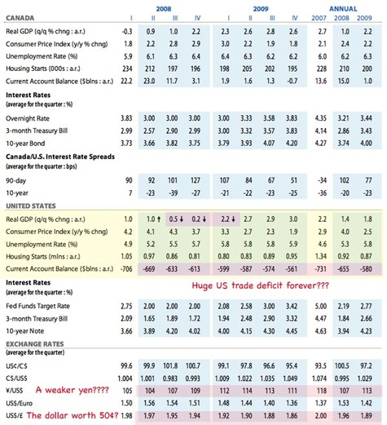

Common PowerPoint Errors No. 4
Proof read for errors
Notes:
Spelling errors and grammatical errors will detract from your presentation. People will make a game out of ‘spotting the errors’, and they won’t be listening to your narrative!

Slide 26
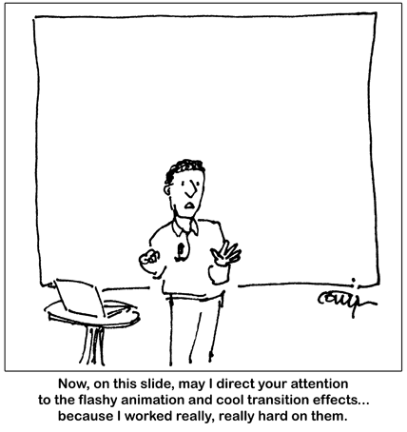
Common PowerPoint Errors No.6
Notes:
Don’t waste your time – keep it simple, stupid!

Slide 27
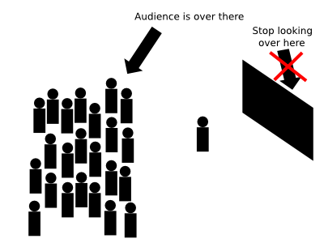
Common PowerPoint Errors No. 7
Notes:
Engage with the audience – they want you to do well, and they want to engage with you.

Slide 28
Common PowerPoint Errors No. 8
Although we are taught how to talk, read and write, we are not taught how to listen, yet this is a vitally important skill. Although we spend a lot of time hearing, experts estimate that only 25-50% of this time is actually spent listening. Often problems that occur in the workplace are due to misinterpretation or assumptions that are made as a result of what we hear.
Listening carefully presents a challenge. There are several faults that we can develop in our listening skills:
Not giving the speaker undivided attention
Thinking about replies before listening to the full message
Evaluating whether the speaker was ‘right or wrong’ before all the facts are given or the message is fully understood
These are not the only mistakes we can make when listening to others, but they are some of the more common, they need to be recognised and avoided if we are to communicate effectively.
How we listen and respond to others is important if we wish to build effective relationships with our customers and colleagues. In supervising others communicating ineffectively can distance us from the other person and detract from the outcome. Communicating effectively can be a powerful tool for building and strengthening the relationship between yourself and members of your team.
In contact with others you can communicate your willingness to develop an effective working relationship by demonstrating that you have clearly heard and understood what the other person is saying to you. When you listen accurately and respond relevantly, you communicate ‘I value you as an individual and take what you have to say seriously.’
Active listening involves listening to the whole of what is being said and showing this through – good eye contact and open body posture.
Listening involves absorbing the words that are being said
Hearing involves the extra step of understanding
Hearing involves showing empathy and caring
Listening is more detached than hearing
Active listening gestures include: yes, right, OK, I see, certainly and so on.
The core of our communication difficulties is often linked to our tendency not to listen carefully to what is being said. We often make assumptions rather than checking out others perspective. Making assumptions is not necessarily a fault. We make assumptions daily and unless we did not we would waste much time in verifying general accepted facts. For example, when we walk down the stairs we usually assume that the next step will be there and will be safe to tread on. We assume that if someone smiles and say hello, they are friendly. Also in order to make sense of our environment, we assume that what we see is reality. Because we are correct more often than not, we come to depend u
Hearing involves the extra step of understanding
Hearing involves showing empathy and caring
Listening is more detached than hearing
Active listening gestures include: yes, right, OK, I see, certainly and so on.
pon our ability to understand and interpret the facts.
Notes:
Too many words!

Slide 29

Common PowerPoint Errors No. 9
Any ‘handouts’/materials should be distributed to the audience ‘after’ the presentation, unless integral to the delivery of the presentation.

Slide 30

The Presenter - YOU
Nerves are natural
Analyse your fear
Plan your welcome and first few minutes of the presentation
Plan an interesting session
Relax & enjoy
“What does not kill you makes you stronger”
Friedrich Nietzsche (1878)

Slide 31

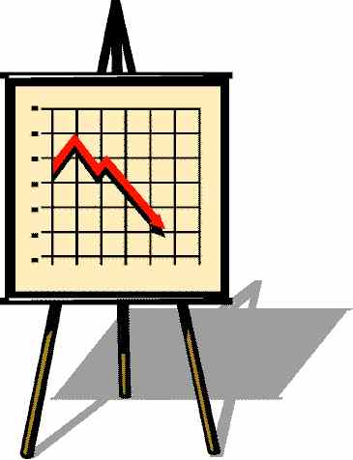



Prepare the location, equipment and materials for presentation
Where is the venue?
What facilities and equipment will be provided?
How is the room set up?
Where are the action points?

Slide 32
Flip Tips
If in doubt - Flip
Invisible Outlines
Corner
Crib
Ready Made
Write clearly & Big
Space it out
Use dark colours

Slide 33

Presentations
Any Questions?
If you don't ask a question, you’ll never know!
Notes:
You will ask your audience this exact same question…..and I can assure you that your tutors will have some questions at the end of your presentation, so be prepared to answer them! How will you manage these? Who will do what? Prepare for these.

Slide 34

Presentation Assignment

Slide 35
Identify appropriate information in line with the objectives of the presentation
Prepare a plan for the content of the presentation
Use appropriate presentation techniques and aids to enhance understanding of the topic of presentation

Slide 36
Present information clearly and logically
Present information within agreed time limits
Respond to questions raised accurately and clearly
Design a simple evaluation form to gather feedback on presentation

Slide 37

Use feedback to identify areas for improvement in your communication & presentation skills

Slide 38

Written Assignment

Slide 39
Workplace Communication Report
Explain the relevance of the communication cycle for effective communication in management
Explain, with examples, the importance of selecting an appropriate tone, language, and level of formality in management communications
Assess the effectiveness of a range of verbal and written communication methods within your area of the organisation

Slide 40
Workplace Communication Report
Develop appropriate criteria to evaluate own ability to communicate effectively
Collect and analyse feedback on own verbal and written communication skills
Evaluate own communication skills as a manager, identifying strengths and areas for improvement……then Produce a PDP to address these

Slide 41
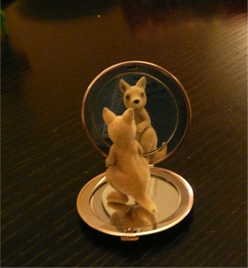
Summary
Take 5 minutes to reflect on the session and summarise your learning from today

Slide 42
Further Reading
Certificate in Higher Education: Skills for the Workplace Student Yearbook (2017)
Duck, S. & McMahan, D.T. (2015). Communication In Everyday Life. 2nd Ed. California: Sage Publications. Inc.
Morgan, P. (2017) The Business Student’s Guide To Study And Employability. London: Sage Publications Ltd.

Slide 43
Further Reading (Cont.)
Griffith, B.A. and Dunham, E.B (2015). Working In Teams. California, USA: Sage Publications, Inc.
Quintanilla, K.M. and Wahl, S.T. (2017). Business And Professional Communication. California, USA: Sage Publications, Inc.

Slide 44
Further Reading (Cont.)
Covey, S. R. (2004) The 7 Habits of Highly Effective People. London: Simon & Schuster UK Ltd.
Karlgaard, R. & Malone, M.S. (2015) Team Genius: The New Science of High-Performing Organisations. New York: HarperCollins Publishing

