Slide 1
University Of Wales Trinity Saint David
Assignment Title: Professional
Development Plan (PDP)
Student number: 2513347
Student Name: Makawe Alsir
Module No: (ACCA4025)
Lecturer: Fernando

Slide 2
Introduction
Welcome to my Learning in the Digital Era assignment 2 presentation:
Student Name: Makawe Alsir
Student ID: 2513347
This presentation evaluates my personal strengths and areas of development, present a professional development plan and summaries a select Topic from Unit 4.

Slide 3
Self-Reflection
Personal Development
Professional Learning

Slide 4
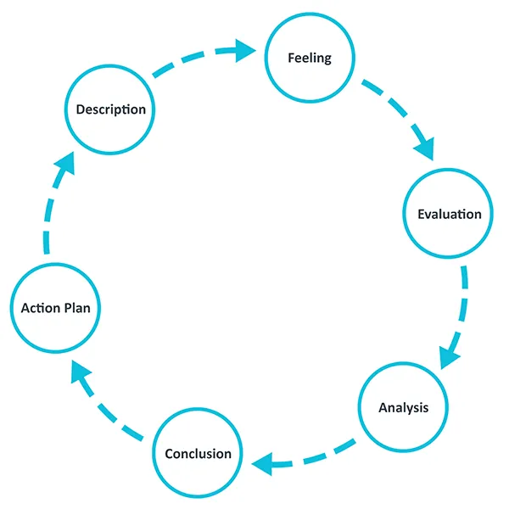
Reflective Model Diagram

Slide 5
Gibbs' Reflective Cycle
Gibbs' Reflective Cycle was developed by Graham Gibbs in 1988 to give structure to learning from experiences. It offers a framework for examining experiences, and given its cyclic nature lends itself particularly well to repeated experiences, allowing you to learn and plan from things that either went well or didn’t go well. It covers 6 stages:
Description of the experience
Feelings and thoughts about the experience
Evaluation of the experience, both good and bad
Analysis to make sense of the situation
Conclusion about what you learned and what you could have done differently
Action plan for how you would deal with similar situations in the future, or general changes you might find appropriate.

Slide 6
Task 1: Self-Evaluation
q
Strengths
Areas for improvement
Willing to learn
Resilient
Quick learner
Attention to details
Academic writing
Time management
Stress management
Teamwork skills

Slide 7

Traits gained from the self-reflection
Self-awareness:
Reflecting on my abilities has helped me understand my strengths, and weaknesses, It has also helped me recognise areas that require improvement.
Self-reflection has helped me understand the importance of remaining resilient when facing challenges
. It has also encouraged me to take greater responsibility for managing my time and stress and for improving the way I contribute when working with others.

Slide 8
Professional Development Plan with SMART Goals
Goal to Achieve | Personal Action Plan | Development Opportunity with Professional Qualification | Performance Measurement | Expected Completion Date
Improve Academic writing | Practise essay writing, read academic sources | Academic writing workshop or study skill support | Submit my assignment with clear structure and correct referencing | 10 weeks
Improve time management | create a weekly study, set deadlines before the original date | Time management or study support sessions | Complete 60% before the deadline | 8 weeks
Improve Stress management | divide large tasks into smaller tasks | personal develop or wellbeing workshop | Feel confident and reduce last minute pressure | 8 weeks

Slide 9
Task 3: Unit 4 Topic Summary
Bouncing Forward
Developing Resilience:-
Resilience is a personal quality that allows you to adapt to difficult situation and overcome adversity
Four elements of resilience:
according to Cooper, Flint.
Confidence
Adaptability
Social support
Purposefulness
References are required in this task (Use in-text citation in the body)

Slide 10
Reducing stress and anxiety:
• Identify common causes of stress and anxiety.
• Use protective factors to reduce vulnerability to stress.
• Understand how change can create anxiety.
• Build resilience to manage change more effectively.

Slide 11
Optimising well-being for learning:-
I recognized the physical and mental health benefits of being more active.
I identified ways in which I can improve my physical and mental well-being to optimize learning.

Slide 12
Conclusion
The overall summary:
This presentation discussed my self-evaluation, personal strengths, areas for improvement, SMART professional development plan, and Unit 4 topic, Bouncing Forward.
Lesson Learnt:
I learned that self-reflection helps me understand my abilities, recognise areas I need to improve, and plan realistic actions for my development.
Personal Evaluation and recommendation:
I will continue building on my strengths, such as resilience and willingness to learn, while improving my academic writing, time management, stress management, and teamwork skills. I will also apply resilience and well-being strategies to support my learning and future professional growth.

Slide 13
References
Task 1:
https://reflection.ed.ac.uk/reflectors-toolkit/reflecting-on-experience/gibbs-reflective-cycle
W. Suzuki, “4 Ways Exercise Strengthens the Brain | Wendy Suzuki”, Available: https://www.youtube.com/watch?v=fbLol8q9zCE
Task3:
[1]
UWTSD, “Bouncing forward”, Available: https://moodle.uwtsd.ac.uk/mod/scorm/view.php?id=471945
[2]
P. Al Siebert, “Resiliency Quiz - How Resilient Are You?”, Available: https://www.resiliencyquiz.com/index.shtml

