Slide 1

Name: Shamaila Sakhawat
Student ID:2309140
Lecturer: Neale Haddon
Module: Psychological Classifications and Provisions
Module Code: BMHP6029
Assignment Title: Component1:Presentation(Academic Poster)

Slide 2
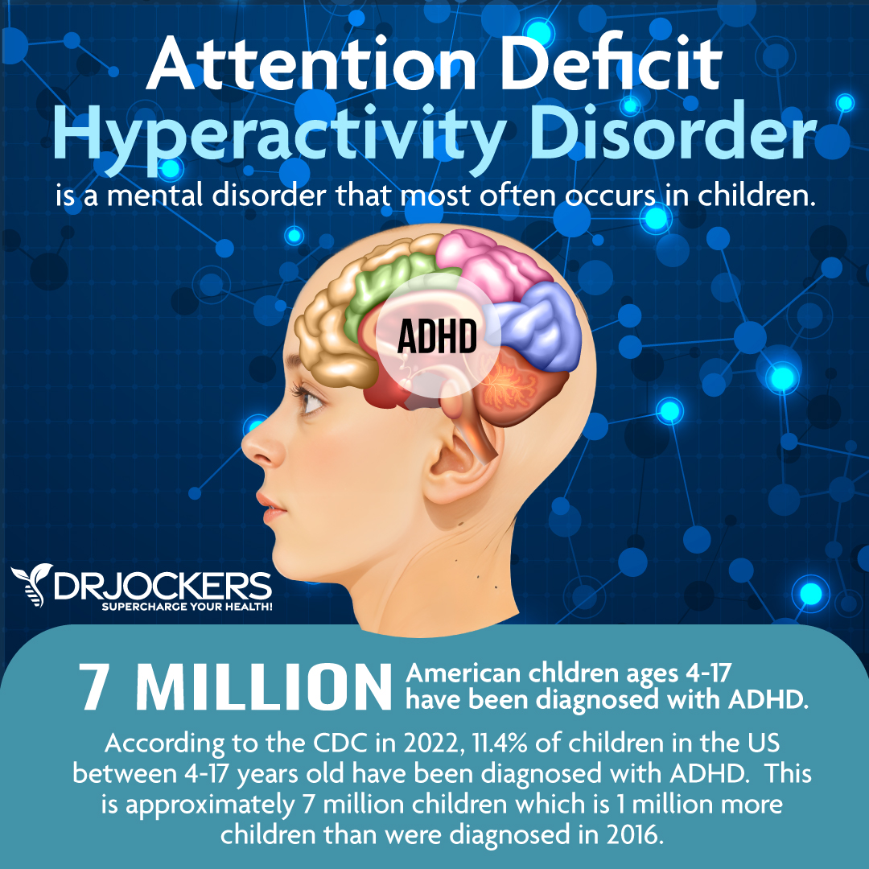
Title: ADHD: Form Historical Misconception to Contemporary Understanding and Provision of Care
Introduction Attention Deficit Hyperactivity Disorder (ADHD) is a neurodevelopment disorder characterised by persistent inattention, hyperactivity, and impulsivity, impairing academic, occupational, and social functioning (WHO, 2019). Diagnosis requires symptoms across multiple settings, with onset typically before age 12 (ICD-11, 2019). This presentation examines the evolution of ADHD understanding, stigma, and policy responses, while offering recommendations for future practice. According to NHS Digital (2023), around 3-5% of school-aged children meet diagnostic criteria for ADHD ,with condition more commonly identified in boys then girls. | Historical Context In the early 20th century, ADHD-like behaviours were often dismissed as poor discipline or moral failing rather than a neurodevelopment disorder (Singh, 2008). Medical understanding evolved from terms like “minimal brain dysfunction” to the modern conceptualisation of ADHD, reflecting growing scientific recognition and shifting cultural attitudes (Lange et al., 2010).
Contemporary Understanding and Provision Current treatment approaches combine pharmacological and psychosocial interventions. The UK’s NICE Guidelines (2018) recommend stimulant medication (methylphenidate, lisdexamfetamine) alongside behavioural therapies (NICE, 2018). However, disparities persist in diagnosis and access, particularly for women and ethnic minorities (Mueller et. al., 2012).
Figure 1:Prevalence and awareness of attention Deficit Hyperactivity Disorder (ADHD) in children within the United Kingdom.(Adapted from DR Jockers, 2023; NHS Digital, 2023; NICE, 2018)
Critical Analysis
Despite advances, ADHD continues to be underdiagnosed in adults and misdiagnosed in children, revealing systemic issues in primary care pathways (Young et. al., 2021).
Historical mistrust of psychiatry and evolving diagnostic criteria have also contributed to inconsistency in recognition and treatment across the UK (Thomas et. al., 2022).

Slide 3
Social, Cultural and Political Influences
Social stigma remains a major barrier to ADHD diagnosis and treatment, with cultural stereotypes portraying ADHD as a behavioural issue rather than a legitimate disorder (Mueller et. al., 2012).
Educational policy reforms and media narratives have influenced public perception and service provision, often reflecting broader inequalities in mental health access (Hinshaw & Scheffler, 2014).
Stigma, Discrimination, and Inequalities
Stigma surrounding ADHD continues to influence diagnosis and care. Public misconceptions often frame ADHD by means of poor parenting or social failure, particularly affecting women and ethnic minorities who are underdiagnosed and undertreated (Sayal et. al., 2018).
Cultural stereotypes also contribute to unequal service access, as non-white children are less likely to receive a diagnosis or treatment referral (Thomas et .al., 2022).
Furthermore, socio-economic inequality shapes ADHD outcomes, with children from lower-income families facing more barriers to diagnosis and educational support (Hinshaw & Scheffler, 2014).
Critical Analysis
Despite advances, ADHD continues to be underdiagnosed in adults and misdiagnosed in children, revealing systemic issues in primary care pathways (Young et. al., 2021).
Historical mistrust of psychiatry and evolving diagnostic criteria have also contributed to inconsistency in recognition and treatment across the UK (Thomas et. al., 2022).
Recommendations for Future Policy and Practice
Improve training for healthcare and educational professionals to ensure early recognition and equitable access DuPaul and Jimerson (2014).
Promote anti-stigma campaigns to challenge misconceptions about ADHD (Mueller et. Al., 2012).
Expand NHS ADHD services and ensure consistency in adult diagnosis pathways across regions.
Support longitudinal research into ADHD in adulthood and gender/ethnic disparities.
NHS England data (2022) shows significant regional disparities in ADHD service provision-with the North Weast waiting nearly four times longer than London.

Slide 4
References
DuPaul, G.J. and Jimerson, S.R., 2014. Assessing, understanding, and supporting students with ADHD at school: Contemporary science, practice, and policy.
Hinshaw, S.P. and Scheffler, R.M., 2014. The ADHD explosion: Myths, medication, money, and today’s push for performance. Oxford: Oxford University Press.
Lange, K.W., Reichl, S., Lange, K.M., Tucha, L. and Tucha, O., 2010. The history of attention deficit hyperactivity disorder. ADHD Attention Deficit and Hyperactivity Disorders, 2(4), pp.241–255.
Mueller, A.K., Fuermaier, A.B., Koerts, J. and Tucha, L., 2012. Stigma in attention deficit hyperactivity disorder. ADHD Attention Deficit and Hyperactivity Disorders, 4(3), pp.101–114.
National Institute for Health and Care Excellence (NICE), 2018. Attention deficit hyperactivity disorder: Diagnosis and management (NG87). London: NICE.
Sayal, K., Prasad, V., Daley, D., Ford, T. and Coghill, D., 2018. ADHD in children and young people: prevalence, care pathways, and service provision. The Lancet Psychiatry, 5(2), pp.175–186.
Singh, I., 2008. ADHD, culture and education. Early Child Development and Care, 178(4), pp.347–361.
Thomas, R., Sanders, S., Doust, J., Beller, E. and Glasziou, P., 2015. Prevalence of attention-deficit/hyperactivity disorder: a systematic review and meta-analysis. Pediatrics, 135(4), pp.e994–e1001.
World Health Organisation, 2019. International Classification of Diseases, 11th Revision (ICD-11). Geneva: WHO.
Young, S., Moss, D., Sedgwick, O., Fridman, M. and Hodgkins, P., 2015. A meta-analysis of the prevalence of attention deficit hyperactivity disorder in incarcerated populations. Psychological Medicine, 45(2), pp.247–258
DrJockers. (2023). Attention Deficit Hyperactivity Disorder (ADHD) [Infographic]. DrJockers Functional Nutrition Blog.
Retrieved from https://drjockers.com/adhd/

