Slide 1

Collaboration in action: The critical role of teamwork in achieving success
Claire Williams
2416992
BMPL4014

Slide 2
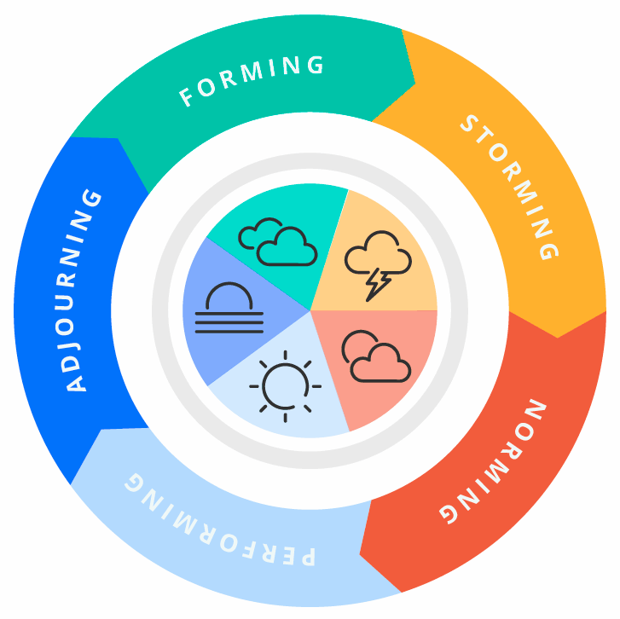
What is an effective team?
Bruce Tuckman's Model
A team is a group of individuals with a common goal, vision, and drive, working together to achieve mutual objectives.
(Kilgallon and Wright,2022)
(Gathergood,2024)

Slide 3
Characteristics
Clear direction
Effective Communication
Build a mindset of collective effort
Defined roles
Mutual accountability
Decision Making
Trust
The work of Katzenbach and Smith (1992, cited Wood et al 2024) - The most effective way to ensure team success is by emphasizing collective performance rather than individual contributions.
(Kilgallon and Wright, 2022)

Slide 4
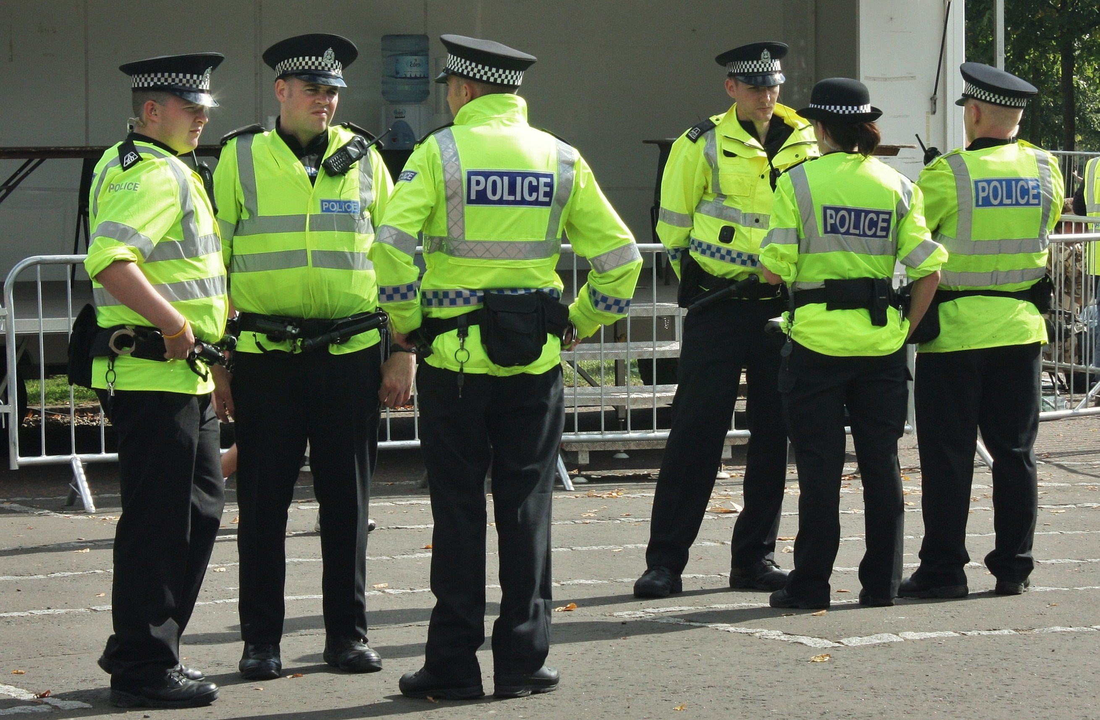
The importance of teamwork within policing
As Police officers, working within a team will be a constant part of daily life
The ability to work effectively with others is paramount to the role
Partnership with different agencies is key for a positive outcome (Wood et al. 2024)
Effectively combat crime, ensure public safety, and confront misconduct within the force
(College of Policing,2023)

Slide 5
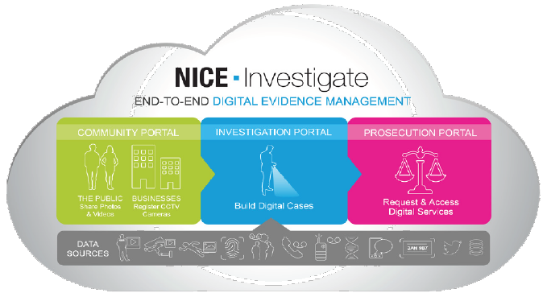
South Yorkshire Police
Over 2,000 police officers, investigators and control room operators
Stronger community engagement
Evidence management
Digitally transform investigation
(Policing Insight, 2024)
(Policing insight, 2023)

Slide 6
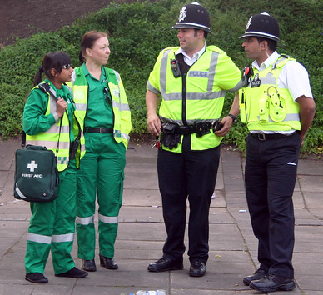
Policing and partnership - Why is this vital?
Leveraging their expertise and skills to address challenges.
Reduce crime and disorder
Protect their local communities from crime
Help people feel safer
Identify underlying problems
(Farell,2024)

Slide 7

Cleveland POLICE AND cps
Shared ambition to increase number of rape cases going to court
Joint working starting to make difference for victims of rape
By working closely together CPS and police secured the conviction of a man who exploited young children online
Early engagement produced a clear path
Collaborated and communicated effectively
Additional evidence contradicted defendant's claims
(Crown Prosecution Service, 2022)
(BBC NEWS, 2019)

Slide 8
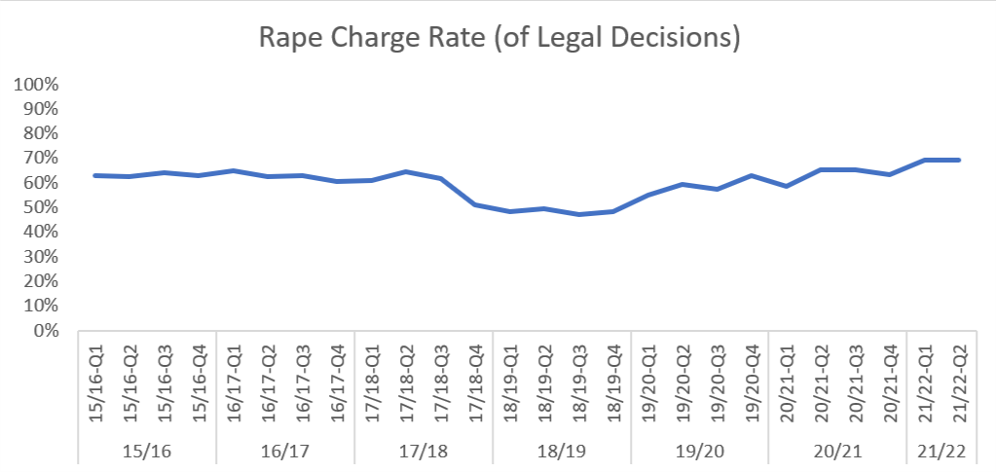
(Crown Prosecution Service,2022)
Rise in charge rate
Rising police referrals
Promising Pattern
(Crown Prosecution Service, 2022)

Slide 9
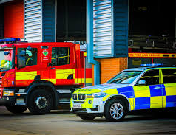
What Collaboration means
Effective Policing can only be achieved by working with others
To forge durable and effective partnerships
Joint Solutions
To provide services together
(College of Policing, 2024)

Slide 10

Police community collaboration
Local people within their own community
Help prevent crime
Increase chance of criminals being arrested
Neighbourhood watch
By mid 1990s estimated 115,000 schemes across England and Wales and estimated 3.3 million people lived in areas covered by Neighbourhood watch
(Rowe,2018)

Slide 11
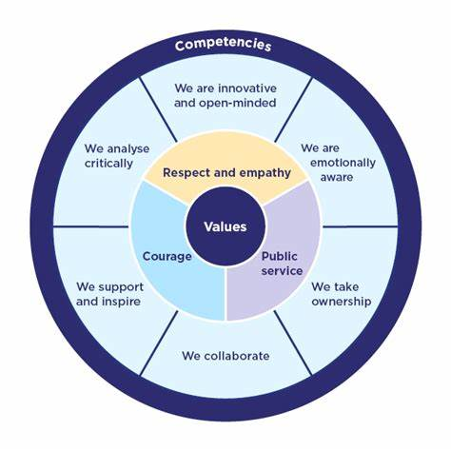
COLLABORATION = competency
Collaboration is one of the six competencies in the competency and values framework (CVF).
Competencies are the abilities, expertise, and behaviours that contribute to efficient and effective job performance.
(College of Policing 2024)
(College of Policing 2024)

Slide 12

Characteristics of an ineffective team
Lacking Unity
Disorganisation
Knowledge Gap
Job Distribution
Inability to self-reflect
(Rush,2017)
(Leadership Fluent,2024)

Slide 13
Multi agency Failure
Michael Gilbert killed 2009 kept as slave and tortured for benefit money
Years of abuse by Watt Family in Luton
Mr Gilbert's mother had contacted the IPCC in July 2010, informing police had failed to investigate three incidents involving her son. 2002,2007,2008
Inaccurate Information
Incorrect telephone number taken for Mr Gilbert
Social Services informed Mr Gilbert had a history of making false allegations.
(BBC NEWS,2011)

Slide 14
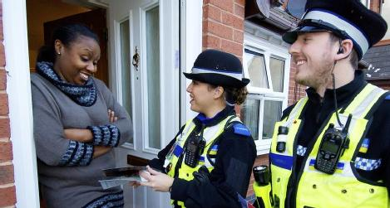
Conclusion
Collaboration produces effective policing
Strengthens trust in communities when done well
Achievement and value when there are solutions
Police are more effective in urgent situations
Community is just as important as other organisations
(College of Policing, 2024)
(Warwick,2022)

Slide 15

Any Questions?

Slide 16
Reference page
College of Policing (2023). New leadership standards for officers, staff and volunteers. College of Policing. Available at: https://www.college.police.uk/article/leadership-standards. (Accessed:28/11/2024)
College of Policing (2024a). Competency and values framework (CVF) | College of Policing. www.college.police.uk. Available at: https://www.college.police.uk/career-learning/competency-and-values-framework. (Accessed: 02/12/24)
College of Policing (2024). We collaborate – CVF competency | College of Policing. www.college.police.uk. Available at: https://www.college.police.uk/career-learning/competency-and-values-framework/we-collaborate. (Accessed: 26/11/24)
CPS (2022). Rape Strategy update | The Crown Prosecution Service. www.cps.gov.uk. Available at: https://www.cps.gov.uk/publication/rape-strategy-update. (Accessed:07/12/2024)
Farrell, C. (2022). Partnership Working – Why is this important. Careers in Blue. Available at: https://careersinblue.co.uk/partnership-working-why-is-this-important/. (Accessed:26/11/2024)
Gathergood, A. (2024). Tuckman’s Five Stages of Team Development. Still Relevant? Alun Gathergood. Available at: https://www.alungathergood.com/tuckmans-five-stages-of-team-development-still-relevant/. (Accessed:27/11/24)

Slide 17
REFERENCE PAGE CONTINUED
Kilgallon, M. and Wright, M. (2022). Behavioural Skills for Effective Policing. Critical Publishing.
Michael Gilbert: Police lagoon victim probes ‘flawed’. (2011). BBC News. Available at: https://www.bbc.co.uk/news/uk-england-beds-bucks-herts-14059610. (Accessed:08/12/2024)
Policing Insight. (2024). South Yorkshire Police strengthens community engagement, reduces costs and improves officer efficiency with NICE Investigate. Available at: https://policinginsight.com/feature/advertisement/south-yorkshire-police-strengthens-community-engagement-reduces-costs-and-improves-officer-efficiency-with-nice-investigate/ (Accessed :07/12/ 2024).
Rowe, M. (2017). Introduction to Policing. 3rd edn. London :SAGE.
Rush, M. (2017). Characteristics of an Ineffective Team. Bizfluent. Available at: https://bizfluent.com/info-8406516-characteristics-ineffective-team.html.(Accessed:08/12/2024)
Wood, D., Bradshaw, S., Dickens, T., Parker-McLeod, J. and Davis, C. (2024). Blackstone’s Handbook for Policing Students 2024. Oxford University Press, USA.
www.cps.gov.uk. (2022). Successful joint working with police on rape cases | The Crown Prosecution Service. Available at: https://www.cps.gov.uk/cps/successful-joint-working-police-rape-cases. (Accessed: 07/12/2024)

Slide 18
Research TIMELINE
WC 04/11/24- Began research using books from reading list on module tile. I used these as they are reliable sources provided by Lecturer.
WC 11/11/24- I used the index looking for keywords that were relevant to assignment which led me to right direction for the foundation of my presentation
WC 18/11/24- I structured my work around the effective and ineffective characteristics providing positive and negative outcomes in police collaborations
WC 25/11/2024- I used additional reading resource from the library that included further reading on community collaboration – Neighbourhood watch
WC 02/12/2024- I faced a challenge of finding alternative cases that provided a clear finding of multi-agency failures. Next time I would like to source more cases and see if I can provide statistics that show a development is effective policing when collaboration has worked well.

