Slide 1
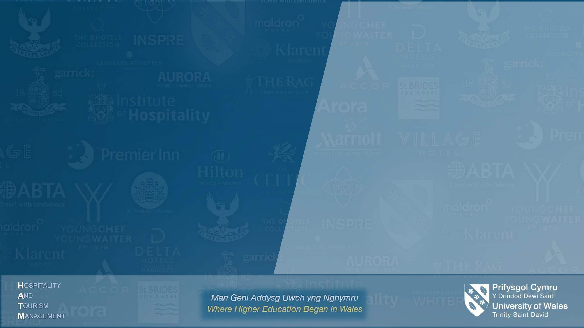

BMTP5019
Operations
Management for
Tourism,
and Events
Human Resources
Leisure

Slide 2

Today ………wake up your inner lion
NAM MYOHO RENGE KYO
- THE LIONS ROAR
MASCOT OF SELF-TRANSFORMATION
SELF MASTERY IS AVAILABLE TO ALL NO MATTER WHERE YOU BEGIN
SYMBOLISES:
STRENGTH
COURAGE
BRAVERY
PEACE

Slide 3

WHAT DO YOU KNOW?
What do you know about human resource management?
Tell us about where you have worked and experienced this area ?

Slide 4
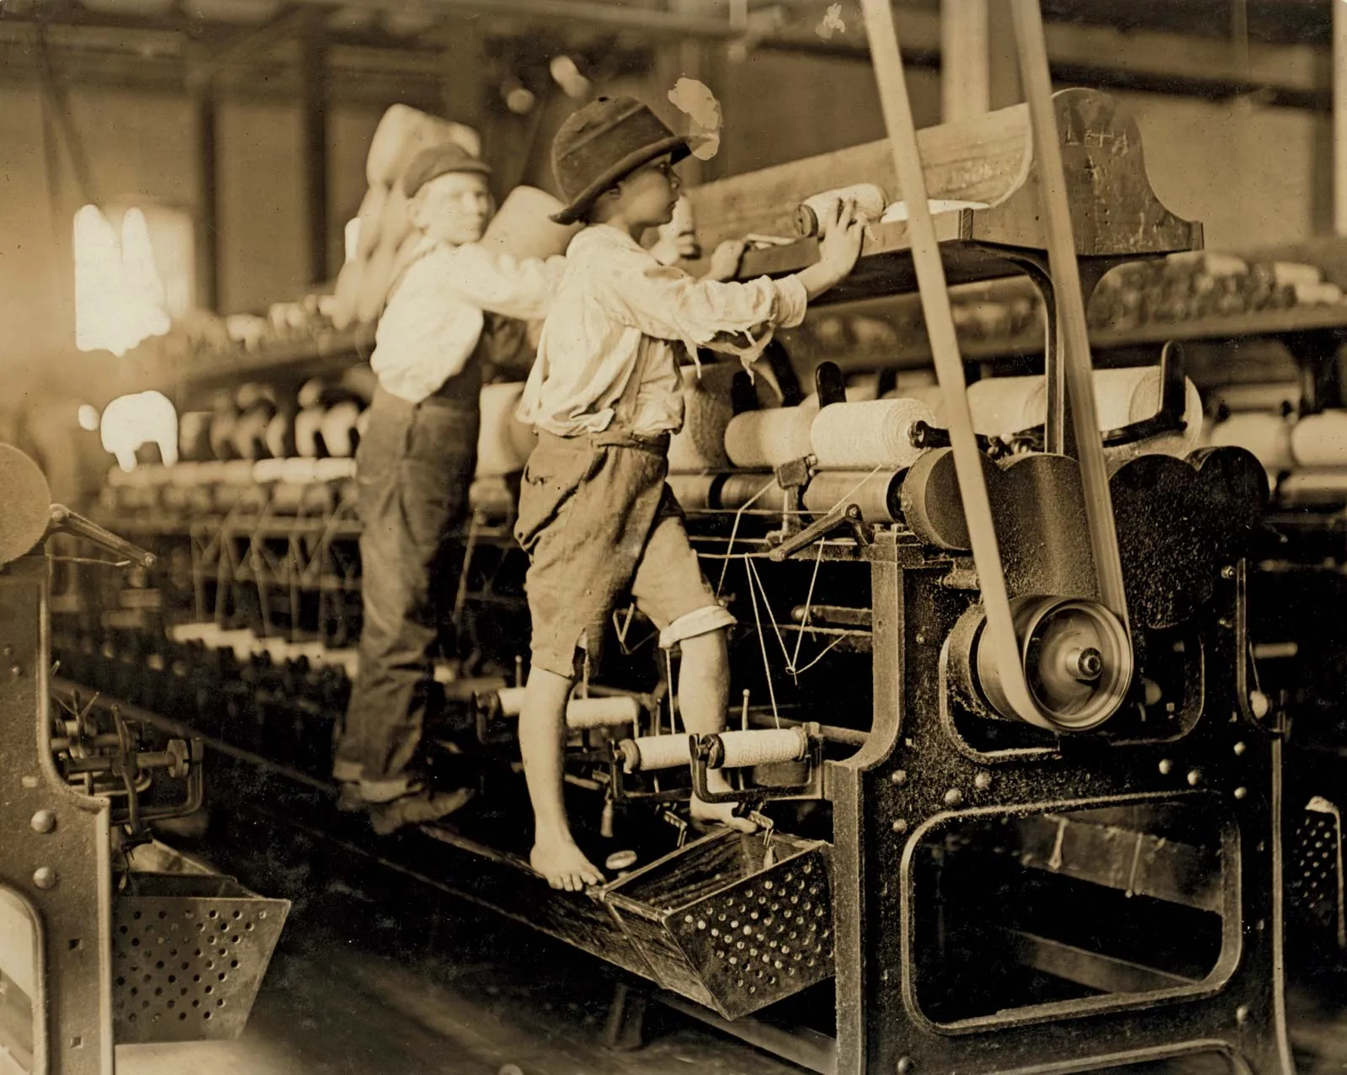
The History of Human Resource Management (HRM)
Early Beginnings (Pre-Industrial Era)
Before the Industrial Revolution, work was mainly agricultural or craft-based. People learned skills through apprenticeships, and labour management was informal, handled by family members or master craftsmen. There was little separation between workers and owners.
Industrial Revolution (Late 18th–19th Century)
The rise of factories created a large workforce and new challenges:
Long working hours
Poor working conditions
Child labour
Low wages
Early “personnel” roles emerged to manage hiring, pay, and discipline, mainly to control labour and improve productivity, not employee wellbeing.

Slide 5
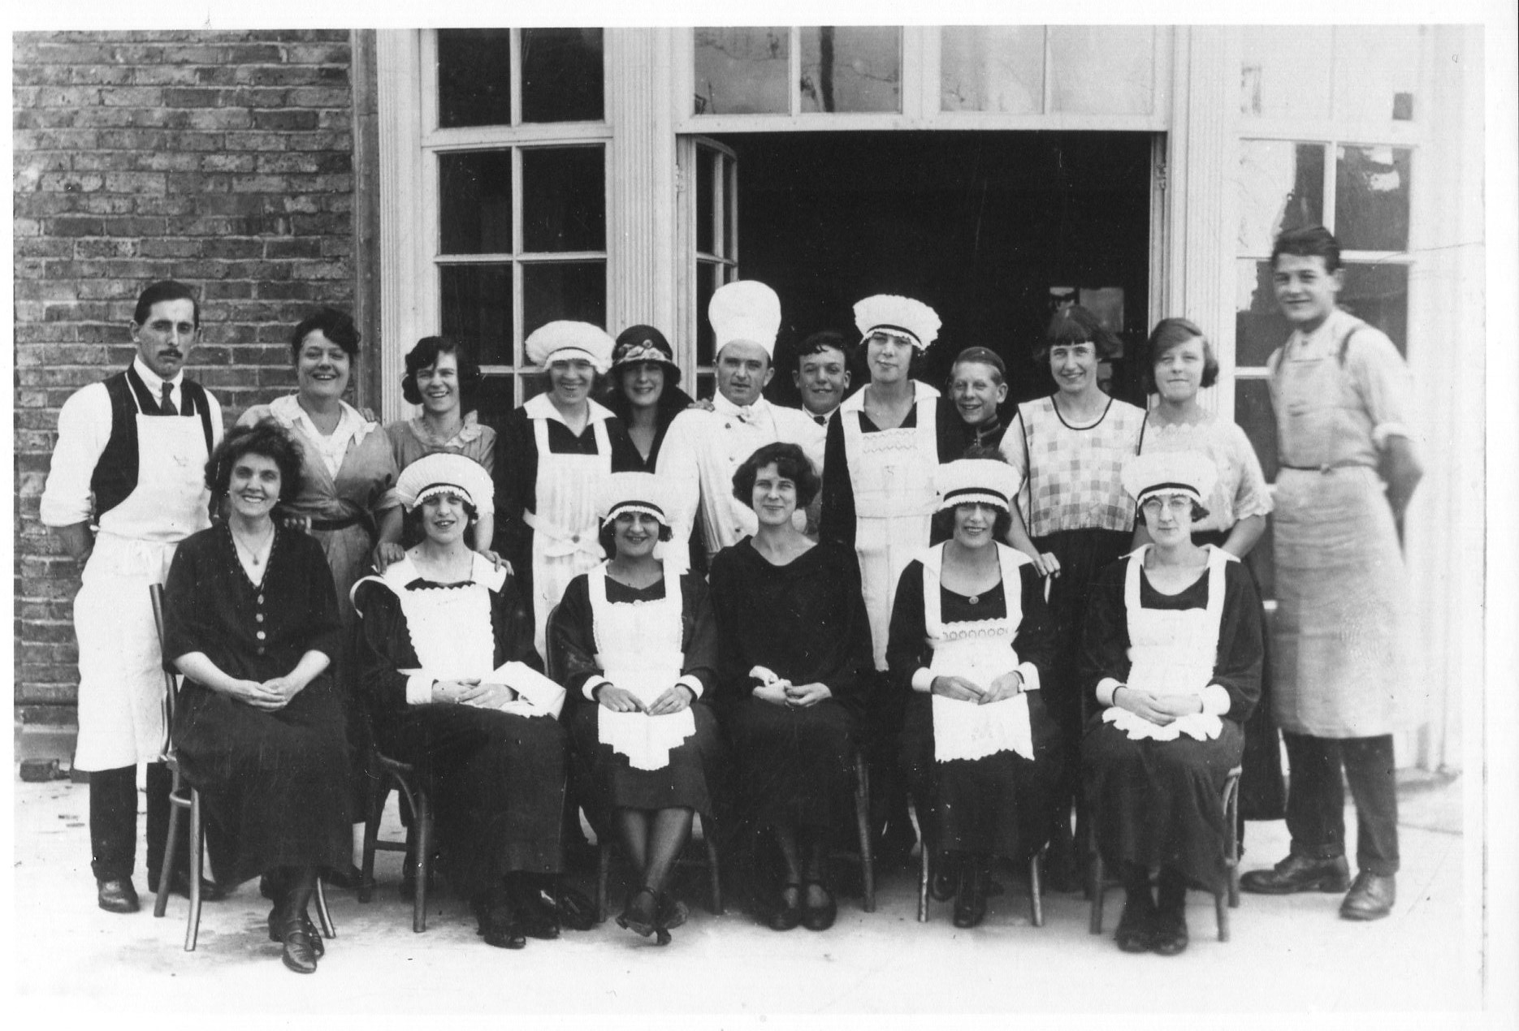
The History of Human Resource Management (HRM)
Scientific Management (Early 20th Century)
Frederick W. Taylor introduced Scientific Management, focusing on:
Efficiency and standardisation
Time and motion studies
Maximising output
Workers were viewed largely as machines, and motivation was
assumed to be mainly financial.
Human Relations Movement (1930s–1950s)
The Hawthorne Studies revealed that:
Social relationships and morale affect productivity
Employees respond to recognition and involvement
This shifted thinking toward employee motivation, communication, and teamwork,
marking a major turning point in people management.

Slide 6
The History of Human Resource Management (HRM)
Personnel Management Era (1940s–1970s)
Organisations began formalising personnel departments responsible for:
Recruitment and selection
Training and development
Industrial relations and compliance with labour laws
The focus expanded from control to employee welfare and administration.
Modern Human Resource Management (1980s–Present)
HRM evolved into a strategic function, aligned with organisational goals. Key features include:
Talent management
Performance management
Diversity, equity, and inclusion
Employee engagement and wellbeing
Learning and development
Employees are now viewed as valuable assets and contributors to competitive advantage.

Slide 7
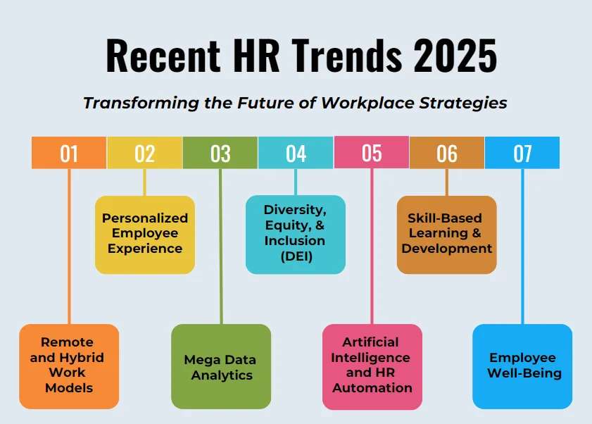
The History of Human Resource Management (HRM)
Contemporary HRM Trends
Today, HRM is shaped by:
Digital HR technologies and AI
Remote and hybrid work
Employer branding
Sustainability and ethical practices
Data-driven decision-making (HR analytics)

Slide 8
Human Resources (HR) Management
Staffing Structure: Outline the hotel’s organisational structure, making links and detailing the different departments (e.g., Front Desk, Housekeeping, F&B, conferences & events) staff roles.
Recruitment and Training: Discuss strategies for recruiting and onboarding new employees, especially considering the seasonal demand from international tourists.
Discuss training programs (e.g., customer service, cultural sensitivity for international guests, emergency response procedures).
Identify any specific training for high-traffic periods (peak tourist seasons).
Staff Scheduling and Allocation:
Plan for flexible staffing models, considering fluctuating guest numbers based on seasonality etc.
Discuss shift schedules/ rotas, part time, full time employment for different departments /areas to ensure adequate coverage and smooth operations.
Performance Management: Describe how employee performance will be monitored and managed, incentivised including KPIs for customer service and operational efficiency.

Slide 9
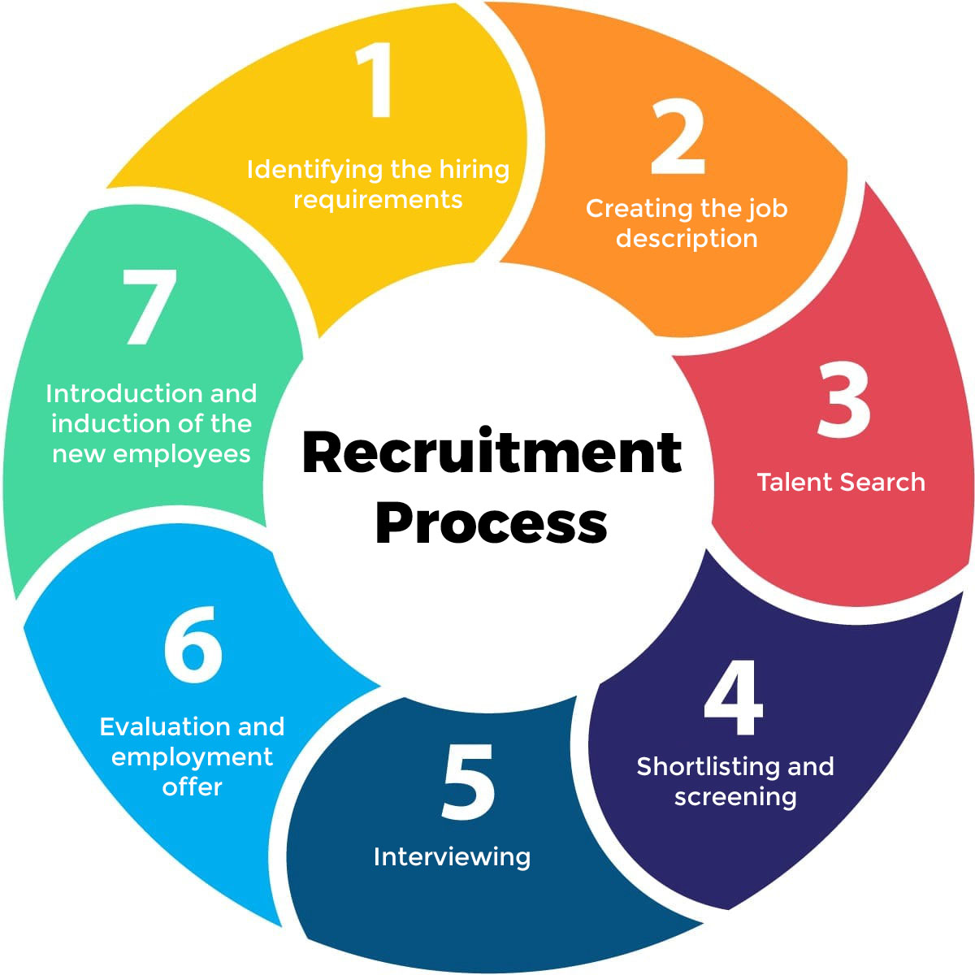
Topic-Specific Guidance (Choose One)
Recruitment
Recruitment is the comprehensive process of identifying, sourcing, screening, shortlisting, interviewing, and hiring candidates for permanent or temporary positions within an organisation
Benefits:
hiring for attitude and service mindset
employer branding
realistic job previews
diversity and cultural fit
Key link: Right people = better service experiences.
Let’s discuss your recruitment experiences

Slide 10
Managing Staff Performance and Training
Let’s discuss this …………….

Slide 11
Training and Development: Lifecycle
HR ensures new employees have a smooth start with onboarding, training, and ongoing development.
Onboarding: HR introduces new hires to policies, culture, and job expectations, making them feel welcome and prepared.
Training:
HR provides the
Continuous Development: HR offers ongoing learning opportunities, such as leadership training and customer service workshops, to help employees grow and stay motivated.
necessary training to ensure
employees can perform their roles
effectively and meet hotel standards.

Slide 12


Slide 13

Training and Development
Training and Development helps employees learn the skills they need to do their job well and grow in their careers.
How is this done?
Onboarding:
  When new employees join, they go through an onboarding to get familiar with the hotel’s rules, culture, and job expectations. It’s like an introduction to the workplace.

Slide 14

2. On-Boarding
Onboarding is the process of integrating new employees into an organization to equip them with the necessary knowledge, skills, behaviours, and culture to become productive, engaged, and effective members.
It is a long-term strategy, often lasting several months to a year, and goes beyond a single-day orientation to encompass the entire new employee experience
Benefits :
early socialisation
service culture integration
role clarity
reducing early turnover
Key link: First impressions shape long-term performance.

Slide 15
The Purpose and Importance of Onboarding:
Improved retention - Companies with a structured onboarding process experience significantly higher employee retention rates.
Increased productivity - New hires reach maximum productivity faster when provided with the right tools, knowledge, and support.
Stronger culture - The process introduces new employees to the company's mission, values, and norms, helping them feel connected and valued from the start.
Reduced stress and anxiety - A well-planned process helps alleviate the nerves and uncertainty associated with starting a new job, making the transition smoother.
Compliance - A structured program ensures that all legal and regulatory requirements, such as necessary paperwork and policy reviews, are met consistently

Slide 16

Training and Development
Training Methods: Training can be done in different ways, such as:
  Online: Employees can watch videos or take courses online at their own pace.
  In-Person: Hands-on training, where employees learn directly from supervisors or trainers in real-life settings.
  Hands-On: Employees learn by doing their tasks on the job with guidance, such as practicing checking in guests or cleaning rooms.

Slide 17
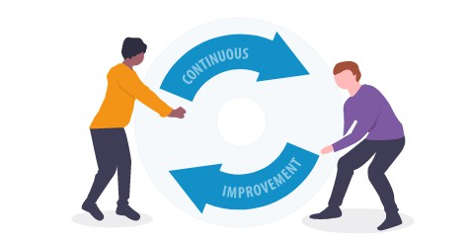
Training and Development
Continuous Improvement:
  HR encourages employees to keep learning and improving their skills over time.
What does this give to employees?
  stay motivated
  do their job better
  move up in their careers
  they creates an environment where employees feel supported to grow and develop

Slide 18
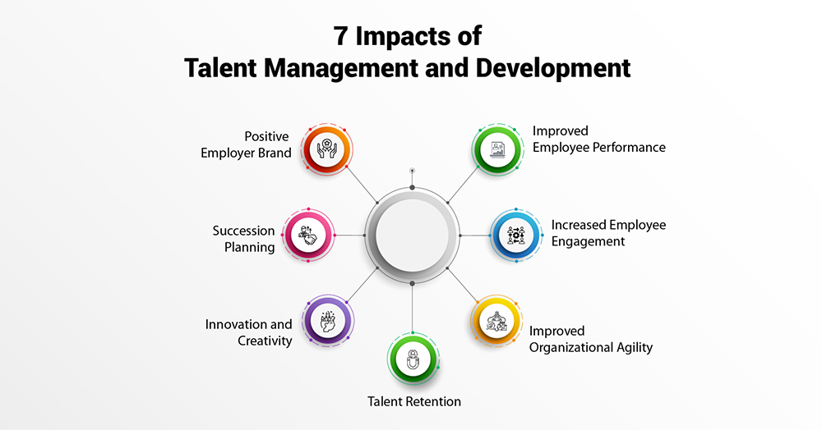
3. Talent Development
Talent development is the strategic, ongoing process of enhancing employees' skills, knowledge, and capabilities to support individual career growth and align with the overall goals of the organization. It is a core component of human resources and is crucial for building a skilled, adaptable, and engaged workforce.
Benefits:
training for service excellence
leadership pipelines
continuous learning
career progression
Key link: Skilled, confident staff deliver higher service quality.

Slide 19
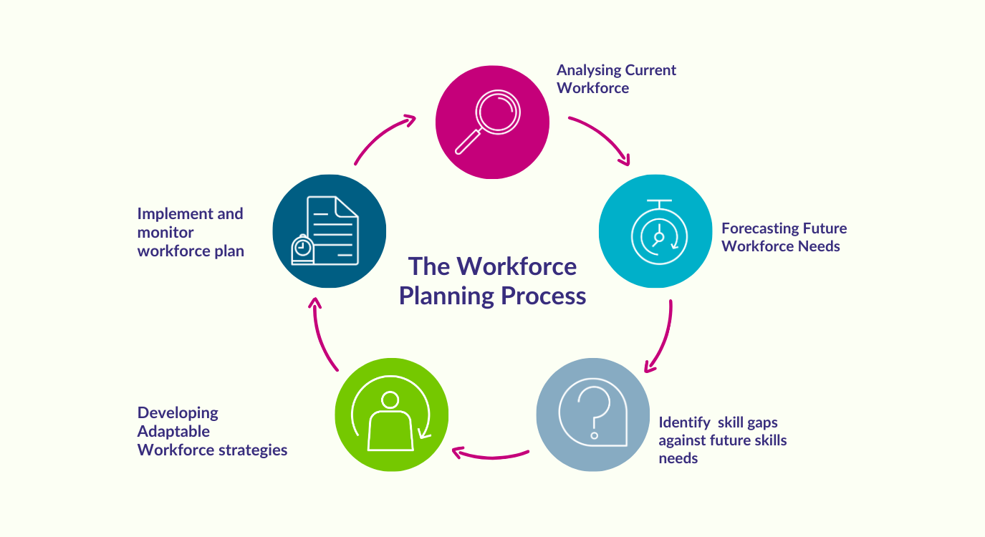
4. Workforce Planning
Workforce planning is the strategic process of analysing, forecasting, and balancing labour supply against future demand to ensure an organisation has the right people with the right skills in the right positions at the right time. It involves identifying talent gaps, planning for future needs, and implementing solutions to achieve long-term goals.
Benefits :
staffing levels
seasonal demand
flexible work arrangements
avoiding burnout
Key link: Right staff, right time = consistent guest experience.

Slide 20

5. Compensation & Benefits
Compensation & Benefits (C&B) covers all direct pay (salary, bonuses) and indirect rewards (health insurance, PTO, perks) employers offer for work, crucial for attracting, retaining, and motivating talent, forming a complete employee reward system.
Compensation is cash (wages, incentives), while benefits are non-cash perks like insurance, retirement plans, and flexible work, designed to support overall employee well-being and satisfaction.
Benefits:
financial and non-financial rewards
motivation and retention
fairness and transparency
recognition programs
Key link: Valued staff provide better hospitality.

Slide 21
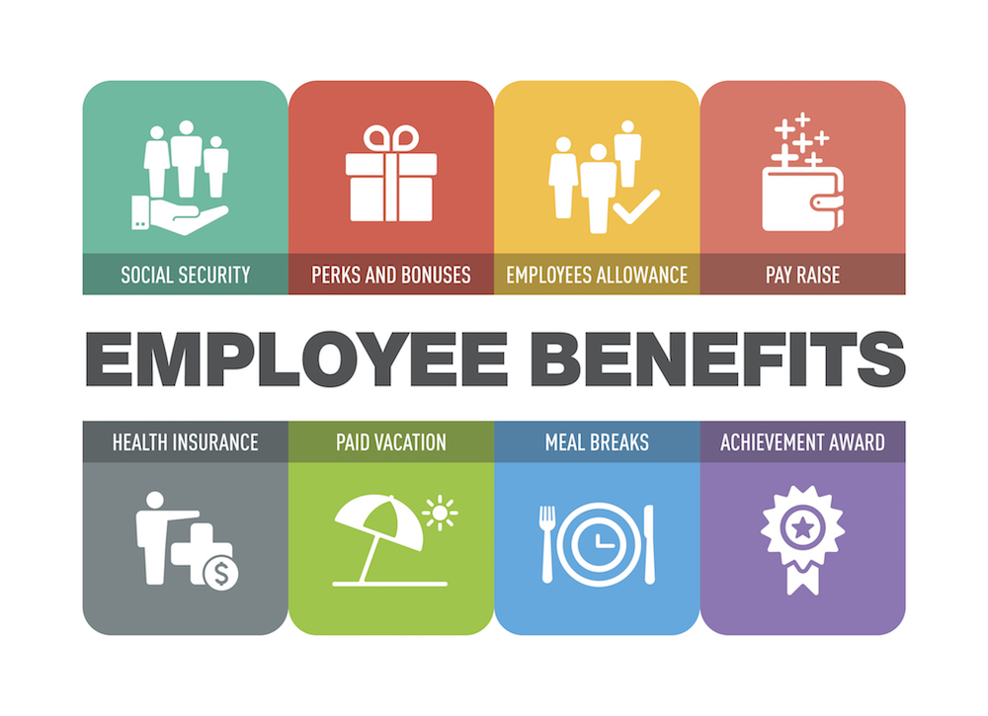
Compensation (Direct Rewards):
Base Pay: Salary, hourly wages.
Variable Pay: Bonuses (sign-on, performance, retention), commissions, overtime.
Equity: Stock options
Benefits (Indirect Rewards):
Health & Wellness:
Medical, dental, vision insurance, wellness programs, gym memberships
Financial Security: Retirement plans (401k, pension), life insurance, HSAs/FSAs
Work-Life Balance: Paid Time Off (PTO), sick leave, holidays, flexible work (remote/hybrid)
Development: Tuition reimbursement, training, learning opportunities
Perks: Childcare assistance, meal reimbursements, employee discounts, on-site amenities

Slide 22
6. Performance Management
Performance management is an ongoing, strategic process that aligns individual employee goals with organisational objectives to improve overall productivity and foster development.
It involves continuous, two-way communication, including regular check-ins, feedback, and performance reviews rather than just annual appraisals, to boost engagement and employee growth.
Benefits:
service-based KPIs
feedback and coaching
linking performance to guest satisfaction
continuous improvement
Key link: What gets measured gets delivered.

Slide 23
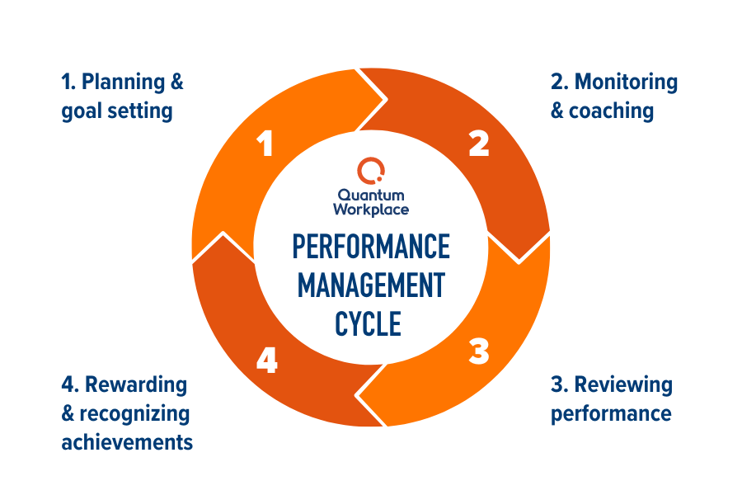
The Performance Management Cycle
Planning: Setting SMART goals and defining expectations at the beginning of a cycle
Monitoring: Tracking progress regularly through meetings and feedback
Reviewing: Assessing achievements against goals (often in formal, but regular, appraisals)
Rewarding/Developing: Recognising achievements,
providing rewards, and creating development plans

Slide 24
Assignment : 1st May 2026 11.59pm - 2000 words
Section 2: HR advisory operational plan - 2,000 words 50%
Task Overview
Using your chosen project (hotel / resort / tourism business), you must select ONE of the following HR areas and develop an advisory operational plan:
Recruitment
On-Boarding
Talent Development
Workforce Planning
Compensation & Benefits
Performance Management

Slide 25
Your plan must:
Be advisory (written as if you are HR professionals)
Be operational (focused on practical implementation)
Be supported by academic theory and project-specific research
What Is an Advisory Operational Plan?
An advisory operational plan:
Identifies a problem or opportunity
Uses theory + evidence to justify decisions
Recommends clear, realistic actions
Is written for management decision-makers

Slide 26
Required Structure (All Topics)
1. Project Context
Briefly explain:
Your chosen hotel / tourism project
Target market
Service level (budget, mid-range, luxury, events-focused, etc.)
Why this HR area is critical for service quality and guest experience

Slide 27
2. Problem or Opportunity Identification
Clearly define:
A current or potential issue related to your chosen topic
How this impacts:
  service quality
  staff performance
  guest satisfaction
  brand reputation
🔗 Link the issue to tourism and hospitality characteristics (seasonality, turnover, emotional labour, service intensity).

Slide 28
3. Academic Theory & Literature
Apply relevant HR and service theories, such as:
Service-Profit Chain
Human Capital Theory
Psychological Contract
Motivation theories (Herzberg, Maslow, Self-Determination)
High-Performance Work Systems (HPWS)
Talent Management theory

Slide 29
4. Advisory Operational Plan (Core Section)
Include:
Objectives (what the plan aims to achieve)
Key actions / strategies
Who is responsible
Timeline
Resources required
Expected outcomes
Use tables, flowcharts, or step-by-step models where appropriate.

Slide 30
5. Impact on Service, Hospitality & Guest Experience
Explicitly explain how your plan will:
improve staff capability and engagement
enhance service consistency
support the organisation’s service philosophy
improve guest satisfaction and loyalty
6. Risk & Evaluation
Briefly identify:
potential risks or limitations
how success will be measured (KPIs, turnover, guest reviews, performance metrics)

Slide 31

Part 2

Slide 32

Introduction to HR in Hotels
HR in a hotel involves:
Recruitment and Staffing: Hiring the right people for roles like front desk, housekeeping, food and beverage, and events.
Training and Development: Training staff to meet guest needs, maintain service standards,
and manage busy seasons or international tourists.
Employee Welfare and Engagement: Creating a positive work environment to reduce turnover and boost morale.
Cultural Sensitivity: Managing a diverse workforce and understanding the needs of international guests.

Slide 33
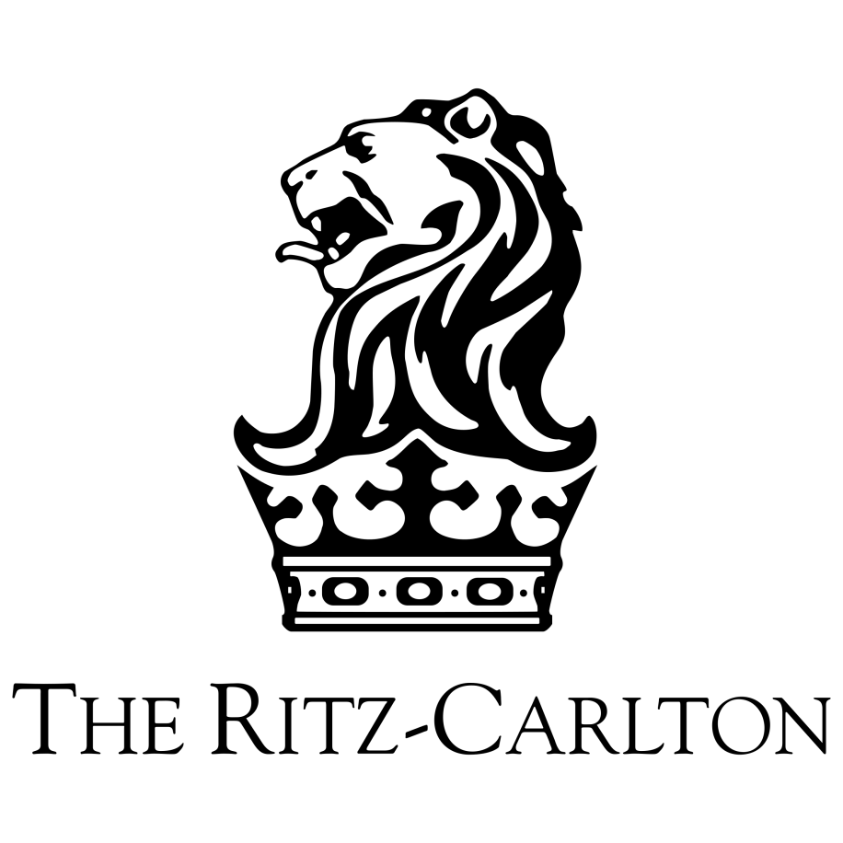
Case Study: The Ritz-Carlton's Employee Engagement and Guest Satisfaction
https://stephenblandino.com/2016/07/how-the-ritz-carlton-delivers-exceptional-customer-service.html
What do you reckon this resulted in?
This approach boosted employee morale and improved guest satisfaction, leading to more repeat business and positive reviews.
The program showed that HR strategies focused on empowering staff can greatly enhance both service quality and the guest experience.

Slide 34
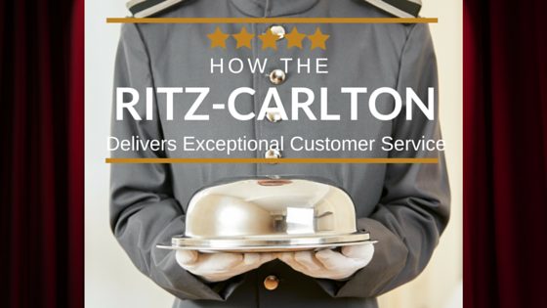
HR’s Role in Hiring and Training

Slide 35

Hiring for Success in Hotels
In the hotel industry, recruitment focuses on hiring skilled and motivated people who can provide great customer service in a fast-paced setting.
HR looks for candidates with strong communication, problem-solving skills, a positive attitude, and a good fit for the company culture.
They ensure staff are adaptable and quick to meet guests' needs, especially during busy times, helping create smooth operations and positive guest experiences.

Slide 36
Hiring for Success in Hotels: Key Steps
Job Descriptions:
  Clear and detailed job descriptions are crucial for attracting the right candidates.
  Job descriptions help candidates understand what’s expected of them and ensure the hotel
hires employees with the right skills and motivation.
What should a job description outline?
  key responsibilities, required skills, qualifications, and expectations for the role.

Slide 37
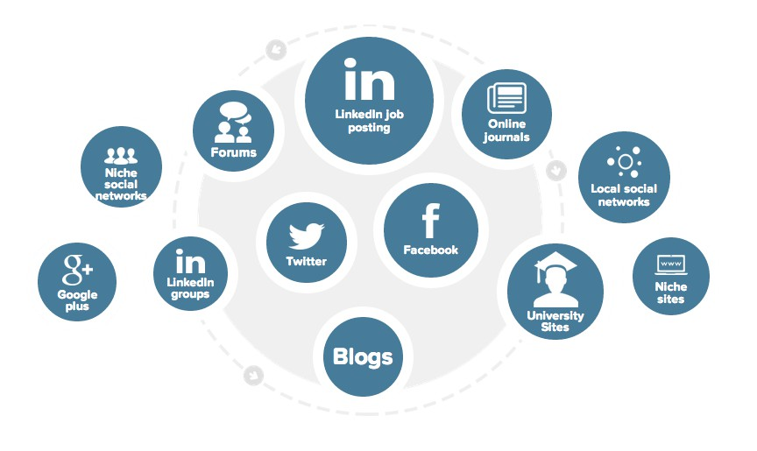
Hiring for Success in Hotels: Key Steps
Recruitment Channels:
Hotels use various channels to attract candidates, such as online job boards, recruitment agencies, social media platforms, and industry-specific sites.
Networking and partnerships with hospitality schools can also be effective in reaching a pool of skilled candidates.

Slide 38

Hiring for Success in Hotels: Key Steps
Selection Process:
The selection process reviewing applications, possibly assessments.
usually includes interviews, and
Candidates are evaluated
for both
technical skills (e.g., communication, problem-solving) and soft skills (e.g., attitude, cultural fit).

Slide 39

Hiring for Success in Hotels: Key Steps
Candidate Evaluation:
Evaluation includes checking qualifications, experience, and personality traits that match the hotel’s culture.
Interviews and reference checks help confirm the
candidate’s suitability for the role.
It’s also important to evaluate how well they align with the hotel’s values and customer service standards.

Slide 40

HR ensuring a good fit for roles at a luxury hotel
Recruitment Process:
  HR will create clear job descriptions for the available roles, emphasising key skills required.
  They will use job boards, social media, and
local hospitality schools to attract candidates.
Interviews and Evaluation:
  HR will ask situational questions related to the job, ensuring a match with the hotel’s luxury image.

Slide 41
HR Ensuring a Good Fit for Roles at a Luxury Hotel
Personality and Cultural Fit:
  HR will evaluate candidates for teamwork, composure, and friendliness, key traits for excellent guest service.
  This is dependent on the job they are applying
for.
Training and Onboarding:
  New employees will receive training on job tasks, hotel values, and customer service standards to help them fit into the hotel culture.

Slide 42
references
Wolniak, R., 2020. Main functions of operation management. [online] ResearchGate. Available at: https://www.researchgate.net/publication/341656435_Main_functions_of_operation_management [Accessed 27 January 2025].
Operations Management Research Journal, 2023. Capacity planning and operational goals. [online] Pubsonline. Available at: https://pubsonline.informs.org/doi/10.1287/msom.2023.0691 [Accessed 27 January 2025].
Journal of Operations Management Research, 2023. Supply chain optimization and operational excellence. [online] Available at: https://pmc.ncbi.nlm.nih.gov/articles/PMC8249437 [Accessed 27 January 2025].

