Slide 1
Electromagnetic
Radiation
(ACDC5009)
Lecture - 13

Slide 2
Content
Electromagnetic Tracking
Radar Cross section
Stealth

Slide 3
Electromagnetic Tracking system
Electromagnetic Tracking Systems (EMTS) use electromagnetic field to detect the pose of electromagnetic sensors.
It involves the generation of electromagnetic fields by a transmitter and the detection of these fields by one or more receivers attached to the object being tracked.
When a receiving sensor moving in space, electromagnetic tracking system can accurately calculate its position and orientation, it can provide real-time measuring position and orientation angle.

Slide 4
Electromagnetic Tracking system
This technology enables precise, real-time tracking of the movement and orientation of objects without the need for line-of-sight.
This system is used in fields such as navigation, ballistic missile tracking, robots, biomechanics, etc

Slide 5
Electromagnetic Tracking system
The system generates electromagnetic fields through a set of coils or antenna in the transmitter.
The object to be tracked has a receiver consisting of one or more sensors equipped with coils.
These sensors detect the generated electromagnetic fields. The characteristics of the detected fields (such as strength and phase) vary depending on the sensor's position and orientation relative to the transmitter.
The signals received by the sensors are processed to calculate the precise position and orientation of the sensor relative to the transmitter.
The system provides real-time data on the position and orientation of the object

Slide 6
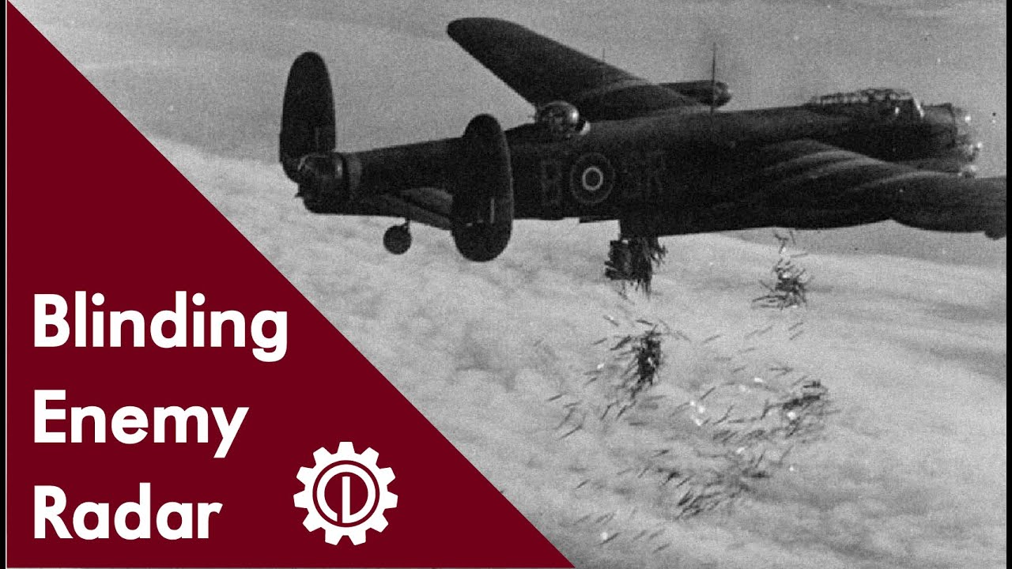

Chaff released from aircraft, a technique used to blind enemy radar.
Chaff consists of thin strips of aluminium, metallised glass fiber, or plastic, which are dropped in large quantities to create false radar echoes.

Slide 7
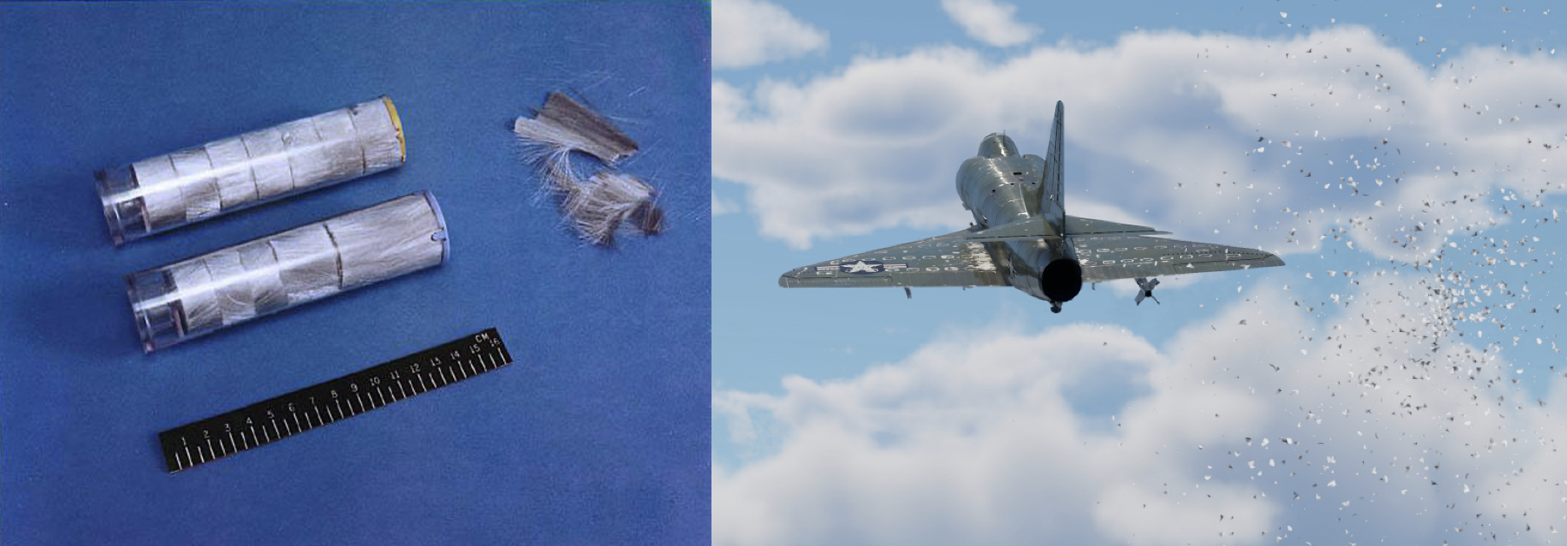
Modern Chaff Cartridges
The chaff creates multiple radar reflections, making it difficult for enemy radar to track the actual aircraft.
The radar system may lock onto the chaff instead of the aircraft, allowing it to escape or evade detection.
A large amount of chaff can overwhelm radar screens, making it nearly impossible to identify real targets.

Slide 8
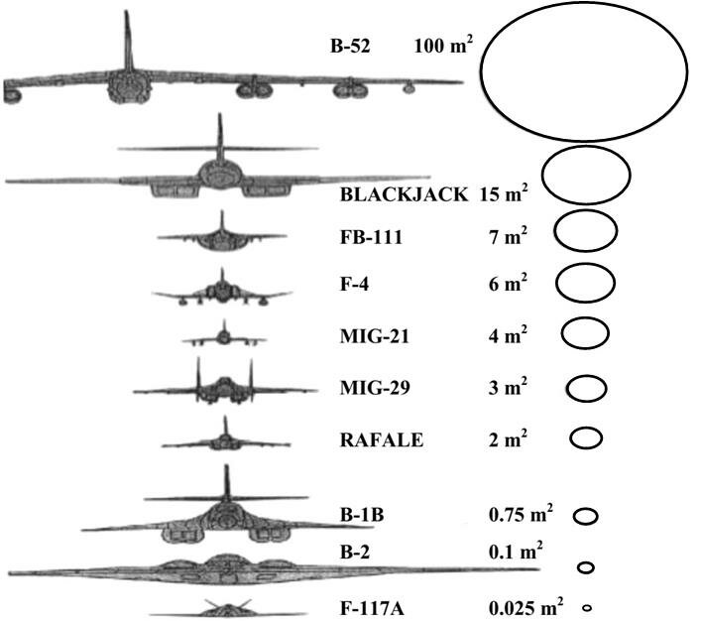
Radar Cross Section and Stealth
Radar Cross Section (RCS) is a measure of how much radar signal an object reflects back to the radar receiver.
It determines how easily an object can be detected by radar.
The unit of RCS is square meters (m²).

Slide 9
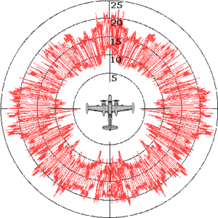
Radar Cross Section and Stealth
The RCS is an overall measure of how much energy is reflected back in different directions.
A circular representation gives a general equivalent reflection area, making it easier to visualise.

Slide 10
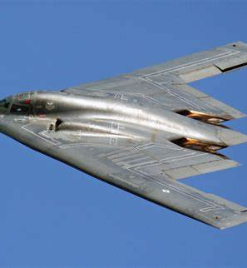
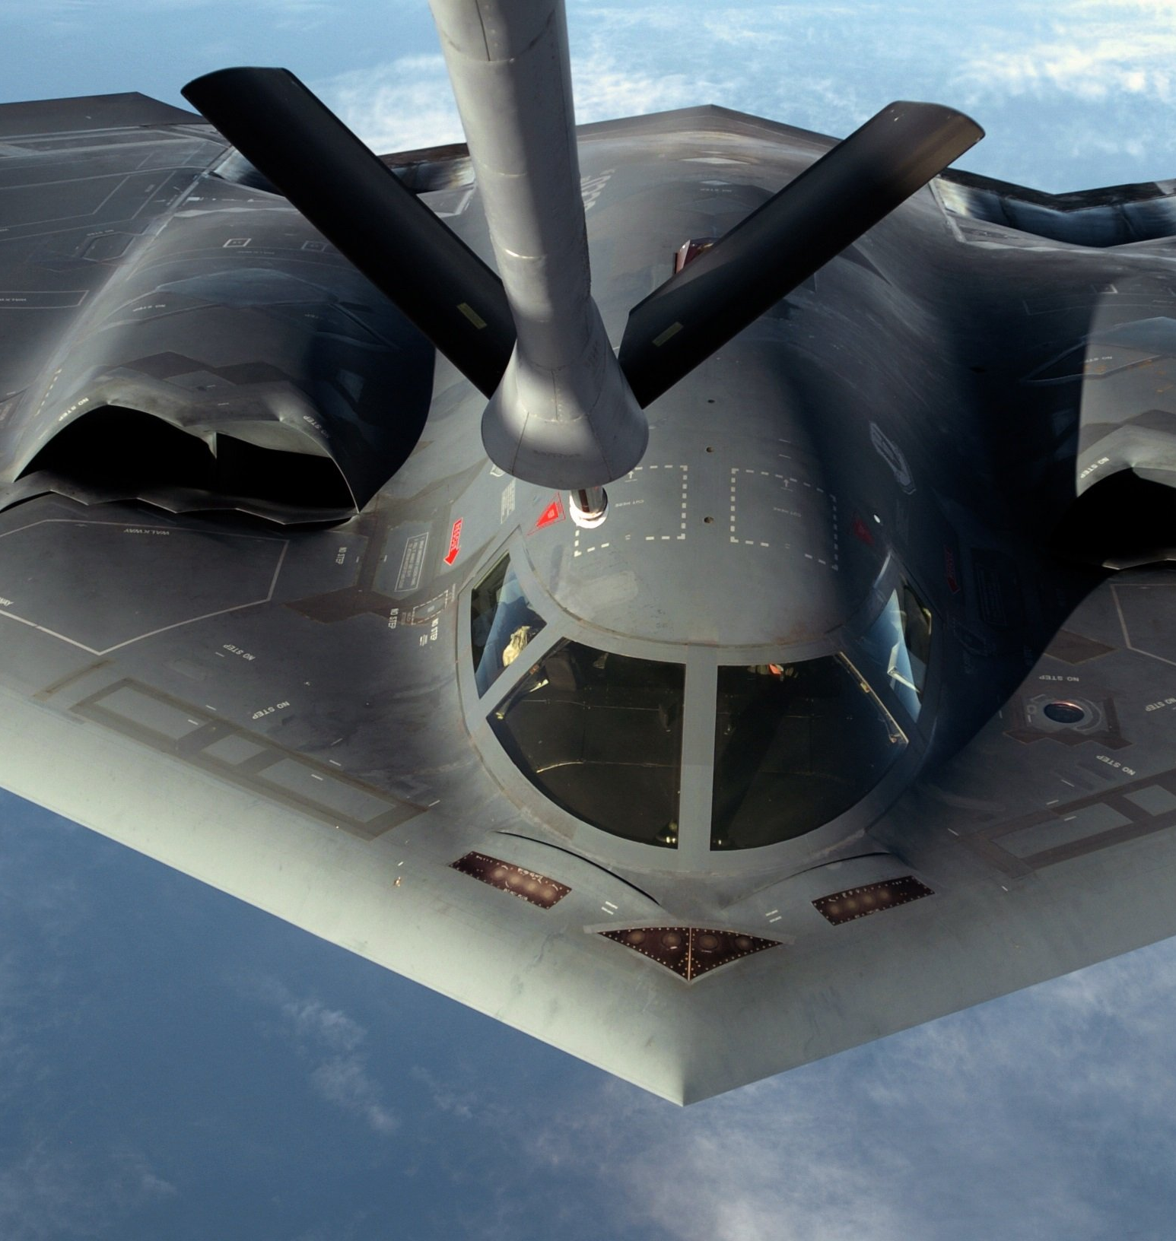
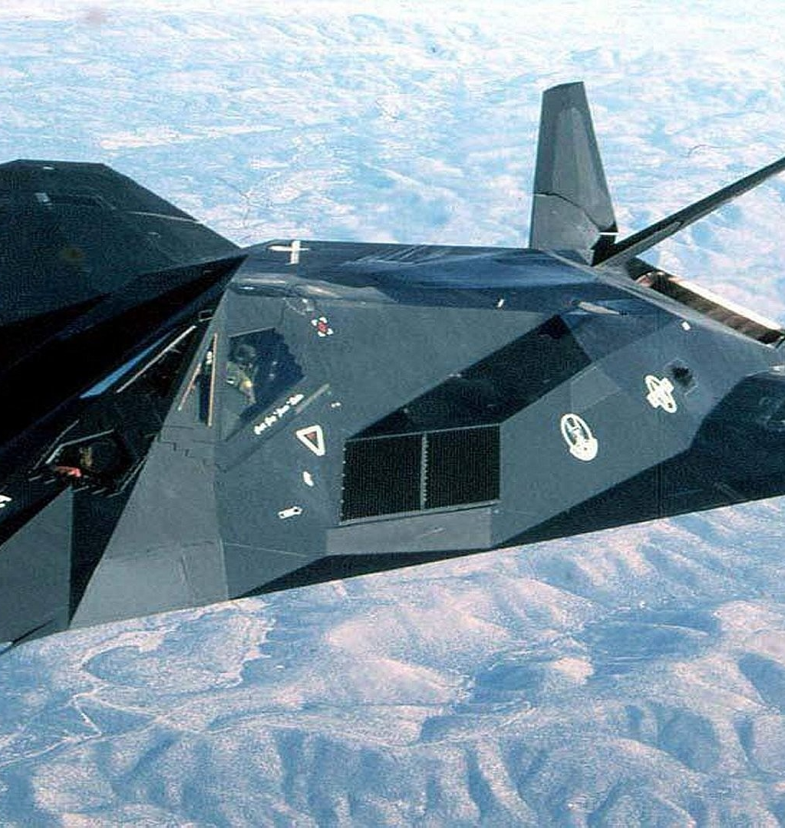
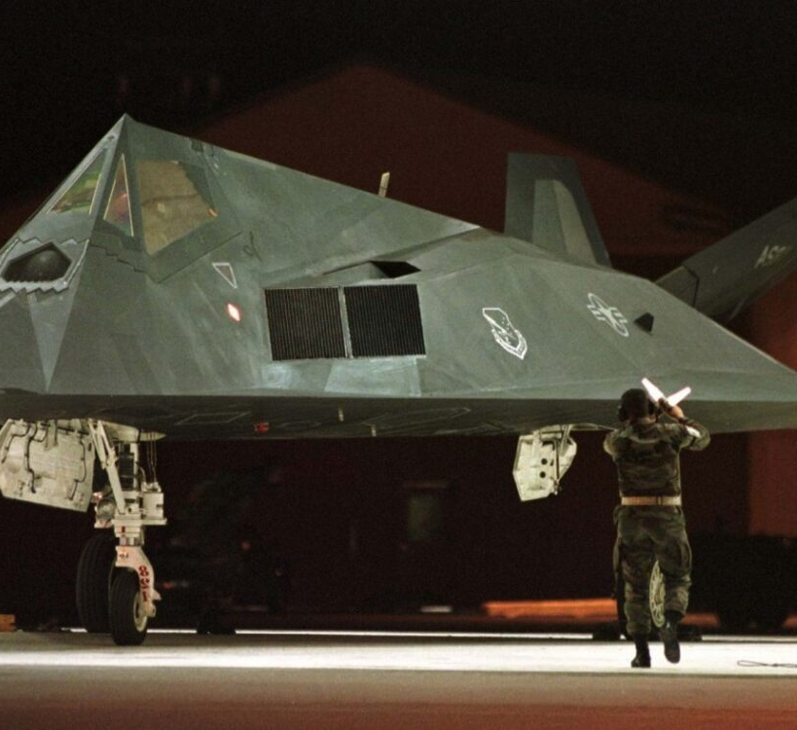
F117 and B2
Designed to minimise reflections and hence reduce detectability.

Slide 11
Radar Cross Section and Stealth
Factors Affecting RCS:
Larger objects typically have a higher RCS.
Smooth, angled surfaces (stealth aircraft) deflect radar waves away, reducing RCS.
Radar-Absorbing Materials (RAM) absorb radar waves, reducing detectability.
Different radar frequencies and wave polarisations interact differently with objects.
RCS Depends On:
Shape of the aircraft
Material used
Orientation of the aircraft relative to the radar

Slide 12
Stealth
Stealth Technology:
Stealth refers to an object's ability to reduce detection by radar, infrared sensors, and other tracking methods.
Flat or angular surfaces (avoidance of right angles) scatter radar waves in different directions.
Radar-Absorbing Materials (RAM):
  Special coatings absorb radar waves instead of reflecting them (e.g., carbon-based composite materials).
  Converts electromagnetic waves into heat, reducing radar detection.

Slide 13
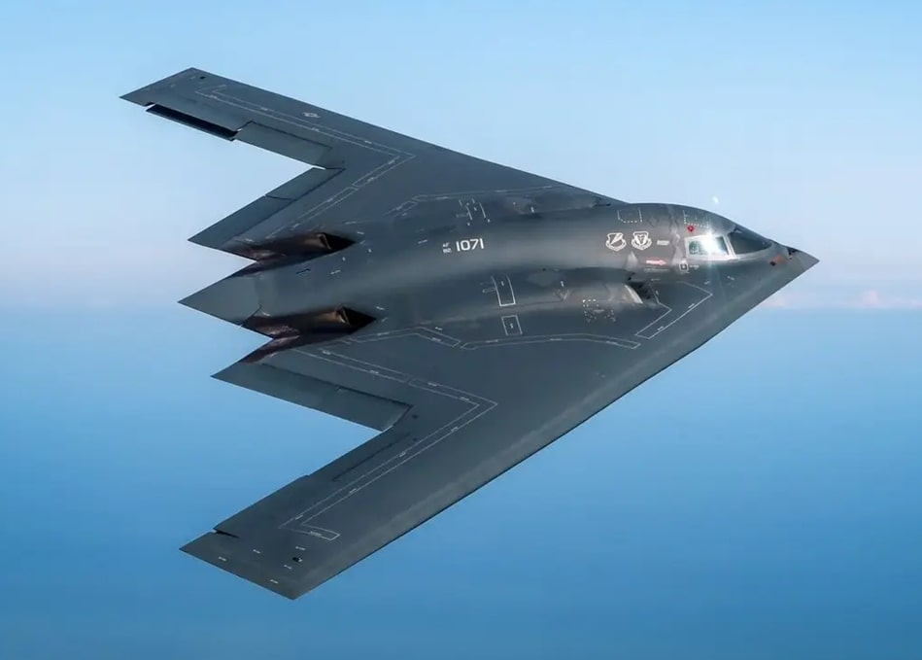
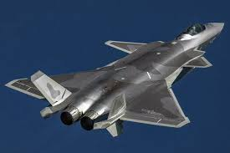
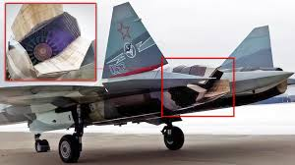
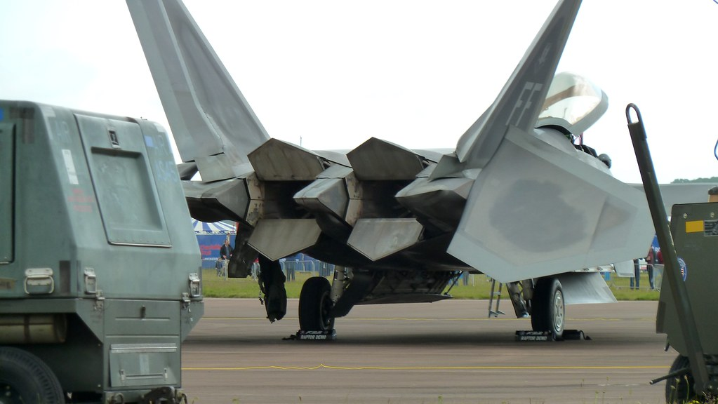
Stealth
Reducing Heat Emissions:
Jet engines produce a large amount of heat, which can be detected by infrared sensors (heat-seeking missiles).
Engines are buried inside the aircraft to reduce exhaust visibility.
Cooling exhaust gases before releasing them.
Using coatings that absorb and dissipate heat efficiently (Carbon-Based Coatings, Magnetic RAM Coatings, Metallic Thermal Coatings)

Slide 14
Radar Cross Section and Stealth
Noise Reduction
Used in stealth aircrafts, submarines and stealth helicopters to reduce sound emissions.
Coatings and designs minimise noise and vibrations.
Minimising Electromagnetic Emissions
Reduce radio communication and electronic emissions to avoid detection by enemy Electronic Warfare (EW) systems.

Slide 15
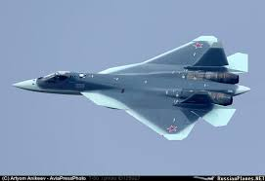
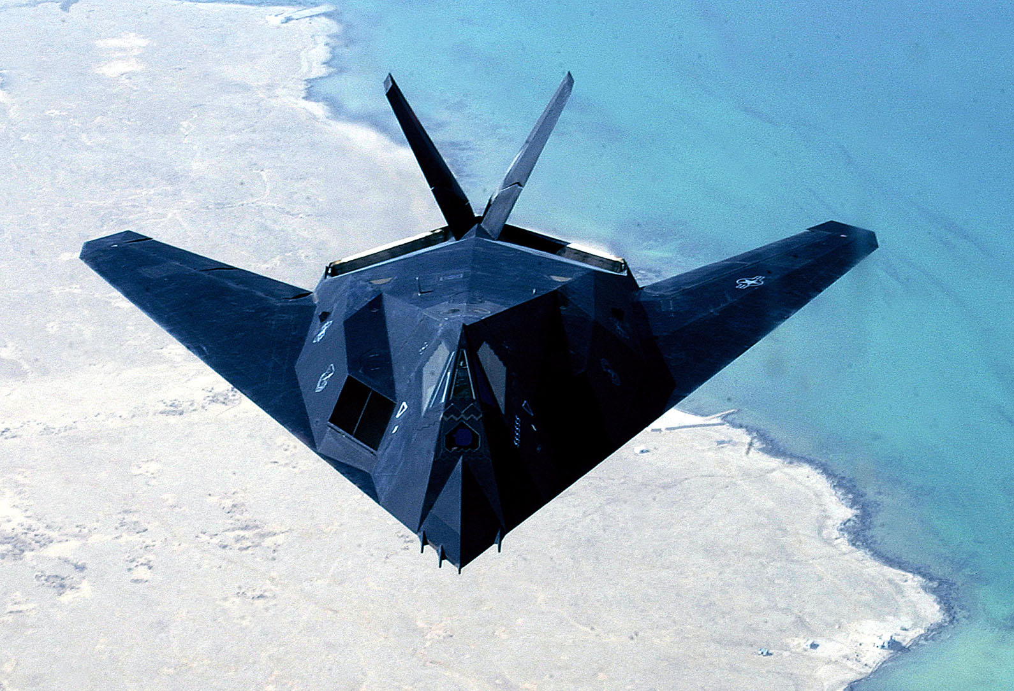
Radar Cross Section and Stealth
Visual Camouflage
Dark or gray camouflage makes aircraft harder to see at high altitudes.
Some stealth vehicles use adaptive camouflage (e.g., heat signature-changing paint).

Slide 16

Thank You

