Slide 1
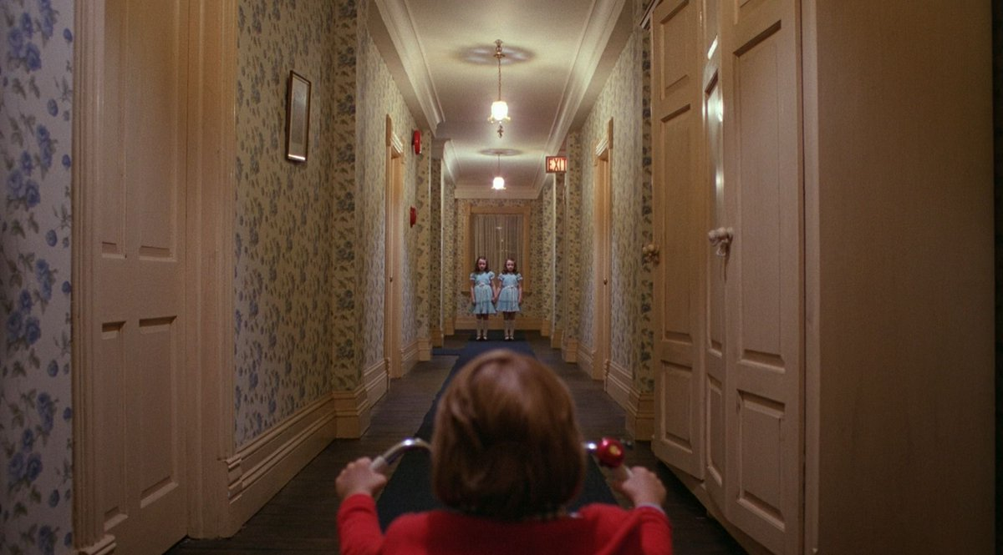
Adaptation The Shining

Slide 2
A dialogue between two mediums
“To consider a film and its parental work of fiction together is to imagine a dialogue going on between two mediums. This imagining consists of more than a mere comparison of paired narratives. We ask how the text informs the film and vice-versa.”
Rick Wallach, No Country for Old Men: From Novel to Film, eds. Lynnea Chapman King, Rick Wallach and Jim Welsh (Plymouth: The Scarecrow Press, 2009)

Slide 3
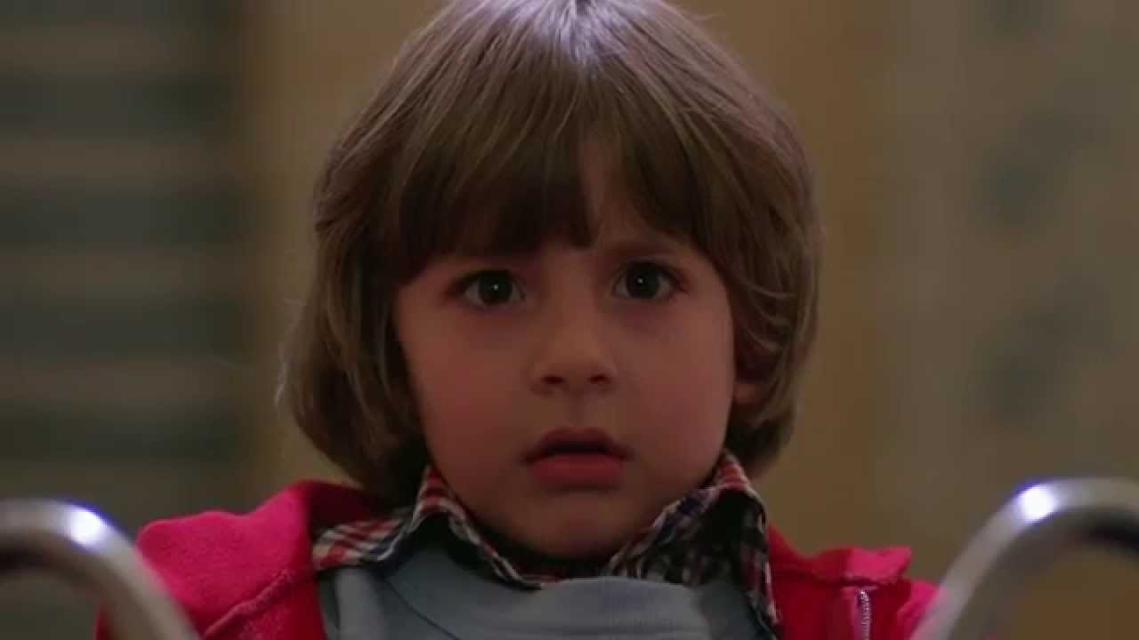
Danny: the psychic child
Danny Torrance is [a] 1970s psychic child whose magical thinking allows him to evade the marshalled forces of a punitive and psychotic patriarchal order (Luckhurst)

Slide 4
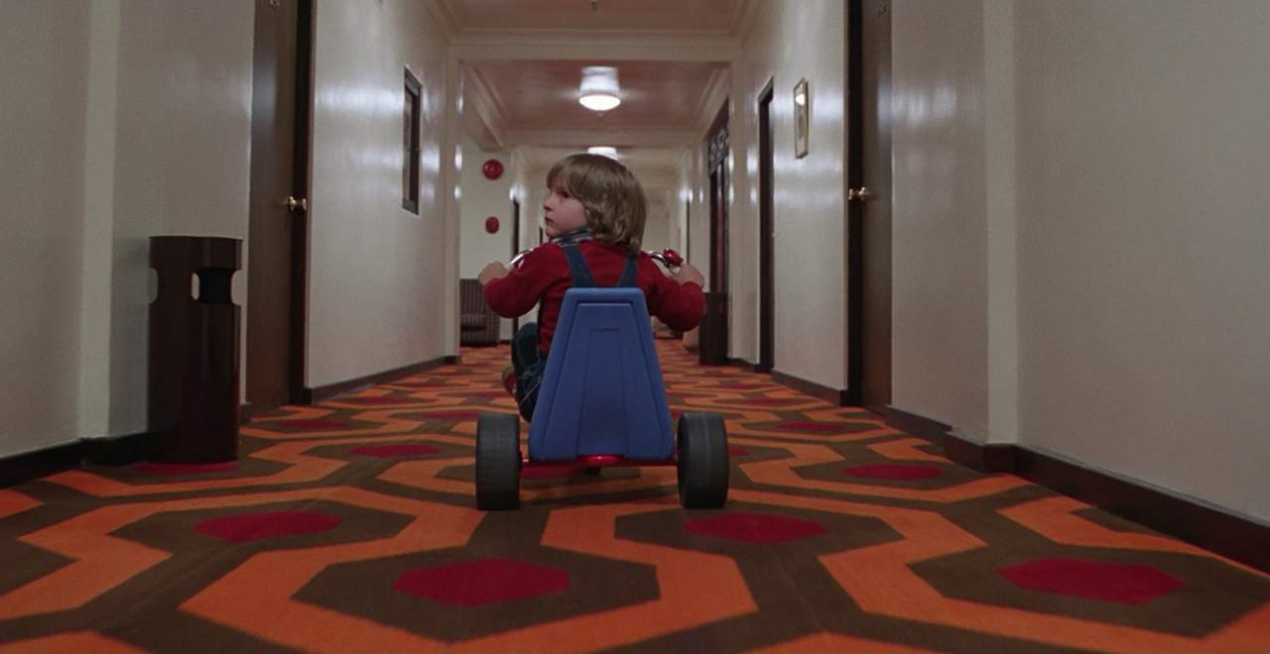
Danny: the psychic child (2)
Danny [is] a figure who registers receptive vulnerability to the traumas embedded in his environment, but also conveys the anxiety that children may be the conduits for strange and inexplicable forces

Slide 5
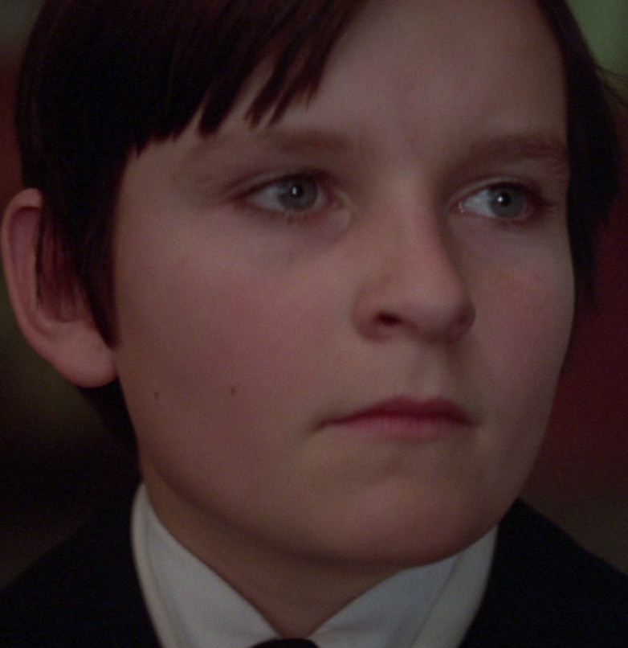
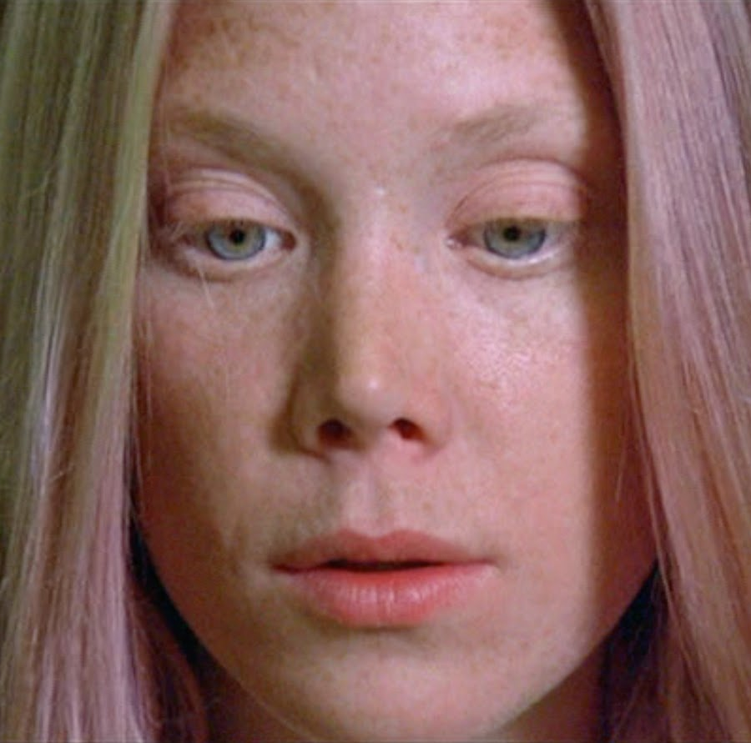
‘Conduits for strange and inexplicable forces’
The Omen 1976
Carrie 1976

Slide 6
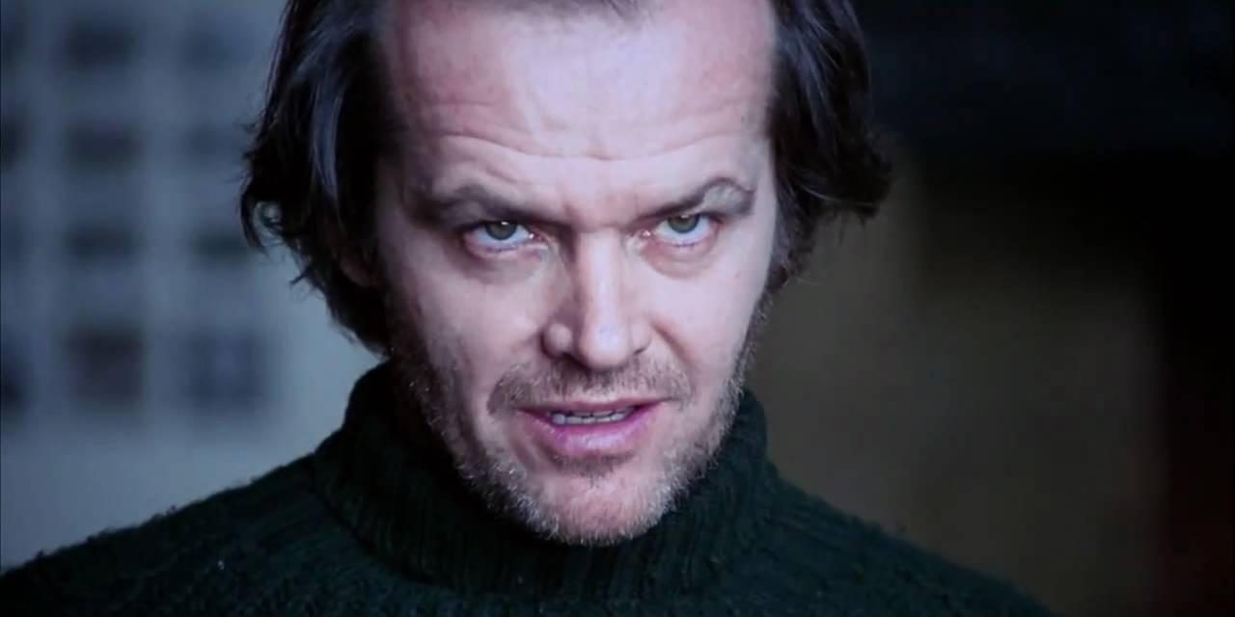
Jack: Oedipal Rages
It is the father’s Oedipal rages that drive Kubrick’s tale, his wounded paternal authority

Slide 7
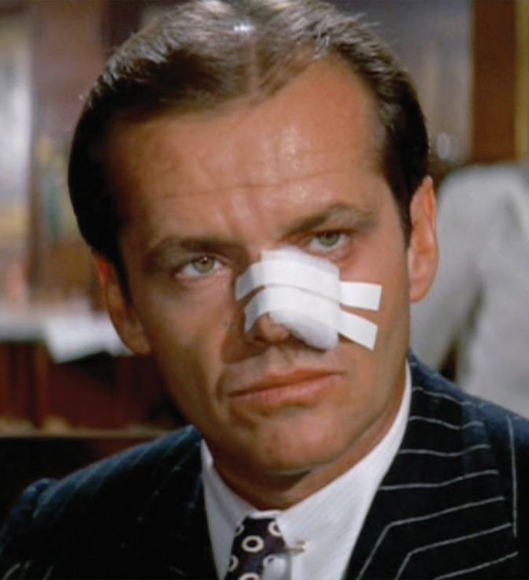
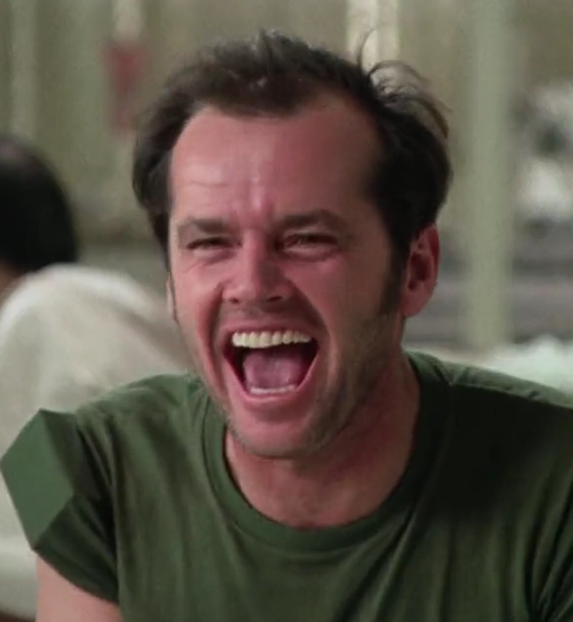
Jack Nicholson
Nicholson was clearly drawn to portraits of conflicted masculinity in the 1970s. Institutional systems bring down Jake Gittes in Chinatown (left) and Randle McMurphy in One Flew Over the Cuckoo’s Nest (right)

Slide 8
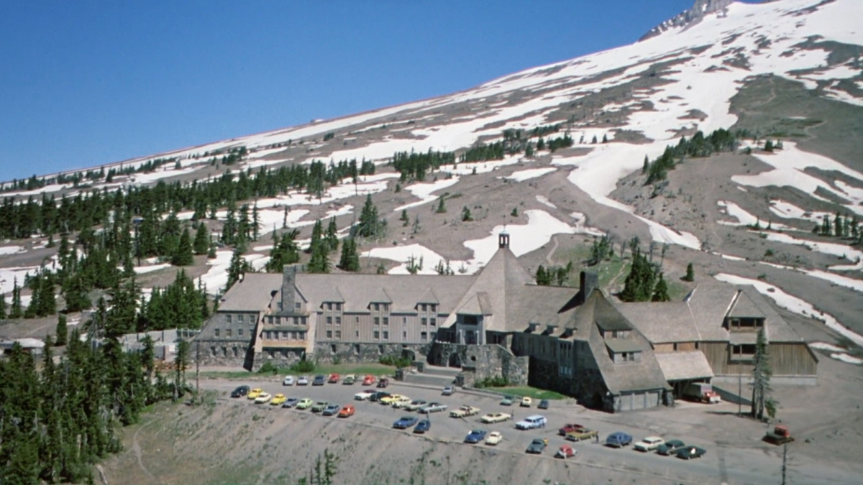
The Overlook Hotel
We are invited to read the cues in [The Overlook Hotel] historically, and in relation to the violent history of the America frontier and the destruction of Native Americans (Luckhurst)

Slide 9
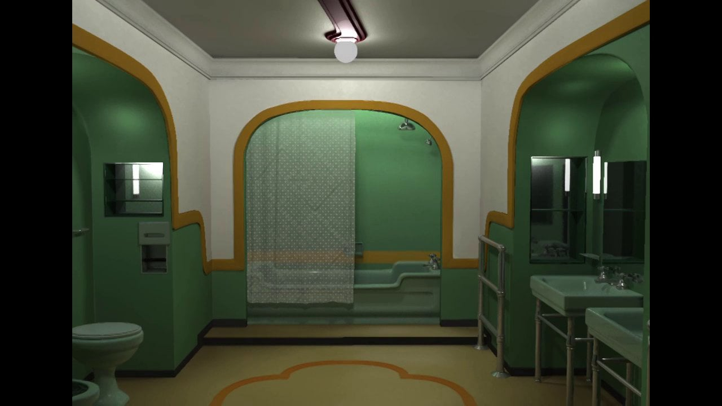
Room 237
The scene in Room 237 impossibly intertwines the psychic lives of Wendy, Danny, Hallorann, Jack and the hotel. We enter a whole new way of navigating cinematic intersubjectivity

Slide 10
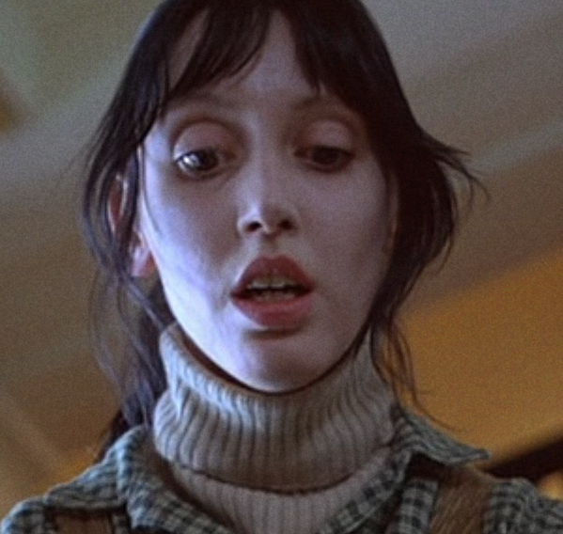
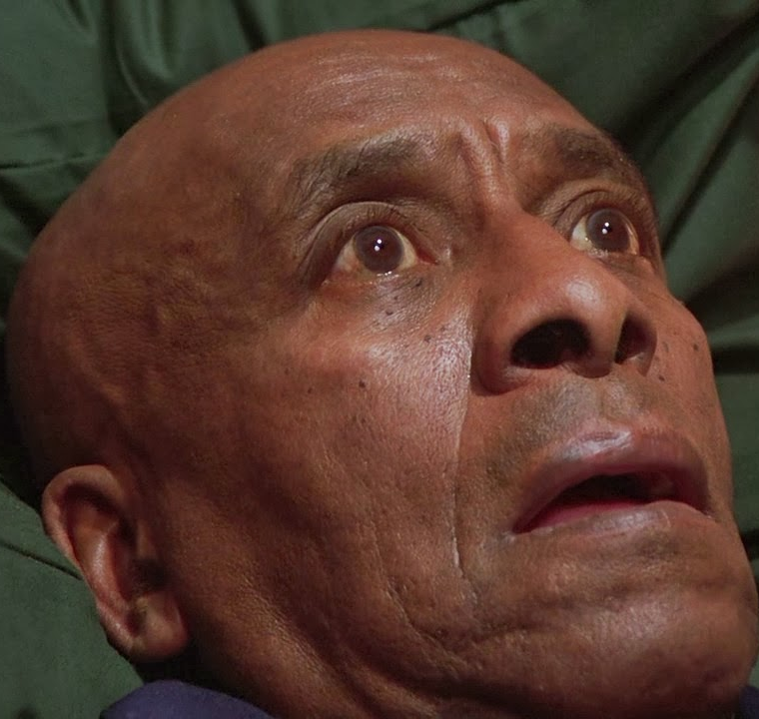
Wendy and Hallorann
The counter-force [to the lethal force of the ‘white manhood’ of American authority] will come from an alliance of the marginal and the overlooked – the black man, the child, and the mother

