Slide 1

– MACRO-ECONOMICS
AGGREGATE DEMAND 1

Slide 2

What Happens When There are Changes J and W ?
Try and explain this to me ?

Slide 3
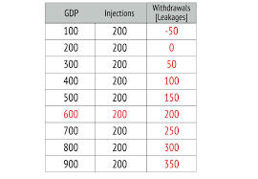
Relationships between GDP, J and W

Slide 4
Question Practice ;
1) In N country , the nominal gross domestic product grew by 10% and the real gross domestic product increased by 4%.
Inflation is
a)-4%
b) 13%
c) 6%
2. In country M a third runway at the national airport is being built. Investment is N 500 million. This will increase GDP N2Billion.
Identify and explain if this N500mn represents an injection or withdrawal.

Slide 5
QP Answer(s)
QP 2 = 6% (10-4%)

Slide 6
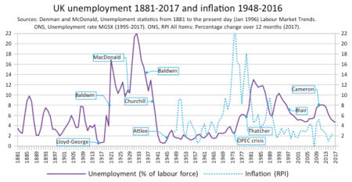
What are the implications of the circular flow of income given the changes in Unemployment

Slide 7

WHAT IS AGGREGATE DEMAND (AD)
AD is the total planned expenditure on final goods and services in an economy.
It can also be defined as ’Aggregate demand is the total amount of goods and services demanded in the economy at a given time and price level. Aggregate demand is the sum of consumption expenditure, investment expenditure, government expenditure and net exports. (AD=C+I+G+X-M)’ ( Tutor 2 U, May 2024)
Note: Import spending has to be removed/deducted as some of the spending in C +I + G is on foreign goods and services and does not stay within the domestic economy.

Slide 8

IMPLICATIONS – AGGREGATE DEMAND
AD WILL INCREASE GIVEN:
An increase in Consumption ( for example – because of reduced income tax)
An increase in Investment ( for example – lower interest rates)
An increase in Government spending ( due to a budget deficit)
An increase in Exports ( a lower exchange rate / cheaper pound ) A
A fall in Imports ( maybe the government has imposed quotas)

Slide 9
AD = C + I + G + X – M
AN INCREASE IN INJECTIONS
Greater Exports
Increased Government spending
More Investment
WILL INCREASE AGGREGATE DEMAND
AN INCREASE IN WITHDRAWALS
INCREASED SAVINGS
HIGHER SPENDING ON IMPORTS.
HIGHER TAXES
DECREASES AGGREGATE DEMAND

Slide 10
What affects Consumption ?
Income
Taxes
Wealth Changes
Future expectations about income
https://www.statista.com/statistics/623579/consumer-confidence-in-the-uk/
https://www.statista.com/statistics/1272447/uk-wage-growth-vs-inflation/#:~:text=Average%20weekly%20earning%20growth%20in%20the%20UK%20compared%20with%20inflation%202001%2D2024&text=In%20the%20three%20months%20to,the%20same%20period%20in%202023.

