Slide 1
Individual Presentation
Name and ID: Dan Zamsa (2028094)
Module name :International Business Communications module code : Lcbb6001

Slide 2

Main content / Agenda of the presentation
It focuses on analysing the effectiveness of doing a joint venture in China
Cultural differences between China and the UK are offered
Effective recommendations are offered to manage a successful business in China through a joint venture
Notes:
This presentation focuses on the delivery of a detailed understanding of different aspects that are creating failure as well as success in the case of performing business activities within the existing business market of China through the engagement of joint ventures. Therefore, cultural considerations that are associated with the Chinese business environment are also analysed in the discussion part along with the analysis of the cultural dimensions of two different countries such as the UK and China. There is also the presence of developed strategies as the form of recommendations to offer proper guidance to the global business organisation based in the UK to manage the successful business within the business market of China by reducing failure from joint ventures.

Slide 3

Introduction to the context
It delivers knowledge about a UK company that is going to China for doing business
The company is going to do a joint venture agreement with a Chinese business
Differences between UK and China are delivered
Success and failure in the joint venture within China are presented
Notes:
The discussion of this presentation focuses on the delivery of clear knowledge regarding the joint venture operations that global business based in the UK is trying to perform within the context of the Chinese market. In this regard, within the discussion part of this presentation, there is an in-depth analysis of Chinese culture and that helps in measuring the differences between the UK and China. Therefore, Success, as well as failure related to the joint venture in the Chinese context, are also presented in the analysis section. Implementation of the Hofstead cultural dimension model is also performed to analyse cultural differences between China and the UK from various perspectives.

Slide 4

Introduce the Chinese culture
The main focus of Chinese culture is on collectivism
English culture or the culture of the UK focuses on individualism
The business culture of China is very dynamic (Jiang et al. 2019)
The UK's business culture is planned and organised
Notes:
A clear analysis of the overall business culture of China clearly stated that the business culture of this country is following a dynamic structure. Organisations that are operating within this country feel confident about their decision-making operations (Jiang et al. 2019). For example, it can be added that in Chinese culture a business organisation might not get a related start as the partner of the business might decide to make changes and depicts the idea at the last minute before others are ready for the changes. On the other hand, in the culture of the UK, business organisations are offering a high value of time, and all the activities are done based on a proper schedule.

Slide 5

Introduce the Chinese culture
The business culture of China is influenced through Confucianism
In this culture relationship networks are more crucial (Santandertrade, 2023)
Relationship networks in business based on values of solidarity
UK's business culture focuses on managing discipline, courtesy, and punctuality
Notes:
Considering the business culture of two different countries such as China and the UK it is recognised that the business cultures of both countries are different from each other (Santandertrade, 2023). The organisations in the business culture of the UK are managing an iconic humour to manage successful business operations. On the other hand, within the business culture of China, the maintenance of relationship culture is crucial enough as it is based on values related to solidarity (Santandertrade, 2023).

Slide 6

Success and failure factors of joint ventures
Success
Joint venture in China delivers access to the Chinese organisations
It helps to get support from existing workforces (Harris, 2023)
Failure
Most of the joint venture in China fails due to the presence of fundamental mistakes
There is the presence of division in leadership and decision-making activities (Donnelly, 2023)
Notes:
Performances of joint ventures within the context of China are offering success to the organisation and in that case, it is noticed that through joint ventures the leaders of most organisations are getting support from the existing organisations. It helps the leaders of the companies to get a clear view of the existing sales and distribution challenges to maintain a developed connection within the business (Harris, 2023). For example, it can say that with the performance of joint ventures in China, McDonald's gets support from the existing workforce and that helps to maintain a successful business in a completely new market. On the other hand, in the case of performing joint ventures in China, there is the presence of high risks related to disputes over the management operations. It might affect the profit-sharing process of a business (Donnelly, 2023).

Slide 7

Cultural sensitivity in China / The differences from the UK
Cultural sensitivity in China is very high
It helps to craft marketing strategies in China (DeGennaro, 2022)
It also helps to select the right marketing channels
The right spokesperson for the brand is selected
Notes:
Within the context of China, cultural sensitivity is very high and that helps the business organisations within this country to create developed marketing strategies for the maintenance of a successful business. Therefore, people in China are trying to live in harmony and they are showing courtesy as well as honesty to others. It helps in the maintenance of business operations through joint ventures. In the current context, it is noticed that the social media platform has become an indispensable facet of the daily life activities of people of this country. The process must create opportunities for business organisations to manage marketing operations through social media platforms considering the culture of China (DeGennaro, 2022).

Slide 8
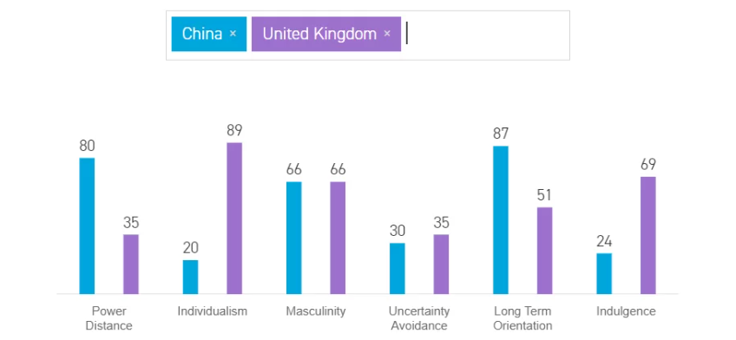
Hofstede cultural Dimensions: UK and China
Power distance
The power distance of the UK is approximately 35%
China got approximately 80% in power distance
Individualism
A score of the UK in this dimension is 89%
China got approximately 20% in this area (Iulia-Cristina, 2023)
Masculinity
The masculinity of the UK is approximately 66%
China also get approximately 66% score in this aspect
Notes:
Implementation of the cultural dimension model of Hofstede it is encountered that the society of the UK believes that inequalities among people must be minimised. On the other hand, the society of China believes that inequality among people is acceptable. Due to presence of difference the UK-based organization might face issue in managing a healthy culture in the company at the time of dealing business in China. Therefore, Chinese culture is highly collectivist and in this culture, people act in the interest of the group. Furthermore, the people in the UK are highly success-oriented and that follows a driven culture (Iulia-Cristina, 2023).

Slide 9
Hofstede cultural Dimensions: UK and China
Uncertainty avoidance
A score of UK is approximately 35%
Score of China in this segment is 30%
Long-term orientation
The UK has approximately 51% long-term orientation
China has approximately 87% (Iulia-Cristina, 2023)
Indulgence
The indulgence rate in the UK is 69%
24% score is acquired by China in this section
Notes:
Analysis of the scores in regards to the cultural dimension process clearly stated that the society of the UK equally values its own past at the time of dealing with challenges related to the present or future. The cultural context of China has the ability for adopting traditions to change conditions. People in China do not put much emphasis on spending laser time for the fulfillment of their desires (Iulia-Cristina, 2023). The provess might allow the organisation to maintain potential cahnges within busienss at the time of doing joint venture in China and it must help in the mainteance of sucess of the company in a completelly new business environment.

Slide 10

my recommendations
The leaders of the business should focus on involving an interactive approach
It must help to acquire knowledge about the culture of China
It also helps to manage shared stories through subjective or individual experiences (El Sayed et al. 2021)
Notes:
Through the engagement of the interpretive approach within the joint venture operations of the UK-based company, the leaders of this brand can manage intellectual communication with different organisations in China. It must help to acquire in-depth knowledge regarding the culture of China based on the establishment of communication which must be performed to the share stories process and that might allow the organization to enhance the individual experience for dealing with challenges that are associated with the performance of joint ventures in China.

Slide 11

my recommendations
Implementation of critical theory should be performed
It must help to explain and transform communication (Jahn, 2021)
The behaviour of human beings in China will be analysed
Notes:
The introduction of critical theory as part of intercultural communication must allow the UK-based organisation to get detailed knowledge about the behaviour of human beings in China. It would allow this brand to manage the delivery of satisfactory services to the cultures in China based on the creation of joint ventures within the existing companies in China.

Slide 12
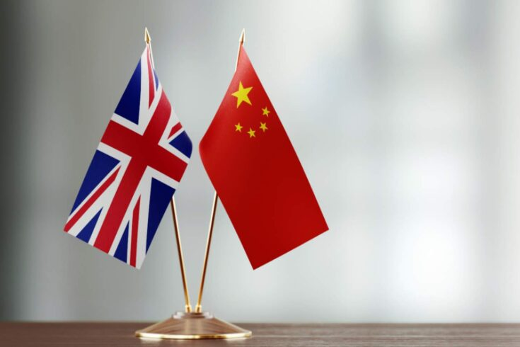
Conclusion
The presence of cultural changes between the UK and China created barriers for the UK-based company to perform joint venture
Engagement of an interactive approach within the joint venture must allow this company to manage a successful business in China
Notes:
Based on the detailed analysis of the overall discussion of this presentation it is recognised that the maintenance of cultural relationship networks within China is crucial enough and on the other hand the business culture of the UK focuses on maintaining discipline. Therefore, in terms of performing joint ventures in China, there is the presence of failure that is associated with the fundamental mistakes and the joint venture process of this country also produces support from the existing work forces and that is recognized as the success factor.

Slide 13
References :
DeGennaro, A. (2022) The key to marketing in China: Cultural sensitivity, Digital Agency Network. Available at: https://digitalagencynetwork.com/the-key-to-marketing-in-china-cultural-sensitivity/#:~:text=Cultural%20sensitivity%20is%20incredibly%20helpful,facet%20of%20their%20daily%20lives. (Accessed: 07 July 2023).
Donnelly, D. (2023) Alternatives to joint venture in China [complete guide], Horizons. Available at: https://nhglobalpartners.com/joint-venture-china-risks/#:~:text=Disadvantages%20of%20Joint%20Ventures,-In%20brief%2C%20JVs&text=Division%20in%20leadership%20and%20decision,sharing%2C%20and%20other%20such%20issues. (Accessed: 07 July 2023).
El Sayed, M.A., Farahat, F.A. and Elsisy, M.A., 2022. A novel interactive approach for solving uncertain bi-level multi-objective supply chain model. Computers & Industrial Engineering, 169, p.108225.
Harris, (2023) China Joint Ventures: Everything you should know, Harris Bricken Sliwoski LLP. Available at: https://harrisbricken.com/chinalawblog/china-joint-venture/#:~:text=A%20joint%20venture%20can%20be,distribution%20channels%2C%20or%20other%20connections (Accessed: 07 July 2023).
Iulia-Cristina, (2023) What is Hofstede’s cultural dimensions theory? UK vs China, a comparison, BRAND MINDS. Available at: https://brandminds.com/what-is-hofstedes-cultural-dimensions-theory-uk-vs-china-a-comparison/#:~:text=China%2020%25%20%E2%80%93%20a%20highly%20collectivist,and%20not%20necessarily%20of%20themselves.&text=UK%2066%25%20%E2%80%93%20a%20highly%20success,and%20leisure%20priorities%20to%20work. (Accessed: 07 July 2023).
Jahn, B., 2021. Critical theory in crisis? a reconsideration. European Journal of International Relations, 27(4), pp.1274-1299.
Jiang, T., Li, H. and Hou, Y., 2019. Cultural differences in humor perception, usage, and implications. Frontiers in psychology, 10, p.123.
Santandertrade (2023) China: Business practices, Business practices in China - Santandertrade.com. Available at: https://santandertrade.com/en/portal/establish-overseas/china/business-practices#:~:text=Business%20culture,-The%20Fundamental%20Principles&text=Chinese%20business%20culture
Santandertrade (2023) United Kingdom: Business practices, Business practices in the United Kingdom - Santandertrade.com. Available at: https://santandertrade.com/en/portal/establish-overseas/united-kingdom/business-practices#:~:text=Business%20culture,-The%20Fundamental%20Principles&text=The%20fundamental%20principles%20of%20business%20culture%20in%20the%20United%20Kingdom,may%20use%20when%20doing%20business. (Accessed: 07 July 2023).

