Slide 1
Name: Sajida Wahidi
Student Number: 2211607
Module Code: (BMHP6030_BIRM)
Module Name:Health, Wellbeing and Sustainable Development
Lecturer Name: Tomy Adattu Chacko
Assignment Title:Integrating Health, Wellbeing and Sustainable Development in UK Health and Social Care

Slide 2
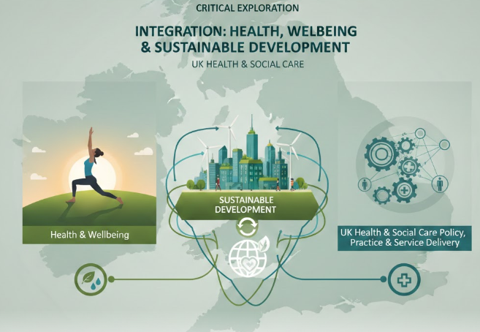
Introduction
Health and social care systems face growing pressure from ageing populations, long-term conditions, inequalities and environmental challenges (NHS England, 2024).
Integrating health, wellbeing and sustainable development is now essential.
This presentation critically explores the integration of health, wellbeing and sustainable development within UK health and social care policy, practice and service delivery.

Slide 3
Definitions and Key Concepts
Health: state of complete physical, mental and social well-being and not merely the absence of disease or infirmity (World Health Organisation, 2025).
Wellbeing: refers to a positive state of comfort, health and happiness not merely the absence of illness(WHO,2021).
Sustainable development: is development that meets the needs of the present without compromising the ability of future generations to meet their own needs Kulik, R. (2019).

Slide 4

Integration of Health and Wellbeing Approaches
Integration of holistic health and wellbeing in healthcare
Holistic healthcare integrates physical, mental, social and emotional wellbeing alongside clinical treatment, supporting person-centred and preventative care (WHO, 2023).
This approach contributes to improved health outcomes and aligns with SDG 3 Good Health and Well-Being (United Nations, 2025).
Sustainable development frameworks in health policies
Health in All Policies: promotes the integration of health considerations across all sectors, addressing the social determinants of health through cross sector collaboration (WHO, 2018).
HiAP: supports sustainable and equitable health systems in line with the 2030 Sustainable Development Agenda (WHO, 2021).

Slide 5
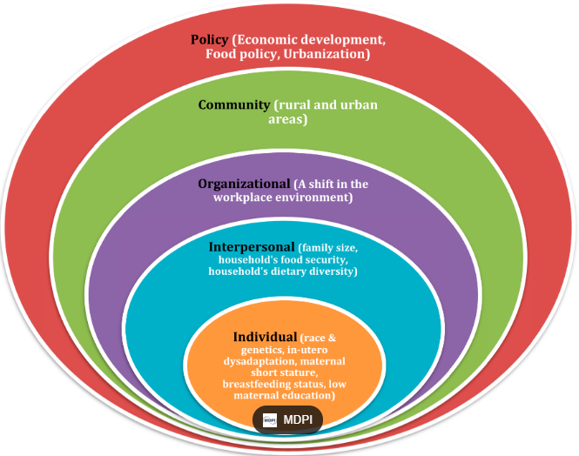
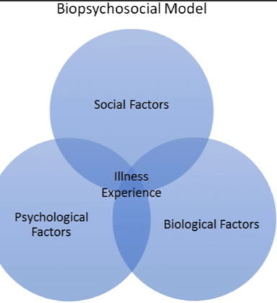
Models of Health
Ecological Model
The ecological model recognises multiple layers of influence on health, from individual behaviours to wider social, economic, and environmental determinants. This model strongly aligns with sustainable development (Buckley and Budzyna, 2023).
Biopsychosocial Model
This model emphasises that health outcomes result from the interaction of biological, psychological, and social factors. It underpins person-centred care and long-term condition (Bolton, 2023).
(Rankin, 2020)

Slide 6
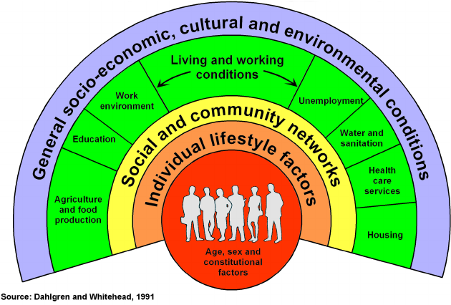
Dahlgren and Whitehead’s Rainbow Model
The Rainbow Model: highlights that health is shaped by multiple social, economic and environmental determinants, not just healthcare services (Dahlgren and Whitehead, 2021). The model informs service design by encouraging preventative, population-based and community-focused approaches (Lee et al., 2018).
It supports equity-driven service delivery through integrated working across health, social care and other sectors (Marmot et al., 2020).
Barriers: the model is conceptual and lacks practical implementation guidance, requiring complementary planning frameworks (Lee et al., 2018).
(Tsakos, Watt and Guarnizo‐Herreño, 2023)

Slide 7
Policy and Governance
Policies Supporting Holistic Health
1. Preventive Care: Vaccinations and routine health screenings, Maternal and childcare programmes (NHS Confederation, 2024).
2. Mental Health Initiatives: Counselling and community-based support, National and global anti-stigma campaigns(WHO, 2025).
3. Wellness and Lifestyle Promotion: Nutrition and physical activity guidelines Workplace wellbeing programmes (NHS Confederation, 2024).
4. Social Determinants of Health: Housing, education and food security Safe communities and access to social services (WHO, 2025).

Slide 8
Challenges of the Policy and Governance of health and social care
High cost and limited funding (OECD, 2025).
Lack of trained professionals (WHO, 2019).
Access inequality (rural vs urban) (Brezzi and Luongo, 2016).
Cultural and social barriers (Price et al., 2025).

Slide 9

Service Delivery in Health and Social Care
Services include wellness programmes, telehealth and community health services.
Wellness programmes: support exercise, nutrition and mental health prevent illness and reduce stress (NHS, 2021).
Telehealth: online GP appointments improve access and reduce hospital visits (Ezeamii, 2024).
Community and holistic care: integrate physical, mental and social support; care closer to home enhances wellbeing (Care Learning, 2024) and NHS, (2025).
Sustainability: digital and preventative services reduce pressure on hospitals (Gov.scot, 2024).

Slide 10

Case study example
Telehealth GP Services
According to Crouch, (2018) the NHS England launched online GP telehealth service in November 2017 Patients could speak to a GP by phone or video on the same day. This improved access to care, especially for minor health problems. As a result, fewer patients visited hospitals for non-urgent issues. Telehealth reduced pressure on emergency departments and improved patient satisfaction and saving time for patients and the health system.
(O’Riordan, 2024)

Slide 11
Public Health Initiatives
Public health campaigns promote healthy eating, exercise, smoking cessation, and mental wellbeing to improve population health (Public Health England, 2017).
Programmes like Change4Life and WHO tobacco control reduce preventable disease and improve wellbeing (Public Health England, 2017) and (WHO, 2025).
Mental health campaigns increase awareness and reduce stigma (Plackett et al., 2024).
Effectiveness is often moderate, improving awareness more than long-term behaviour change, especially in disadvantaged groups (NIHR, 2019).

Slide 12

Equity and Access
What is Equity?
Ensuring fairness in who receives care and the quality of the care.
Everyone should access services regardless of income, ethnicity, or location (WHO, 2020).
Inequalities:
Low-income groups, ethnic minorities, rural populations face:
  High costs, Long travel distances, Extended waiting times.
These barriers lead to poorer health outcomes (Scobie and Morris, 2020).
Legal and Policy Measures:
NHS Act 2006 & Health and Care Act 2022: require NHS to reduce inequalities (NHS England, 2025)
Equality Act 2010: protects against discrimination based on protected characteristics (age, disability, race, gender, etc.), ensuring fair treatment in healthcare (Gov.uk, 2010)

Slide 13
Equity and Access
Initiatives to Improve Equity:
Universal Health Coverage (UHC): care for all without financial hardship
Free targeted services programs for marginalised populations (WHO, 2025)
Goal:
Reduce systemic and social inequalities a fairer, more accessible healthcare system.

Slide 14
Conclusion
In conclusion, integrating health, wellbeing and sustainable development is essential for improving UK health and social care. Holistic models, strong policies and innovative services such as telehealth help create person-centred, preventative and sustainable systems. However, challenges in governance and inequalities in access must be addressed. By focusing on equity, collaboration and long-term sustainability, health and social care services can improve outcomes and create a fairer and healthier society for all.

Slide 15
Reference list
Bolton, D. (2023) ‘A Revitalized Biopsychosocial model: Core theory, Research paradigms, and Clinical Implications’, Psychological Medicine, 53(16), pp. 1–8. Available at: https://doi.org/10.1017/s0033291723002660. (Accessed: 5 February 2026).
Brezzi, M. and Luongo, P. (2016) ‘Regional Disparities in Access to Health Care’, OECD regional development working papers [Preprint]. Available at: https://doi.org/10.1787/5jm0tn1s035c-en. (Accessed: 5 February 2026).
Buckley, D. and Budzyna, D. (2023) ‘Ecological Theory’, rotel.pressbooks.pub, 2(1). Available at: https://rotel.pressbooks.pub/whole-child/chapter/ecological-theory-2/. (Accessed: 5 February 2026).
Crouch, H. (2018) Babylon founder: ‘GP at Hand meets the needs of the NHS’, Digital Health. Available at: https://www.digitalhealth.net/2018/06/babylon-founder-talks-about-gp-at-hand-success (Accessed: 10 February 2026).
Dahlgren, G. and Whitehead, M. (1991) Policies and strategies to promote social equity in health. Stockholm: Institute for Futures Studies. Available at: https://www.gov.uk/government/publications/health-profile-for-england/chapter-6-social-determinants-of-health (Accessed: 5 May 2025).
Dahlgren, G. and Whitehead, M. (2021) ‘The Dahlgren-Whitehead Model of Health Determinants: 30 Years on and Still Chasing Rainbows’, Public Health, 199(1), pp. 20–24. Available at: https://doi.org/10.1016/j.puhe.2021.08.009 (Accessed: 4 February 2026).
England, N. (2025) NHS England» Health inequalities and equality legal duties: A reference document for NHS commissioners and providers, England.nhs.uk. Available at: https://www.england.nhs.uk/long-read/health-inequalities-equality-legal-duties (Accessed: 8 February 2026

Slide 16
delivered by neighbourhood multidisciplinary teams (high intensity use focused), England.nhs.uk. Available at: https://www.england.nhs.uk/long-read/provision-of-person-centred-holistic-care-delivered-by-neighbourhood-multidisciplinary-teams-high-intensity-use-focused/ (Accessed: 5 February 2026).
Ezeamii, V. (2024) ‘Revolutionizing healthcare: How Telemedicine Is Improving Patient Outcomes and Expanding Access to Care’, Cureus, 16(7). Available at: https://doi.org/10.7759/cureus.63881 (Accessed: 7 February 2026).
GOV.UK (2010) Equality Act 2010, GOV.UK. Available at: https://www.gov.uk/guidance/equality-act-2010-guidance (Accessed: 3 February 2026).
Health at a Glance 2025 OECD Indicators Available at: https://www.oecd.org/content/dam/oecd/en/publications/reports/2025/11/health-at-a-glance-2025_a894f72e/8f9e3f98-en.pdf (Accessed: 2 February 2026).
Lee, J. et al. (2018) ‘Addressing Health Equity Through Action on the Social Determinants of Health: A Global Review of Policy Outcome Evaluation Methods’, International Journal of Health Policy and Management, 7(7), pp. 581–592. Available at: https://doi.org/10.15171/ijhpm.2018.04 (Accessed: 4 February 2026).
Marmot, M. et al. (2020) Health Equity in England: The Marmot Review 10 Years on, The Health Foundation. Available at: https://www.health.org.uk/reports-and-analysis/reports/health-equity-in-england-the-marmot-review-10-years-on-0 (Accessed: 6 February 2026).
NHS (2021). Creating a health and wellbeing culture Elements of Health and Wellbeing. Available at: https://www.england.nhs.uk/wp-content/uploads/2021/11/NHS-health-and-wellbeing-framework-elements-of-health-and-wellbeing.pdf (Accessed: 8 February 2026).
NHS Confederation (2024) Unlocking prevention in integrated care systems, NHS Confederation. Available at: https://www.nhsconfed.org/publications/report-unlocking-prevention-integrated-care-systems (Accessed: 9 February 2026).

Slide 17
https://www.britannica.com/topic/sustainable-development (Accessed: 7 February 2026).
The Scottish Government (2024) NHS Recovery Plan 2021-2026: annual progress update report 2024, Gov.scot. The Scottish Government. Available at: https://www.gov.scot/publications/nhs-recovery-plan-2021-2026-annual-progress-update-report-2024/pages/9/ (Accessed: 8 February 2026).
Tsakos, G., Watt, R.G. and Guarnizo‐Herreño, C.C. (2023) ‘Reflections on oral health inequalities: Theories, pathways and next steps for research priorities’, Community Dentistry and Oral Epidemiology, 51(1). Available at: https://doi.org/10.1111/cdoe.12830 (Accessed: 11 February 2026).
UN (2025) Sustainable Development Goal 3: Good Health and Well‑Being SDG Facts and Figures. Available at: https://un.org/sustainabledevelopment/health/ (Accessed: 5 February 2026).
What is the Holistic Model in Mental Health? – Care Learning (2025) Care Learning. Available at: https://carelearning.org.uk/blog/mental-health/what-is-the-holistic-model-in-mental-health/ (Accessed: 10 February 2026).
WHO (2018). Promoting Health in All Policies and intersectoral action capacities, world health organization. Available at: https://www.who.int/activities/promoting-health-in-all-policies-and-intersectoral-action-capacities (Accessed: 9 February 2026).
WHO (2021) Health in All Policies (HiAP) framework for country action. Available at: https://www.who.int/activities/promoting-health-in-all-policies-and-intersectoral-action-capacities (Accessed: 5 February 2026).
WHO (2023) WHO global framework for wellbeing. Available at: https://www.who.int/publications/i/item/WHO-HEP-ECH-WSH-23.01 (Accessed: 5 February 2026).
WHO (2025) Tobacco Control (TFI), www.who.int. Available at: https://www.who.int/teams/health-promotion/tobacco-control (Accessed: 6 February 2026).
World (2019) Health workforce, Who.int. World Health Organization: WHO. Available at: https://www.who.int/health-topics/health-workforce? (Accessed: 4 February 2026).
World Health Organisation (2025) New WHO Guidance Calls for Urgent Transformation of Mental Health Policies, Who.int. World Health Organization: WHO. Available at: https://www.who.int/news/item/25-03-2025-new-who-guidance-calls-for-urgent-transformation-of-mental-health-policies (Accessed: 12 February 2026).

Slide 18
NHS England (2024) Evolving to meet a changing world, NHS England. Available at: https://www.england.nhs.uk/future-of-human-resources-and-organisational-development/the-future-of-nhs-human-resources-and-organisational-development-report/evolving-to-meet-a-changing-world/. (Accessed:1February 2026).
NIHR (2019) Mixed evidence shows some impact of mass media campaigns promoting tobacco control, physical activity and sexual health, NIHR Evidence. Available at: https://evidence.nihr.ac.uk/alert/mixed-evidence-shows-some-impact-of-mass-media-campaigns-promoting-tobacco-control-physical-activity-and-sexual-health/ (Accessed: 5 February 2026).
O’Riordan, M. (2024) Payment Parity for Telehealth Linked to Better BP Treatment, TCTMD.com. Available at: https://www.tctmd.com/news/payment-parity-telehealth-linked-better-bp-treatment (Accessed: 9 February 2026).
Plackett, R. et al. (2024) ‘The effectiveness of social media campaigns in improving knowledge and attitudes towards mental health and help-seeking in high-income countries: A scoping review (Preprint)’, Journal of Medical Internet Research, 27. Available at: https://doi.org/10.2196/68124 (Accessed: 10 February 2026).
Price, T. et al. (2025) ‘Exploring the impact of stigma on the health of inclusion health groups: a qualitative scoping review and critical analysis’, BMC Public Health [Preprint]. Available at: https://doi.org/10.1186/s12889-025-25603-x (Accessed: 11February 2026).
Public Health England (2017) New Change4Life Campaign Encourages Parents to ‘Be Food Smart’, gov.uk. Public Health England. Available at: https://www.gov.uk/government/news/new-change4life-campaign-encourages-parents-to-be-food-smart (Accessed: 4 February 2026).
Rankin, L. (2020) What is the Bio-Psycho-Social Model of Pain? European Pain Federation. Available at: https://europeanpainfederation.eu/what-is-the-bio-psycho-social-model-of-pain/ (Accessed: 2 February 2026).
Regional Disparities in Access to Health Care (2025) OECD. Available at: https://www.oecd.org/en/publications/regional-disparities-in-access-to-health-care_5jm0tn1s035c-en.html (Accessed: 12 February 2026).
Scobie, S. and Morris, J. (2020) Quality and inequality: digging deeper, The Nuffield Trust. Available at: https://www.nuffieldtrust.org.uk/resource/quality-and-inequality-digging-deeper (Accessed: 5 February 2026).

Slide 19
World Health Organization (2020) Health Equity -- Global, www.who.int. Available at: https://www.who.int/health-topics/health-equity (Accessed: 10 February 2026).
World Health Organization (2021) Promoting well-being, World Health Organization. Available at: https://www.who.int/activities/promoting-well-being (Accessed: 10 February 2026).
World Health Organization (2025) Universal Health Coverage (UHC), World Health Organization. Available at: https://www.who.int/news-room/fact-sheets/detail/universal-health-coverage-(uhc) (Accessed: 9 February 2026).
World Health Organization (2025). Health and Well-Being. World Health Organization. Available at: https://www.who.int/data/gho/data/major-themes/health-and-well-being (Accessed: 3 February 2026).

