Slide 1

BMIH6001 A2: Contemporary Themes in the Hotel and Hospitality Sector
Student Name: Mirela Mihaela Motohoi
Student ID: 2206811

Slide 2
Table of contents
01
02
03
04
05
Introduction
Literature Review
Methods
Conclusion
References List

Slide 3

Introduction
AI in hotels- works alongside staff
Adapts to digital guest needs and operation
Face-to-face culture vs. new tech challenges
Risk management: future staff roles and delivey changes

Slide 4
Literature Review
Theoretical Foundations and Contemporary Relevance of AI in Hospitality

Slide 5
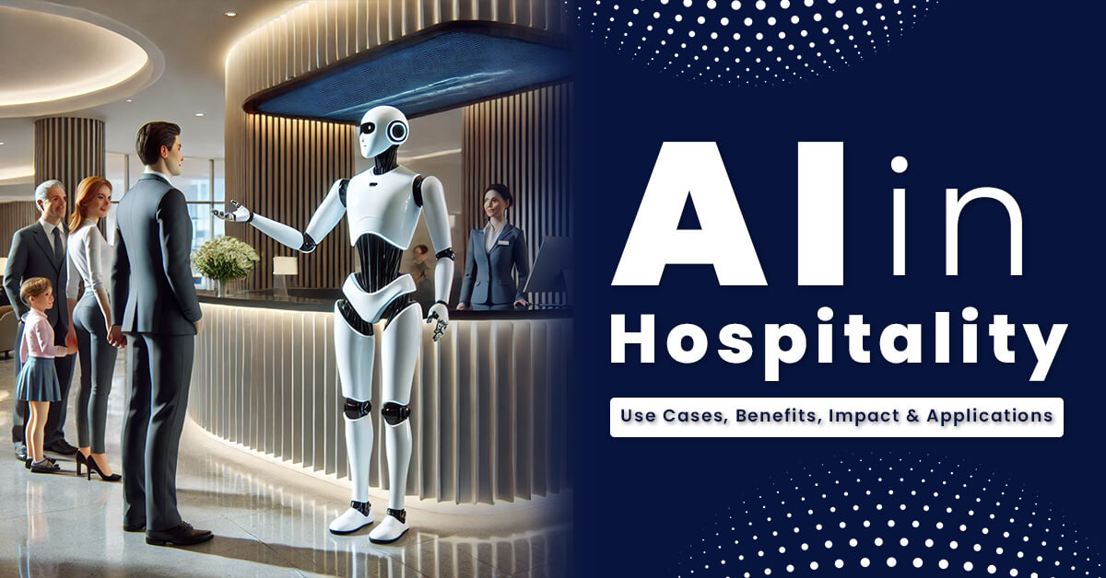
1nd Paragraph
AI simplifies routine tasks and changes how people work
Technology helps staff respond quickly and focus on important activities
Ai boosts efficiency without lowering service quality .
Robots serve as concierges deliver meals, and handle cleaning.

Slide 6

2nd Paragraph
Mobile technology with AI allows guests to check in easily.
AI automates hotel room control like lights, temperature, and entertainment
These smart systems help save energy and improve guest comfort (Sharma et al., 2023)
The growth of AI in hospitality shows the need to use it wisely (SARKAR, 2025)

Slide 7

02
METHODS

Slide 8
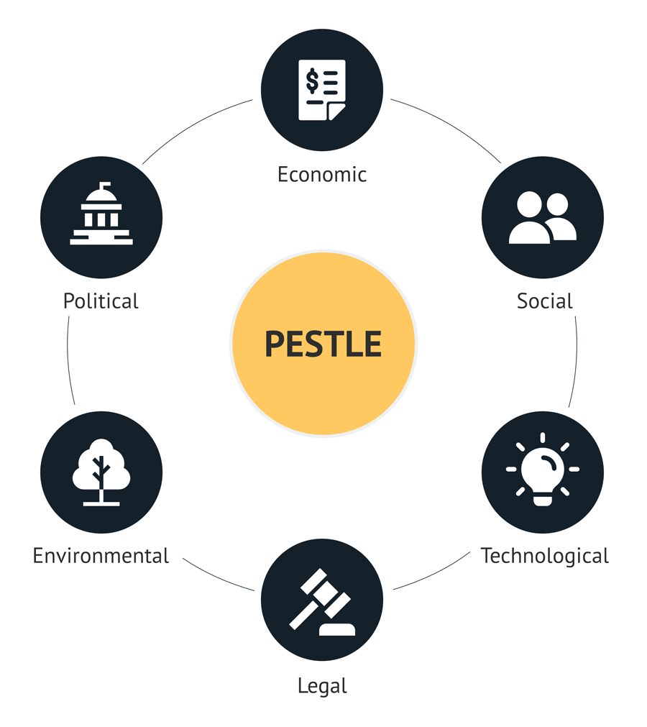
METHODS
The PESTEL framework analyzes external factors in hospitality.
It divides the macro-environment into six key ares.
PESTEL helps understand how strategy and operations are influenced.
It also shows how new product ideas are shaped by outside factors.

Slide 9
PESTEL Analysis
POLITICAL FACTOR
AI use in hospitality is shaped by laws, regulations, and trade policies.
Hotels must follow strict data protection rules for guest information.
Global tensions and labour unions can slow AI adoption.
Government support helps, but inconsistent policies create challenges.
ECONOMIC FACTOR
AI helps reduce costs and improve hotel performance.
Big hotels use it for pricing, efficiency, and personalization.
Smaller hotels can try flexible, cloud-based AI solutions.
SOCIAL FACTOR
AI offers fast check-ins, smart suggestions, and better service.
Too much automation may feel impersonal and worry staff.
Training employees to work with AI keeps service human and strong.

Slide 10
TECHNOLOGICAL FACTORS
AI tools like chatbots, robotics, and smart rooms improve hotel services.
Tech issues like old systems and cybersecurity slow down integration.
Hotels must invest in IT training and keep up with rapid changes.
ENVIRONMENTAL FACTORS
AI saves hotel energy based on occupancy
AI hardware impacts the environment
Eco-friendly certifications give hotels a competitive advantage with green-minded customers.
LEGAL FACTORS
Hotels must protect guest data with transparency and consent.
Labor laws affect AI use in hospitality jobs.
Clear rules for AI help avoid legal risks.

Slide 11
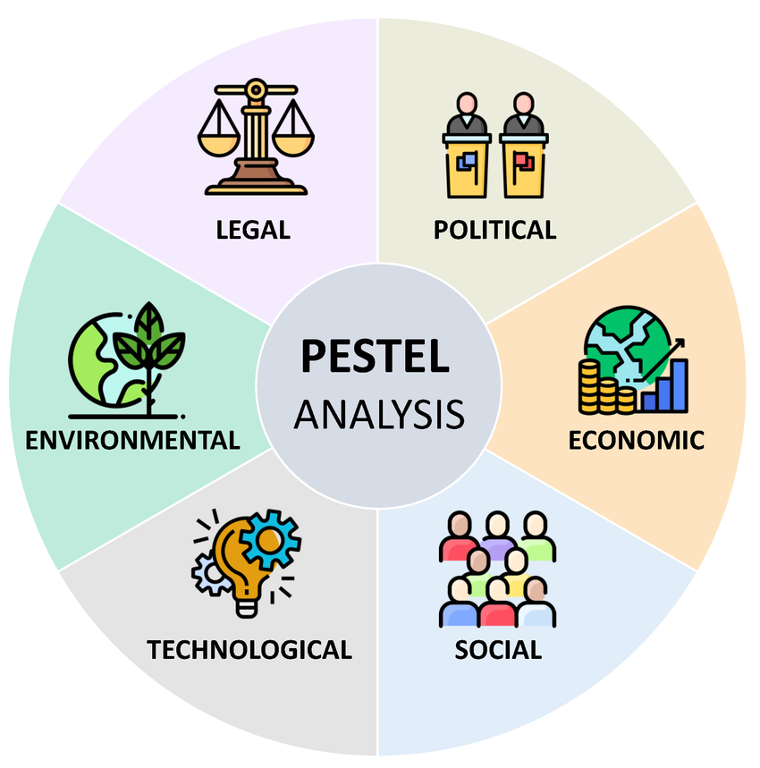
Continuation..
AI success depends on political and legal rules.
Financial gaps and laws can limit AI use.
Social acceptance, tech use, and eco care matter.
Understanting these helps keep hospitality people-focused while using AI.

Slide 12

03
Conclusion
AI and staff teamwork are key in hospitality
AI boosts efficiency and personal servivce.
It raises job loss, ethics, and data concerns.
Responsible use ensures a sustainable future.

Slide 13
References List
Amoako, S. and Boateng, E., 2022. Considering factors that leads to sustainability of Small and Medium Enterprises in Ghana using PESTEL and theories of entrepreneurship as a measuring tool. Technium Soc. Sci. J., 31, p.594.
Dinh, T.Q., 2023. Frequent types of undertaken piuots and their external triggering factors: A multi-case study of software startups in Vietnam (Master's thesis, Handelshøyskolen BI).
Helmold, M., Küçük Yılmaz, A., Dathe, T. and Flouris, T.G., 2022. SCRM Strategy. In Supply Chain Risk Management: Cases and Industry Insights (pp. 13-35). Cham: Springer International Publishing.
Kariru, A.N., 2023. Contemporary trends and issues in the hospitality and tourism industry.
Kumar, S., Kapoor, B. and Shah, M.A., 2024. Contemporary Issues and Challenges Facing the Hospitality Industry. In The Framework for Resilient Industry: A Holistic Approach for Developing Economies (pp. 55-64). Emerald Publishing Limited.
Mehraliyev, F., Chan, I.C.C. and Kirilenko, A.P., 2022. Sentiment analysis in hospitality and tourism: a thematic and methodological review. International Journal of Contemporary Hospitality Management, 34(1), pp.46-77.
Rossidis, I., Belias, D. and Vasiliadis, L., 2021, June. Strategic human resource management in the international hospitality industry. An extensive literature review. In Culture and Tourism in a Smart, Globalized, and Sustainable World: 7th International Conference of IACuDiT, Hydra, Greece, 2020 (pp. 337-346). Cham: Springer International Publishing.
SARKAR, D.A.K., 2025. Strategic Management: Concepts and Applications.
Sharma, G.D., Taheri, B., Gupta, M. and Chopra, R., 2023. Over 33 years of the hospitality research: a bibliometric review of the international journal of contemporary hospitality management. International Journal of Contemporary Hospitality Management, 35(7), pp.2564-2589.

Slide 14
THANK YOU FOR YOUR ATTENTION!
Questions or feedback are welcome.

